Slide 1
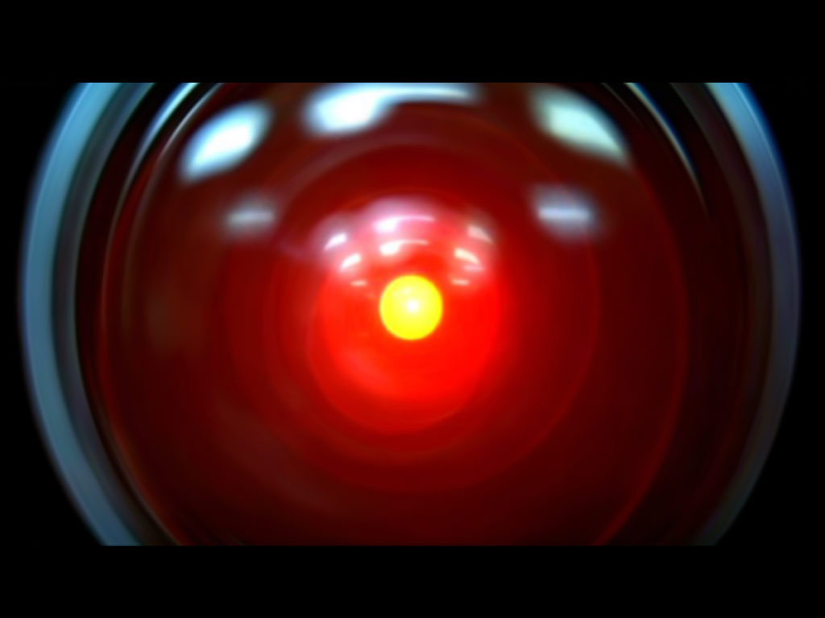

Slide 2
Anonymous
"Artificial Intelligence is the study of how to make real computers act like the ones in the movies."

Slide 3
Anonymous
"Artificial Intelligence is the study of how to make real computers act like the ones in the movies."
Think of some things that computers in the movies can do, but real computers cannot…

Slide 4
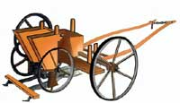
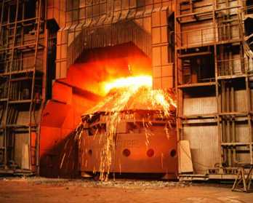
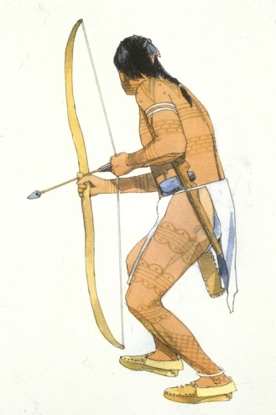
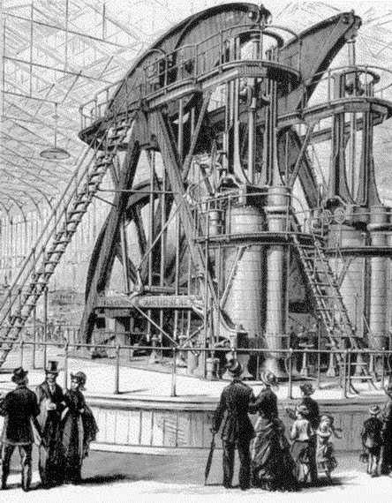
AI is the next big thing

Slide 5
AI is the next big thing
Energy, material, raw power is mastered

Slide 6
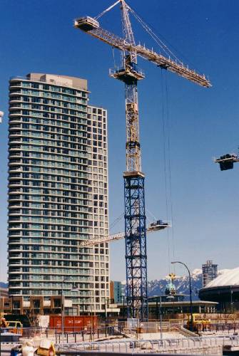
AI is the next big thing
We have the brawn,
but what about the brain?

Slide 7
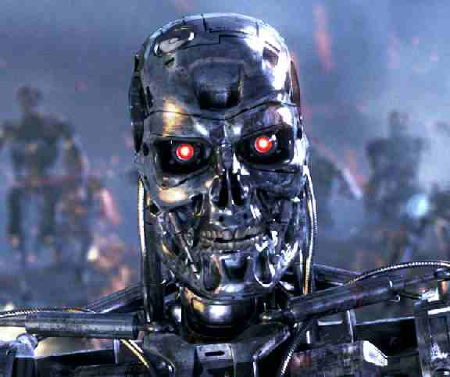
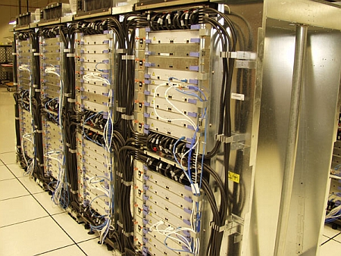
AI is the next big thing

Slide 8






Computing in the World Today

Slide 9
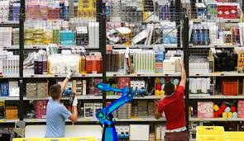
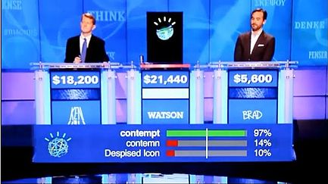
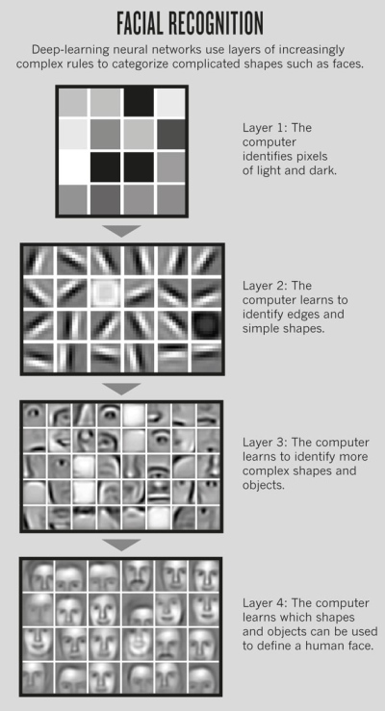
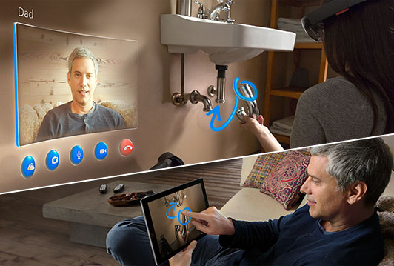
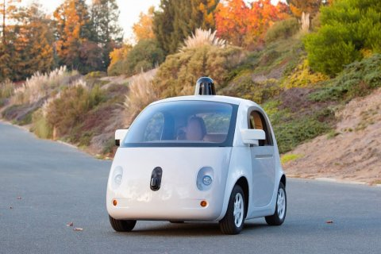
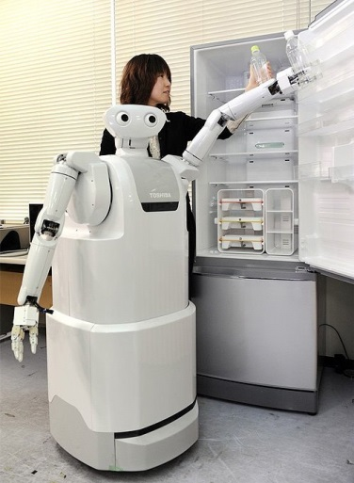
AI/Computing in the World Today

Slide 10
Course Overview
What is AI?
What are the Major Challenges?
What are the Main Techniques?
Where are we failing, and why?
Step back and look at the Science
Step back and look at the History of AI
What are the Major Schools of Thought?
What of the Future?
Part I:
Introduce you to what’s happening in Artificial Intelligence
Part II:
Give you an appreciation for the big picture
➢ Why it is a
grand challenge
Notes:
What are we trying to do
How do we do it
A lot of people would start with the history – but it’s a bit meaningless at first

Slide 11
Course Overview
What is AI?
What are the Major Challenges?
What are the Main Techniques?
Where are we failing, and why?
Step back and look at the Science
Step back and look at the History of AI
What are the Major Schools of Thought?
What of the Future?

Slide 12
Course Overview
✓Done
What is AI?
What are the Major Challenges?
What are the Main Techniques?
Where are we failing, and why?
Step back and look at the Science
Step back and look at the History of AI
What are the Major Schools of Thought?
What of the Future?

Slide 13
Course Overview
What is AI?
What are the Major Challenges?
What are the Main Techniques?
Where are we failing, and why?
Step back and look at the Science
Step back and look at the History of AI
What are the Major Schools of Thought?
What of the Future?

Slide 14
Course Overview
What is AI?
What are the Major Challenges?
What are the Main Techniques?
Where are we failing, and why?
Step back and look at the Science
Step back and look at the History of AI
What are the Major Schools of Thought?
What of the Future?
What are we trying to do? How far have we got?
Natural language (text & speech)
Computer vision
Robotics
Board games
Problem solving
Learning
Applied areas: Video games, healthcare, …
What has been achieved, and not achieved,
and why is it hard?

Slide 15
Example of Machine Translation (Sept. 2007)
Martial Leconte leaves this Monday prison after having purged the totality of his sorrow. However, it will carry an electronic bracelet. It is a first in France because it is usually reserved to the prisoners profiting from a parole. Martial Leconte, paedophile considered to be dangerous, gave his agreement to carry the bracelet during at least two years.
Martial Leconte, who must leave this Monday the penitentiary center of Caen in the Apple-brandy, will carry the bracelet to ankle for one two years period, renewable once. A GPS will make it possible to follow it in all its displacements. Until now, the placement under mobile electronic monitoring was reserved to the prisoners profiting from a parole.
Regarded as dangerous, the 42 year old paedophile already saw pushing back 30 days his release because in particular of the repetition very mediatized of one of his ex-fellows-prisoner, Francis Evrard, which had been caught some in small Enis less than two months after its exit of the center penitentiary of Caen. Its imminent release had then alerted the media and the discovery of photographs of children in his cell had not arranged its case.
Notes:
purgé la totalité de sa peine
Served his time/sentence
Peine has different meanings, also serve
Does not connect prison with phrase
Calvados = Apple-brandy

Slide 16
Example of Machine Translation (Sept. 2011)
Martial Leconte released from prison Monday after serving his full sentence.Yet there will an electronic bracelet. This is a first in France because it is usually reserved for inmates on parole. Martial Leconte, considered dangerous pedophile, has agreed to wear the bracelet for at least two years. This is a first in France . An inmate, sentenced in 1998 to 14 years in prison for the rape of a schoolgirl 11 years, has pledged to bring an electronic bracelet when he finished serving his entire sentence. Martial Leconte, due out Monday that the detention center to Caen in Calvados, bringing the ankle bracelet for a period of two years, renewable once. A GPS will follow him wherever he goes. So far, the mobile electronic monitoring was reserved for inmates on parole.
Considered dangerous , the pedophile 42 years has seen the 30-day delay his release in particular because of the recurrence of well-publicized one of his former fellow inmates, Francis Evrard, who had attacked at least two small Enis months after leaving the penitentiary center of Caen. His release was imminent then alerted the media and the discovery of photos of children in his cell had not helped his case.
Notes:
purgé la totalité de sa peine
Served his time/sentence
Peine has different meanings, also serve
Does not connect prison with phrase
Calvados = Apple-brandy

Slide 17
Example of Machine Translation (Sept. 2014)
Martial Leconte out of jail Monday after serving his full sentence . Yet there will an electronic bracelet. This is a first in France as it is usually reserved for inmates on parole. Martial Leconte, considered dangerous pedophile , has agreed to wear the bracelet for at least two years.
This is a first in France . An inmate sentenced in 1998 to 14 years in prison for the rape of a schoolgirl 11 years , pledged to wear an electronic bracelet when he finished serving his full sentence. Martial Leconte , due out on Monday the penitentiary of Caen in Calvados, carry the ankle bracelet for a period of two years, renewable once. A GPS will follow him wherever he goes . So far, the investment in mobile electronic surveillance was reserved for inmates on parole.
Considered dangerous, the pedophile 42 years has seen 30 days push its release mainly because of the recurrence of highly publicized one of its former inmates , Francis Evrard, who had attacked the little Enis least two months after leaving the penitentiary center of Caen. His imminent release had alerted the media and the discovery of photos of children in his cell did not help his case .
Notes:
purgé la totalité de sa peine
Served his time/sentence
Peine has different meanings, also serve
Does not connect prison with phrase
Calvados = Apple-brandy

Slide 18
Machine Translation Difficulties
They thought
  Map words in one language to words in the other language using a dictionary
  Map grammatical structures in one language to grammatical structures in the other language
  Easy!
They didn’t think
  Words don’t map one to one
    Example: Open {shop, market, question, position} – loose ice?
  It is necessary to model the situation in your mind, and then describe it in the other language
So why not make the computer model it?
  Commonsense knowledge problem

Slide 19
Course Overview
What is AI?
What are the Major Challenges?
What are the Main Techniques?
Where are we failing, and why?
Step back and look at the Science
Step back and look at the History of AI
What are the Major Schools of Thought?
What of the Future?
What are we trying to do? How far have we got?
Natural language (text & speech)
Computer vision
Robotics
Board games
Problem solving
Learning
Applied areas: Video games, healthcare, …
What has been achieved, and not achieved,
and why is it hard?

Slide 20
Course Overview
What is AI?
What are the Major Challenges?
What are the Main Techniques?
Where are we failing, and why?
Step back and look at the Science
Step back and look at the History of AI
What are the Major Schools of Thought?
What of the Future?

Slide 21
Course Overview
What is AI?
What are the Major Challenges?
What are the Main Techniques? (How do we do it?)
Where are we failing, and why?
Step back and look at the Science
Step back and look at the History of AI
What are the Major Schools of Thought?
What of the Future?
Search
Logics (knowledge representation and reasoning)
Planning and acting
Bayesian belief networks
Neural networks
Evolutionary computation
Reinforcement learning
Language parsing and speech techniques
Statistical methods (language, learning)

Slide 22
Course Overview
What is AI?
What are the Major Challenges?
What are the Main Techniques?
Where are we failing, and why?
Step back and look at the Science
Step back and look at the History of AI
What are the Major Schools of Thought?
What of the Future?

Slide 23
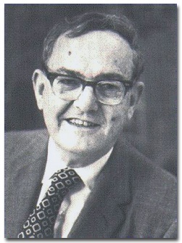
Course Overview
What is AI?
What are the Major Challenges?
What are the Main Techniques?
Where are we failing, and why?
Step back and look at the Science
Step back and look at the History of AI
What are the Major Schools of Thought?
What of the Future?
“Machines will be capable,
within twenty years,
of doing any work that a man can do.”
Herbert Simon, 1965.
Notes:
e.g. can’t even do a blind dog

Slide 24
Course Overview
What is AI?
What are the Major Challenges?
What are the Main Techniques?
Where are we failing, and why?
Step back and look at the Science
Step back and look at the History of AI
What are the Major Schools of Thought?
What of the Future?
The first law of AI:
“the hard problems are easy
and the easy problems are hard”

Slide 25
Course Overview
What is AI?
What are the Major Challenges?
What are the Main Techniques?
Where are we failing, and why?
Step back and look at the Science
Step back and look at the History of AI
What are the Major Schools of Thought?
What of the Future?
The first law of AI:
“the hard problems are easy
and the easy problems are hard”
AI has failed at:
Commonsense
Generalisation

Slide 26
Course Overview
What is AI?
What are the Major Challenges?
What are the Main Techniques?
Where are we failing, and why?
Step back and look at the Science
Step back and look at the History of AI
What are the Major Schools of Thought?
What of the Future?
Part I:
Introduce you to what’s happening in Artificial Intelligence

Slide 27
Course Overview
What is AI?
What are the Major Challenges?
What are the Main Techniques?
Where are we failing, and why?
Step back and look at the Science
Step back and look at the History of AI
What are the Major Schools of Thought?
What of the Future?
Part I:
Introduce you to what’s happening in Artificial Intelligence

Slide 28
Course Overview
What is AI?
What are the Major Challenges?
What are the Main Techniques?
Where are we failing, and why?
Step back and look at the Science
Step back and look at the History of AI
What are the Major Schools of Thought?
What of the Future?
Theory of Intelligence?
Cognitive Science
Psychology
Philosophy
Neuroscience
Artificial Intelligence
Linguistics
Anthropology

Slide 29
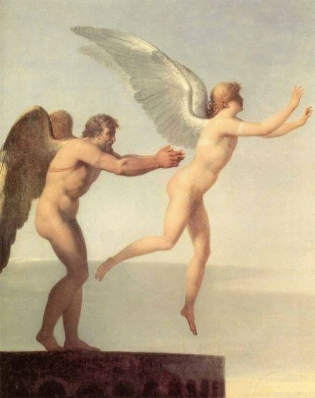
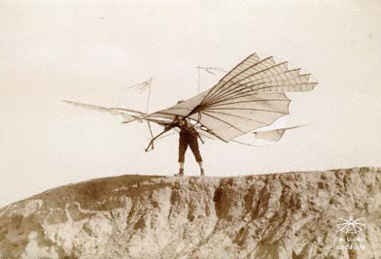

Slide 30
Course Overview
What is AI?
What are the Major Challenges?
What are the Main Techniques?
Where are we failing, and why?
Step back and look at the Science
Step back and look at the History of AI
What are the Major Schools of Thought?
What of the Future?
Theory of Intelligence?
Cognitive Science
Psychology
Philosophy
Neuroscience
Artificial Intelligence
Linguistics
Anthropology

Slide 31
Course Overview
What is AI?
What are the Major Challenges?
What are the Main Techniques?
Where are we failing, and why?
Step back and look at the Science
Step back and look at the History of AI
What are the Major Schools of Thought?
What of the Future?

Slide 32
Course Overview
What is AI?
What are the Major Challenges?
What are the Main Techniques?
Where are we failing, and why?
Step back and look at the Science
Step back and look at the History of AI
What are the Major Schools of Thought?
What of the Future?
Alan Turing
Dartmouth Conference
Early Successes
AI Winter
Industrial Successes
Connectionism and Robotics

Slide 33
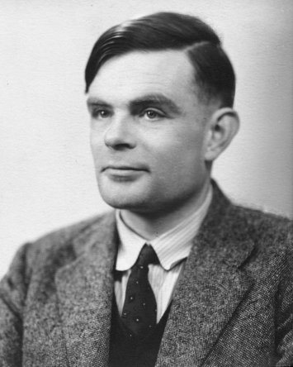
Course Overview
What is AI?
What are the Major Challenges?
What are the Main Techniques?
Where are we failing, and why?
Step back and look at the Science
Step back and look at the History of AI
What are the Major Schools of Thought?
What of the Future?
Alan Turing
Dartmouth Conference
Early Successes
AI Winter
Industrial Successes
Connectionism and Robotics

Slide 34
Course Overview
What is AI?
What are the Major Challenges?
What are the Main Techniques?
Where are we failing, and why?
Step back and look at the Science
Step back and look at the History of AI
What are the Major Schools of Thought?
What of the Future?
Alan Turing
Dartmouth Conference
Early Successes
AI Winter
Industrial Successes
Connectionism and Robotics

Slide 35
Course Overview
What is AI?
What are the Major Challenges?
What are the Main Techniques?
Where are we failing, and why?
Step back and look at the Science
Step back and look at the History of AI
What are the Major Schools of Thought?
What of the Future?
Alan Turing
Dartmouth Conference
Early Successes
AI Winter
Industrial Successes
Connectionism and Robotics

Slide 36
Course Overview
What is AI?
What are the Major Challenges?
What are the Main Techniques?
Where are we failing, and why?
Step back and look at the Science
Step back and look at the History of AI
What are the Major Schools of Thought?
What of the Future?
Alan Turing
Dartmouth Conference
Early Successes
AI Winter
Industrial Successes
Connectionism and Robotics

Slide 37
Course Overview
What is AI?
What are the Major Challenges?
What are the Main Techniques?
Where are we failing, and why?
Step back and look at the Science
Step back and look at the History of AI
What are the Major Schools of Thought?
What of the Future?
Alan Turing
Dartmouth Conference
Early Successes
AI Winter
Industrial Successes
Connectionism and Robotics
Expert Systems
Diagnose faults
Investment advice
MYCIN

Slide 38
Course Overview
What is AI?
What are the Major Challenges?
What are the Main Techniques?
Where are we failing, and why?
Step back and look at the Science
Step back and look at the History of AI
What are the Major Schools of Thought?
What of the Future?
Alan Turing
Dartmouth Conference
Early Successes
AI Winter
Industrial Successes
Connectionism and Robotics
Expert Systems
Diagnose faults
Investment advice
MYCIN
(they work, but don’t understand)

Slide 39
Course Overview
What is AI?
What are the Major Challenges?
What are the Main Techniques?
Where are we failing, and why?
Step back and look at the Science
Step back and look at the History of AI
What are the Major Schools of Thought?
What of the Future?
Alan Turing
Dartmouth Conference
Early Successes
AI Winter
Industrial Successes
Connectionism and Robotics

Slide 40
Course Overview
What is AI?
What are the Major Challenges?
What are the Main Techniques?
Where are we failing, and why?
Step back and look at the Science
Step back and look at the History of AI
What are the Major Schools of Thought?
What of the Future?

Slide 41
Course Overview
What is AI?
What are the Major Challenges?
What are the Main Techniques?
Where are we failing, and why?
Step back and look at the Science
Step back and look at the History of AI
What are the Major Schools of Thought?
What of the Future?
Weak vs. Strong
Neat vs. Scruffy
Cyc
Brooks – Robotics - Embodiment
Developmental approaches
Imitation approaches
Theoretical approaches

Slide 42
Course Overview
What is AI?
What are the Major Challenges?
What are the Main Techniques?
Where are we failing, and why?
Step back and look at the Science
Step back and look at the History of AI
What are the Major Schools of Thought?
What of the Future?

Slide 43
Course Overview
What is AI?
What are the Major Challenges?
What are the Main Techniques?
Where are we failing, and why?
Step back and look at the Science
Step back and look at the History of AI
What are the Major Schools of Thought?
What of the Future?
Big Brother Scenario?
– Human Technical Ruling Class
Rise of the machines?
Singularity?
Transhumanism?
Next step of evolution?
Rights for Robots?
Exit of humanity?

Slide 44
Course Overview
What is AI?
What are the Major Challenges?
What are the Main Techniques?
Where are we failing, and why?
Step back and look at the Science
Step back and look at the History of AI
What are the Major Schools of Thought?
What of the Future?
Part I:
Introduce you to what’s happening in Artificial Intelligence
Part II:
Give you an appreciation for the big picture
Notes:
What are we trying to do
How do we do it
A lot of people would start with the history – but it’s a bit meaningless at first

Slide 45
Take home message from the course
Why AI an is exciting area to work in
Why AI is hard
⇨ In other words:
Why AI is really a grand challenge.
Next big thing
We know it’s possible (not antigravity or warp drive)
AI very new (1956), not Physics
Cited as “field I would most like to be in”
Waiting for a breakthrough
Commonsense
Generalisation

Slide 46
Practical Matters…

Slide 47
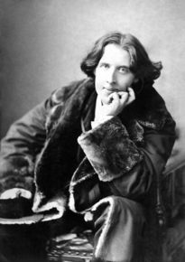
Oscar Wilde in
“The Soul of Man Under Socialism"
"The fact is, that civilisation requires slaves …
Human slavery is wrong, insecure, and demoralizing.
On mechanical slavery, on the slavery of the machine,
the future of the world depends."
Notes:
Slavery of machine and implications

