Slide 1
Course Overview
What is AI?
What are the Major Challenges?
What are the Main Techniques?
Where are we failing, and why?
Step back and look at the Science
Step back and look at the History of AI
What are the Major Schools of Thought?
What of the Future?

Slide 2
Course Overview
What is AI?
What are the Major Challenges?
What are the Main Techniques?
Where are we failing, and why?
Step back and look at the Science
Step back and look at the History of AI
What are the Major Schools of Thought?
What of the Future?
What are we trying to do? How far have we got?
Natural language (text & speech)
Computer vision
Robotics
Board games
Problem solving
Learning
Applied areas: Video games, healthcare, …
What has been achieved, and not achieved, and why is it hard?

Slide 3
Course Overview
What is AI?
What are the Major Challenges?
What are the Main Techniques?
Where are we failing, and why?
Step back and look at the Science
Step back and look at the History of AI
What are the Major Schools of Thought?
What of the Future?
What are we trying to do? How far have we got?
Natural language (text & speech)
Computer vision
Robotics
Board games
Problem solving
Learning
Applied areas: Video games, healthcare, …
What has been achieved, and not achieved, and why is it hard?

Slide 4
What Competences do you Need for Robots?
Perception
Motor Skills
Transfer
Motivation
Learning
Concepts and Representation

Slide 5
What Competences do you Need for Robots?
Perception
Vision
For Recognition
For Action
Touch or other modalities
Motor Skills
Transfer
Motivation
Learning
Concepts and Representation

Slide 6
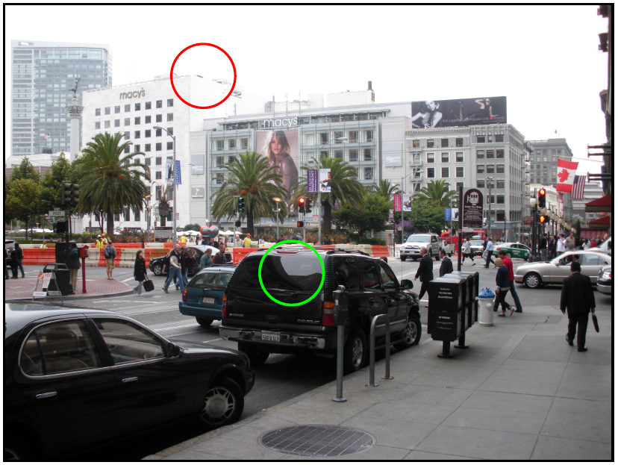

Slide 7


Slide 8
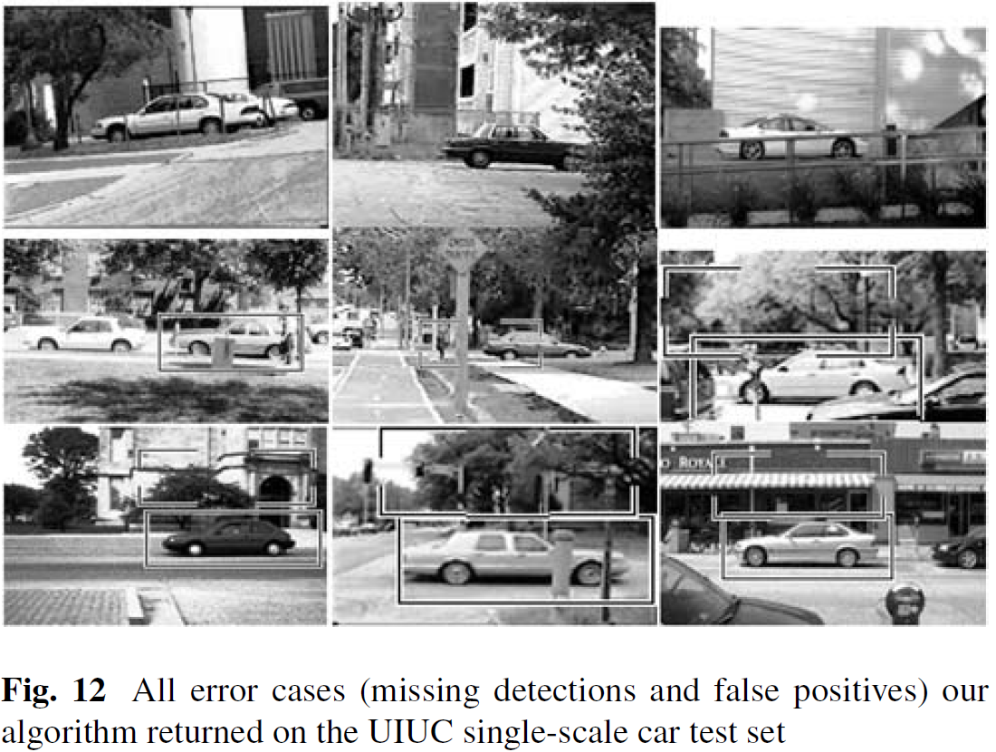

Slide 9
Vision for Recognition
Segmentation: developmental studies assume objects as entities,
BUT... one of the big open visual perception questions
Gestalts: unclear how to group percepts and how to weigh different Gestalt principles
Stable object and object class recognition
Small parts and objects: difficult to perceive and difficult to find reliably

Slide 10
As Szeliski (2010) puts it, “It may be many years before computers can name and outline all of the objects in a photograph with the same skill as a two year old child."

Slide 11
What Competences do you Need for Robots?
Perception
Vision
For Recognition
For Action
Touch or other modalities
Motor Skills
Transfer
Motivation
Learning
Concepts and Representation

Slide 12
Vision for Action
Grasping – Krueger, Kragic, Vincze, Saxena
Small community compared to recognition
Making progress – but probs for vision, haptic, motor readjustment
Nowhere near infant level – 6 months?
Single object affordances – Ugur, Stoytchev
Very small community
Need to get more generic features
Moving towards parts of objects
Pairs of objects – Fichtl, Rosman&Ramamoorthy

Slide 13
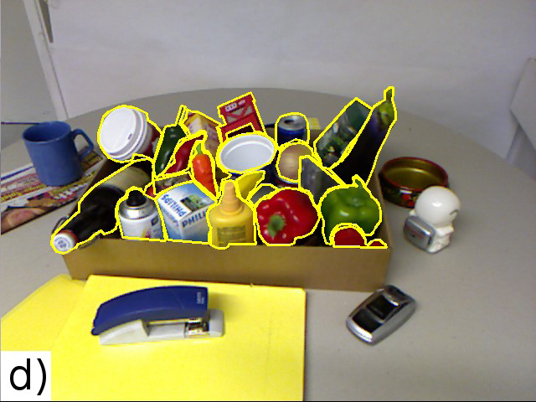
“Empty the box”

Slide 14
“I saw a 8 month old in a train investigating a bag on Friday. It was really depressing. He was so skilled.”
(e-mail communication from N. Krueger, 2012)

Slide 15
What Competences do you Need for Robots?
Perception
Vision
For Recognition
For Action
Touch or other modalities
Motor Skills
Transfer
Motivation
Learning
Concepts and Representation

Slide 16
Touch or other modalities
Stoytchev is a pioneer – e.g. vibrotactile sensor, audio
Helge Ritter in Bielefeld – e.g. Pressure sensor
Skin on iCub
Infant recognising in dark... Forget it!

Slide 17
“It can be depressing to compare the outcome of a five-year, multi-million-euro/dollar/yen project with what an infant can do after four months.
Infants are so clearly doing what we want robots to do; is there any way to learn from research on infant development?”
(Fitzpatrick, Needham, Natale, Metta, 2008)

Slide 18
Vision Overview
Like all AI: in its infancy
Many methods which work well in specific applications
No universal solution
Classic problem: Recognition problem
Recognise a type of object
Identify an instance (e.g. a person)
Easy for human
Computers limited:
Specific objects: faces, characters, vehicles
Specific situations: lighting, background, orientation

Slide 19
Vision Hierarchy
4. High level Models
3. Mid level Segmentation
2. Putting together Multiple images
1. Low level processing on a single image
0. The physics of image formation

Slide 20
Vision Hierarchy
4. High level Models
3. Mid level Segmentation
2. Putting together Multiple images
1. Low level processing on a single image
0. The physics of image formation

Slide 21
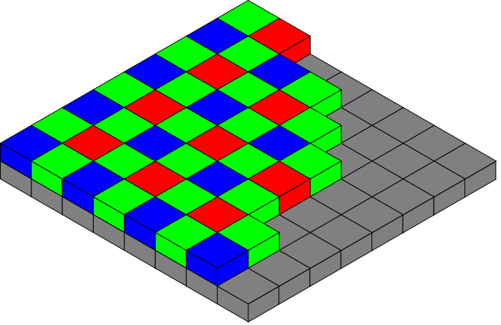
Camera
Lens focuses light
Charge-coupled device (CCD) detects
Bayer filter for colour
Individual spots in the digital image are “pixels”

Slide 22
Physics of Light
Important to know how light behaves
To guess the objects that generated what you see
Light travels straight
Can assume it is constant along a straight line
When it shines on a surface
Absorbed
Transmitted
Scattered
Combination
Simplifying assumptions
Light leaving a surface only due to light arriving
Light leaving of a specific colour only due to that colour arriving

Slide 23
Physics of Light
In general the amount reflected in some direction depends on
Direction of incoming and reflecting light
But simpler in some special cases:
Lambertian surfaces, e.g. cotton, matt surfaces
Specular surfaces, like a mirror
Modelled by combination

Slide 24
Shadows, Shading…Shading models
Shading model explains brightness of surfaces
allows you to reconstruct the objects in the scene
Local shading model
Surface light due only to sources visible at each point
Shadows appear when a patch can’t see sources
Advantages: easy to extract shape information
Global shading model
Also consider light reflected from other surfaces
Accurate, but too hard to extract shape information

Slide 25
Colour Perception
Color appearance is affected by
other nearby colors
adaptation to previous views
“state of mind”

Slide 26

Computer Vision - A Modern Approach
Set: Color
Slides by D.A. Forsyth

Slide 27

Computer Vision - A Modern Approach
Set: Color
Slides by D.A. Forsyth

Slide 28
Colour Perception
Humans have remarkable ability…
Know the colour a surface would have in white light
Know the colour of light arriving at eye
Know the colour of light falling on surface
(colour constancy)
Colour should help computers recognise objects, but difficult

Slide 29
Vision Hierarchy
4. High level Models
3. Mid level Segmentation
2. Putting together Multiple images
1. Low level processing on a single image
0. The physics of image formation

Slide 30
Edge Detection
Edges useful, could indicate
Visible sharp edge on object
Object boundary
Shadow
Pattern on object
First smooth to remove noise
Then edge detect

Slide 31

Computer Vision - A Modern Approach
Set: Color
Slides by D.A. Forsyth

Slide 32
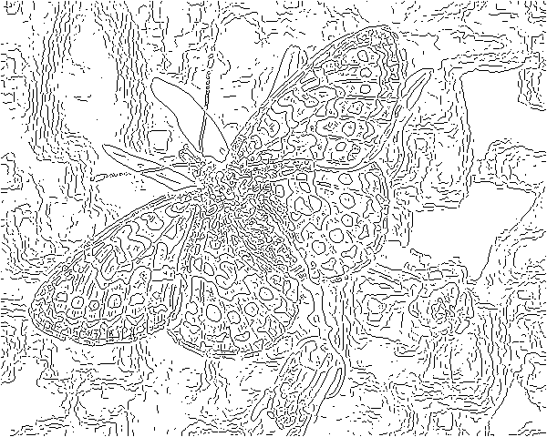
fine scale
high
threshold
Computer Vision - A Modern Approach
Set: Color
Slides by D.A. Forsyth

Slide 33
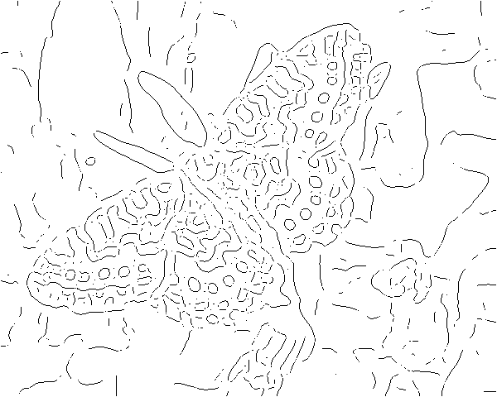
coarse
scale,
high
threshold
Computer Vision - A Modern Approach
Set: Color
Slides by D.A. Forsyth

Slide 34
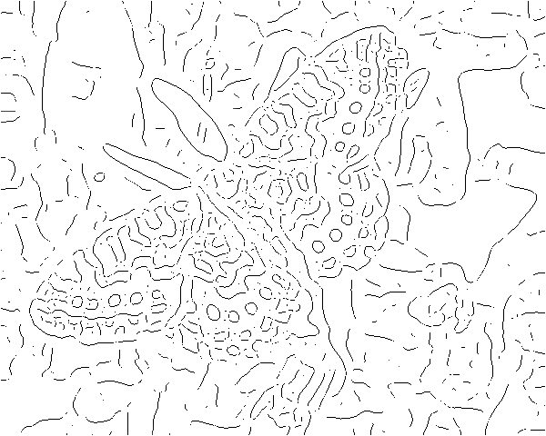
coarse
scale
low
threshold
Computer Vision - A Modern Approach
Set: Color
Slides by D.A. Forsyth

Slide 35
Texture
Depends on scale, can include: grass pebbles, hair
Segment image into areas of different texture
Advanced vision
Reconstruct shape from texture
Assume real texture is same on surface
Hence change is due to shape change
Texture elements get squashed or separated, or a different side visible
Humans very good at using this

Slide 36
Vision Hierarchy
4. High level Models
3. Mid level Segmentation
2. Putting together Multiple images
1. Low level processing on a single image
0. The physics of image formation

Slide 37
Multiple Views
Gives information about 3D distance
Methods
Two cameras (like human)
More cameras – 3 even better
Moving camera – same effect as multiple cameras
Maybe moving and zooming
“Structure from motion” problem
Can extract
shape of scene
Position of cameras (remember robot localisation)
Kinect has been a major development – widely used

Slide 38
Vision Hierarchy
4. High level Models
3. Mid level Segmentation
2. Putting together Multiple images
1. Low level processing on a single image
0. The physics of image formation

Slide 39
Segmentation
Group parts that are similar
Difficult problem
No comprehensive theory as yet
Combine high and low level
Top down – combine because same object
Bottom up – combine because locally similar
Example problems
Summarise video (similar sequences)
Find machined parts (lines, circles)
Find people (bodies, faces)
Find buildings by satellite (edge points, lines, polygons)
Example approaches
Find regions that have same texture/colour
Find blobs of same texture/colour/motion that look like limbs
Fit lines to edge points (grouping things that belong together)

Slide 40
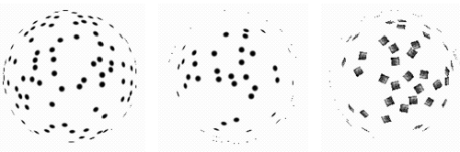
Computer Vision - A Modern Approach
Set: Color
Slides by D.A. Forsyth
Notes:
A disturbing possibility is that they all lie on a sphere -- but then, if we didn’t know that the tokens belonged together,
where did the sphere come from?

Slide 41
Segmentation
Group parts that are similar
Difficult problem
No comprehensive theory as yet
Combine high and low level
Top down – combine because same object
Bottom up – combine because locally similar
Example problems
Summarise video (similar sequences)
Find machined parts (lines, circles)
Find people (bodies, faces)
Find buildings by satellite (edge points, lines, polygons)
Example approaches
Find regions that have same texture/colour – works well
Find blobs of same texture/colour/motion that look like limbs
Fit lines to edge points (grouping things that belong together)

Slide 42
Human Approach
Gestalt (Psychology)
View as a whole group

Slide 43
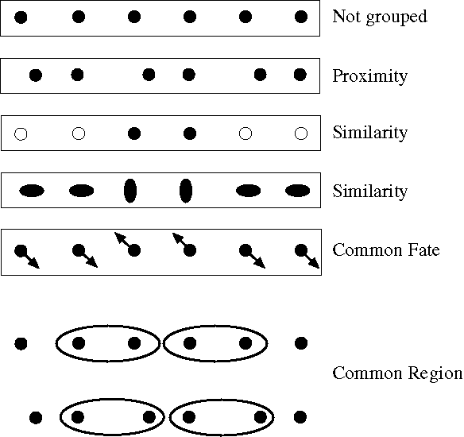
Notes:
Some criteria that tend to cause tokens to be grouped.

Slide 44
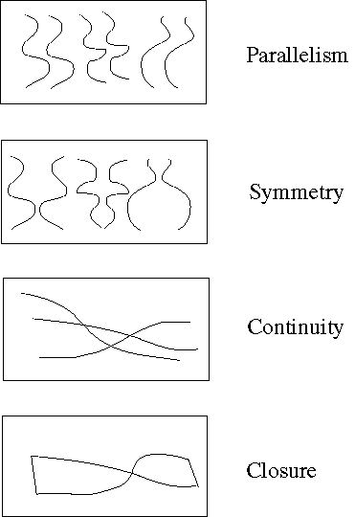
Notes:
More such

Slide 45
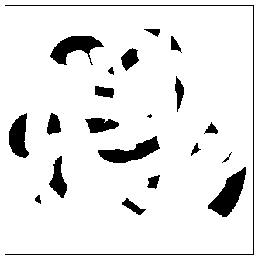
Notes:
Occlusion cues seem to be very important in grouping. Most people find it hard to read the 5 numerals in
this picture

Slide 46

Notes:
but easy in this

Slide 47
Segmentation – Fit a Model
Group parts that are similar
Fit points to a line
Fit points to a curve
Fit to a movement in video (tracking)
Motion capture
Recognition
Surveillance
Targetting
Use high level knowledge for models also…

Slide 48
Vision Hierarchy
4. High level Models
3. Mid level Segmentation
2. Putting together Multiple images
1. Low level processing on a single image
0. The physics of image formation

Slide 49
Object Models
Modelbase
Collection of models of objects to be recognised
e.g. aeroplane, building, nuts and bolts
Method:
Look at features and guess what object they come from
Use the position of features to guess the pose (position & orientation) of the object
Generate a rendering of the object in that pose
Compare with the object seen and see how good your guess was
What are features?
Should be the same from different points of view
Lines
Circles/ellipses
curves

Slide 50
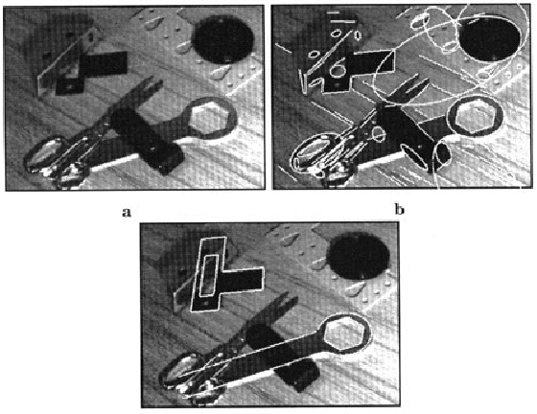
Figure from “Efficient model library access by projectively invariant indexing
functions,” by C.A. Rothwell et al., Proc. Computer Vision and Pattern Recognition,
1992, copyright 1992, IEEE
Notes:
Figure 18.3 - we’re using lines and conics here. You should point out that most of these objects have
more than five lines on them, so occlusion isn’t a catastrophe.

Slide 51
Template matching
Look for parts of an image that match some template
Faces: oval, dark bar for eyes, bright bar for nose
Problem: test if some oval is a face
Solution: Classifiers
Computer can be automatically trained from a set of examples
Neural Networks is a good method

Slide 52
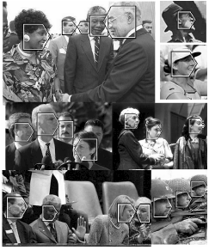
Figure from A Statistical Method for 3D Object Detection Applied to Faces and Cars, H. Schneiderman and T. Kanade, Proc. Computer Vision and Pattern Recognition, 2000, copyright 2000, IEEE

Slide 53
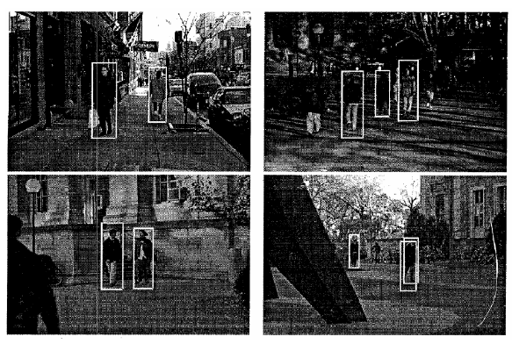
Figure from, “A general framework for object detection,” by C. Papageorgiou, M. Oren and T. Poggio, Proc. Int. Conf. Computer Vision, 1998, copyright 1998, IEEE
Notes:
Figure 22.22 - caption tells the story

Slide 54
Template matching
Look for parts of an image that match some template
Faces: oval, dark bar for eyes, bright bar for nose
Problem: test if some oval is a face
Solution: Classifiers
Computer can be automatically trained from a set of examples
Neural Networks is a good method
Improvement: relations among templates
For face: recognise eyes, nose, mouth
Good for animal faces
For body: recognise arms legs head body
e.g. a horse is made of cylinders

Slide 55
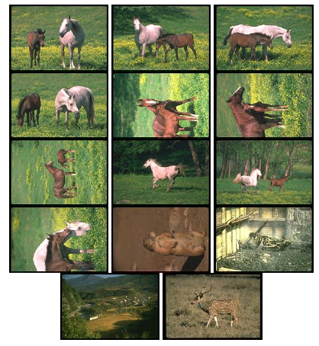
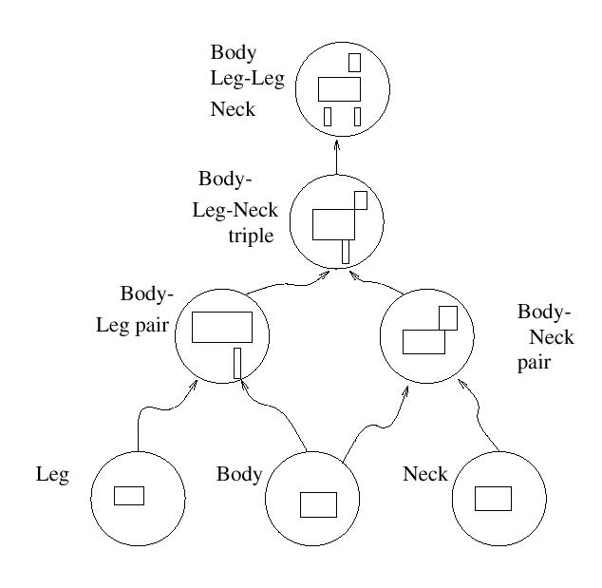
Horses
Notes:
Figure 23.6 and 23.7 - caption tells the story

Slide 56
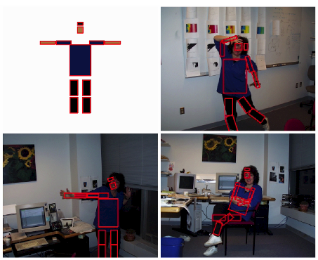
Figure from “Efficient Matching of Pictorial Structures,” P. Felzenszwalb and D.P. Huttenlocher, Proc. Computer Vision and Pattern Recognition2000, copyright 2000, IEEE
Notes:
Fig 23.17 - caption tells the story

Slide 57
Summing up Object Recognition
Much progress recently
Can do things which were the realm of humans a few years ago
Cheaper computation
Better understanding of component problems
Many techniques – which best? Probably combine
Templates work well,
but more work needed on how to group what’s seen, and template relations
Human comparison
Can recognise a huge number of objects
Robust to changing pattern/design
Robust to different backgrounds
Recognise at an abstract level
Can learn to recognise new object from very few examples

Slide 58
Practical Computer Vision
Controlling processes
e.g. an industrial robot or an autonomous vehicle
Detecting events
e.g. for visual surveillance
Finding images in large collections
Web (indexing, organising), military, copyright, stock photos
Difficult to deal with meaning
Interaction
e.g. as the input to a device for computer-human interaction
Modelling objects or environments
e.g. industrial inspection, medical image analysis or topographical modelling
Image based rendering
Difficult to produce models that look real
e.g. texture, dirt, weathering
Rebuild new scene from existing

