Slide 1
Course Overview
What is AI?
What are the Major Challenges?
What are the Main Techniques?
Where are we failing, and why?
Step back and look at the Science
Step back and look at the History of AI
What are the Major Schools of Thought?
What of the Future?

Slide 2
Course Overview
What is AI?
What are the Major Challenges?
What are the Main Techniques?
Where are we failing, and why?
Step back and look at the Science
Step back and look at the History of AI
What are the Major Schools of Thought?
What of the Future?
What are we trying to do? How far have we got?
Natural language (text & speech)
Computer vision
Robotics
Problem solving
Learning
Board games
Applied areas: Video games, healthcare, …
What has been achieved, and not achieved,
and why is it hard?

Slide 3
Course Overview
What is AI?
What are the Major Challenges?
What are the Main Techniques?
Where are we failing, and why?
Step back and look at the Science
Step back and look at the History of AI
What are the Major Schools of Thought?
What of the Future?
What are we trying to do? How far have we got?
Natural language (text & speech)
Computer vision
Robotics
Problem solving
Learning
Board games
Applied areas: Video games, healthcare, …
What has been achieved, and not achieved,
and why is it hard?

Slide 4
Lecture Overview
What are robots good for?
How do we build them?
What are the challenges in their design?
  How to plan movement
  How to control multifingered hands
Some grand challenges
  Robocup
  DARPA autonomous vehicle
Look at some modern robots
Notes:
The Purpose of Robots (Cont)
• Robots are also used for the following tasks:
• Dirty Tasks
• Repetitive tasks
• Dangerous tasks
• Impossible tasks
Labour intensive / boring tasks
• Robots assisting the handicapped.
elderly
Rescue – smaller spaces/fire/lack of oxygen
• EXPLORATION-
– Space Missions
– Robots in the Antarctic
– Exploring Volcanoes
– Underwater Exploration
• MEDICAL SCIENCE
– Surgical assistant
• ASSEMBLY- factories

Slide 5
What are Robots Good For?
Industry and Agriculture
Transport
Hazardous environments
Exploration
Medicine
Elderly care
Personal services
Military
Notes:
The Purpose of Robots (Cont)
• Robots are also used for the following tasks:
• Dirty Tasks
• Repetitive tasks
• Dangerous tasks
• Impossible tasks
Labour intensive / boring tasks
• Robots assisting the handicapped.
elderly
Rescue – smaller spaces/fire/lack of oxygen
• EXPLORATION-
– Space Missions
– Robots in the Antarctic
– Exploring Volcanoes
– Underwater Exploration
• MEDICAL SCIENCE
– Surgical assistant
• ASSEMBLY- factories

Slide 6
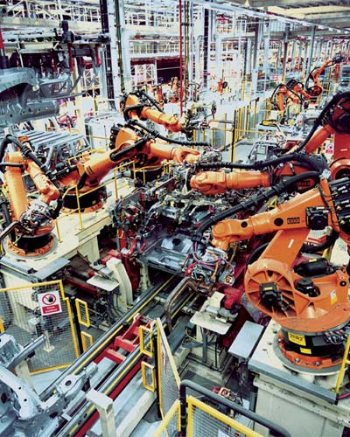
What are Robots Good For?
Industry and Agriculture
Example: Assembly
  Place parts
  Weld
  Paint
More cost effective than humans
Notes:
The Purpose of Robots (Cont)
• Robots are also used for the following tasks:
• Dirty Tasks
• Repetitive tasks
• Dangerous tasks
• Impossible tasks
Labour intensive / boring tasks
• Robots assisting the handicapped.
elderly
Rescue – smaller spaces/fire/lack of oxygen
• EXPLORATION-
– Space Missions
– Robots in the Antarctic
– Exploring Volcanoes
– Underwater Exploration
• MEDICAL SCIENCE
– Surgical assistant
•

Slide 7
What are Robots Good For?
Industry and Agriculture
Transport
Hazardous environments
Exploration
Medicine
Elderly care
Personal services
Military
Autonomous wheelchairs
Autonomous cars
Notes:
The Purpose of Robots (Cont)
• Robots are also used for the following tasks:
• Dirty Tasks
• Repetitive tasks
• Dangerous tasks
• Impossible tasks
Labour intensive / boring tasks
• Robots assisting the handicapped.
elderly
Rescue – smaller spaces/fire/lack of oxygen
• EXPLORATION-
– Space Missions
– Robots in the Antarctic
– Exploring Volcanoes
– Underwater Exploration
• MEDICAL SCIENCE
– Surgical assistant
• ASSEMBLY- factories

Slide 8
What are Robots Good For?
Industry and Agriculture
Transport
Hazardous environments
Exploration
Medicine
Elderly care
Personal services
Military
Fire
Lack of oxygen
Radioactivity
Mines / bomb disposal
Search and Rescue
  smaller spaces
Notes:
The Purpose of Robots (Cont)
• Robots are also used for the following tasks:
• Dirty Tasks
• Repetitive tasks
• Dangerous tasks
• Impossible tasks
Labour intensive / boring tasks
• Robots assisting the handicapped.
elderly
Rescue – smaller spaces/fire/lack of oxygen
• EXPLORATION-
– Space Missions
– Robots in the Antarctic
– Exploring Volcanoes
– Underwater Exploration
• MEDICAL SCIENCE
– Surgical assistant
• ASSEMBLY- factories

Slide 9
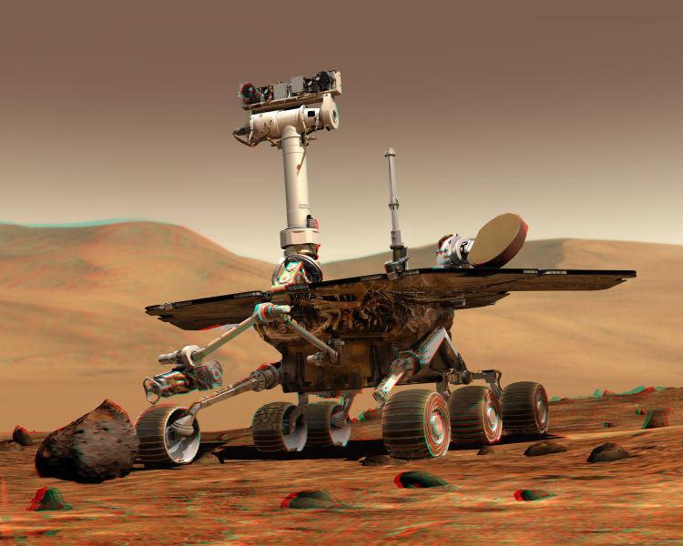
What are Robots Good For?
Industry and Agriculture
Transport
Hazardous environments
Exploration
Medicine
Elderly care
Personal services
Military
Space Missions
Robots in the Antarctic
Exploring Volcanoes
Underwater Exploration
Notes:
The Purpose of Robots (Cont)
• Robots are also used for the following tasks:
• Dirty Tasks
• Repetitive tasks
• Dangerous tasks
• Impossible tasks
Labour intensive / boring tasks
• Robots assisting the handicapped.
elderly
Rescue – smaller spaces/fire/lack of oxygen
• EXPLORATION-
–• MEDICAL SCIENCE
– Surgical assistant
• ASSEMBLY- factories

Slide 10
What are Robots Good For?
Industry and Agriculture
Transport
Hazardous environments
Exploration
Medicine
Elderly care
Personal services
Military
Remote surgery
Precise surgery
  Hip replacement
Notes:
The Purpose of Robots (Cont)
• Robots are also used for the following tasks:
• Dirty Tasks
• Repetitive tasks
• Dangerous tasks
• Impossible tasks
Labour intensive / boring tasks
• Robots assisting the handicapped.
elderly
Rescue – smaller spaces/fire/lack of oxygen
• EXPLORATION-
– Space Missions
– Robots in the Antarctic
– Exploring Volcanoes
– Underwater Exploration
• MEDICAL SCIENCE
– Surgical assistant
• ASSEMBLY- factories

Slide 11
What are Robots Good For?
Industry and Agriculture
Transport
Hazardous environments
Exploration
Medicine
Elderly care
Personal services
Military
Remind to take medicine
Perform household chores
Alert emergency services
Notes:
The Purpose of Robots (Cont)
• Robots are also used for the following tasks:
• Dirty Tasks
• Repetitive tasks
• Dangerous tasks
• Impossible tasks
Labour intensive / boring tasks
• Robots assisting the handicapped.
elderly
Rescue – smaller spaces/fire/lack of oxygen
• EXPLORATION-
– Space Missions
– Robots in the Antarctic
– Exploring Volcanoes
– Underwater Exploration
• MEDICAL SCIENCE
– Surgical assistant
• ASSEMBLY- factories

Slide 12
What are Robots Good For?
Industry and Agriculture
Transport
Hazardous environments
Exploration
Medicine
Elderly care
Personal services
Military
Vacuum cleaner
Lawn mower
Golf caddy
Notes:
The Purpose of Robots (Cont)
• Robots are also used for the following tasks:
• Dirty Tasks
• Repetitive tasks
• Dangerous tasks
• Impossible tasks
Labour intensive / boring tasks
• Robots assisting the handicapped.
elderly
Rescue – smaller spaces/fire/lack of oxygen
• EXPLORATION-
– Space Missions
– Robots in the Antarctic
– Exploring Volcanoes
– Underwater Exploration
• MEDICAL SCIENCE
– Surgical assistant
• ASSEMBLY- factories

Slide 13
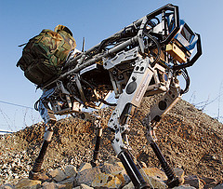
What are Robots Good For?
Industry and Agriculture
Transport
Hazardous environments
Exploration
Medicine
Elderly care
Personal services
Military
Transport
Battlefield surgeon
Surveillance
Notes:
The Purpose of Robots (Cont)
• Robots are also used for the following tasks:
• Dirty Tasks
• Repetitive tasks
• Dangerous tasks
• Impossible tasks
Labour intensive / boring tasks
• Robots assisting the handicapped.
elderly
Rescue – smaller spaces/fire/lack of oxygen
• EXPLORATION-
– Space Missions
– Robots in the Antarctic
– Exploring Volcanoes
– Underwater Exploration
• MEDICAL SCIENCE
– Surgical assistant
• ASSEMBLY- factories

Slide 14
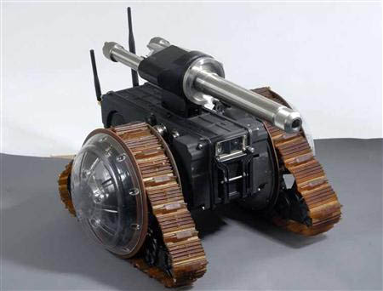
What are Robots Good For?
Industry and Agriculture
Transport
Hazardous environments
Exploration
Medicine
Elderly care
Personal services
Military
Transport
Battlefield surgeon
Surveillance
Hunter-Killer
Notes:
The Purpose of Robots (Cont)
• Robots are also used for the following tasks:
• Dirty Tasks
• Repetitive tasks
• Dangerous tasks
• Impossible tasks
Labour intensive / boring tasks
• Robots assisting the handicapped.
elderly
Rescue – smaller spaces/fire/lack of oxygen
• EXPLORATION-
– Space Missions
– Robots in the Antarctic
– Exploring Volcanoes
– Underwater Exploration
• MEDICAL SCIENCE
– Surgical assistant
• ASSEMBLY- factories

Slide 15
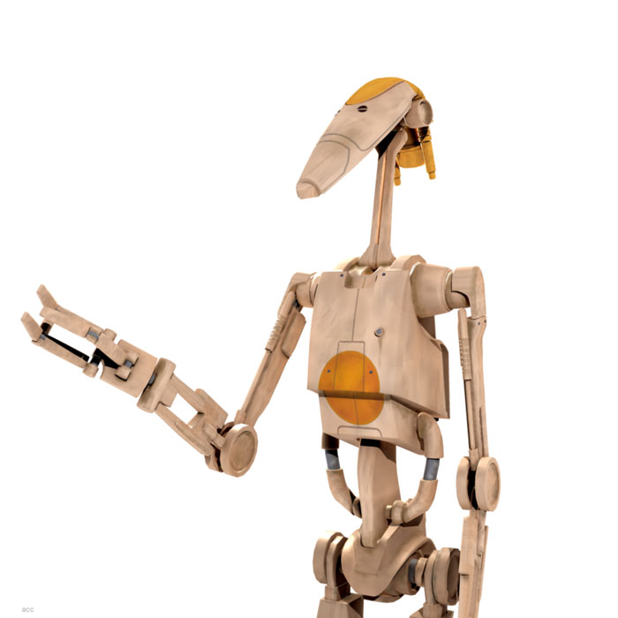
Robot Overview
Sensors
Robot
Environment
Effectors

Slide 16
Robot Overview
Position of joints
Gyroscopes
Forces (e.g. grip)
Range to obstacles
GPS
Vision
Hearing
Sensors
Robot
Environment
Effectors

Slide 17
Robot Overview
Sensors
Robot
Environment
Locomotion
Legs
Wheels
Manipulation
Simple graspers
Multifingered hands
Effectors

Slide 18
AI Robotics
Robotics: Major area of research in Engineering and in Artificial Intelligence (+ intersection)
In AI we are interested in robots that think for themselves
AI is not interested in remote control robots or teleoperation (view through robot eyes)
Autonomous: acting on its own, without human control
  Autonomous robots could be simple (like insects) or advanced (like higher animals)
Two broad categorisations (+hybrids)
Cognitive: knowing; perceiving and understanding the world.
  Cognitive robots are advanced, perceiving, reasoning and planning in a human like way
  Popular since early days
  Still active research, but difficult
Behaviour-based: does not model the world and deliberate
  Some simple behaviours could together produce sophisticated behaviour (insects)
  Popular since 90’s
  Easier, but limited performance
Thus we have two types according to mental abilities
… what about physical? Manipulators, mobile robots, hybrids (e.g. humanoid)

Slide 19
AI Robotics Challenges
A proper intelligent robot needs to solve all the AI problems together!
Natural language (text & speech)
Robotics
Computer vision
Problem solving
Learning
Let us focus on the uniquely robotics problems
How to move in the world

Slide 20
AI Robotics
A proper intelligent robot needs to solve all the AI problems together!
Natural language (text & speech)
Robotics
Computer vision
Problem solving
Learning
Let us focus on the uniquely robotics problems
How to move in the world
Localisation/mapping
  Range finders
  Landmarks
  Always uncertainty
Motion planning
  For body location in world
  For arms/fingers

Slide 21
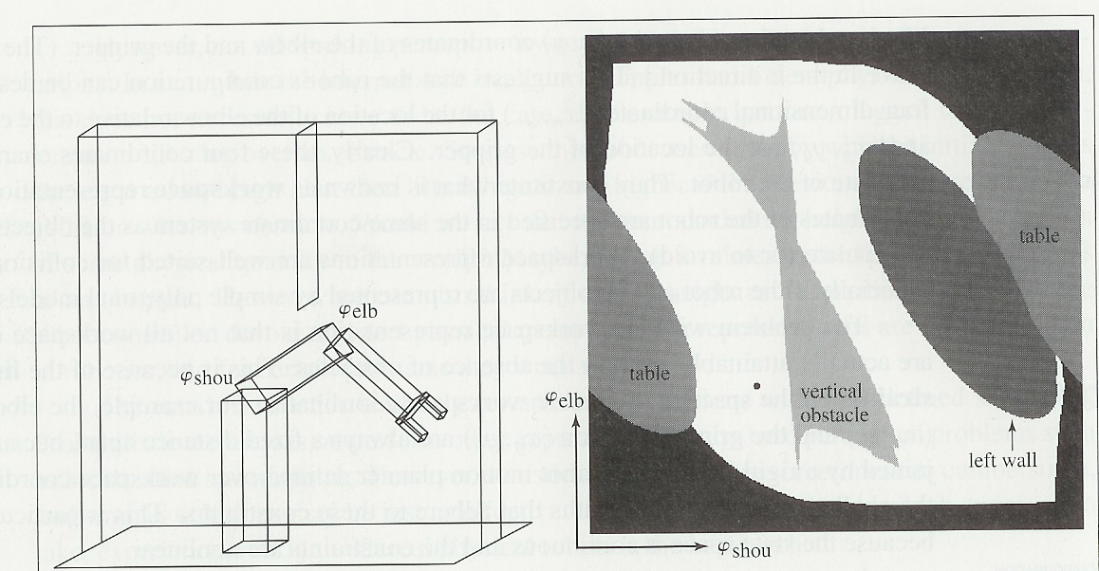
The Motion Planning Problem
Configuration space
Considers all the degrees of freedom (DOF) of the robot
Problem is then to move from one point to another in configuration space

Slide 22
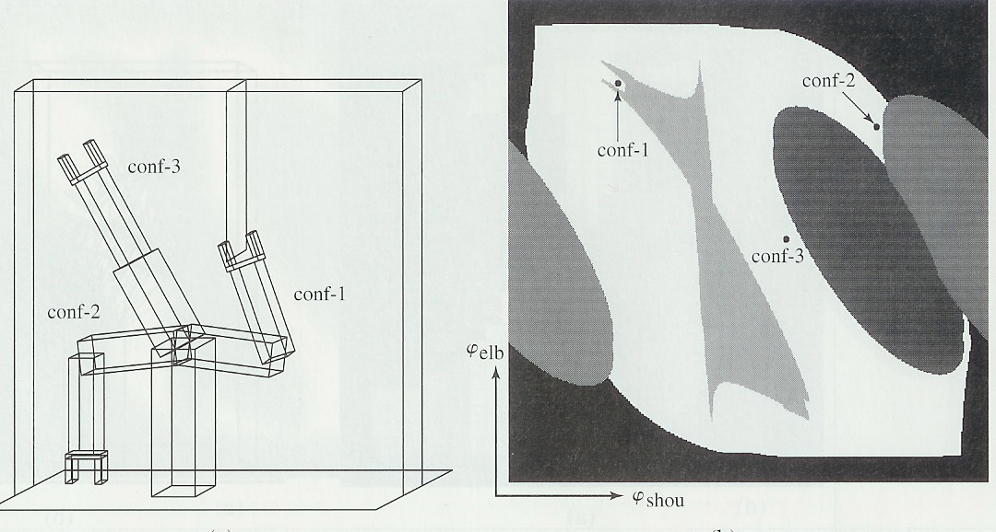
The Motion Planning Problem
Configuration space
Considers all the degrees of freedom (DOF) of the robot
Problem is then to move from one point to another in configuration space

Slide 23
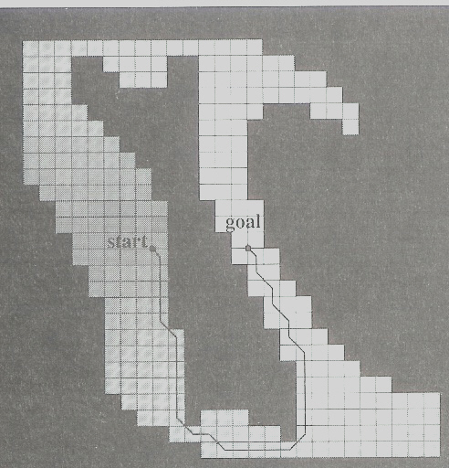
The Motion Planning Problem
Configuration space
Considers all the degrees of freedom (DOF) of the robot
Problem is then to move from one point to another in configuration space
Approaches:
Cell decomposition
(break space into small boxes)
  Problems for detailed movements

Slide 24

The Motion Planning Problem
Configuration space
Considers all the degrees of freedom (DOF) of the robot
Problem is then to move from one point to another in configuration space
Approaches:
Cell decomposition
Skeletonisation (trace out useful paths)
  Hard if multidimensional
  Hard if objects complicated

Slide 25
The Motion Planning Problem
Configuration space
Considers all the degrees of freedom (DOF) of the robot
Problem is then to move from one point to another in configuration space
Approaches:
Cell decomposition
Skeletonisation (trace out useful paths)
  Hard if multidimensional
  Hard if objects complicated

Slide 26
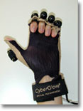
Motion Planning for Multifingered Robots
Current hot area
Applications in home help
Attempt to imitate Human grasping
Steps:
Attempt to recognise 3D shape of object (vision)
  Adjust hand appropriately
Feature extraction – from human hand performance
  Data glove (obstructs; could prevent natural grasp)
  Cameras (vision problem)
  Optical Marker based
How to apply features
Slide topics thanks to Honghai Liu

Slide 27
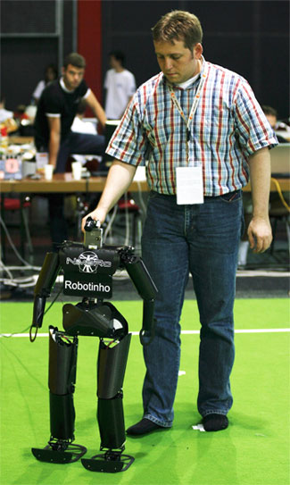
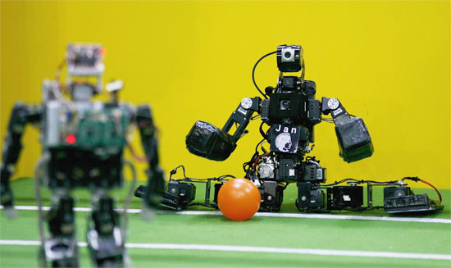
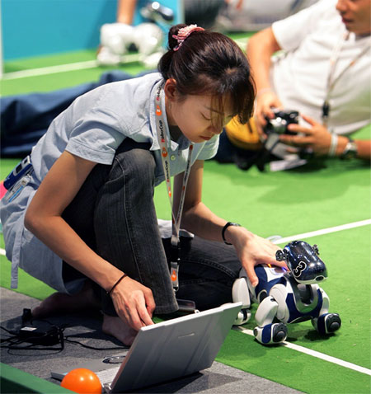
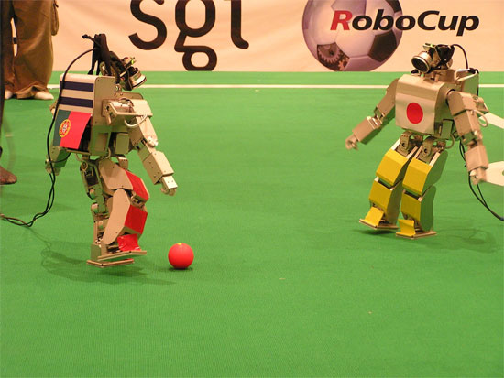
Grand Challenge: Robcup

Slide 28

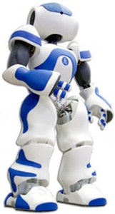
Grand Challenge: Robcup
By the year 2050: a team of fully autonomous humanoid robots that can win against the human world soccer champion team.
Different Leagues
Simulation, small size, mid size, humanoid
E.g. small size:
  Five robots
  Golf ball
  Walled table tennis table
Humanoid (Standard Platform League)
All teams use identical robots
Teams concentrate on software only
No external control by humans or computers
Humanoid Aldebaran Nao (previously Sony AIBO)

Slide 29
Grand Challenge: Robcup
Challenges of controlling multi-robot teams
Robot perceives world → generate representation of environment
Recognise and consider position of team-mates and opponents
Need high-level multi-robot team plan
Assign sub tasks to each robot to achieve team goal
Each team member must carry out part of strategy,
  but must not impede each other!
Moving objects in environment → adds complexity to path planning.
Trade-off aspects (because time limited)
  Communication between robots
  Image interpretation from the camera information
Difficult!
  Time delays inherent in these systems
  Highly dynamic nature of robot soccer
Good domain to stimulate AI research, generate excitement and motivate people

Slide 30
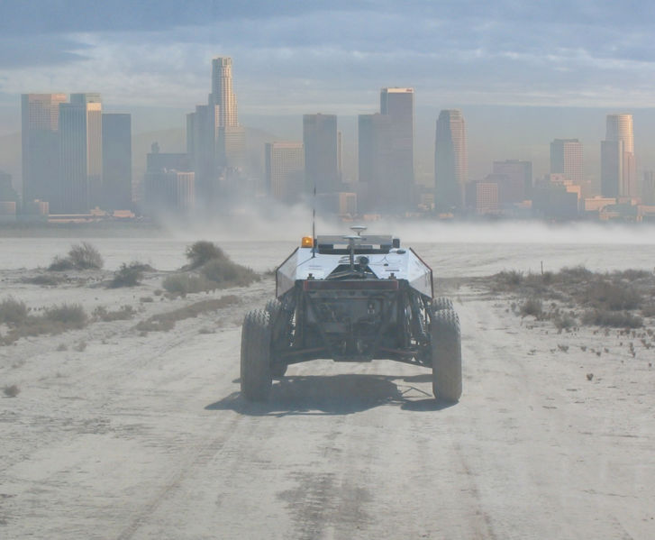
DARPA Grand Challenge
http://en.wikipedia.org/wiki/DARPA_Grand_Challenge

Slide 31
Autonomous Ground Vehicle
vehicle that navigates and drives entirely on its own
  no human driver
  no remote control
Uses sensors and positioning systems
  vehicle determines characteristics of its environment
  carries out the task it has been assigned
http://en.wikipedia.org/wiki/DARPA_Grand_Challenge

Slide 32
DARPA Grand Challenge 2004
Ultimate goal:
  One-third of ground military forces autonomous by 2015
$1 million prize money
More than 100 teams
150-mile route in Mojave Desert (off-road course)
Performance:
  Three hours into the event: four vehicles remained
  Stuck brakes, broken axles, rollovers, malfunctioning satellite navigation equipment
  Within a few hours: all vehicles stuck
  Best performance: 7.36 miles (5%)
Prize money not won
Success: spurred interest

Slide 33
DARPA Grand Challenge 2005
$2 million prize money
132-mile race
More than 195 teams
"Stanley", robotic Volkswagen won
Four other vehicles successfully completed the race.

Slide 34
DARPA Grand Challenge 2007
November 3, 2007
DARPA has selected 35 teams for National Qualification Event
“Urban Challenge”
  vehicles manoeuvring in a mock city environment
  executing simulated military supply missions
  merging into moving traffic
  navigating traffic circles
  negotiating busy intersections
  avoiding obstacles
Vehicles judged
  not just based how fast they navigate the course
  also how well they perform: http://www.darpa.mil/grandchallenge/docs/Technical_Evaluation_Criteria_031607.pdf

Slide 35
DARPA Grand Challenge 2012
Drive a utility vehicle at the site.
Travel dismounted across rubble.
Remove debris blocking an entryway.
Open a door and enter a building.
Climb an industrial ladder and traverse an industrial walkway.
Use a tool to break through a concrete panel.
Locate and close a valve near a leaking pipe.
Replace a component such as a cooling pump.

Slide 36
Summary/Conclusions
Much progress recently esp. on engineering side
On AI side…
  Dichotomy between behaviour based and cognitive similar to deep/shallow in language processing
  Hybrid popular
Suffers all the problems of AI vision
  Cannot interpret what it sees reliably
  Cannot recognise objects reliably
Still suffers commonsense knowledge problems
  Cannot know what to expect from objects in the world e.g.
    Physical properties – water/sand/breakable materials
    People/animals (makes it dangerous)
  Limited ability to interpret intentions/social situations
    Limited interaction with people

Slide 37
Some examples of modern robots…

Slide 38
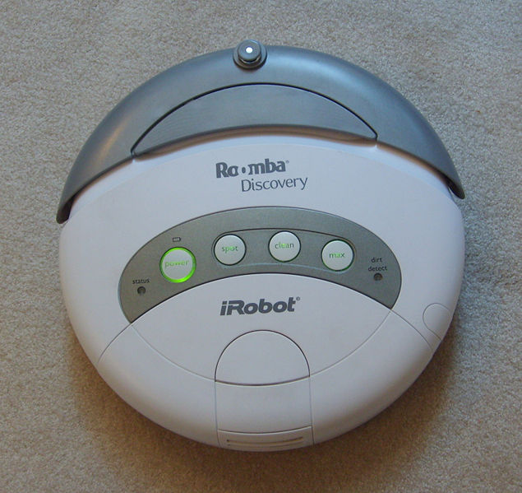
Roomba
Capabilities
Detects bumping into walls and furniture,
Accessories: "virtual wall" infrared transmitter units
Automatically tries to find self-charging homebase
Begin cleaning automatically at the time of day
Simple behaviours:
  Spiral cleaning
  Wall-following
  Random walk angle-changing after bumping
Effectiveness
  Takes longer than a person
  Covers some areas many times and others not at all
Over 2 million Roombas sold
Most successful household robot

Slide 39
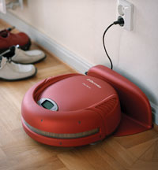
Trilobite
(Much more expensive)
Capabilities
Automatically makes a map of the room
Cleans efficiently
Remembers where it has been

Slide 40
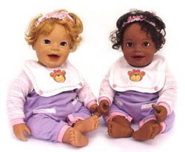
My Real Baby
Capabilities
Facial muscles: smile, frown, cry
Blink, suck its thumb and bottle
Baby noises
Realistic facial expressions and emotional responses
  E.g. if not fed: gets hungry and cries
No longer in production, but expect more of this type…

Slide 41
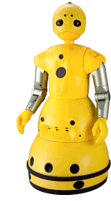
Wakamaru
Companionship for elderly and disabled people
Capabilities
Detection of moving persons
Face recognition of 10 persons.
Voice recognition 10,000 words
Memorises his owner's daily rhythm of waking up, eating, sleeping, etc.
Remind the user to take medicine on time
Calling for help if he suspects something is wrong
Calling for help if he detects a moving objects around him while you are away (e.g. intruder)
Provides information and services by connecting to the Internet.

Slide 42
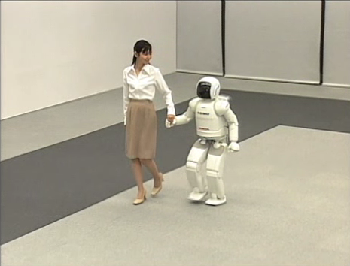
Honda’s ASIMO

Slide 43
State of the Art : Honda’s ASIMO
(name not from Isaac Asimov; ashimo ="legs also“)
Capabilities:
Walking, Running: 6 km/h (like a human)
Vision: camera mounted in head
  Detect movements of multiple objects
  Can follow the movements of a person
  greet a person when s/he approaches
Recognition of postures and gestures
  recognise when a handshake is offered
  recognise person waving, respond
  recognise pointing
Environment recognition
  Recognise nearby humans and not hit them
  Recognise stairs and not fall down
Face recognition
  recognise 10 different faces
  address them by name

Slide 44
State of the Art : Honda’s ASIMO
(name not from Isaac Asimov; ashimo ="legs also“)
Capabilities:
Walking, Running: 6 km/h (like a human)
Vision: camera mounted in head
  Detect movements of multiple objects
  Can follow the movements of a person
  greet a person when s/he approaches
Recognition of postures and gestures
  recognise when a handshake is offered
  recognise person waving, respond
  recognise pointing
Environment recognition
  Recognise nearby humans and not hit them
  Recognise stairs and not fall down
Face recognition
  recognise 10 different faces
  address them by name
Hearing
  distinguish between voices and other sounds
  respond to its name
  face people when being spoken to
Can use Internet
  provide of news and weather updates
Possible Application: receptionist
  inform personnel of visitor's arrival by transmitting messages and pictures of the visitor's face
  guide guests to a meeting room
  serve coffee on a tray
  push a cart

