Slide 1
Course Overview
What is AI?
What are the Major Challenges?
What are the Main Techniques?
Where are we failing, and why?
Step back and look at the Science
Step back and look at the History of AI
What are the Major Schools of Thought?
What of the Future?

Slide 2
Course Overview
What is AI?
What are the Major Challenges?
What are the Main Techniques?
Where are we failing, and why?
Step back and look at the Science
Step back and look at the History of AI
What are the Major Schools of Thought?
What of the Future?
What are we trying to do? How far have we got?
Natural language (text & speech)
Robotics
Computer vision
Board games
Problem solving
Learning
Applied areas: Video games, healthcare, …
What has been achieved, and not achieved,
and why is it hard?

Slide 3
Course Overview
What is AI?
What are the Major Challenges?
What are the Main Techniques?
Where are we failing, and why?
Step back and look at the Science
Step back and look at the History of AI
What are the Major Schools of Thought?
What of the Future?
What are we trying to do? How far have we got?
Natural language (text & speech)
Robotics
Computer vision
Board games
Problem solving
Learning
Applied areas: Video games, healthcare, …
What has been achieved, and not achieved,
and why is it hard?

Slide 4
Course Overview
What is AI?
What are the Major Challenges?
What are the Main Techniques?
Where are we failing, and why?
Step back and look at the Science
Step back and look at the History of AI
What are the Major Schools of Thought?
What of the Future?
What are we trying to do? How far have we got?
Natural language (text & speech)
Robotics
Computer vision
Board games
Problem solving
Learning
Applied areas: Video games, healthcare, …
What has been achieved, and not achieved,
and why is it hard?

Slide 5
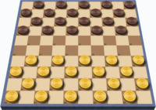
Board Games
Draughts/Checkers
  Humans 0 – 1 Computers
  1962 Arthur Samuel’s program
  beat state champion
  1990 world champ beaten
  Completely solved in 2007
    Program: Chinook
Why is draughts easy for computers?
  Limited number of possible moves

Slide 6
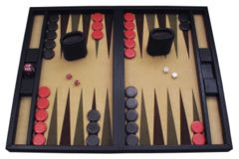
Board Games
Backgammon
  Humans 0 – 1 Computers
  World champ defeated in 1979
  Used Fuzzy logic
  Later used neural networks
Features of Backgammon
  Lots of random dice throws
  Many possibilities

Slide 7
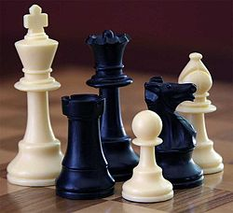
Board Games
Chess
  Humans 0 – 1 Computers
  World champ defeated in 1997
  Deep Fritz beat champ in 2006
  Humans don’t want to
  play computers because
  computers are too good
  But computers can be useful for practice
Why is chess (relatively) easy for computers?
  (Very easy to beat non-experts)
  Not so many possibilities
  Good evaluation functions
    pieces, their positions, and stage in game

Slide 8
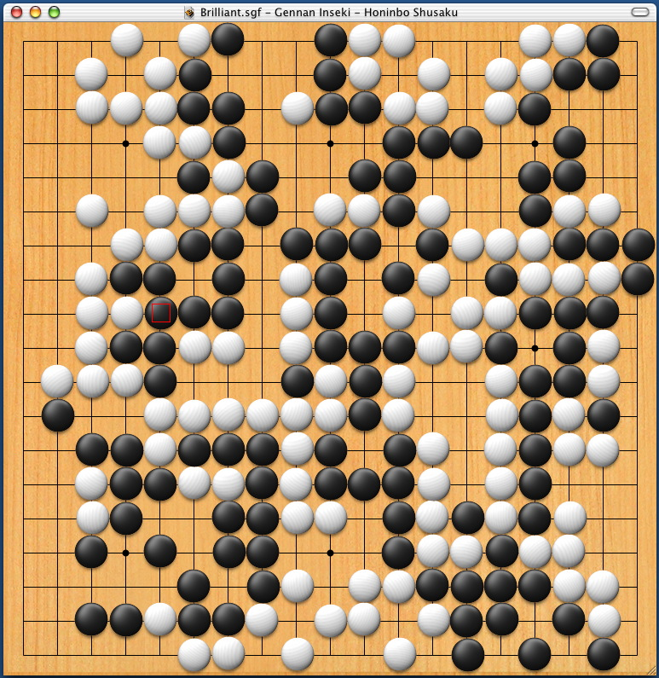
Board Games
Go (Wei Qi)
  Humans 1 – 0 Computers
  Humans don’t want to play computers
  because computers are too bad
  But computers can be useful in the endgame
Why is go so hard for computers?
  19x19 board
  Bigger board, more possibilities
  Gets harder as board fills up
  Local analysis not enough
  Evaluation seems to require pattern recognition – “good shape”

Slide 9
Problem solving
More general than board games

Slide 10



Problem solving
More general than board games
Classic problems…
  monkey
  chair
  banana

Slide 11

Problem solving
Towers of Hanoi
Missionaries and cannibals
Pouring jugs
Movable squares
Route finding
Find order to assemble machine parts
Find amino acids to build proteins
6 | 1 | 7
3 | 4
5 | 8 | 2

Slide 12
General Problem Solving
Problem formulation
  Initial situation
  Goal situation
  Actions that can be done
    +cost of action
  Constraints
  Task:
    Find the best sequence of permissible actions that can transform the initial situation into the goal situation.
6 | 1 | 7
3 | 4
5 | 8 | 2

Slide 13
Problem solving
Humans vs. Computers
Computers good when
  The problem can be well defined
  The relevant knowledge is all available in a form the computer can use
    Coded in a regular systematic way (like a table)
    Doesn’t matter if there is a huge amount of this knowledge
  Example: route finding
Humans good when
  Problem is vaguely defined
  Relevant knowledge not readily available in a convenient form
  (Doesn’t matter if knowledge is in diverse forms)
  May need to adapt knowledge and solutions from similar problems
  Not too much knowledge in one form (massive tables)
    Unless computer support
Many modern problems actually solved by hybrid
  Computer+human
  Maths, medicine, astronomy, genetics, ….

Slide 14
Learning
Many different types of learning
  Simple: associate some stimulus with a response
    When I press the red button food drops down
  Intermediate: Learn the map of the room I am in
  Learn to drive without error
  Learn to recognise faces
  Advanced: Scientific Discovery
    learn about the world through experiments and observation

Slide 15
Machine Learning Successes (from Mitchell)
Recognise spoken words
  Automatically adapt to speaker accent, vocabulary etc.
Drive a vehicle autonomously
  ALVINN drove on a public highway
  DARPA challengers drove off-road
Classify new astronomical structures
  Search through terabytes of data
Backgammon
  TD-Gammon program
  Played over 1Million games against itself

Slide 16
Learning
Machine Learning Definition
  We are learning in order to get better at some set of tasks
  We have some way to measure our performance on those tasks
  We get some experience from the environment when doing the tasks
  We use that experience to learn to perform better at the task
  A computer program is said to learn if its performance on the tasks improves with the experience
  (Mitchell, simplified)

Slide 17
Example Learning Problems (from Mitchell)
Draughts/Checkers learning problem
  Task: play checkers
  Performance measure: percent of games won against opponents
  Training experience: playing practice games against itself
Handwriting recognition learning problem
  Task: recognise and classify handwritten words in images
  Performance measure: percent of words correctly classified
  Training experience: database of classified images of handwriting
Autonomous vehicle learning problem
  Task: drive on a public motorway using vision sensors
  Performance measure: average distance travelled before an error
  Training experience: a sequence recorded from a human driver (what is seen and what actions are taken)

Slide 18
How to Learn?
Supervised
  Examples are given, classified as positive or negative
  Example: database of classified images of handwriting
Unsupervised
  Find patterns in the data
  Example: Amazon’s recommendations
Reinforcement learning
  Trial and error
  Example: TD-Gammon playing practice games against itself

Slide 19
Learning
Humans vs. Computers
(Just like problem solving – learning is really an approach to problem solving)
Computers good when
  The learning task can be well defined
  The relevant knowledge is all available in a form the computer can use
    Coded in a regular systematic way (like a table)
    Doesn’t matter if there is a huge amount of this knowledge
  Example: find patterns Amazon data, credit card fraud, medical diagnosis, …
Humans good when
  Problem is vaguely defined
  Relevant knowledge not readily available in a convenient form
  (Doesn’t matter if knowledge is in diverse forms)
  May need to adapt knowledge and solutions from similar problems
  Not too much knowledge in one form (massive tables)
    Unless computer support
Many modern problems actually solved by hybrid learner
  Computer+human

Slide 20
Learning
Humans vs. Computers
(Just like problem solving – learning is really an approach to problem solving)
Computers good when
  The learning task can be well defined
  The relevant knowledge is all available in a form the computer can use
    Coded in a regular systematic way (like a table)
    Doesn’t matter if there is a huge amount of this knowledge
  Example: find patterns Amazon data, credit card fraud, medical diagnosis, …
Humans good when
  Problem is vaguely defined
  Relevant knowledge not readily available in a convenient form
  (Doesn’t matter if knowledge is in diverse forms)
  May need to adapt knowledge and solutions from similar problems
  Not too much knowledge in one form (massive tables)
    Unless computer support
Many modern problems actually solved by hybrid learner
  Computer+human

Slide 21
Daniel Crevier
"Pattern recognition and association make up the core of our thought. These activities involve millions of operations carried out in parallel, outside the field of our consciousness. If AI appeared to hit a brick wall after a few quick victories, it did so owing to its inability to emulate these processes.”
Notes:
Slavery of machine and implications

Slide 22

Howard Gardner (Psychologist)
“An individual understands a concept, skill, theory, or domain of knowledge to the extent that he or she can apply it appropriately in a new situation.”
Notes:
Slavery of machine and implications

Slide 23

Two Serious Stumbling Blocks for AI:

Slide 24
Two Serious Stumbling Blocks for AI:
Commonsense
Generalising

Slide 25
Two Serious Stumbling Blocks for AI:
Commonsense
Generalising
Are they related?

Slide 26
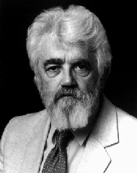
John McCarthy,
"Programs with Common Sense", 1958.
"Our ultimate objective is to make programs that learn from their experience as effectively as humans do. We shall…say that a program has common sense if it automatically deduces for itself a sufficient wide class of immediate consequences of anything it is told and what it already knows.”
Notes:
Slavery of machine and implications

Slide 27
Recap – computers vs. humans
What is AI?
What are the Major Challenges?
What are the Main Techniques?
Where are we failing, and why?
Step back and look at the Science
Step back and look at the History of AI
What are the Major Schools of Thought?
What of the Future?
What are we trying to do? How far have we got?
Natural language (text & speech)
Computer vision
Robotics
Board games
Problem solving
Learning
Applied areas: Video games, healthcare, …
What has been achieved, and not achieved,
and why is it hard?

