Slide 1
Course Overview
✓Done
What is AI?
What are the Major Challenges?
What are the Main Techniques?
Where are we failing, and why?
Step back and look at the Science
Step back and look at the History of AI
What are the Major Schools of Thought?
What of the Future?
✓Done

Slide 2
Course Overview
What is AI?
What are the Major Challenges?
What are the Main Techniques? (How do we do it?)
Where are we failing, and why?
Step back and look at the Science
Step back and look at the History of AI
What are the Major Schools of Thought?
What of the Future?

Slide 3
Course Overview
What is AI?
What are the Major Challenges?
What are the Main Techniques? (How do we do it?)
Where are we failing, and why?
Step back and look at the Science
Step back and look at the History of AI
What are the Major Schools of Thought?
What of the Future?
Search
Logics (knowledge representation and reasoning)
Planning
Bayesian belief networks
Neural networks
Evolutionary computation
Reinforcement learning
These are all in fact types of
“Machine Learning”

Slide 4
Course Overview
What is AI?
What are the Major Challenges?
What are the Main Techniques? (How do we do it?)
Where are we failing, and why?
Step back and look at the Science
Step back and look at the History of AI
What are the Major Schools of Thought?
What of the Future?
Search
Logics (knowledge representation and reasoning)
Planning
Bayesian belief networks
Neural networks
Evolutionary computation
Reinforcement learning
These are all in fact types of
“Machine Learning”

Slide 5
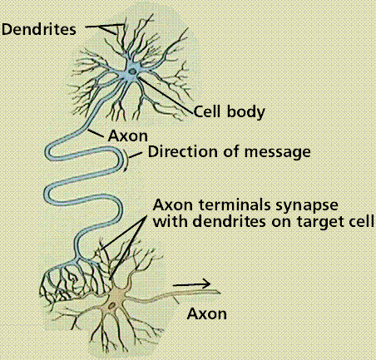
Biological Inspiration
Artificial Neural Network (ANN)
loosely based on biological neuron
Each unit is simple, but many connected in a complex network
If enough inputs are received
  Neuron gets “excited”
  Passes on a signal, or “fires”
ANN different to biological:
  ANN outputs a single value
  Biological neuron sends out a complex series of spikes
  Biological neurons not fully understood
Image from Purves et al., Life: The Science of Biology, 4th Edition, by Sinauer Associates and WH Freeman

Slide 6
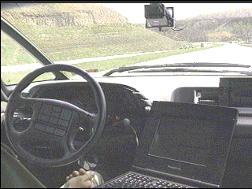
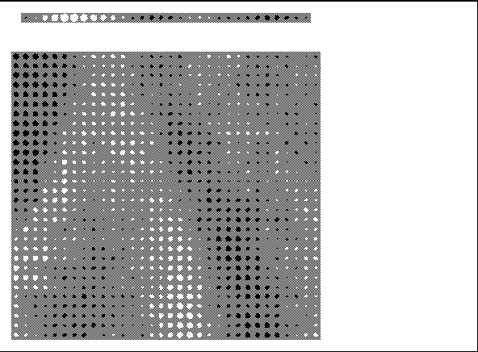
Neural Net example: ALVINN
Autonomous vehicle controlled by Artificial Neural Network
Drives up to 70mph on public highways
Note: most images are from the online slides for Tom Mitchell’s book “Machine Learning”

Slide 7
Neural Net example: ALVINN
Autonomous vehicle controlled by Artificial Neural Network
Drives up to 70mph on public highways

Slide 8
Neural Net example: ALVINN
Sharp left
Straight ahead
Sharp right
30 output units
4 hidden units
1 input pixel
Input is 30x32 pixels
= 960 values

Slide 9
Neural Net example: ALVINN
Sharp left
Straight ahead
Sharp right
30 output units
4 hidden units
Learning means adjusting weight values
1 input pixel
Input is 30x32 pixels
= 960 values

Slide 10
Neural Net example: ALVINN
Sharp left
Straight ahead
Sharp right
30 output units
4 hidden units
1 input pixel
Input is 30x32 pixels
= 960 values

Slide 11
Neural Net example: ALVINN

Slide 12
Neural Net example: ALVINN
This shows one hidden node
Input is 30x32 array of pixel values
= 960 values
Note: no special visual processing
Size/colour corresponds to weight on link

Slide 13
Neural Net example: ALVINN
Output is array of 30 values
This corresponds to steering instructions
E.g. hard left, hard right
This shows one hidden node
Input is 30x32 array of pixel values
= 960 values
Note: no special visual processing
Size/colour corresponds to weight on link

Slide 14
The Perceptron
input₁
weight₁
weight₂
add
output
input₂
weight₃
(threshold)
weight₄
input₃
input₄

Slide 15
The Perceptron
 | student | first last year | male | works hard | Lives in halls | First this year
1 | Richard | 1 | 1 | 0 | 1 | 0
2 | Alan | 1 | 1 | 1 | 0 | 1
3 | Alison | 0 | 0 | 1 | 0 | 0
4 | Jeff | 0 | 1 | 0 | 1 | 0
5 | Gail | 1 | 0 | 1 | 1 | 1
6 | Simon | 0 | 1 | 1 | 1 | 0
Note: example from Alison Cawsey

Slide 16
The Perceptron
First last year
_
0.2
Male
_
0.2
add
_
output
0.2
Threshold
= 0.5
0.2
_
hardworking
_
Lives in halls
 | student | first last year | male | works hard | Lives in halls | First this year
1 | Richard | 1 | 1 | 0 | 1 | 0
Note: example from Alison Cawsey

Slide 17
The Perceptron
First last year
_
0.15
Male
_
0.15
add
_
output
0.2
Threshold
= 0.5
0.15
_
hardworking
_
Lives in halls
 | student | first last year | male | works hard | Lives in halls | First this year
1 | Richard | 1 | 1 | 0 | 1 | 0
Note: example from Alison Cawsey

Slide 18
The Perceptron
First last year
_
0.15
Male
_
0.15
add
_
output
0.2
Threshold
= 0.5
0.15
_
hardworking
_
Lives in halls
 | student | first last year | male | works hard | Lives in halls | First this year
2 | Alan | 1 | 1 | 1 | 0 | 1
Note: example from Alison Cawsey

Slide 19
The Perceptron
First last year
_
0.2
Male
_
0.2
add
_
output
0.25
Threshold
= 0.5
0.15
_
hardworking
_
Lives in halls
 | student | first last year | male | works hard | Lives in halls | First this year
2 | Alan | 1 | 1 | 1 | 0 | 1
Note: example from Alison Cawsey

Slide 20
The Perceptron
First last year
_
0.2
Male
_
0.2
add
_
output
0.25
Threshold
= 0.5
0.15
_
hardworking
_
Lives in halls
 | student | first last year | male | works hard | Lives in halls | First this year
3 | Alison | 0 | 0 | 1 | 0 | 0
Note: example from Alison Cawsey

Slide 21
The Perceptron
First last year
_
0.2
Male
_
0.2
add
_
output
0.25
Threshold
= 0.5
0.15
_
hardworking
_
Lives in halls
 | student | first last year | male | works hard | Lives in halls | First this year
4 | Jeff | 0 | 1 | 0 | 1 | 0
Note: example from Alison Cawsey

Slide 22
The Perceptron
First last year
_
0.2
Male
_
0.2
add
_
output
0.25
Threshold
= 0.5
0.15
_
hardworking
_
Lives in halls
 | student | first last year | male | works hard | Lives in halls | First this year
5 | Gail | 1 | 0 | 1 | 1 | 1
Note: example from Alison Cawsey

Slide 23
The Perceptron
First last year
_
0.2
Male
_
0.2
add
_
output
0.25
Threshold
= 0.5
0.15
_
hardworking
_
Lives in halls
 | student | first last year | male | works hard | Lives in halls | First this year
6 | Simon | 0 | 1 | 1 | 1 | 0
Note: example from Alison Cawsey

Slide 24
The Perceptron
First last year
_
0.2
Male
_
0.15
add
_
output
0.20
Threshold
= 0.5
0.10
_
hardworking
_
Lives in halls
 | student | first last year | male | works hard | Lives in halls | First this year
6 | Simon | 0 | 1 | 1 | 1 | 0
Note: example from Alison Cawsey

Slide 25
The Perceptron
First last year
_
0.2
Male
_
0.15
add
_
output
0.20
Threshold
= 0.5
0.10
_
hardworking
_
Lives in halls
 | student | first last year | male | works hard | Lives in halls | First this year
1 | Richard | 1 | 1 | 0 | 1 | 0
Note: example from Alison Cawsey

Slide 26
The Perceptron
First last year
_
0.2
Male
_
0.15
add
_
output
0.20
Threshold
= 0.5
0.10
_
hardworking
_
Lives in halls
 | student | first last year | male | works hard | Lives in halls | First this year
2 | Alan | 1 | 1 | 1 | 0 | 1
Note: example from Alison Cawsey

Slide 27
The Perceptron
First last year
_
0.2
Male
_
0.15
add
_
output
0.20
Threshold
= 0.5
0.10
_
hardworking
_
Lives in halls
 | student | first last year | male | works hard | Lives in halls | First this year
3 | Alison | 0 | 0 | 1 | 0 | 0
Note: example from Alison Cawsey

Slide 28
The Perceptron
First last year
_
0.2
Male
_
0.15
add
_
output
0.20
Threshold
= 0.5
0.10
_
hardworking
_
Lives in halls
 | student | first last year | male | works hard | Lives in halls | First this year
4 | Jeff | 0 | 1 | 0 | 1 | 0
Note: example from Alison Cawsey

Slide 29
The Perceptron
First last year
_
0.2
Male
_
0.15
add
_
output
0.20
Threshold
= 0.5
0.10
_
hardworking
_
Lives in halls
 | student | first last year | male | works hard | Lives in halls | First this year
5 | Gail | 1 | 0 | 1 | 1 | 1
Note: example from Alison Cawsey

Slide 30
The Perceptron
First last year
_
0.25
Male
_
0.15
add
_
output
0.25
Threshold
= 0.5
0.15
_
hardworking
_
Lives in halls
 | student | first last year | male | works hard | Lives in halls | First this year
5 | Gail | 1 | 0 | 1 | 1 | 1
Note: example from Alison Cawsey

Slide 31
The Perceptron
First last year
_
0.25
Male
_
0.15
add
_
output
0.25
Threshold
= 0.5
0.15
_
hardworking
_
Lives in halls
 | student | first last year | male | works hard | Lives in halls | First this year
6 | Simon | 0 | 1 | 1 | 1 | 0
Note: example from Alison Cawsey

Slide 32
The Perceptron
First last year
_
0.25
Male
_
0.10
add
_
output
0.20
Threshold
= 0.5
0.10
_
hardworking
_
Lives in halls
 | student | first last year | male | works hard | Lives in halls | First this year
6 | Simon | 0 | 1 | 1 | 1 | 0
Note: example from Alison Cawsey

Slide 33
The Perceptron
First last year
_
0.25
Male
_
0.10
add
_
output
0.20
Threshold
= 0.5
0.10
_
hardworking
_
Lives in halls
Finished
Notes:
Apply idea in many applications

Slide 34
The Perceptron
First last year
_
0.25
Male
_
0.10
add
_
output
0.20
Threshold
= 0.5
0.10
_
hardworking
_
Lives in halls
Finished
Ready to try unseen examples
Notes:
Apply idea in many applications

Slide 35
The Perceptron
First last year
_
0.25
Male
_
0.10
add
_
output
0.20
Threshold
= 0.5
0.10
_
hardworking
_
Lives in halls
Simple perceptron works ok for this example
But sometimes will never find weights that fit everything
In our example:
  Important: Getting a first last year, Being hardworking
  Not so important: Male, Living in halls
Suppose there was an “exclusive or”
  Important: (male) OR (live in halls), but not both
  Can’t capture this relationship

Slide 36
The Perceptron
If no weights fit all the examples…
  Could we find a good approximation?
  (i.e. won’t be correct 100% of the time)
Our current training method looks at output 0 or 1
  whenever it meets the examples that don’t fit:
    It will make the weights jump up and down
  It will never settle down to a best approximation
What if we don’t “threshold” the output?
  Look at how big the error is rather than 0 or 1
  Can add up the error over all examples
  Tells you how good current weights are

Slide 37
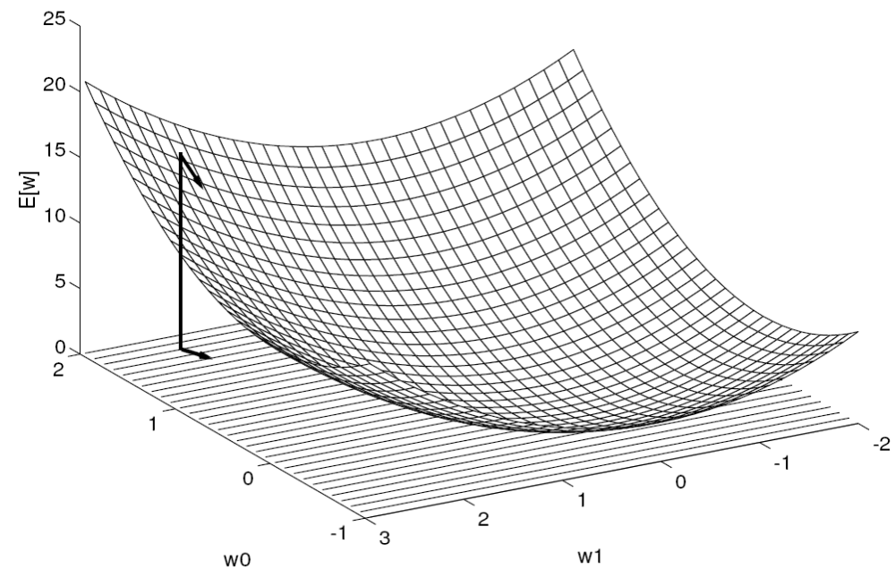
Neural Network Training – Gradient Descent
Note: images are from the online slides for Tom Mitchell’s book “Machine Learning”

Slide 38
Neural Network Training – Gradient Descent
Alternative view of learning:
Search for a hypothesis

Slide 39
Neural Network Training – Gradient Descent
Alternative view of learning:
Search for a hypothesis
+ Using a heuristic

Slide 40
Multilayer Networks
We saw: perceptron can’t capture relationships among inputs
Multilayer networks can capture complicated relationships
E.g. learning to distinguish English vowels

Slide 41
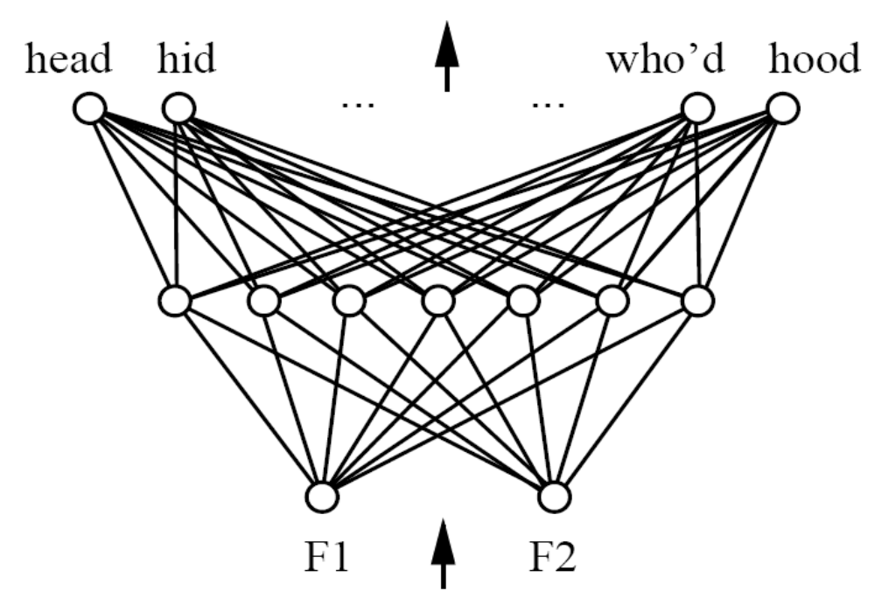
Multilayer Networks
We saw: perceptron can’t capture relationships among inputs
Multilayer networks can capture complicated relationships
E.g. learning to distinguish English vowels
Hidden layer

Slide 42
Multilayer Networks
We saw: perceptron can’t capture relationships among inputs
Multilayer networks can capture complicated relationships
E.g. learning to distinguish English vowels
input₁
weight₁
weight₂
add
output
input₂
weight₃
Smooth function
(not threshold)
weight₄
input₃
input₄

Slide 43
Multilayer Networks
We saw: perceptron can’t capture relationships among inputs
Multilayer networks can capture complicated relationships
E.g. learning to distinguish English vowels
Allows gradient descent
input₁
weight₁
weight₂
add
output
input₂
weight₃
Smooth function
(not threshold)
weight₄
input₃
input₄

Slide 44
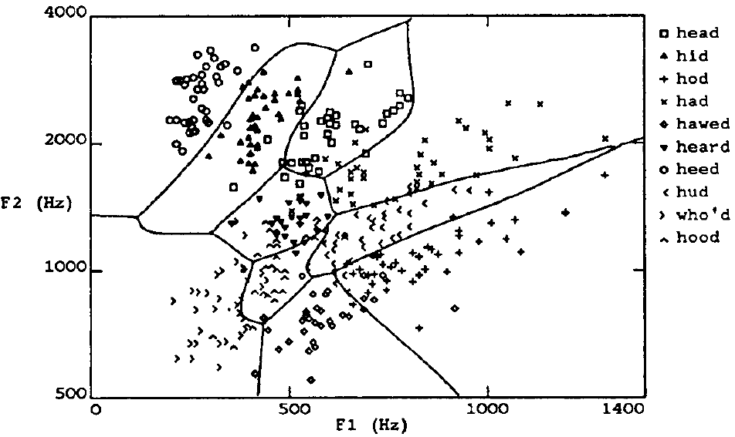
Multilayer Networks
Note: images are from the online slides for Tom Mitchell’s book “Machine Learning”

Slide 45
Neural Network for Speech
Distinguish nonlinear regions

Slide 46
Issues in Multilayer Networks
Landscape will no be so neat
  My be multiple local minima
  Can use “momentum”
  Takes you out of minima and across flat surfaces
Danger of overfitting
  Fit noise
  Fit exact details of training examples
Can stop by monitoring separate set of examples
(validation set)
  Tricky to know when to stop

Slide 47
Issues in Multilayer Networks
Landscape will no be so neat
  My be multiple local minima
  Can use “momentum”
  Takes you out of minima and across flat surfaces
Danger of overfitting
  Fit noise
  Fit exact details of training examples
Can stop by monitoring separate set of examples
(validation set)
  Tricky to know when to stop

Slide 48
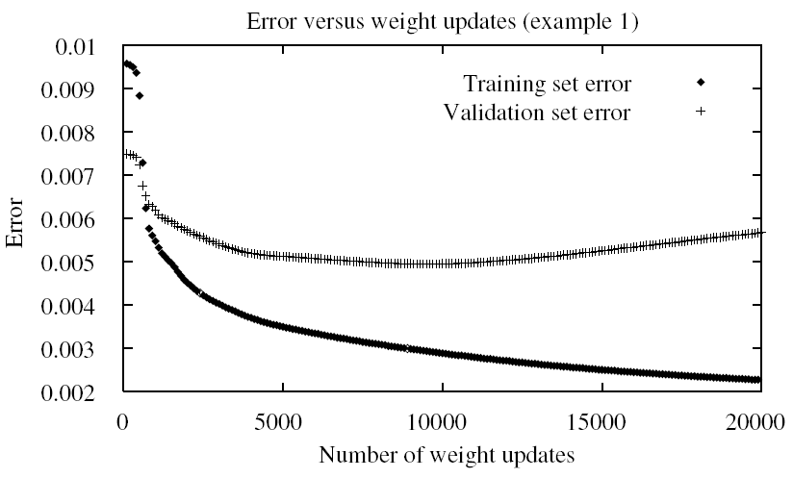
Issues in Multilayer Networks
Landscape will no be so neat
  My be multiple local minima
  Can use “momentum”
  Takes you out of minima and across flat surfaces
Danger of overfitting
  Fit noise
  Fit exact details of training examples
Can stop by monitoring separate set of examples
(validation set)
  Tricky to know when to stop

Slide 49
Issues in Multilayer Networks
Landscape will no be so neat
  My be multiple local minima
  Can use “momentum”
  Takes you out of minima and across flat surfaces
Danger of overfitting
  Fit noise
  Fit exact details of training examples
Can stop by monitoring separate set of examples
(validation set)

Slide 50
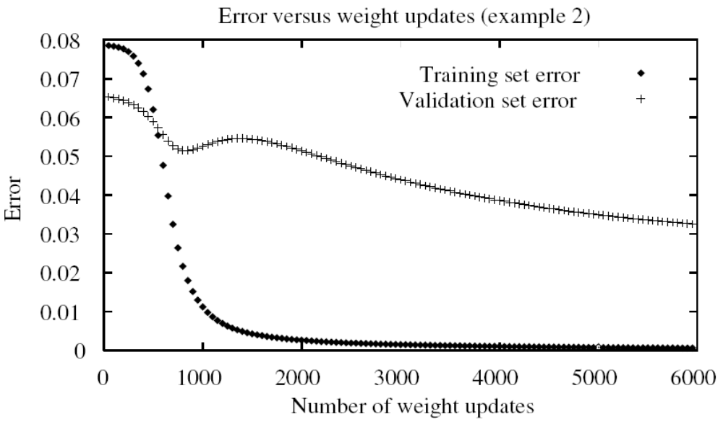
Issues in Multilayer Networks
Landscape will no be so neat
  My be multiple local minima
  Can use “momentum”
  Takes you out of minima and across flat surfaces
Danger of overfitting
  Fit noise
  Fit exact details of training examples
Can stop by monitoring separate set of examples
(validation set)
  Tricky to know when
  to stop

Slide 51
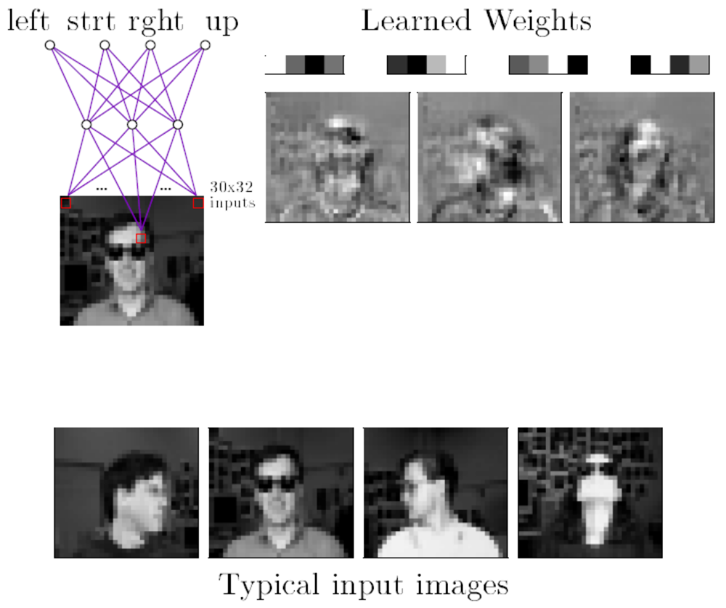
Example: recognise direction of face
Note: images are from the online slides for Tom Mitchell’s book “Machine Learning”

Slide 52
Neural Network Applications
Particularly good for pattern recognition
  Sound recognition – voice, or medical
  Character recognition (typed or handwritten)
  Image recognition (e.g. is there a tank?)
  Robot control
  ECG pattern – had a heart attack?
  Application for credit card or mortgage
  Recommender systems
  Other types of Data Mining
  Spam filtering
  Shape in Go
Note: just like search
  When we take an abstract view of problems,
  many seemingly different problems can be solved by one technique
  Neural can be applied to tasks that logic could also be applied to

Slide 53
What are Neural Networks Good For?
When training data is noisy, or inaccurate
  E.g. camera or microphone inputs
Very fast performance once network is trained
Can accept input numbers from sensors directly
  Human doesn’t need to translate world into logic

Slide 54
What are Neural Networks Good For?
When training data is noisy, or inaccurate
  E.g. camera or microphone inputs
Very fast performance once network is trained
Can accept input numbers from sensors directly
  Human doesn’t need to translate world into logic
Disadvantages?
Need a lot of data – training examples
Training time could be very long
  This is the big problem for large networks
Network is like a “black box”
  A human can’t look inside and understand what has been learnt
  Learnt logical rules would be easier to understand

Slide 55
Representation in Neural Networks
Neural Networks give us a sort of representation
Weights on connections are a sort of representation
  E.g. consider autonomous vehicle
  Could represent road, objects, positions in logic
Computer learns for itself - comes up with its own weights
  It finds its own representation
  Especially in hidden layers
We say
  Logical/symbolic representation is “NEAT”
  Neural Network representation is “SCRUFFY”
What’s best?
  Neural could be good if you’re not sure what representation to use, or how to solve problem
  Not easy to inspect solution though

Slide 56
An AI Koan
Notes:
Slavery of machine and implications

Slide 57
In the days when Sussman was a novice,
an old man once came to him as he sat hacking at the PDP-6.
"What are you doing?",
asked the old man.
"I am training a randomly wired neural net to play Tic-tac-toe",
Sussman replied.
"Why is the net wired randomly?",
asked the old man.
"I do not want it to have any preconceptions of how to play",
Sussman said.
The old man then shut his eyes.
"Why do you close your eyes?"
Sussman asked the man.
"So that the room will be empty.“
At that moment, Sussman was enlightened.
Notes:
Slavery of machine and implications

Slide 58
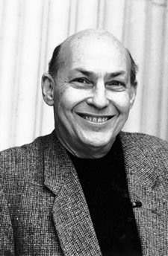
In the days when Sussman was a novice,
an old man once came to him as he sat hacking at the PDP-6.
"What are you doing?",
asked the old man.
"I am training a randomly wired neural net to play Tic-tac-toe",
Sussman replied.
"Why is the net wired randomly?",
asked the old man.
"I do not want it to have any preconceptions of how to play",
Sussman said.
The old man then shut his eyes.
"Why do you close your eyes?"
Sussman asked the man.
"So that the room will be empty.“
At that moment, Sussman was enlightened.
Marvin Minsky
Notes:
Slavery of machine and implications

