Slide 1
Course Overview
✓Done
What is AI?
What are the Major Challenges?
What are the Main Techniques?
Where are we failing, and why?
Step back and look at the Science
Step back and look at the History of AI
What are the Major Schools of Thought?
What of the Future?
✓Done

Slide 2
Course Overview
What is AI?
What are the Major Challenges?
What are the Main Techniques? (How do we do it?)
Where are we failing, and why?
Step back and look at the Science
Step back and look at the History of AI
What are the Major Schools of Thought?
What of the Future?

Slide 3
Course Overview
What is AI?
What are the Major Challenges?
What are the Main Techniques? (How do we do it?)
Where are we failing, and why?
Step back and look at the Science
Step back and look at the History of AI
What are the Major Schools of Thought?
What of the Future?
Search
Logics (knowledge representation and reasoning)
Planning
Bayesian belief networks
Neural networks
Evolutionary computation
Reinforcement learning
These are all in fact types of
“Machine Learning”

Slide 4
Course Overview
What is AI?
What are the Major Challenges?
What are the Main Techniques? (How do we do it?)
Where are we failing, and why?
Step back and look at the Science
Step back and look at the History of AI
What are the Major Schools of Thought?
What of the Future?
Search
Logics (knowledge representation and reasoning)
Planning
Bayesian belief networks
Neural networks
Evolutionary computation
Reinforcement learning
These are all in fact types of
“Machine Learning”

Slide 5
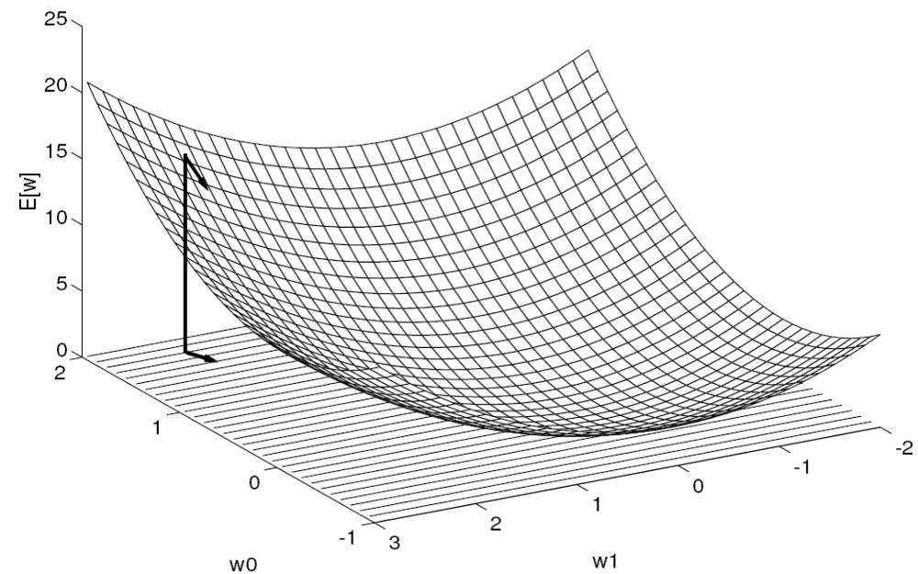
Genetic Algorithms
Recall Neural Net was finding a hypothesis by gradient descent

Slide 6
Genetic Algorithms
Recall Neural Net was finding a hypothesis by gradient descent
Each point on plane is a hypothesis
i.e. a possible solution to your problem

Slide 7
Genetic Algorithms
Recall Neural Net was finding a hypothesis by gradient descent
Each point on plane is a hypothesis
i.e. a possible solution to your problem
1
1
0
1
0
1
1
0
w0
w1

Slide 8
Genetic Algorithms
Recall Neural Net was finding a hypothesis by gradient descent
Genetic Algorithm searches randomly
Heuristic: Fitness
  The fittest individuals reproduce more
Each point on plane is a hypothesis
i.e. a possible solution to your problem
1
1
0
1
0
1
1
0
w0
w1

Slide 9
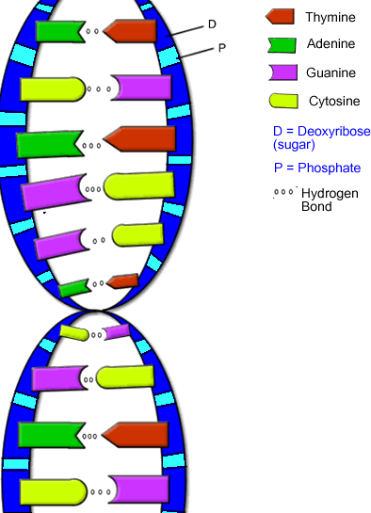
Biological Inspiration
How does Evolution work?
Many individuals in a population
Each individual has chromosomes
  Chromosome describes the individual
Individuals are possible solutions to the problem of thriving in the world
  Some are better than others
  Some die / get eaten
  Some are successful
Individuals get together to reproduce
  Fit individuals have a higher chance to reproduce
  But even unfit individuals get lucky sometimes
  Sometimes individuals fight for the chance to reproduce
When they reproduce
  Offspring: Some genetic material comes from each parent
  Some mutations may be introduced
After a long long time
  Individuals in the population should be quite fit
  New interesting individuals are created

Slide 10
Genetic Algorithm
0
0
1
0
1
0
0
1
Represent possible solutions to your problem as a chromosome
Generate a population of individual chromosomes
Find the fitness of each individual
  How well it performs on the problem
Select individuals who will reproduce
  Give highest probability to fittest
  Can pick two individuals and let them compete
    Tournament selection
When they reproduce
  Crossover chromosomes
  Some mutations may be introduced
  http://cs.felk.cvut.cz/~xobitko/ga/gaintro.html
1
0
0
1
0
1
0
0
1
1
0
1
0
1
1
0
0
1
0
1
0
0
1
0

Slide 11
What’s good about evolutionary computation?
We know it works in principle - Proof is all around
Very robust to noise or errors
Doesn’t get stuck in local minima
Can solve very complex problems, where human has little intuition
  For example many complex interacting parts in hypothesis
  Human doesn’t understand impact of each part
  Genetic program can find these parts itself, and how to combine them
Algorithms easy to parallelise, and run on clusters of computers
  Evaluate fitness of sub-populations on separate machines

Slide 12
What’s good about evolutionary computation?
We know it works in principle - Proof is all around
Very robust to noise or errors
Doesn’t get stuck in local minima
Can solve very complex problems, where human has little intuition
  For example many complex interacting parts in hypothesis
  Human doesn’t understand impact of each part
  Genetic program can find these parts itself, and how to combine them
Algorithms easy to parallelise, and run on clusters of computers
  Evaluate fitness of sub-populations on separate machines
Disadvantages?
Can take a long time and a lot of computer power

Slide 13
Evolutionary Computation Applications
Particularly good for hard optimisation problems
  Travelling Salesman
  Learn parameters for Neural Network
    Topology (connections) + weights
Learn rules for robot control
Evolving artificial life forms (video)
Genetic Programming
  Evolve a computer program
Note: again, like Neural Net and Search
  When we take an abstract view of problems,
  many seemingly different problems can be solved by one technique
  Just need to find a way to code the problem as chromosomes

Slide 14
Course Overview
What is AI?
What are the Major Challenges?
What are the Main Techniques? (How do we do it?)
Where are we failing, and why?
Step back and look at the Science
Step back and look at the History of AI
What are the Major Schools of Thought?
What of the Future?
Search
Logics (knowledge representation and reasoning)
Planning
Bayesian belief networks
Neural networks
Evolutionary computation
Reinforcement learning
These are all in fact types of
“Machine Learning”

Slide 15
Course Overview
What is AI?
What are the Major Challenges?
What are the Main Techniques? (How do we do it?)
Where are we failing, and why?
Step back and look at the Science
Step back and look at the History of AI
What are the Major Schools of Thought?
What of the Future?
Search
Logics (knowledge representation and reasoning)
Planning
Bayesian belief networks
Neural networks
Evolutionary computation
Reinforcement learning
These are all in fact types of
“Machine Learning”

Slide 16
Reinforcement Learning Applications
Very popular technique, especially for robot control (video)
Example: learning to walk
  http://sysplan.nams.kyushu-u.ac.jp/gen/papers/JavaDemoML97/robodemo.html

Slide 17
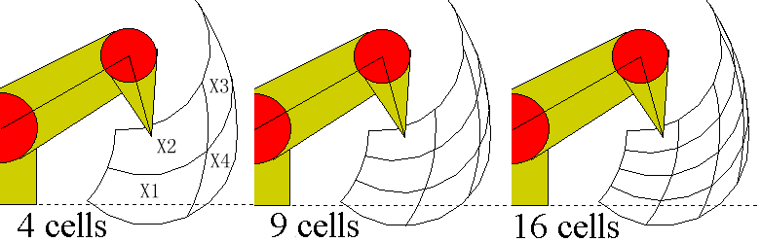
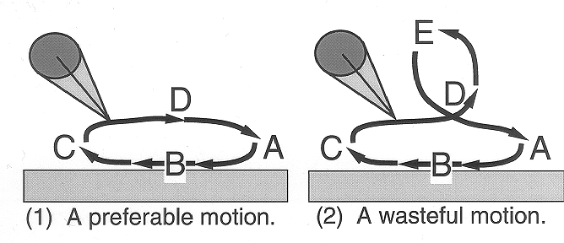
Reinforcement Learning Applications
Very popular technique, especially for robot control (video)
Example: learning to walk
  http://sysplan.nams.kyushu-u.ac.jp/gen/papers/JavaDemoML97/robodemo.html

Slide 18
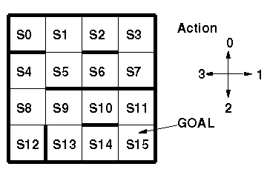
Reinforcement Learning Applications
Example: learning to get around a maze
  http://sysplan.nams.kyushu-u.ac.jp/gen/edu/applets/MazeQL.html

Slide 19
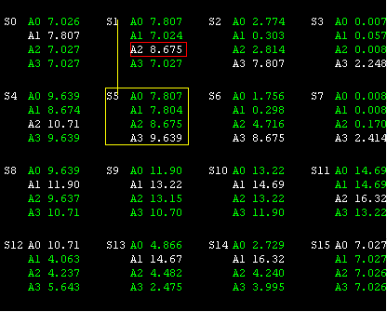
Reinforcement Learning Applications
Example: learning to get around a maze
  http://sysplan.nams.kyushu-u.ac.jp/gen/edu/applets/MazeQL.html

Slide 20
Reinforcement Learning Overview
Idea: learn from interactions
  Try out some actions and see what happens
  If it’s good, remember to do that again
  If it’s bad, remember to avoid it
Also has a biological inspiration
  Animal can learn by reward and punishment
Sort of Unsupervised
  No teacher to tell the robot what to do
  (Except for reward (sort of supervised))
  Very useful for unknown domains, or complicated robot apparatus
Considers the complete problem for a robot in some world
  Includes the planning aspect
  Includes building a model/map of the environment
  Includes dealing with uncertain environments
    Actions might have different effects at different times
    Information about the environment might be incomplete
      Don’t know exactly what state you are in

Slide 21
Reinforcement Learning Overview
Two key aspects:
  Trial-and-error search
  Delayed reward
Challenges:
  Trial-and-error: how to balance exploitation and exploration?
    Exploit: keep doing actions you know will get reward
    Explore: try some new action
      could be bad, or could be better than anything you tried before
    Usually take actions you know are good,
      but have a small chance to take random actions
  Delayed reward: “Credit Assignment Problem”
    I did a lot of actions in a sequence, and I got a reward
    Which were the actions that caused the reward?
Cannot represent every state
  Need to generalise from the value function you have
  “Function approximation” – approximate value function
  Often use Neural Network or Genetic Algorithm

Slide 22
Main Elements of a Reinforcement Learner
Policy
  What’s my current best action for each state
  Could also be seen as best response to a stimulus
Reward function
  What actions in what states cause rewards (or punishments)?
  Goal is defined by reward function
  Reward function is what dictates how you’ll change your policy
Value function
  How good is it to be in this state?
  How good is it to take action “left” (e.g.) from this state?
  Value is the long term rewards you expect to get from this state/action
    Reward is immediate, but value is all you expect in long term
  Adjust your value function as you learn more about the world
Model
  Optional – many Reinforcement Learners have none
  If I take “left” (e.g.) from this state, what state do I get to?
  Use it to plan

Slide 23
Q-Learning
Very popular type of Reinforcement Learning
Value function – Q value
  How good is each action from each state
Model
  No model

Slide 24
Reinforcement Learning Applications
Very popular technique, especially for robot control (video)
Computer game opponents
Elevator scheduling
Telecommunications
  Channel allocation for mobile cells
Backgammon
  Game has 10²⁰ states → cannot make a complete table
  One version of TD-Gammon used Neural Network for function approximation
  Another version used human knowledge to describe features
  Training Games Results
  300,000 Lost by 13 points in 51 games
  800,000 Lost by 7 points in 38 games
  1,500,000 Lost by 1 point in 40 games
Chess, Go (but not as successful as backgammon)

Slide 25
Course Overview
What is AI?
What are the Major Challenges?
What are the Main Techniques? (How do we do it?)
Where are we failing, and why?
Step back and look at the Science
Step back and look at the History of AI
What are the Major Schools of Thought?
What of the Future?
Search
Logics (knowledge representation and reasoning)
Planning
Bayesian belief networks
Neural networks
Evolutionary computation
Reinforcement learning
These are all in fact types of
“Machine Learning”

Slide 26
Course Overview
✓Done
What is AI?
What are the Major Challenges?
What are the Main Techniques?
Where are we failing, and why?
Step back and look at the Science
Step back and look at the History of AI
What are the Major Schools of Thought?
What of the Future?
✓Done
✓Done

Slide 27
Course Overview
What is AI?
What are the Major Challenges?
What are the Main Techniques?
Where are we failing, and why?
Step back and look at the Science
Step back and look at the History of AI
What are the Major Schools of Thought?
What of the Future?

Slide 28
Course Overview
What is AI?
What are the Major Challenges?
What are the Main Techniques?
Where are we failing, and why?
Step back and look at the Science
Step back and look at the History of AI
What are the Major Schools of Thought?
What of the Future?
What are we trying to do? How far have we got?
Natural language (text & speech)
Computer vision
Robotics
Board games
Problem solving
Learning
Applied areas: Video games, healthcare, …
What has been achieved, and not achieved,
and why is it hard?

Slide 29
Course Overview
What is AI?
What are the Major Challenges?
What are the Main Techniques?
Where are we failing, and why?
Step back and look at the Science
Step back and look at the History of AI
What are the Major Schools of Thought?
What of the Future?
What are we trying to do? How far have we got?
Natural language (text & speech)
  Progress: more shallow methods
Computer vision
Robotics
Board games
Problem solving
Learning
Applied areas: Video games, healthcare, …
What has been achieved, and not achieved,
and why is it hard?

Slide 30
Course Overview
What is AI?
What are the Major Challenges?
What are the Main Techniques?
Where are we failing, and why?
Step back and look at the Science
Step back and look at the History of AI
What are the Major Schools of Thought?
What of the Future?
What are we trying to do? How far have we got?
Natural language (text & speech)
Computer vision
  Progress: hardware, matching modelbases
Robotics
Board games
Problem solving
Learning
Applied areas: Video games, healthcare, …
What has been achieved, and not achieved,
and why is it hard?

Slide 31
Course Overview
What is AI?
What are the Major Challenges?
What are the Main Techniques?
Where are we failing, and why?
Step back and look at the Science
Step back and look at the History of AI
What are the Major Schools of Thought?
What of the Future?
What are we trying to do? How far have we got?
Natural language (text & speech)
Computer vision
Robotics
  Progress:
    Engineering going great
    High level thought?
Board games
Problem solving
Learning
Applied areas: Video games, healthcare, …
What has been achieved, and not achieved,
and why is it hard?

Slide 32
Course Overview
What is AI?
What are the Major Challenges?
What are the Main Techniques?
Where are we failing, and why?
Step back and look at the Science
Step back and look at the History of AI
What are the Major Schools of Thought?
What of the Future?
What are we trying to do? How far have we got?
Natural language (text & speech)
Computer vision
Robotics
Board games
  Progress and successes, but…
  Possibly an example of first law
Problem solving
Learning
Applied areas: Video games, healthcare, …
What has been achieved, and not achieved,
and why is it hard?

Slide 33
Course Overview
What is AI?
What are the Major Challenges?
What are the Main Techniques?
Where are we failing, and why?
Step back and look at the Science
Step back and look at the History of AI
What are the Major Schools of Thought?
What of the Future?
What are we trying to do? How far have we got?
Natural language (text & speech)
Computer vision
Robotics
Board games
Problem solving
  Progress and successes, but…
  Human does the formulation of problem,
  computers crank it out
Learning
Applied areas: Video games, healthcare, …
What has been achieved, and not achieved,
and why is it hard?

Slide 34
Course Overview
What is AI?
What are the Major Challenges?
What are the Main Techniques?
Where are we failing, and why?
Step back and look at the Science
Step back and look at the History of AI
What are the Major Schools of Thought?
What of the Future?
What are we trying to do? How far have we got?
Natural language (text & speech)
Computer vision
Robotics
Board games
Problem solving
Learning
  Similar to problem solving for applications
  For learning like a human…
  not much success in adapting knowledge and solutions from similar problems
Applied areas: Video games, healthcare, …
What has been achieved, and not achieved,
and why is it hard?

Slide 35
Course Overview
What is AI?
What are the Major Challenges?
What are the Main Techniques?
Where are we failing, and why?
Step back and look at the Science
Step back and look at the History of AI
What are the Major Schools of Thought?
What of the Future?
What are we trying to do? How far have we got?
Natural language (text & speech)
Computer vision
Robotics
Board games
Problem solving
Learning
Applied areas: Video games, healthcare, …
What has been achieved, and not achieved,
and why is it hard?

Slide 36
Course Overview
What is AI?
What are the Major Challenges?
What are the Main Techniques? (How do we do it?)
Where are we failing, and why?
Step back and look at the Science
Step back and look at the History of AI
What are the Major Schools of Thought?
What of the Future?
Search
Logics (knowledge representation and reasoning)
Planning
Bayesian belief networks
Neural networks
Evolutionary computation
Reinforcement learning
Good on specific problems, but focusing on a specific technique is moving away from the original goal…

Slide 37
Summing up 50 years’ progress in AI
We’re able to tackle specific problems,
But the more we go into them,
the further we get from the original goal of AI
  (“original goal” = AI as good as a human)
Like language moving more shallow than deep
Move more to specific techniques
What about general purpose AI?

Slide 38
AI Stumbling Blocks
Commonsense
(all the stuff every human knows)
Representation
(internal coding)
Generalising
(Adapt knowledge to new situation)

Slide 39
Course Overview
What is AI?
What are the Major Challenges?
What are the Main Techniques?
Where are we failing, and why?
Step back and look at the Science
Step back and look at the History of AI
What are the Major Schools of Thought?
What of the Future?
Part I:
Introduce you to what’s happening in Artificial Intelligence
✓Done
Part II:
Give you an appreciation for the big picture
➢ Why it is a
grand challenge
Notes:
What are we trying to do
How do we do it
A lot of people would start with the history – but it’s a bit meaningless at first

