Slide 1
Genetics
With Stefan and Josh
A brief telling

Slide 2
The Field of Genetics
Growing Field
Lack of Software
Lots of Information
Broad Range of Application

Slide 3
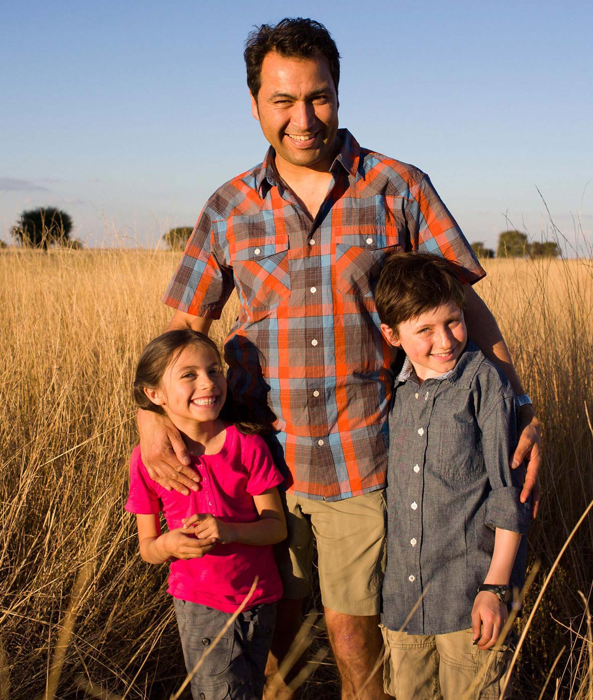
Genes and RSIDs
Refers to SNPs
Distinguish health and people
Gene Therapy
Genetic Selection

Slide 4
Our Project
Search for RSID
Search our Text file and see examples
View User Searches
See Recent News
Explore

Slide 5
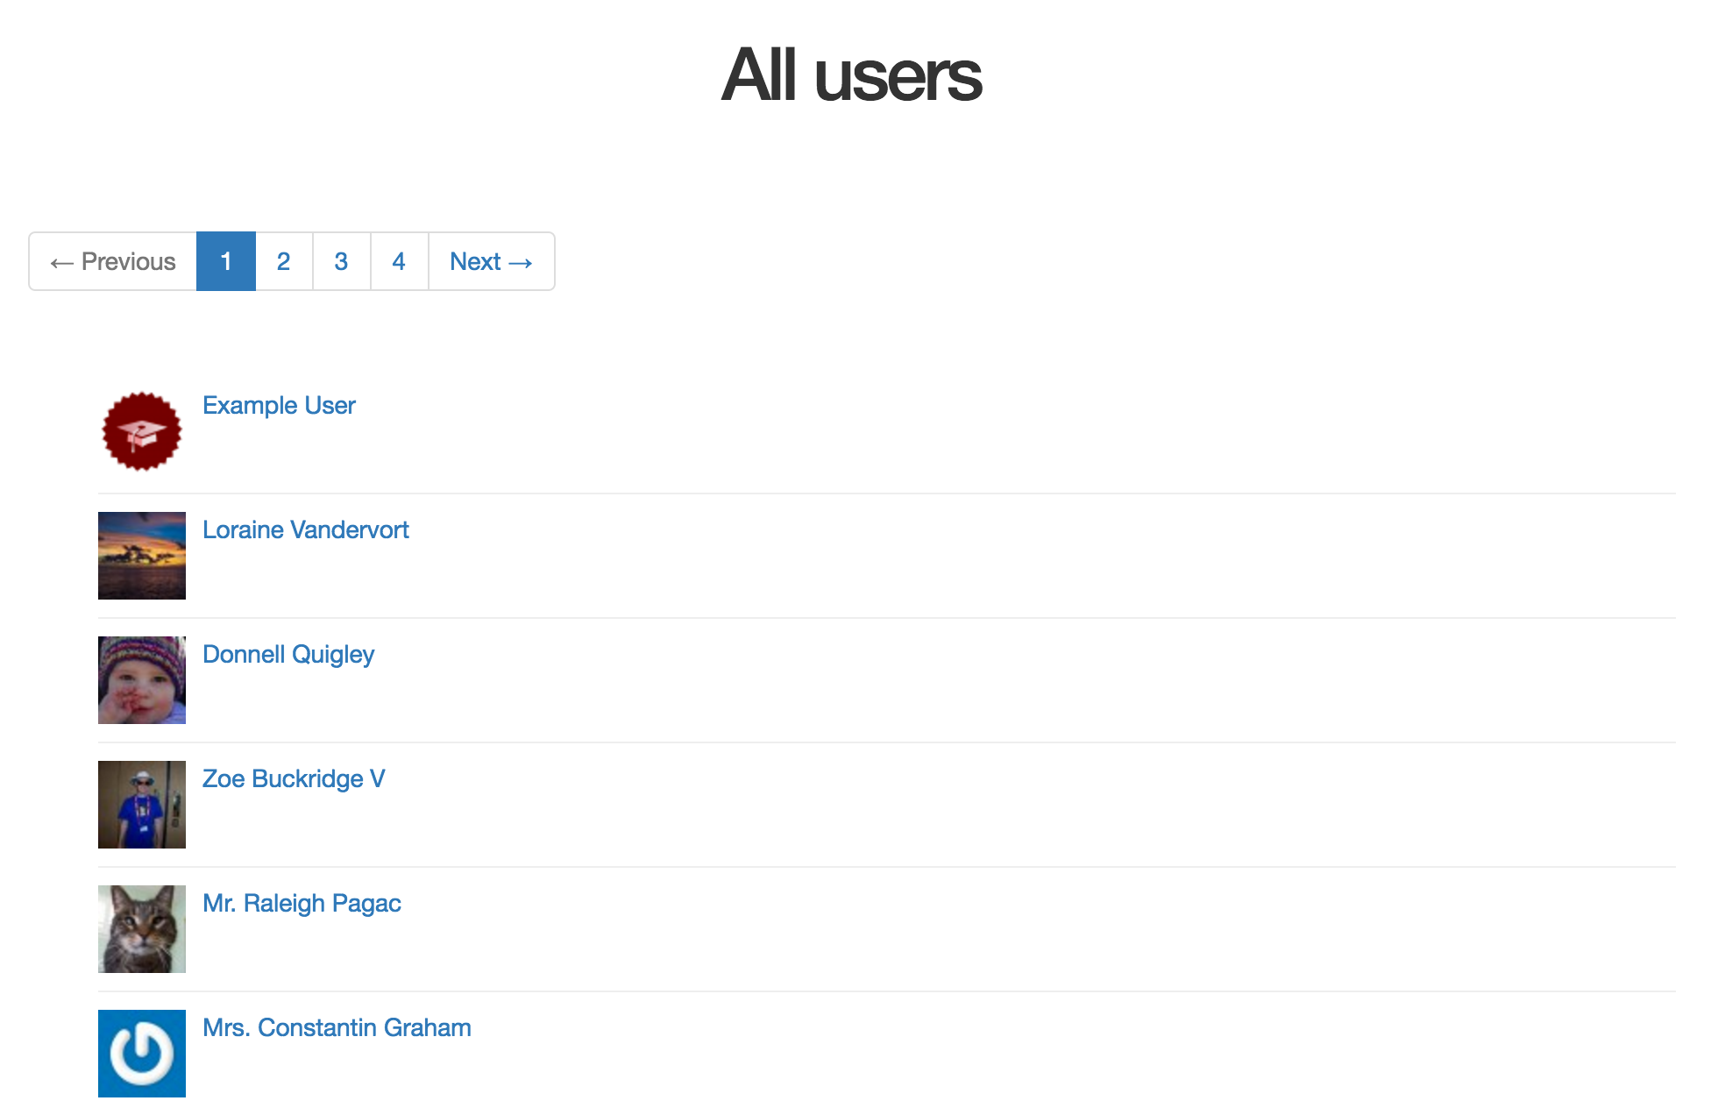
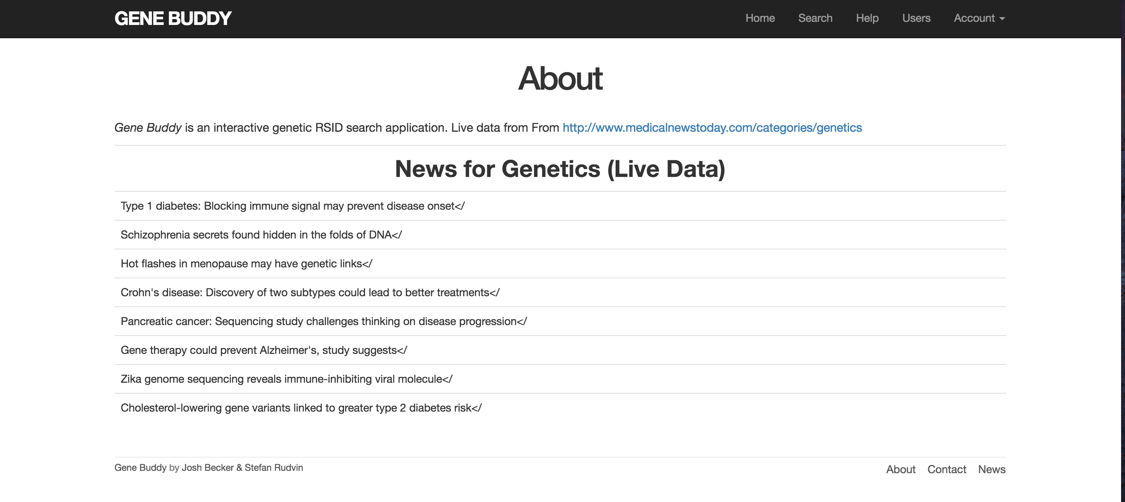
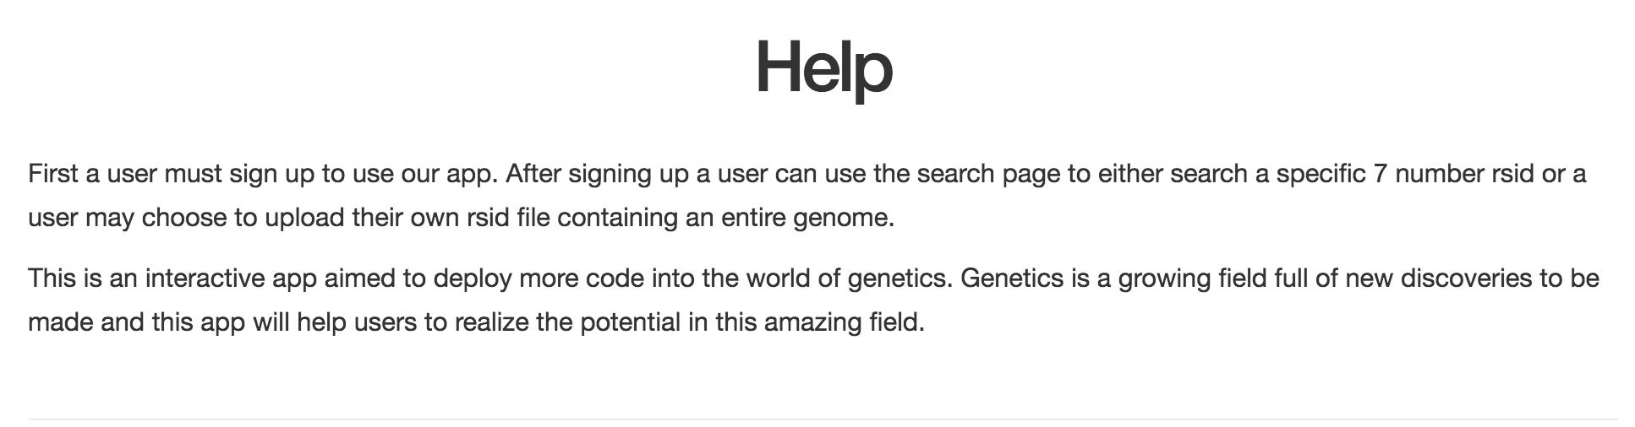
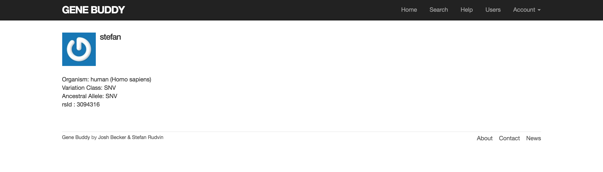
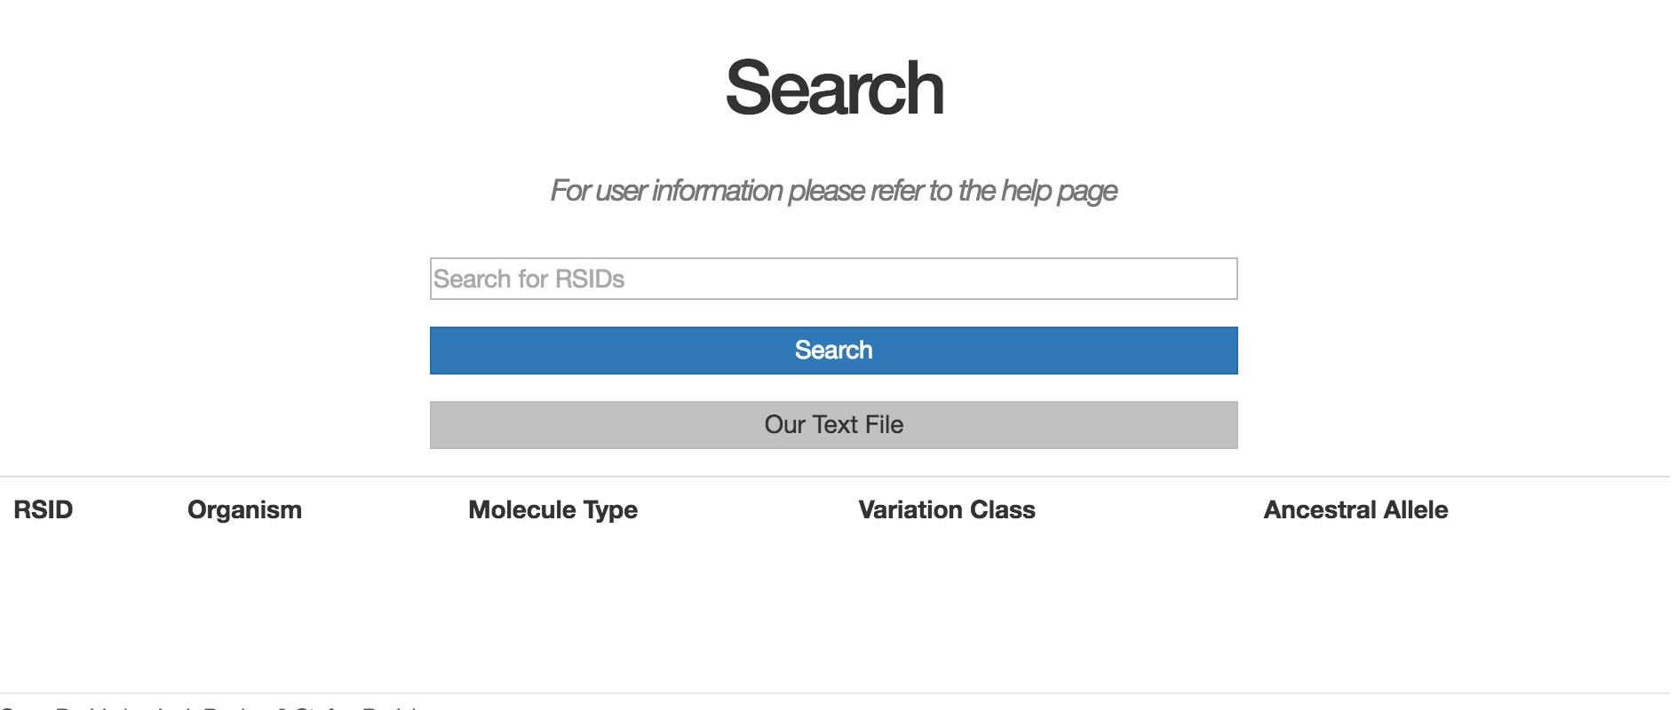
Views
Our Pages look like this

Slide 6
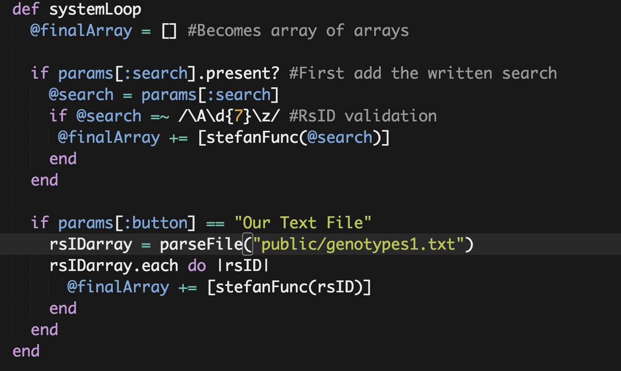
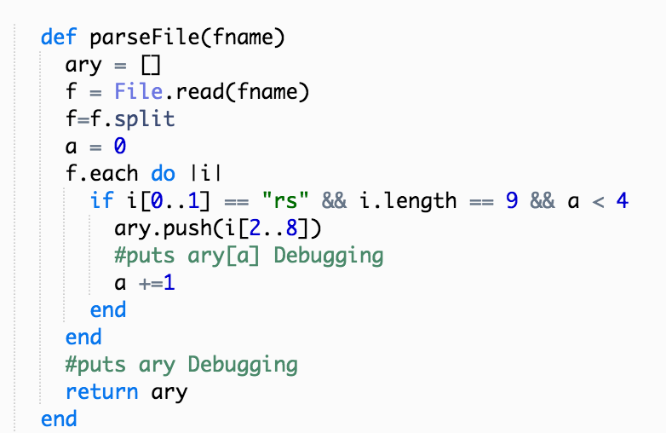
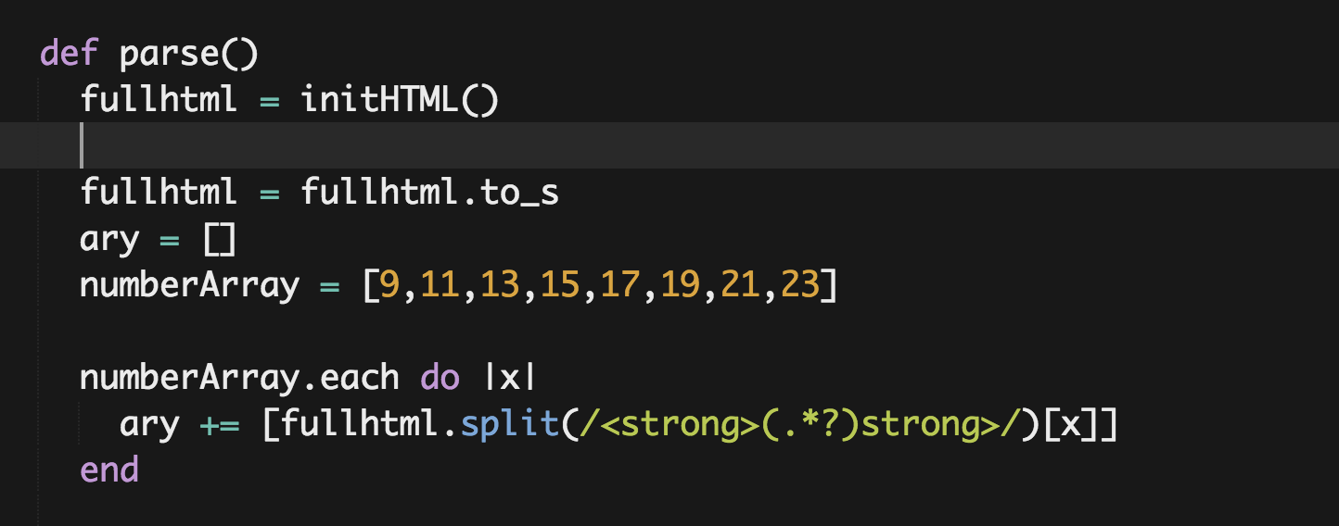
Controllers
And here are some of our controller functions

Slide 7
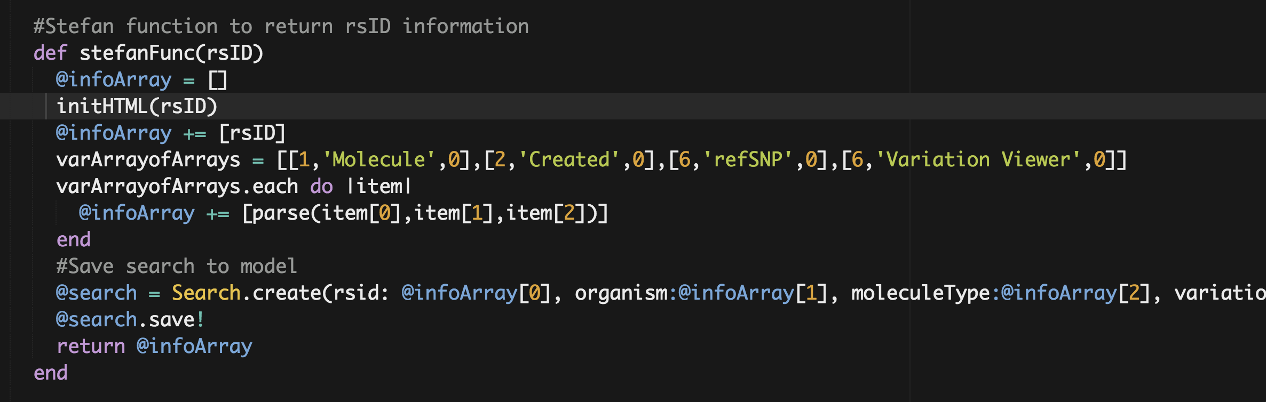
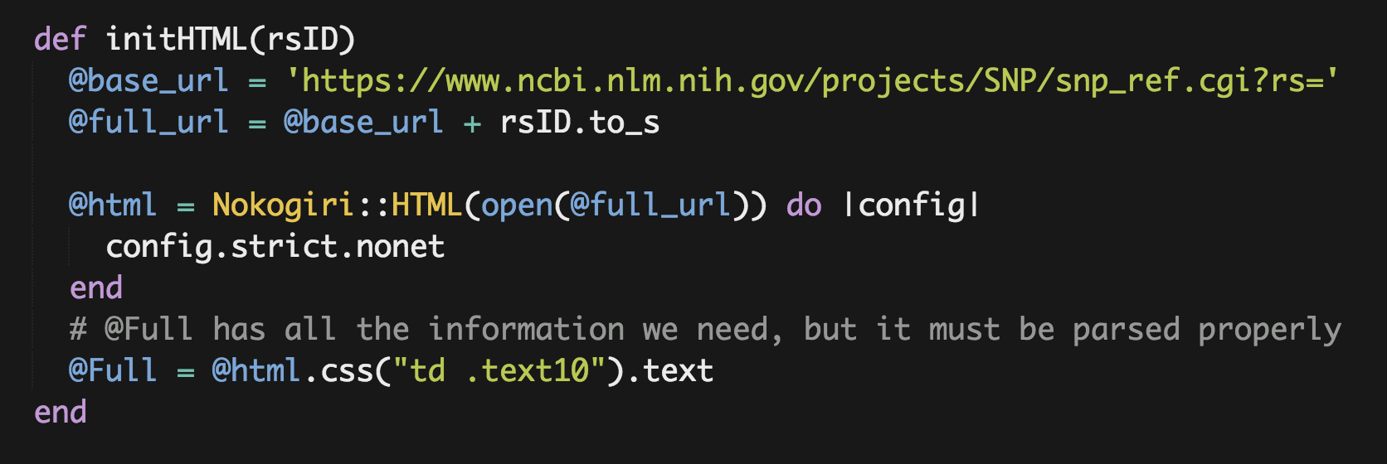
Controllers
And here are some of our controller functions

Slide 8
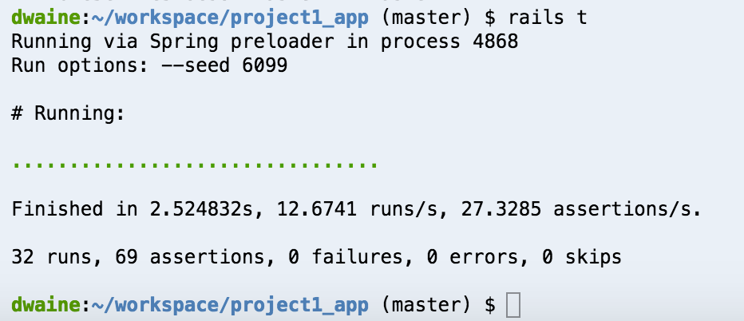
Tests
Views
Users
Login/Logout

Slide 9
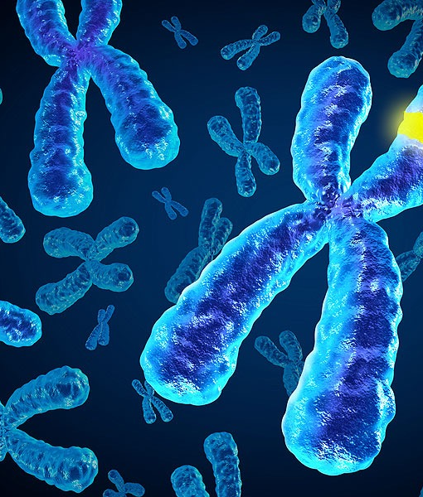
Going Forward
More Parsing of DNA
Relations between creatures
Cancer research
Collaboration between fields
Discovery of the world

