Slide 1

Advanced Web Application Development Ruby on Rails - Basics

Slide 2
What we have learnt so far
Web Applications
The Ruby Programming Language
Installed Ruby, Rails
Try a few commands of Rails?

Slide 3
About This Lecture
Form
~40 minutes lectures
Question time
Learning Material
The Hartl Book
Agile Web Development with Rails Chapters 1~6

Slide 4
What is Rails
Ruby on Rails (or simply Rails, RoR)
open source Ruby framework
developing database-backed web applications
ten times faster (than Java)
Rail's guiding principles:
less software
faster development and fewer bugs
easier to understand, maintain, and enhance
convention over configuration
Notes:
Less software means you write fewer lines of code to implement your application. Keeping your code small means faster development and fewer bugs, which makes your code easier to understand, maintain, and enhance. Very shortly, you will see how Rails cuts your code burden.
Convention over configuration means an end to verbose XML configuration files--there aren't any in Rails! Instead of configuration files, a Rails application uses a few simple programming conventions that allow it to figure out everything through reflection and discovery. Your application code and your running database already contain everything that Rails needs to know!

Slide 5
Why Rails?
Best Technologies
MVC: Model View Controller
Convention over Configuration
DRY: Don’t Repeat Yourself
REST: Representational State Transfer
TDD: Test Driven Development
Continuous and Active Development
Version 1.0 in 2005
Version 3.2.11 in Jan 2013
Version 4.2.5.1 in Jan 25 2016 (Rails 5.0.0.1 was released in August)
Helpful Online Communities
RailCasts, Rails Tutorial, Rails Hotline, Rails for Zombies

Slide 6




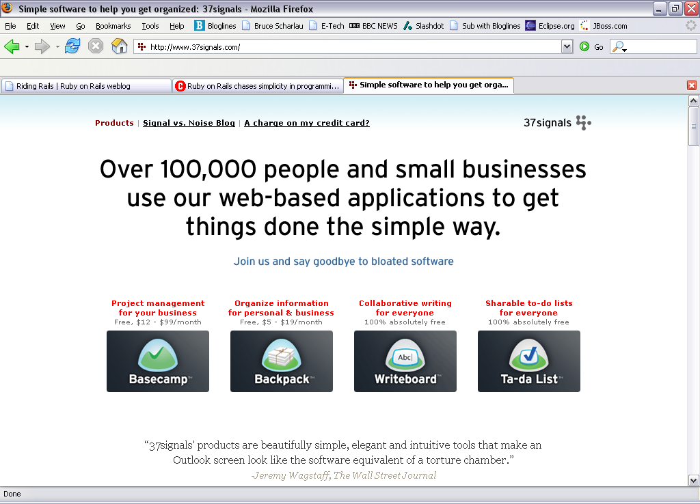
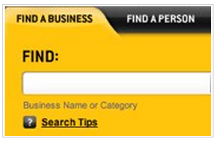


Around 235,000 sites are using Ruby on Rails
Groupon
Twitter
Shopify
Basecamp
Yellowpages
Top 10 websites built with Ruby on Rails
Notes:
BBC, 37 Signals, Odeo, Amazon use it internally too.
It is estimated 235,000 websites using RoR.

Slide 7
First Touch with Rails
Create a new application
Rails new cookbook
Generate a controller (and its view)
Rails generate controller say hello
app/controllers/say_controller.rb
app/view/say/hello.html.erb

Slide 8
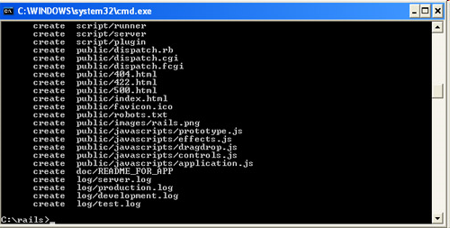
Creating standard directory structure
rails new cookbook
create a cookbook subdirectory
containing a complete directory tree of folders and files for an empty Rails application
Notes:
Create models of the objects in the database, and
Controllers which determine what happens in the application

Slide 9
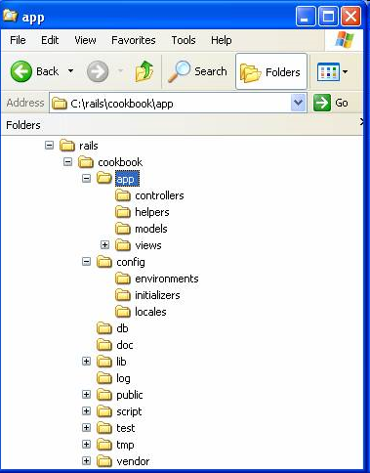
Created standard directory structure
controllers subdirectory
where Rails looks to find controller classes
views subdirectory
holds the display templates to fill in with data
models subdirectory
holds the classes that model and wrap the data
helpers subdirectory
holds any helper classes used to assist the model, view, and controller classes
Notes:
Create models of the objects in the database, and
Controllers which determine what happens in the application

Slide 10
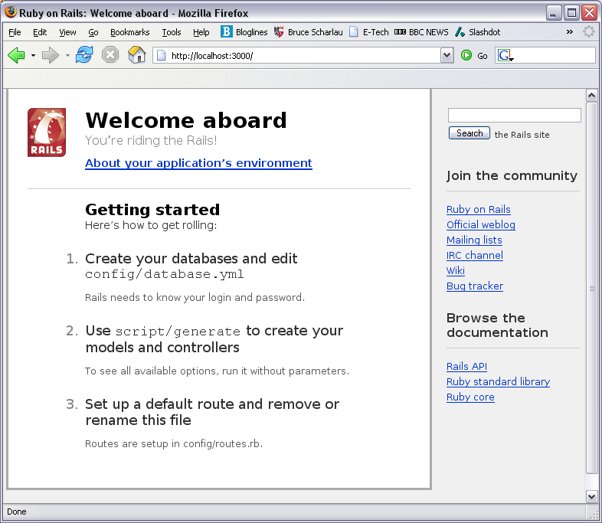
Start the built in web server
rails server
http://127.0.0.1:3000
Notes:
Each application has built-in development server for using in the app that sits under app/script/server just call it with ‘ruby script/server’ and it starts up on port 3000

Slide 11
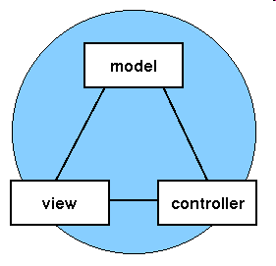
MVC Design pattern
Model
represents the data in the program and business logic
View (templates)
manages the visual display of the data (Presentation Logic)
Controller
provides the means for user interaction with the data (application logic)
[ Photo credit:
www. javaworld.com]

Slide 12
Benefits of MVC
Scalability (the ability for an application to grow)
separate the database from other components
Easy maintenance
components have a low dependency on each other
Reuse
a model may be reused by multiple views, and vice versa
[ Photo credit:
www. javaworld.com]

Slide 13
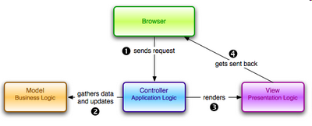
So what’s happening with Rails
The browser, on the client, sends a request for a page to the controller on the server.
The controller retrieves the data it needs from the model in order to respond to the request.
The controller renders the data and sends it to the view.
The view sends the page back to the client for the browser to display.

Slide 14
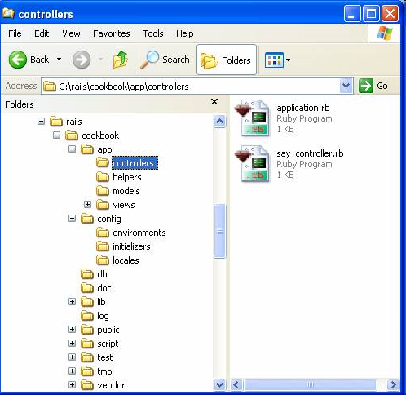
Add controllers for the logic
rails generate controller Say hello
Provides a class to direct requests and responses
Convention: The folder that stores the template is named after the controller
File Generated:
app/controllers/say_controller.rb
app/view/say/hello.html.erb

Slide 15
Example - Controller
Request: http://127.0.0.1:3000/say/hello
app/controllers/say_controller.rb:
class SayController < ApplicationController def hello @time = Time.now end end

Slide 16
Example - Controller
Request: http://127.0.0.1:3000/say/hello
SayController is a class
hello is a method, or an action
Convention: A template has a one-to-one mapping to the method of a controller
say_controller.rb:
class SayController < ApplicationController def hello @time = Time.now end end

Slide 17
Example - Model
Time class
described in the documentation for the time.rb library.

Slide 18
Example - View
app/views/say/hello.html.erb:
<html><head>
<title>Hello rails!</title>
</head>
<body>
<h2>hello rails!</h2>
<p><%=@time %></p>
</body>
</html>

Slide 19
Understand hello.html.erb
hello.html.erb:
<html><head>
<title>Hello rails!</title>
</head>
<body>
<h2>hello rails!</h2>
<p><%=@time %></p>
</body>
</html>
Convention: html.erb is the extension of standard HTML template that allows ERB tags
<%=…%>: this ERB tag pair is for displaying the output of the Ruby expression @time

Slide 20
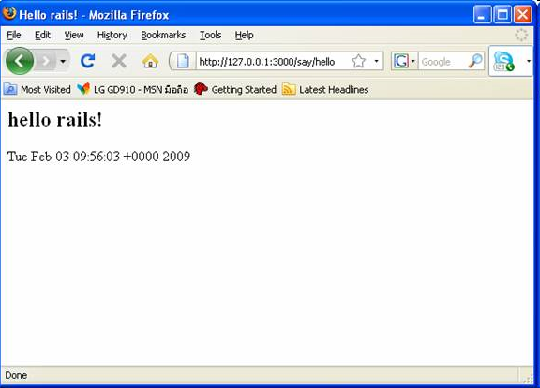
Example - Result
Request: http://127.0.0.1:3000/say/hello

Slide 21
How did this work?
User request http://127.0.0.1:3000/say/hello
In cookbook/config/routes.rb
get "say/hello” shorthand for the following code:
match ‘say/hello’ => ‘say#hello’ via => :get
More details about Rails routing
http://guides.rubyonrails.org/routing.html
Try “rake routes” in the command line to see all routing information

Slide 22
How did this work? Cont.
app/controllers/say_controller.rb:
class SayController < ApplicationController def hello @time = Time.now end end
The controller first “talked” to the model Time, retrieve the data (current time).
The controller then asked the view:
hello.html.erb to display the data
Check the Hartl Book Sec 2.2.2 Figure 2.11 for more details

Slide 23
Model
rails generate model User name:string email:string
Generate the following two files:
db/migrate/2012xxxxx_create_users.rb
app/models/user.rb
2012XXXXXX_create_users.rb:
class CreateUsers < ActiveRecord::Migration def change create_table :users do |t|
t.string :name
t.string :email
t.timestamps end end
end
Run the database migration by
rake db:migrate
Question: What files were generated?

Slide 24
Database Migration
rake db:migrate
In the Unix tradition, the make utility has played an important role in building executable programs from source code
Rake is Ruby make, a make-like language written in Ruby
Rails comes with built-in support for SQLite3
SQLite3 is a lightweight serverless database application
Rails can support other database system too

Slide 25
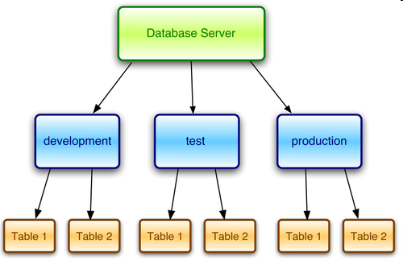
Database Configurations
config/database.yml
YML: lightweight format
used in Rails for configuration
development:
adapter: sqlite3
database: db/development.sqlite3 timeout: 5000
test:
adapter: sqlite3
database: db/test.sqlite3
timeout: 5000
production:
adapter: sqlite3
database: db/production.sqlite3 timeout: 5000
If you use sqlite3, you don’t need to do anything, everything is already configured.
If you use mySQL, check the manual.

Slide 26
The Model File
app/models/user.rb:
class User < ActiveRecord::Base
end
In a controller, you can use:
User.all retrieve all users
User.find_by_email(XXXX) retrieve a user whose email is XXXX

Slide 27
Try It Yourself: Scaffolding
rails generate scaffold Recipe name:string content: text
rake db:migrate
What files are generated?
The meaning of these files?
How the database changes are migrated?
Try in your browser:
http://127.0.0.1:3000/recipes

Slide 28
Something you can try later
The temperature Calculator
You need to know how to write a html form
The form helper in Rails
Address book
You need to do the database migration and retrieve data from model.

Slide 29

Summary
Ruby on Rails = (very) quick web app development
MVC design pattern
Keep Practicing

Slide 30
Next Lecture
Rails Routing
Learning Material
The Hartl Book Sec 2.1, Sec 2.2, Sec 2.3.1, Sec 2.3.3. Sec 6.1; Sec 11.1.2
Agile Web Development with Rails Chapters 19 and 23

