Slide 1

Routing in Rails
(Advanced) Web Application Development

Slide 2
About This Lecture
Form
  ~50 minutes lectures
  Question time
Learning Material
  Rails Routing from the Outside In
  http://guides.rubyonrails.org/routing.html

Slide 3
Lecture Outline
What is Routing for?
HTTP Request
Resourceful Routing
Non-resourceful Routing (get, match)

Slide 4
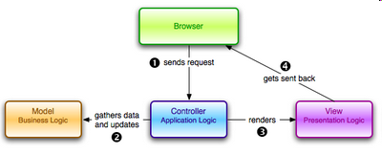
Rails Routing: What is it for?
1. Recognize URLs from a user, and map them to a controller’s actions.
2. Generate Path and URL by route helpers.
Notes:
What is Rails helpers? Basically helpers in Rails are used to extract complex logic out of the view so that you can organize your code better
http://mixandgo.com/blog/the-beginner-s-guide-to-rails-helpers

Slide 5
HTTP Requests
PUT:
  Put a file or resource at a specific URI
POST:
  Send data to a specific URI and expect the resource at the URI to process the request
GET:
  Request Data from a specific resource
DELETE:
  Request the origin sever delete the resource identified by the request URI
Examples: GET photo/1; DELETE photo/2;
Notes:
In computing, a uniform resource identifier (URI) is a string of characters used to identify a name or a web resource. Such identification enables interaction with representations of the web resource over a network (typically the World Wide Web) using specific protocols.
URIs can be classified as locators (URLs), as names (URNs), or as both. A uniform resource name (URN) functions like a person's name, while a uniform resource locator (URL) resembles that person's street address.

Slide 6
routes.rb
In folder config/routes.rb
All routing rules are writing in the block:
  YourAppName::Application.routes.draw do
  ………
  end
The routing rules appear first will be matched first.
  The order matters
  The most popular routing rules should be written first

Slide 7
Resourceful Routing
Map from HTTP verbs and URLs to controller actions.
Each action maps to CRUD in a database
  Create, Read, Update, Destroy, index, show, new
For example:
  User Request: DELETE photos/17
  Matching route: resources: photos
  Map to the destroy action on the photos controller with {id: ‘17’) in params.

Slide 8
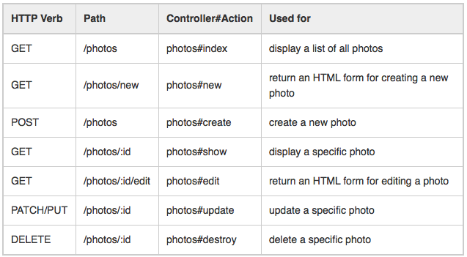
Resourceful Routing
resources :photos
create 7 routes mapping to the controller

Slide 9
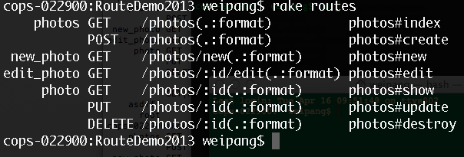
Resourceful Routing
resources :photos
helper
HTTP verb
path
controller#action
Path & URL helpers
photos_path --------> /photos
photos_url --------> http://yourcomany.com/photos
photo_path(7) --------> /photos/7

Slide 10
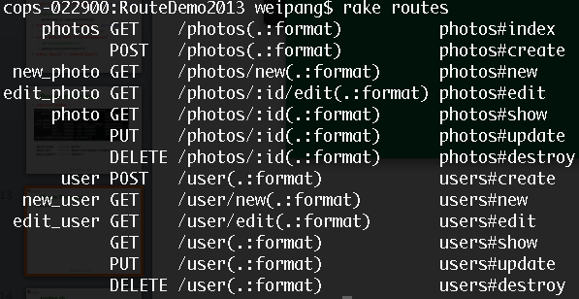
Single Resource
resource :user
user_path ----> /user
edit_user_path ----> /user/edit

Slide 11
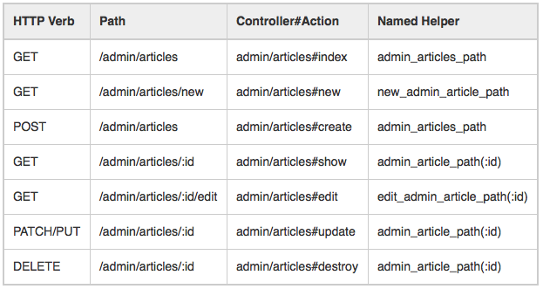
Namespace, Scope, and Module
Put controllers under app/controllers/admin directory,
namespace :admin do
resources :articles, :comments
end
Notes:
Rail 4: scope module: 'admin' do
resources :posts, :comments
end

Slide 12
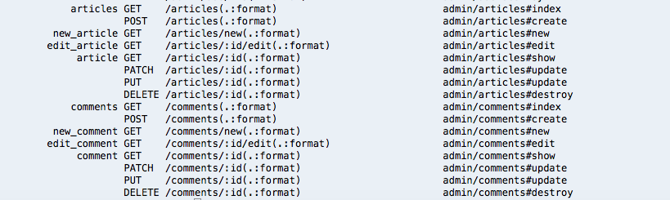
Namespace, Scope, and Module
If you want to route /articles (without the prefix /admin) to Admin::ArticlesController, you could use:
or, for a single case:
scope module: 'admin' do
resources :articles, :comments
end
resources :articles, module: 'admin'

Slide 13
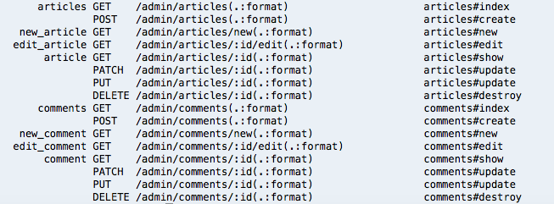
Namespace, Scope, and Module
If you want to route /admin/articles to ArticlesController (without the Admin:: module prefix), you could use
or, for a single case:
scope '/admin' do
resources :articles, :comments
end
resources :articles, path: '/admin/articles'

Slide 14
Nested Resources
Resources are logically children of other resources.
# magazine.rb
class Magazine < ApplicationRecord
has_many :ads
end
# ad.rb
class Ad < ApplicationRecord
belongs_to :magazine
end
# routes.rb
resources :magazines do
resources :ads
end

Slide 15
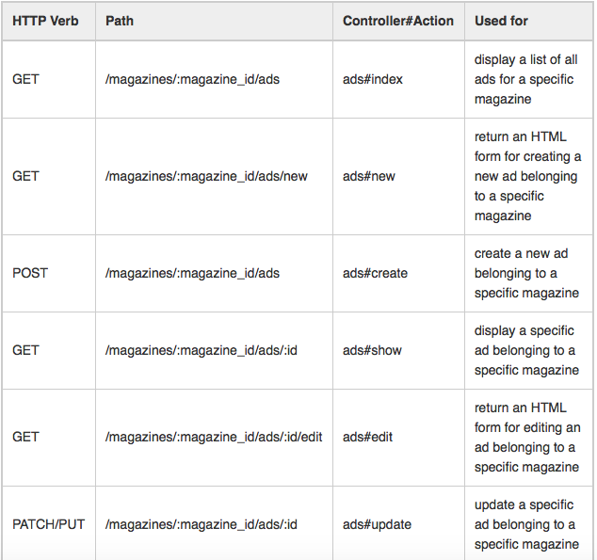

Slide 16
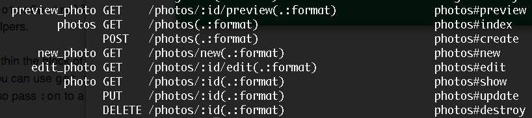
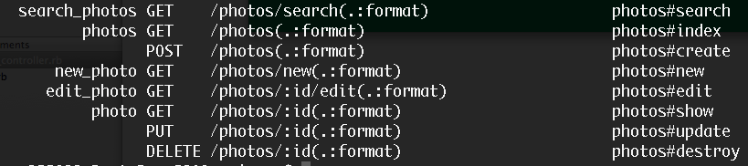
Add Additional Actions to Resource
resources :photos do
member do
get 'preview'
end
end
resources :photos do
collection do
get ‘search'
end
end

Slide 17
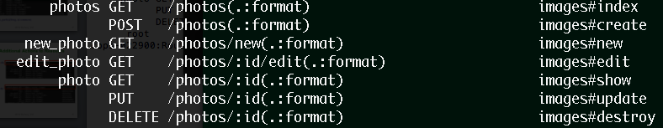
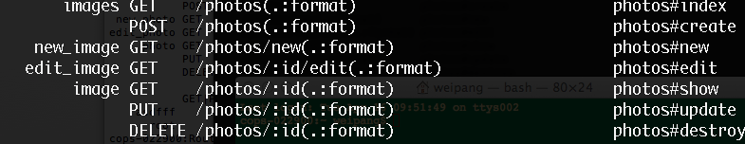
Customized Resources
resources :photos, :controller =>"images” Or
resources :photos, controller: 'images'
resources :photos, :as => "images” Or
resources :photos, as: 'images'
Notes:
resources :photos, controller: 'images'

Slide 18
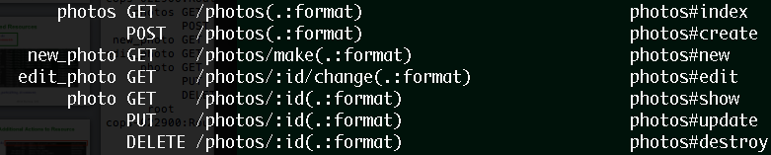
Customized Resources
resources :photos, :path_names => { :new => 'make', :edit => 'change' }
resources :photos, :only => [:index, :show]
resources :photos, :except => :destroy

Slide 19
Non-resourceful Routes 1
Routing arbitrary URLs to actions
  GET ‘:controller(/:action(/:id))’
  get ‘photos/show/1’
Map to the show action of PhotosController with parameter ‘1’

Slide 20
Non-resourceful Routes 2
Dynamic Segments
You can set up this route:
get ':controller/:action/:id/:user_id'
  Incoming path /photos/show/1/2 will be mapped to the show action of the PhotosController.params[:id] will be ‘1’, and params[:user_id] will be ‘2’
  Static Segments
  get ':controller/:action/:id/with_user/:user_id’
  Incoming paths such as /photos/show/1/with_user/2. In this case, params would be { controller: 'photos', action: 'show', id: '1', user_id: '2' }.

Slide 21
Using Root
You can specify what Rails should route '/' to with the root method:
root to: 'pages#main'
root 'pages#main' # shortcut for the above
You should put the root route at the top of the file, because it is the most popular route and should be matched first.
Remember to delete public/index.html

Slide 22

Summary
Resourceful Routing
Non-resourceful Routing
Always Read:
  Rails Routing from the Outside In
  http://guides.rubyonrails.org/routing.html

