Slide 1

Ruby on Rails –
Working with Databases I
(Advanced) Web Application Development

Slide 2
What we have learnt so far
Ruby & Sinatra
Ruby on Rails: Basics
Routing

Slide 3
About This Lecture
Form
  ~40 minutes lectures
  Question time
Learning Material
  The Hartl Book Sec 2.1, Sec 2.2, Sec 2.3.1, Sec 2.3.3. Sec 6.1; Sec 11.1.2
  Agile Web Development with Rails Chapters 19 and 23

Slide 4
Lecture Outline
Introduction to (Relational) Database
Active Record
Database Migration Basics

Slide 5

Four Basic Steps
Application directory generation
Start Web server
Create database
Interactions between templates and methods

Slide 6
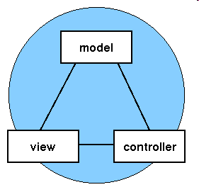
Why do we need a database?
Huge amount of data
Multiple users
Efficient Retrieval
Manage
  Consistency
  Redundancy
Database
[ Photo credit:
www. javaworld.com]

Slide 7
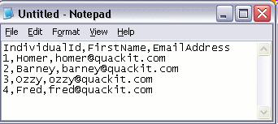
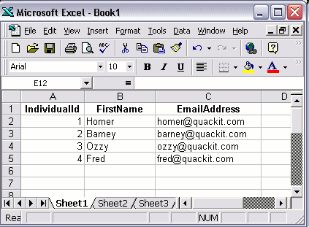
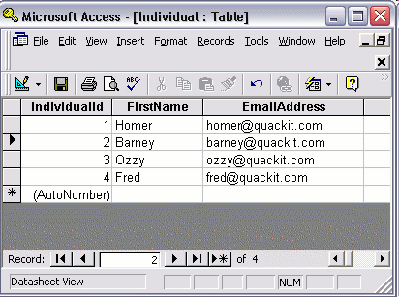
How to Store Data

Slide 8
Database vs. Spreadsheet
Observations | Spreadsheets | Databases
Use of memory | Data and calculations are memory resident | Use both memory and hard drive
Organization of Data | Data cells are independent | Data is organized by fields or records
Data Entry | Limited support | More flexible
Relational Tables | Can link spreadsheets, but has more limitations. | Easy and powerful
Queries | Limited queries especially for multiple tables | Can perform very complex data queries on one or multiple tables. Good theoretical foundation

Slide 9
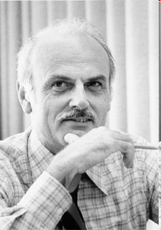

Father of Relational Database
The inventor of the relational database, Ted Codd
  A British computer scientist (1923-2003) at IBM
  received the Turing Award in 1981

Slide 10

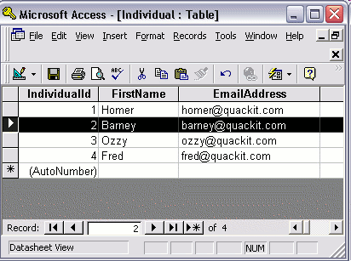
What is Database
Table: building blocks of relational database
  Row/Record, Fields/Column
  Primary key (a value used to uniquely identify a table's row)
Database schema
  The collection of tables and their relationships
Database program: Database Management System (DBMS)

Slide 11
What is SQL
SQL: Structured Query Language
  to create, drop, and modify tables and insert, update, destroy, and query the information stored in those tables
  supported by nearly every relational database in existence
Example: select all in the addresses table
  SELECT * FROM addresses;
The problem with SQL is that it's not object-oriented
  In Rails we don’t use SQL directly

Slide 12
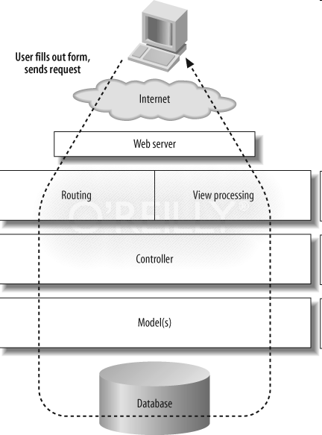
What is Object-Relational Mapping
An ORM framework is written in an object oriented language (like Ruby, Python, PHP etc.) and wrapped around a relational database.
  An object class <-> A table in DB
  An object instances <-> A record in those tables
?
“Patterns of Enterprise Application Architecture” by Martin Fowler
first described a pattern called an active record.
Notes:
When building 37 signals found Ruby scripting language from 1990s and used it for the templates of its website
Rails grew from these templates as a way to bind the web app parts to Ruby

Slide 13
What is Object-Relational Mapping
The below is C code with a SQL
Ruby makes use of an ORM API:
Person.find(10)
Person.find_by(first_name: “David”)
String sql = "SELECT ... FROM persons WHERE first_name = ‘David’ ";
DbCommand cmd = new DbCommand(connection, sql);
Result res = cmd.Execute();

Slide 14
What is Object-Relational Mapping
Advantages
  Database independent – no need to write code specific to a particular DB
  Reduce code and increase efficiency
  Rich query interface
  Concurrency
Disadvantages
  Overhead – more memory and increase CPU usage
  SQL ignorance
Notes:
When building 37 signals found Ruby scripting language from 1990s and used it for the templates of its website
Rails grew from these templates as a way to bind the web app parts to Ruby

Slide 15
Active Record as an ORM Framework
Active Record features:
Data is represented as models.
Associations can be implemented using these models.
Inheritance can be achieved through related models.
Validation of data before being saved into the database.
Object oriented way of dealing with database operations.

Slide 16
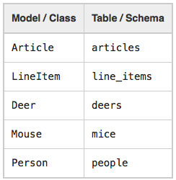
Convention over Configuration in Active Record
Naming Conventions
  Database Table - Plural with underscores separating words (e.g., book_clubs).
  Model Class - Singular with the first letter of each word capitalized (e.g., BookClub).

Slide 17
Convention over Configuration in Active Record
Schema Conventions
Primary Keys: column named id is created
Foreign Keys: use the pattern singularized_table_name_id (e.g., item_id, order_id)
Optional columns
  created_at
  updated_at
  lock_version
  (table_name)_count
  etc..

Slide 18
Creating Active Record Models
Create a subclass of the ApplicationRecord class
class Product < ApplicationRecord
end
^{$ rails console}
Loading development environment.
^{>> product.column_names}
>> ^{product}

Slide 19
Active Record Basics: CRUD
Using the new Constructor
>> article = Article.new
>> article.title = "Introduction to SQL"
>> article.body = "SQL stands for Structured Query Language, .."
>> article.published_at = Date.today
>> article.save
Using the create Method
>> Article.create(:title => "RubyConf 2013", :body => "The annual RubyConf will take place in..", :published_at => '2013-04-13')
>> attributes = { :title => "Rails Pub Nite", :body => "Rails Pub Nite is every 3rd Monday of each month, except in December.", :published_at => "2013-04-13"}
>> Article.create(attributes)

Slide 20
Active Record Basics: CRUD
Reading (Finding) Records
>> Article.find(3)
>> Article.first
>> Article.last
>> articles = Article.all
>> articles.first.title
Finding with Conditions
>> Article.where(:title => 'RailsConf').first

Slide 21
Active Record Basics: CRUD
Updating Records
>> article = Article.first
>> article.title = "Rails 4 is great"
>> article.published_at = Time.now
>> article.save
>> article = Article.first
>> article.update_attributes(:title => "RailsConf2013", :published_at => 1.day.ago)

Slide 22
Active Record Basics: CRUD
Deleting Records
Using destroy
>> article = Article.last >> article.destroy
>> Article.destroy(1)
>> Article.destroy([2,3])
Using delete
>> Article.delete(4)
[Note: destroy runs any callbacks on the model while delete doesn't.]
Deleting with Conditions
>> Article.delete_all("published_at < '2011-01-01'")

Slide 23
Database Migration

Slide 24
Migration
A rails way of creating and updating databases
No need to use SQL
Keep track of database changes
Any wrong operations on database can be rolled back
Related Files:
  db/migrate/* : all migration files
  db/schema.rb : database schema file
  db/seed.rb : seed file, used to populate the database
  db/development.sqlite3 : the actual database file

Slide 25
How to create a migration
Create a model
Create a scaffolding
Create a standalone migration
Create a model:
  rails generate model Student name:string address:string
Response:
  create db/migrate/20121103211410_create_students.rb
  create app/models/student.rb

Slide 26
Create a Migration
app/model/student.rb
class Student < ActiveRecord::Base
end
db/migrate/20151103211410_create_students.rb
class CreateStudents<ActiveRecord::Migration
def change
create_table :students do |t|
t.string :name
t.string :address
t.timestamps
end
end
end

Slide 27
Perform the Migration
  rake db:migrate
== CreateStudents: migrating ==================================
-- create_table(:students)
-> 0.1636s
== CreateStudents: migrated (0.1637s) ==================================
db/schema.rb : describe the structure of the database
ActiveRecord::Schema.define(:version => 20151103211410) do
    create_table "students", :force => true do |t|
    t.string "name"
    t.string "address"
    t.datetime "created_at", :null => false
    t.datetime "updated_at", :null => false
    end
end

Slide 28
Create a Standalone Migration
Add/remove an additional field “age” in the students table
Command: AddXXXToYYY Remove XXXFromYYY
  rails generate migration AddAgeToStudents age:integer
Response:
invoke active_record
create db/migrate/20121103222329_add_age_to_students.rb
File: 20121103222329_add_age_to_students.rb
class AddAgeToStudents < ActiveRecord::Migration
def change
add_column :students, :age, :integer
end
end

Slide 29
Perform the Migration
  rake db:migrate
== AddAgeToStudents: migrating ===========================================-- add_column(:students, :age, :string)
-> 0.0208s
== AddAgeToStudents: migrated (0.0216s) ======================================
db/schema.rb
ActiveRecord::Schema.define(:version => 20121103213456) do
    create_table "students", :force => true do |t|
    t.string "name"
    t.string "address"
    t.datetime "created_at", :null => false
    t.datetime "updated_at", :null => false
    t.integer "age"
    end
end

Slide 30
Write Our Own Migration
Rename a field in a table
1. Generate an empty migration
  rails generate migration RenameAddressToHomeAddrInStudent
2. Edit the migration file
db/migrate/20121103231424_rename_address_to_home_addr_in_student.rb
class RenameAddressToHomeAddrInStudent < ActiveRecord::Migration
def up
end
def down
end
end

Slide 31
Write Your Own Migration
rename_column :table_name, :old_column, :new_column
class RenameAddressToHomeAddrInStudent < ActiveRecord::Migration
def up # change the name of the field (rake db:migrate)
rename_column :students, :address, :homeAddr
end
def down # change back the name (rake db:rollback)
rename_column :students, :homeAddr, :address
end
end
  rake db:migrate
In table student, address will be
changed to homeAddr
  rake db:rollback
homeAddr will be changed back to address

Slide 32
Other ways to change field name
In Rails 3.1 and above
class RenameAddressToHomeAddrInStudent < ActiveRecord::Migration
def change
rename_column :students, :address, :homeAddr
end
end
A third way
class RenameAddressToHomeAddrInStudent < ActiveRecord::Migration
  def change
    change_table :students do |t|
    t.rename :address, :homeAddr
    t.rename: …..
    end
  end
end

Slide 33
What if we made mistakes in migration?
If it is the most recent migration
  1. rollback the migration (rake db:rollback)
  2. modify it
  3. Migrate it again (rake db:migrate)
If it is an old migration
  Don’t go back and try to modify it, because it will cause confusion
  Write a new migration to correct the mistake and perform the changes you require

Slide 34
More Migration Commands
rake db:migrate version=20121103XXXXXX
  Migrate to a specific version
rake db:migrate:redo STEP=3
  Roll back 3 migrations and rerun them
rake db:rollback STEP=3
  Roll back the last three migrations

Slide 35
Notice
Avoid using db editing tools (e.g., sqliteman) to edit the database directly, because it is
1. hard to track the changes of the database
2. hard to rollback wrong db operations
3. not suitable for team development

Slide 36

Summary
Database
  store, manage and retrieve large collection of data
ActiveRecord Class (CRUD)
Migration
  Trace all changes of a database
  Team work

