Slide 1

Ruby on Rails –
Working with Databases II
(Advanced) Web Application Development

Slide 2
About This Lecture
Form
  ~40 minutes lectures
  Question time
Learning Material
  The Hartl Book Sec 2.1, Sec 2.2, Sec 2.3.1, Sec 2.3.3. Sec 6.1; Sec 11.1.2
  Agile Web Development with Rails Chapters 19 and 23

Slide 3
Lecture Outline
Summary of Last Lecture
Database Design
Working with Multiple Tables

Slide 4
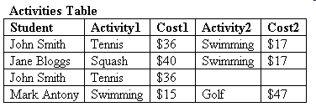
Database design
A database to keep track of students' sports activities
  student's name, activity and cost
Problem
  different students can have the same name
Notes:
When building 37 signals found Ruby scripting language from 1990s and used it for the templates of its website
Rails grew from these templates as a way to bind the web app parts to Ruby

Slide 5
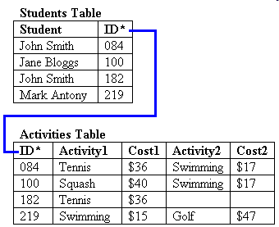
Database design
A database to keep track of students' sports activities
  student's name, activity and cost
Problem
  information about students and activities are mixed in one table
Solution:
  Introduce a primary key (ID) for student and divide the table into two
Notes:
When building 37 signals found Ruby scripting language from 1990s and used it for the templates of its website
Rails grew from these templates as a way to bind the web app parts to Ruby

Slide 6
Database design
A database to keep track of students' sports activities
  Students table: ID is the primary key
  Activities table: ID is a foreign key
Problem
  there can be multiple activities for each student
Notes:
When building 37 signals found Ruby scripting language from 1990s and used it for the templates of its website
Rails grew from these templates as a way to bind the web app parts to Ruby

Slide 7
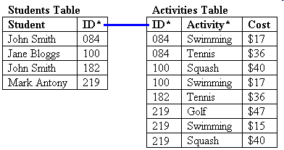
Database design
A database to keep track of students' sports activities
Problem
  there can be more than multiple activities for each student
Solution
  Merge the activity and cost fields
Notes:
When building 37 signals found Ruby scripting language from 1990s and used it for the templates of its website
Rails grew from these templates as a way to bind the web app parts to Ruby

Slide 8
Database design
A database to keep track of students' sports activities
  Students table: ID is the primary key
  Activities table: ID is a foreign key
Problem
  there is no standard fee for activities
Notes:
When building 37 signals found Ruby scripting language from 1990s and used it for the templates of its website
Rails grew from these templates as a way to bind the web app parts to Ruby

Slide 9
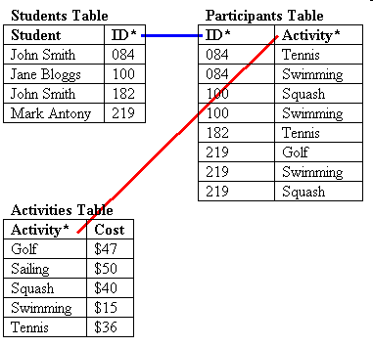
Database design
A database to keep track of students' sports activities
Problem
  there is no standard fee for activities
Solution:
  Separate activity from the participant information
Notes:
When building 37 signals found Ruby scripting language from 1990s and used it for the templates of its website
Rails grew from these templates as a way to bind the web app parts to Ruby

Slide 10
Working with Multiple Tables
-- Associations
Relate tables using a foreign key reference in one table to the primary key of another table.
By Rails convention, the foreign-key column is the singular, lowercase name of the target class with _id appended.
#{singular_name_of_parent_class}_id
Declaring Associations
  belongs_to
  has_one
  has_many
  has_many :through
  has_one :through
  has_and_belongs_to_many

Slide 11
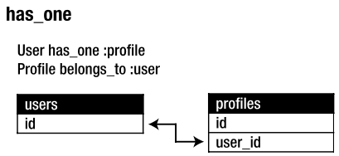
One-to-One Associations
class User < ActiveRecord::Base
has_one :profile
end
class Profile < ActiveRecord::Base
belongs_to :user
end

Slide 12
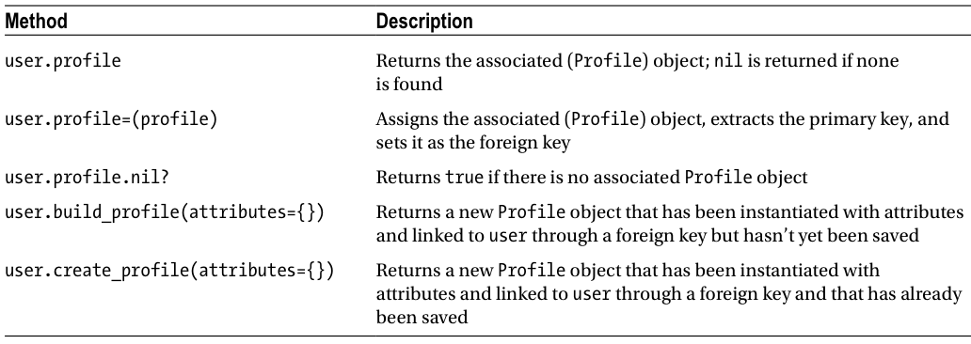
Methods Added by the has_one Association
>> user.create_profile :name => 'Jane Doe', :color => 'pink'

Slide 13
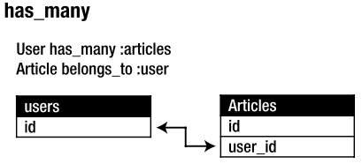
One-to-Many Associations
A row in one table is related to one or more rows in another table
class User < ActiveRecord::Base
has_one :profile
has_many :articles
end
class Article < ActiveRecord::Base
belongs_to :user
end

Slide 14
>> user = User.first
>> user.articles << Article.first
By using the append (<<) operator, you attach Article.first onto your user object.
When you use << with associations, it automatically saves the new association.
>> user.articles << Article.new(:title => 'One-to-many associations’, :body => 'One-to-many associations describe a pattern ..')

Slide 15
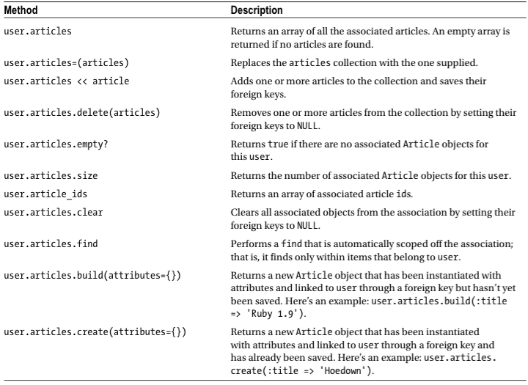
Methods Added by the has_many Association

Slide 16
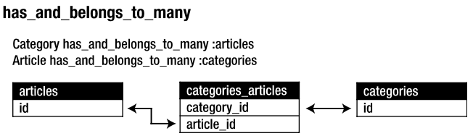
Many-to-Many Associations
Two tables are connected to multiple rows on both sides
class Article < ActiveRecord::Base
belongs_to :user
has_and_belongs_to_many :categories
end
class Category < ActiveRecord::Base
has_and_belongs_to_many :articles
end

Slide 17
Seeding Data
db/seeds.rb contains all the record creation needed to seed the database with its default values.
user = User.create :email => 'mary@example.com', :password => 'guessit’
Category.create [{:name => 'Programming'},
{:name => 'Event'},
{:name => 'Travel'},
{:name => 'Music'},
{:name => 'TV'}]
$ rake db:seed

Slide 18
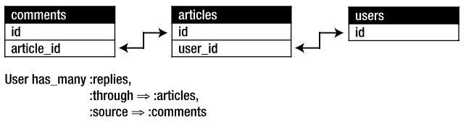
Rich Many-to-Many Associations
Join multiple tables to perform complicated tasks
To retrieve all the comments added to users’ articles.
You can say “users have many comments through articles”

Slide 19
class User < ActiveRecord::Base
has_one :profile
has_many :articles, -> {order('published_at DESC, title ASC')}, :dependent => :nullify
has_many :replies, :through => :articles, :source => :comments
end
has_many :through allows you to easily have nice names for your associations.

Slide 20
Advanced Finding
Using the where Method
>> Article.where(:title => 'Advanced Active Record')
Use AND /OR /NOT LIKE to join together the conditions
>> Article.where("created_at > '23-04-2013' OR body NOT LIKE '%model%'")
%model% means that the word model must occur somewhere (anywhere) in the body of the article.

Slide 21
Using an Array Condition Syntax
The array condition syntax gives you the ability to specify conditions on your database calls in a safer way than using SQL syntax.
Find all the articles that were published before today:
>> Article.where("published_at < ?", Time.now)
Returns all the articles created at the same moment as the last article
>> Article.where("created_at = ?", Article.last.created_at)
You can pass as many conditions as you want.
>> Article.where("created_at = ? OR body LIKE ?", Article.last.created_at, 'model')

Slide 22
Using Association Proxies
Association proxy is a fancy term for the ability to chain together multiple calls to Active Record.
>> User.first.articles.all
The all method is automatically scoped to the user, which is to say it finds articles that belong to that user.
Automatically assign ownership with build and create constructors by setting the appropriate foreign keys.
>> current_user.articles.create(:title => 'Private', :body => ‘Body here..’)

Slide 23
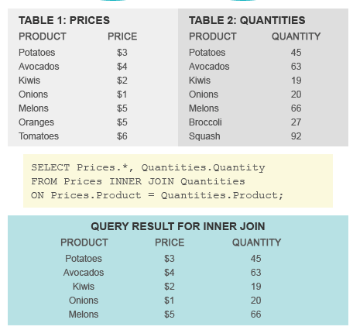
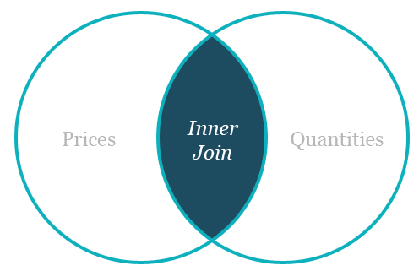
Joining Tables Together
Inner Join and Outer Join
An inner join searches tables for matching or overlapping data, and returns the information into one new table.
Active Record provides Joining a Single Association:
Product.joins(:quantities)

Slide 24
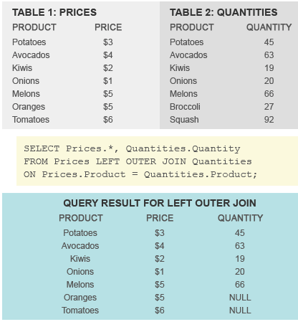
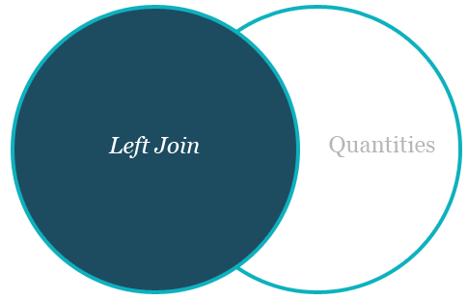
Left Outer Join (or Left Join)
If you want to select a set of records whether or not they have associated records you can use the left_outer_joins method.
Product.left_outer_joins(:quantities)

Slide 25
Joining Multiple Associations
Article.joins(:category, :comments)
"return all articles that have a category and at least one comment".
Specifying Conditions on the Joined Tables
time_range = (Time.now.midnight - 1.day)..Time.now.midnight
Client.joins(:orders).where('orders.created_at' => time_range)

Slide 26

Summary
Database
  store, manage and retrieve large collection of data
ActiveRecord Class (CRUD)
Migration
  Trace all changes of a database
  Team work
Database Design (multiple tables)

