Slide 1
(Advanced) Web Application Development
Test Driven Development with Ruby and Rails

Slide 2
Why do we bother testing?

Slide 3
When should we do testing?

Slide 4
A simple testing game
Three one minute rounds
Done in pairs: pick a developer & a tester
You might need to move seats
Game details at http://homepages.abdn.ac.uk/b.scharlau/pages/blog/?p=390

Slide 5
Outline for this lecture
Testing application options with Rails built-in tools
Unit testing rails
Controller testing rails
Use basic guide on testing with methods, etc
http://guides.rubyonrails.org/testing.html

Slide 6
Testing is part of the agile approach
Ensures the code does what client requests
Can be changed in line with client needs
Can be automated instead of manual

Slide 7
You must test your app
If you don’t test your app, then you don’t know
a) Either when you break it with new features
b) Or which specific part broke
Tests will tell you this information
If you don’t make the time now, then you’ll make the time after your app breaks. And it will break… You choose when to do tests

Slide 8
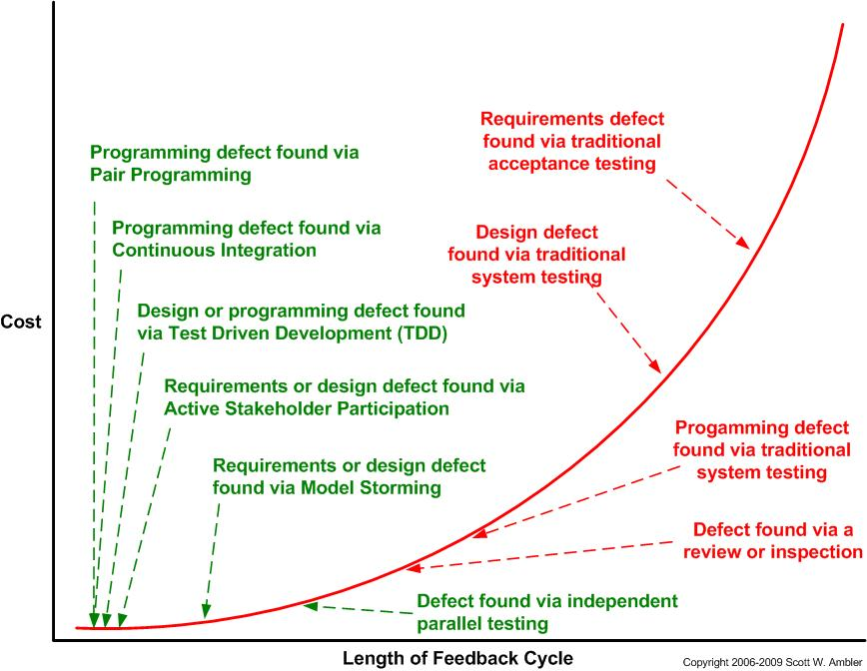
Agile provides better feedback
http://www.agilemodeling.com/essays/costOfChange.htm

Slide 9
Shortening feedback loop saves money
Finding problems sooner, means they are fixed sooner
Fixed sooner costs less money
Fixed sooner means less time spent on them
Fixed sooner means more time for other things, such as deploying app, and bringing in revenue

Slide 10
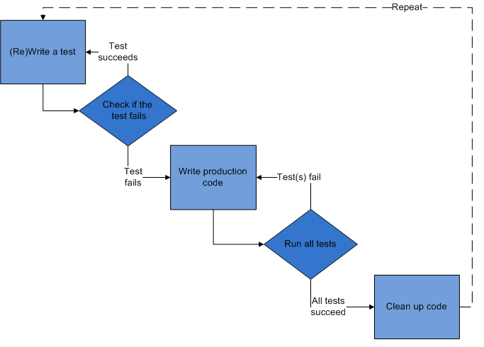
Follow the TDD principles
http://en.wikipedia.org/wiki/File:Test-driven_development.PNG

Slide 11
Use red, green, refactor to code
Make it green, then make it clean
4. Refactor
1. Write a little test
Cycle time < 10 minutes
3. Get test to pass
2. Stub out code.
Watch test fail
http://patrickwilsonwelsh.com/?p=619

Slide 12
Tests based on customer’s business needs
Only write tests for what’s needed in app
This includes acceptance tests co-written by customer – avoids misinterpretation
only code what’s needed, then stop,
move to next feature

Slide 13
There is no one tool for testing
Need to use a variety of tests
Unit test logical unit (class, method, etc) in isolation
Integration test for components
Functional tests for end-to-end
System tests using same interface as users
System integration for collaborating apps
Performance tests to ensure throughput

Slide 14
Ruby provides various approaches to testing
Cucumber and RSpec confirms methods conform to expected behaviour of code
Test::Unit confirms methods work as expected

Slide 15
We’ll use the cookbook for testing
create cookbook: rails new cookbook then cd into cookbook and bundle install
b) setup migrations with rake db:create
c) setup recipe model
rails generate scaffold recipe title:string description:string date:date instructions:text
d) rake db:migrate to push migration to db server
e) rails server to start server (don’t need to really though)
f) rake test:units to setup test db
open test/unit/recipe_test.rb to write tests and run
g) open fixtures file and edit for data
h) open functional test and fix :one for :hot or :cold and run with rake test:functionals
i) test view in functional: assert_select 'h1', "Listing recipes”
j) run rake:tests to do all again as group

Slide 16
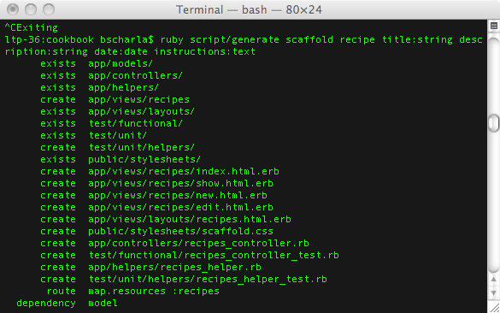
Rails creates tests for us
Tests automatically created
We just need to fill in code to use them

Slide 17
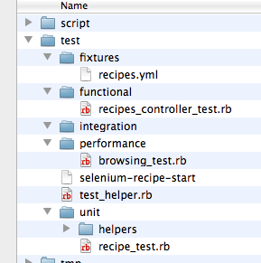
We have a variety of tests available
Tests for controllers
Tests for models
We just need to fill in code to use them

Slide 18
We first check the test framework
Create test database if doesn’t exist
Test database defined in database.yml
ruby test/unit/recipe_test.rb

Slide 19
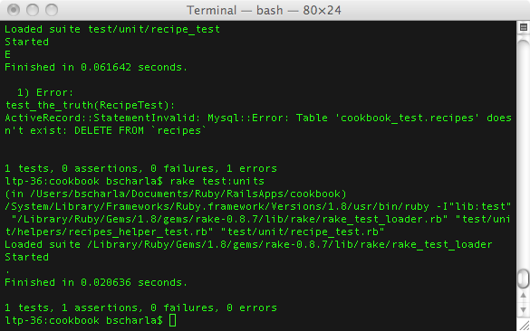
Need to prepare system with rake
Run ‘rake test:units’ to copy schema to test db and run tests
Only works if you’ve used migrations, otherwise need to save table structure and load that into test db

Slide 20
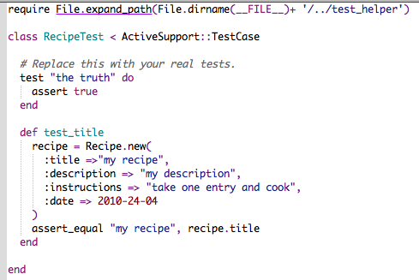
We can use simple unit test code
Might need to change ‘require’ line
http://api.rubyonrails.org/
ActiveSupport::TestCase and Testing for details and examples
Default test, delete
test “recipe test” do
Could also do validation checks

Slide 21
Add more tests for other models
As add models to app, you write tests
Keep checking the methods work
Can run tests independent of server, so speeds up working application

Slide 22
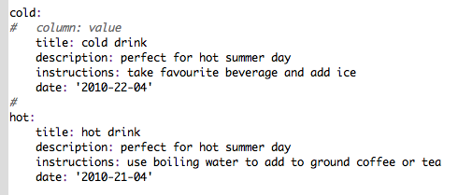
Use fixtures to load test data
Provides continuity of tests
Can have one for each scenario
One place for data instead of being in test file

Slide 23
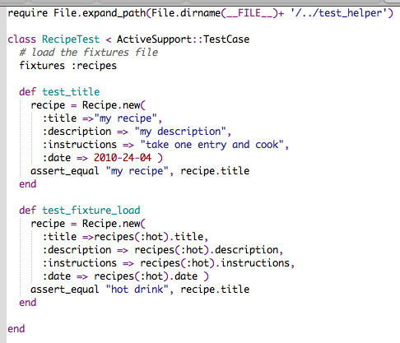
Fixture code in test is cleaner
Load fixture file – must be same as table name
Can use fixture repeatedly in multiple tests
Reference fixture names and values
recipe.save will put it into db

Slide 24
We can also test the controllers
Need to change ‘require’ line when run without rake
Change default of :one to :hot from fixture file
Run as is to check setup
Run with ‘rake test:functionals’

Slide 25
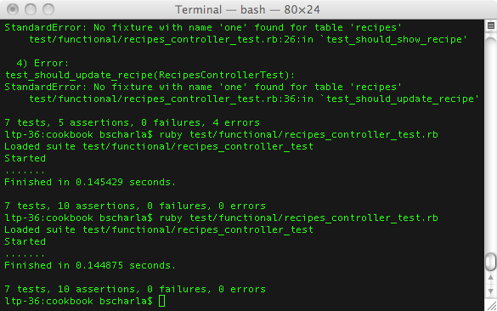
Test the controller outside server
Change default of :one to :hot from fixture file or you will have error
One dot per test with ruby test…

Slide 26
We can write better tests
Basic controller tests 7 methods of controller
Add new tests for methods you add

Slide 27
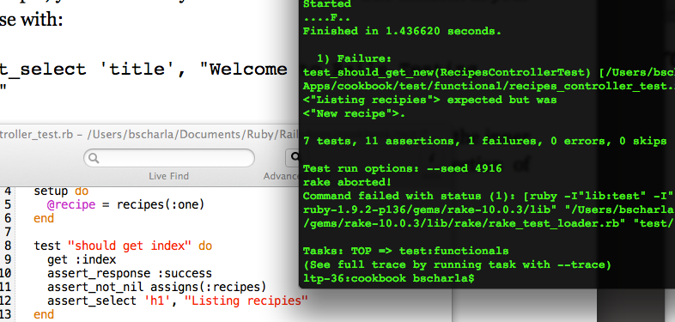
Test views from within controllers
Select element, declare value

Slide 28
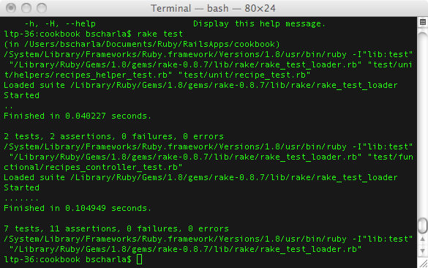
We can run all tests together
We can run all tests at once as app grows

Slide 29
We can test the parts of the application as we write them
We know the code works before we start server
We know code will be checked as we write new code
Provides a safety net for our coding:
mistakes will be caught and fixed sooner

Slide 30
There are still some parts missing from the tests
We can add integration tests from Rails to mix controllers, etc
We can also use Rspec and Cucumber to good effect to test the whole app
Cucumber also tests web pages for us too
We’ll look at Rspec and Cucumber later

Slide 31
Summary
Use unit tests for the models
Use functional tests for the controllers
Use ‘rake test’ to run all tests
Tests provide a safety net for our coding
Testing is a big part of the Ruby community

