Slide 1
(Advanced) Web Application Development
Behaviour Driven Development with Ruby and Rails

Slide 2
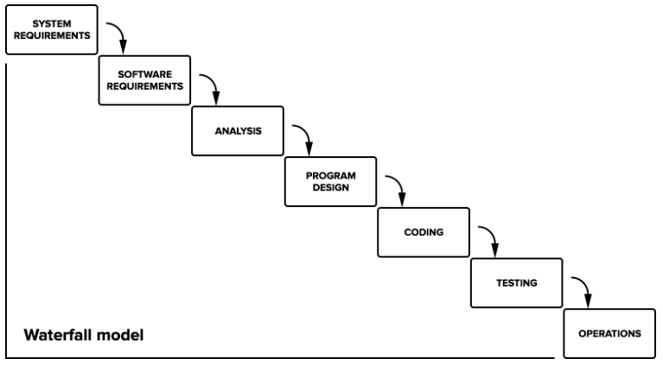
Waterfall

Slide 3
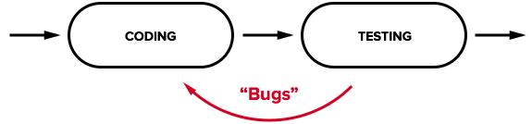
The First Optimization: Test-First Programming

Slide 4
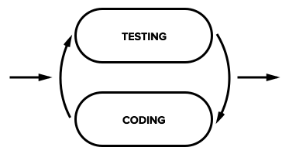
The First Optimization: Test-First Programming

Slide 5
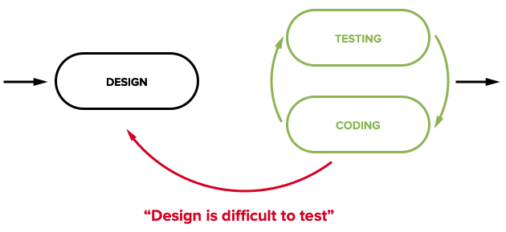
Test-driven Development
d

Slide 6
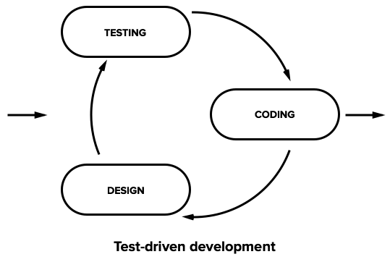
Test-driven Development

Slide 7
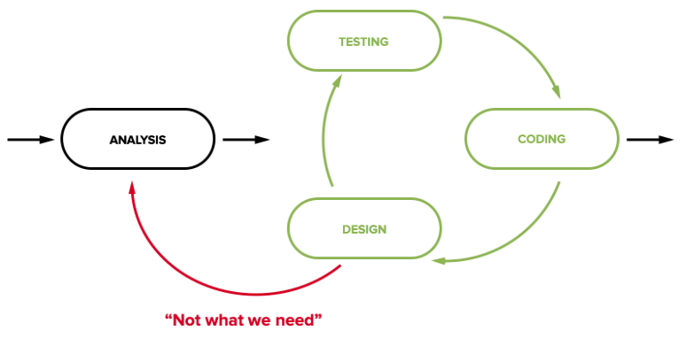
Next Step: Analysis
Understanding what we need to build

Slide 8
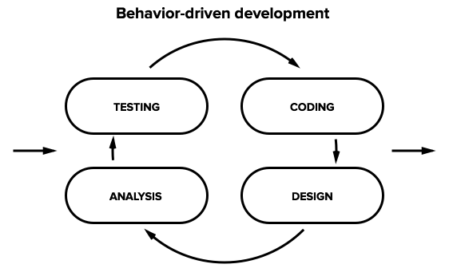
Test-driving the Analysis
Better understand the behavior of the system that we need to build and how to appropriately design and implement it

Slide 9
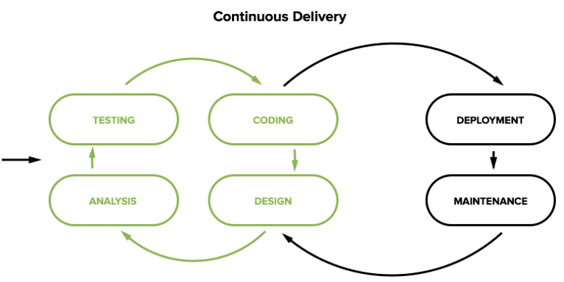
Merging BDD with deployment and operations brings us to the broad concept of continuous delivery.

Slide 10
What is Behaviour Driven Development
BDD is a software development process that emerged from test-drive development (TDD)
Use natural language constructs (e.g., English-like sentences) that can express the behavior and the expected outcomes.
A software developer must:
define a test set for the unit first;
make the tests fail;
then implement the unit;
finally verify that the implementation of the unit makes the tests succeed.

Slide 11
Behavioral specifications
Title: The story should have a clear, explicit title.
Narrative
A short, introductory section that specifies
who (which business or project role) is the driver or primary stakeholder of the story (the actor who derives business benefit from the story)
what effect the stakeholder wants the story to have
what business value the stakeholder will derive from this effect

Slide 12
Behavioral specifications
Acceptance criteria or scenarios
A description of each specific case of the narrative. Such a scenario has the following structure:
It starts by specifying the initial condition that is assumed to be true at the beginning of the scenario. This may consist of a single clause, or several.
It then states which event triggers the start of the scenario.
Finally, it states the expected outcome, in one or more clauses.

Slide 13
Story: Returns go to stock
As a store owner
In order to keep track of stock
I want to add items back to stock when they're returned.
Scenario 1: Refunded items should be returned to stock
Given that a customer previously bought a black sweater from me
And I have three black sweaters in stock.
When he returns the black sweater for a refund
Then I should have four black sweaters in stock.
Scenario 2: Replaced items should be returned to stock
Given that a customer previously bought a blue garment from me
And I have two blue garments in stock
And three black garments in stock.
When he returns the blue garment for a replacement in black
Then I should have three blue garments in stock
And two black garments in stock.

Slide 14
Conclusion
Behavior-driven development is about collaboration & communication
BDD isn’t about fancy ways to validate your results; it’s about sharing expected behaviors across all members of the team.

