Slide 1
Advanced Web Application Development
Behaviour Driven Development with Ruby and Rails

Slide 2
Outline
RSpec
Cucumber
Capybara

Slide 3
What is RSpec
RSpec is a testing tool for Ruby, created for behavior-driven development (BDD).
It is the most frequently used testing library for Ruby in production applications.
RSpec provides a DSL to write executable examples of expected behaviour of a piece of code in a controlled context.
http://rspec.info

Slide 4
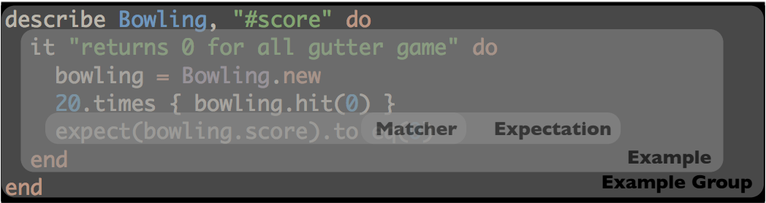
RSpec
RSpec uses the method describe to create and Example Group
Example groups can be nested using the describe or context methods

Slide 5
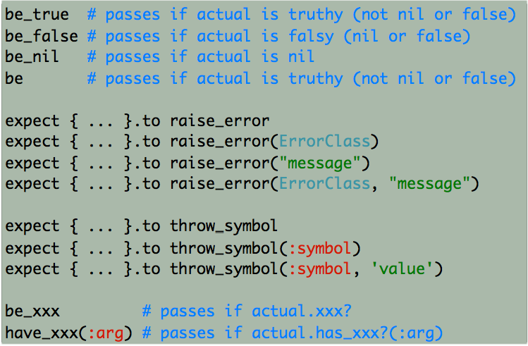
RSpec
RSpec comes built in with a nice collection of matchers, including:

Slide 6
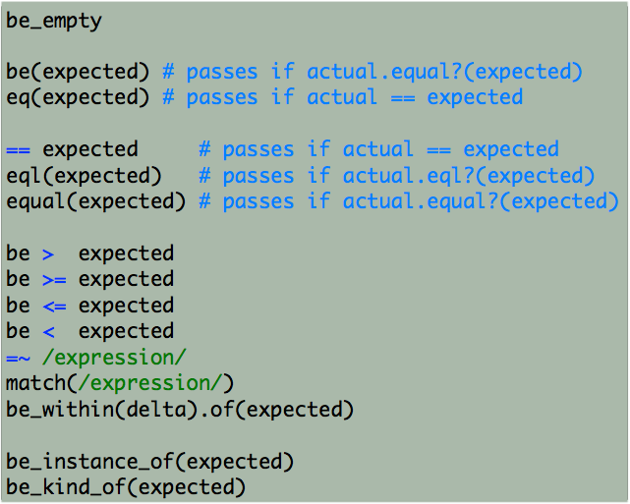
And …

Slide 9
shoulda-matchers lets us spec common Rails functionality, like validations and associations, with less code.
factory_girl is a library for setting up Ruby objects as test data. It's essentially a fixtures replacement.
group :test do
gem 'shoulda-matchers'
end
group :development, :test do
gem 'rspec-rails'
gem 'factory_girl_rails'
end

Slide 10
What is Cucumber?
Supports Behavior Driven Development (BDD)
Writing and executing high level descriptions of your software’s functionality.
Write tests that anybody can understand, regardless of their technical knowledge.
The language that Cucumber understands is called Gherkin

Slide 11
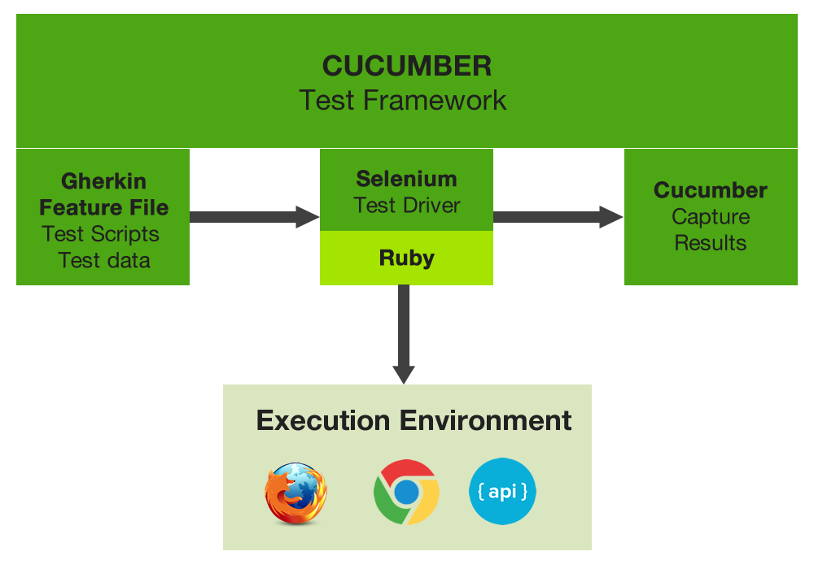

Slide 12
To be able to run Cucumber scenarios which use JavaScript you need selenium-webdriver. Add it to the test group of your Gemfile:
group :test do
gem 'cucumber-rails', require: false
gem 'database_cleaner'
gem 'selenium-webdriver'
end

Slide 13
Features
A feature is a Use Case that describes a specific function of the software being tested.
# features/home_page.feature
Feature: Home page
Scenario: Viewing application's home page
Given there's a post titled "My first" with "Hello, BDD world!" content
When I am on the homepage
Then I should see the "My first" post

Slide 14
Scenarios
Each Feature is made of a collection of scenarios
Scenario: Eric wants to withdraw money from his bank account at an ATM
Given Eric has a valid Credit or Debit card
And his account balance is $100
When he inserts his card
And withdraws $45
Then the ATM should return $45
And his account balance is $55

Slide 15
Scenario Outline
test multiple scenarios at once
Scenario Outline: A user withdraws money from an ATM
Given <Name> has a valid Credit or Debit card
And their account balance is <OriginalBalance>
When they insert their card
And withdraw <WithdrawalAmount>
Then the ATM should return <WithdrawalAmount>
And their account balance is <NewBalance>
Examples:
| Name | OriginalBalance | WithdrawalAmount | NewBalance |
| Eric | 100 | 45 | 55 |
| Pranav | 100 | 40 | 60 |
| Ed | 1000 | 200 | 800 |

Slide 16
implementing steps:
# features/step_definitions/home_page_steps.rb
Given(/^there's a post titled "(.*?)" with "(.*?)" content$/) do |title, content|
@post = FactoryGirl.create(:post, title: title, content: content)
end
When(/^I am on the homepage$/) do
visit "/"
end
Then(/^I should see the "(.*?)" post$/) do |title|
@post = Post.find_by_title(title)
expect(page).to have_content(@post.title)
expect(page).to have_content(@post.content)
end

Slide 17
What is Capybara?
Capybara is a library written in the Ruby programming language which makes it easy to simulate how a user interacts with your application.
Capybara can talk with many different drivers which execute your tests through the same clean and simple interface. You can seamlessly choose between Selenium, Webkit or pure Ruby drivers.
Capybara automatically waits for your content to appear on the page, you never have to issue any manual sleeps.

