Slide 1
Advanced Web Application Development
BDD with Capybara

Slide 2
Acceptance Test
Proper acceptance tests treat your application as a black box
They should know as little as possible about what happens under the hood
They’re just there to interact with the interface and observe the results

Slide 3
Capybara
Capybara is a lightweight alternative to Cucumber
Capybara is a browser automation library
Helps you test web applications by simulating how a real user would interact with your app
It is agnostic about the driver running your tests and comes with Rack::Test and Selenium support built in
WebKit is supported through an external gem

Slide 4
RSpec, Capybara, Steak
Use outside-in testing without the translation step
The Steak project integrated RSpec and Capybara directly
https://github.com/cavalle/steak
Now we can write acceptance tests just like you write unit tests, greatly simplifying the process
In late 2010 the Capybara absorbed the Steak syntax
group :test, :development do
gem ‘steak’
….
> bundle
> rails g steak:install

Slide 5
Rack::Test
Rack::Test is Capybaray’s default driver. Rack::Test driver interacts directly with Rack Interfaces
It runs requests against your app, then provides the resulting HTML to Capybara and RSpec for examination.
Rack::Test is completely headless (and therefore fast) The disadvantage is that it doesn’t process JavaScript (or give you visual)
To test JavaScript in your acceptance tests you can use the selenium-webdriver or capybara-webkit driver.

Slide 6
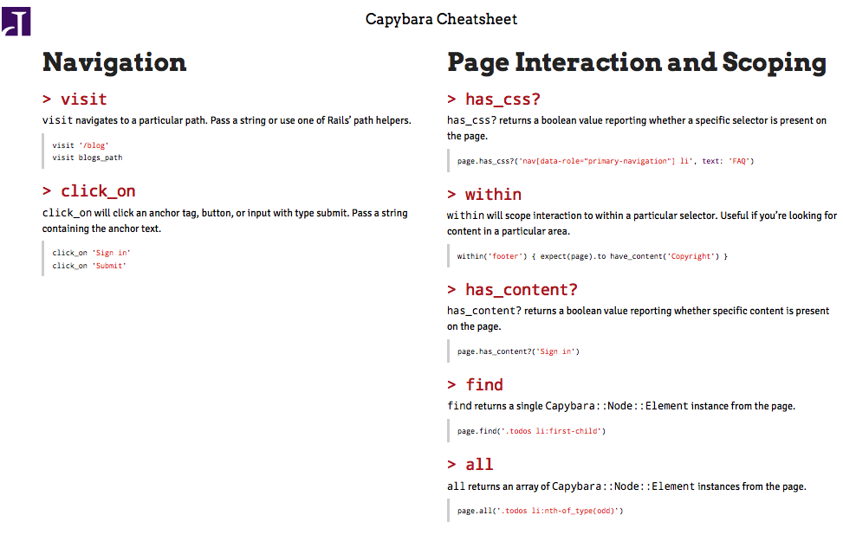
Capybara DSL
ThoughtBot put a nice Capybara Cheat Sheet
https://thoughtbot.com/upcase/test-driven-rails-resources/capybara.pdf

Slide 7
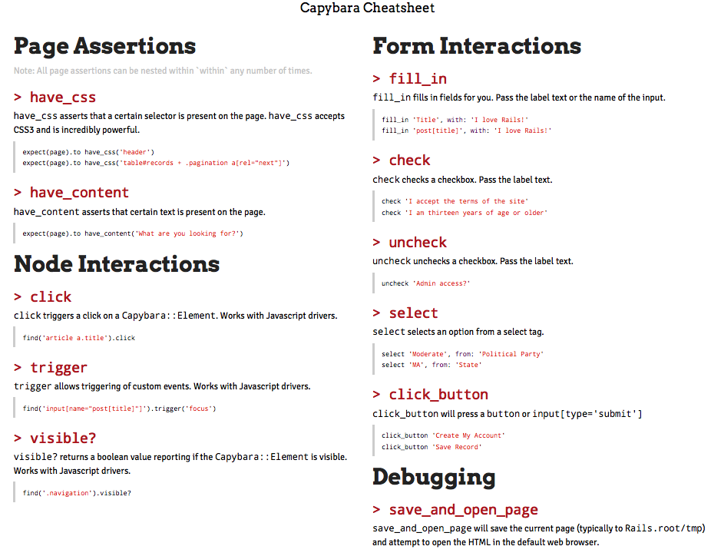

Slide 8
Example
https://github.com/integrallis/learn-rspec-capybara
By Brian Sam-Bodden
Bundle the application (bundle install), migrate it (rake db:migrate), prepare the test database (rake db:test:prepare) and launch it (rails s)

Slide 9
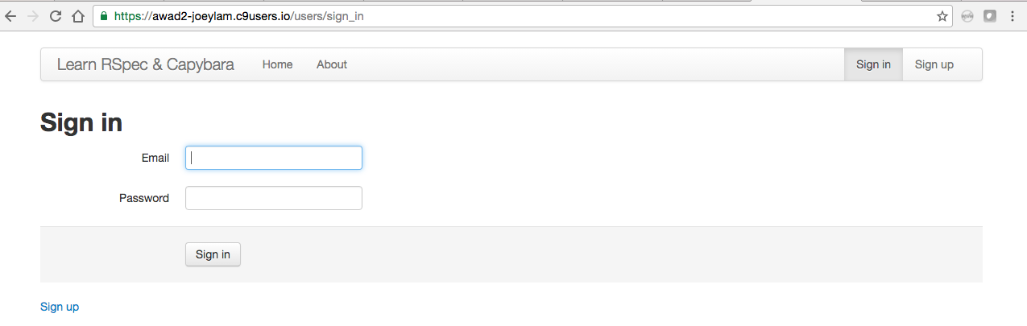
Open the URL http://localhost:3000 on a browser
Sign Up Page
Sign Up Page - /users/sign_up

Slide 10
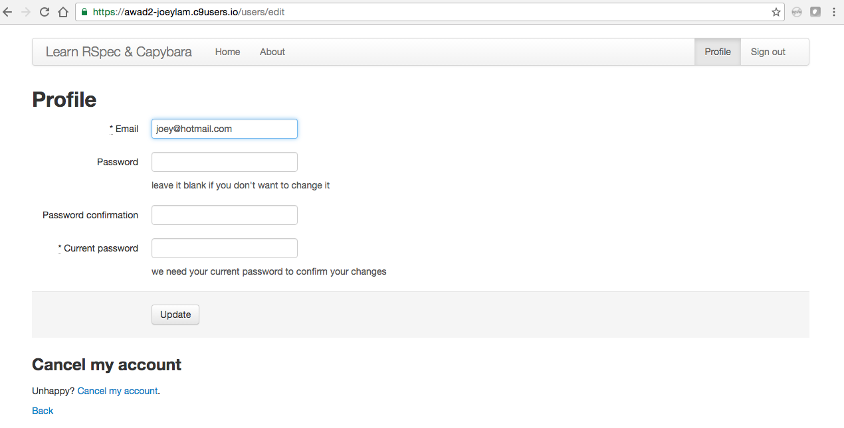
The user profile page:
User Profile page - /users/edit

Slide 11
RSpec, Cucumber and Capybara
RSpec
Unit test, functional tests and integration tests
Cucumber
Non-technical people
Documentation
Capybara
Uses headless webkit

