Slide 1

Web Application Development Advanced Ruby on Rails – User Authentication

Slide 2
About This Lecture
Form
~40 minutes lectures
Question time
Learning Material
The Hartl Book Sec 5.3, Sec 6.1.1, Sec 6.2, Sec 6.3. Sec 7.1.3; Sec 7.2.2
Agile Web Development with Rails Chapter 14

Slide 3
Authentication
?
How do you prove to someone that
you are who you claim to be?
Any system with access control must solve this problem

Slide 4
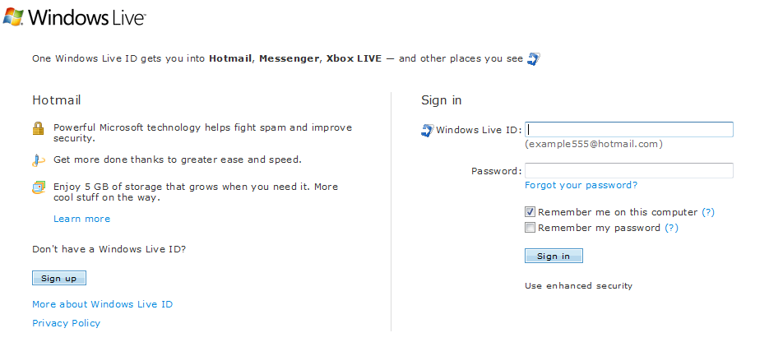
Notes:
When building 37 signals found Ruby scripting language from 1990s and used it for the templates of its website
Rails grew from these templates as a way to bind the web app parts to Ruby

Slide 5
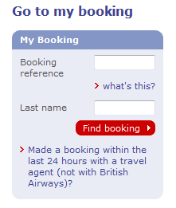
Notes:
When building 37 signals found Ruby scripting language from 1990s and used it for the templates of its website
Rails grew from these templates as a way to bind the web app parts to Ruby

Slide 6
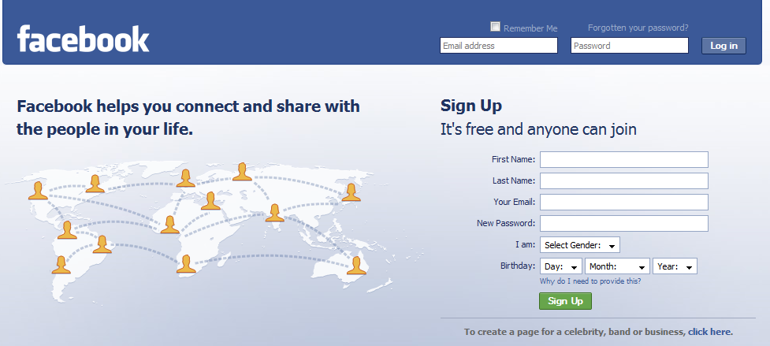

Slide 7
User Authentication
What is user authentication
To prove Who You Are
Many approaches
What you know
Passwords
Secret key
Where you are
IP address
What you are
Biometrics
What you have
Secure tokens

Slide 8
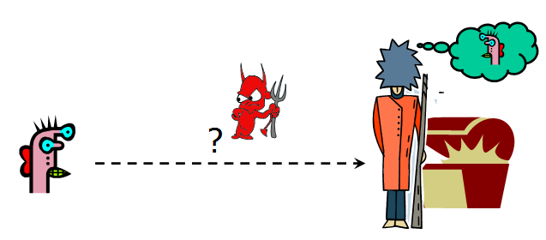
Password-Based Authentication
User has a secret password
System checks it to authenticate the user.
Key questions
How is the password stored?
How does the system check the password?

Slide 9
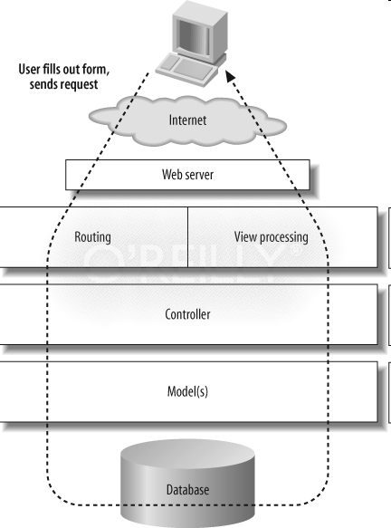
User Authentication in RoR
How is the password stored?
In database
A User AR class <-> A users table
attributes
username
password
How does the system check the password?
https://www.ruby-toolbox.com/categories/rails_authentication
see the following example
Notes:
When building 37 signals found Ruby scripting language from 1990s and used it for the templates of its website
Rails grew from these templates as a way to bind the web app parts to Ruby

Slide 10
Example - View
index.html.erb:
<%= form_tag :action => 'process_login' %>
Username: <%= text_field "user", "username" %><br>
Password: <%= password_field "user", "password" %><br>
<%= submit_tag "log in"%>
Notes:
“user” is the name of the model

Slide 11
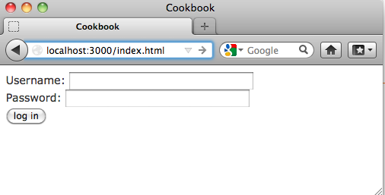
Example - View
index.html.erb:
<%= form_tag :action => 'process_login' %>
Username: <%= text_field "user", "username" %><br>
Password: <%= password_field "user", "password" %><br>
<%= submit_tag "log in"%>
<%=form_tag …> generates the <form> and </form> HTML tags
text_field generates HTML <input> elements with the <type> attribute set to <text>
password_field generates HTML <input> elements with the <type> attribute set to <password>
submit_tag specifies the label of the submit button

Slide 12
Example - Controller
user_controller.rb:
def process_login
if user = User.authenticate(params[:user])
redirect_to :action => ‘welcome'
else
flash.now.alert = "Invalid username or password"
end
end

Slide 13
Example - Controller
user_controller.rb:
def process_login
if user = User.authenticate(params[:user])
redirect_to :action => ‘welcome'
else
flash.now.alert =
"Invalid username or password"
end
end
Call the authenticate method of the User class (see next slide)
If login redirect_to the welcome page
Otherwise
Display a warning with flash
Remember to modify routes.rb
get "sign_up" => "users#new", :as => "sign_up"
root :to => "users#new"
resources :users

Slide 14
Example - Model
app/models/user.rb:
class User < ActiveRecord::Base
def self.authenticate(user_info)
find_by_username_and_password(user_info[:username],
user_info[:password])
end
end

Slide 15
Example - Model
Called in the process_login method
find the user object by its username and password
app/models/user.rb:
class User < ActiveRecord::Base
def self.authenticate(user_info)
find_by_username_and_password(user_info [:username], user_info[:password])
end
end

Slide 16
Clear Text Password
Unsecure password: storing a raw password in the database
known as “clear text”
Key questions
How is the password stored?
How does the system check the password?

Slide 17
Encrypted Password
To store a string generated using a cryptographic hash function
which is essentially irreversible
an attacker in possession of the hashed password unable to infer the original
To verify that a submitted password matches the user’s password
we first encrypt the submitted string and then compare the hashes.

Slide 18
Example – Model for Encrypted Passwords
app/models/user.rb:
class User < ActiveRecord::Base
attr_accessor :password before_save :encrypt_password def encrypt_password if password.present? self.password_salt = BCrypt::Engine.generate_salt self.password_hash = BCrypt::Engine.hash_secret(password, password_salt) end end
… end
Notes:
.present? Check whether an object is nil, empty, or “ ”. In Rails, present? Is defined as
def present?
!blank?
End
attr_accessor is about creating methods to store variables, and attr_accessible is about the security of mass assignments.

Slide 19
Example - Model for Encrypted Passwords
app/models/user.rb:
class User < ActiveRecord::Base
attr_accessor :password before_save :encrypt_password def encrypt_password if password.present? self.password_salt = BCrypt::Engine.generate_salt self.password_hash = BCrypt::Engine.hash_secret(password, password_salt) end end
… end
before_save is a callback that trigger logic before saving
password is NOT stored in database
Instead, it is an attribute of the User class
We generate a salt, then use both the password and the salt to generate the password hash

Slide 20
Verify Users using Encrypted Passwords
app/models/user.rb:
class User < ActiveRecord::Base
def self.authenticate(user_info)
user=find_by_username(user_info[:username])
if user && user.password_hash==Bcrype:Engine.hash_secret (user_info[:password], user.password_salt)
user
else
nil
end
end
end

Slide 21
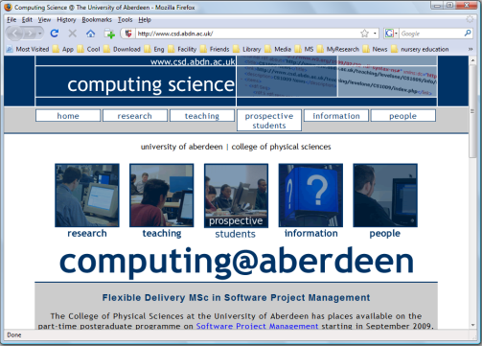
HTTP
Request
Proxy Server
HTTP
Request
HTTP
Response
HTTP Response
http://www.abdn.ac.uk
Web Server
www.abdn.ac.uk
File System

Slide 22
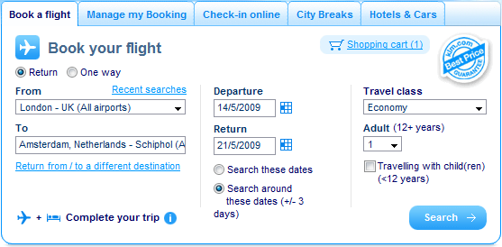
HTTP: a Stateless Protocol
HTTP doesn't make any assumptions about
previous requests between the client and the server.
In HTTP, it's also impossible to tell whether two pages requested in succession were actually requested by the same user!!
Notes:
When building 37 signals found Ruby scripting language from 1990s and used it for the templates of its website
Rails grew from these templates as a way to bind the web app parts to Ruby

Slide 23

Cookie
A cookie consists of a name/value pair
E.g., a cookie with the name colour might have the value green
a tiny snippet of information that a web site places on a user's computer
no other site is able to access the cookie
It is sent as an HTTP header
by a web server to a web client (usually a browser)
and then sent back unchanged by client each time it accesses that server.

Slide 24

Session
A session is like a small container that's stored on the server for each user
used as a temporary storage location for user specific information
Rails uses a session cookie to identify the session of a returning visitor
A session cookie contain the actual session content in a safely encrypted fashion
the server compares the cookie with the stored ones;
if a match is found, the server knows that the request comes from a logged users, and also knows which user its comes from.

Slide 25
Expiration
A site can set the expiration date of a cookie in two ways:
by setting an explicit date (for example, December 31, 2012)
by setting the cookie to expire when the user closes the browser
Different models for session behavior common on the web:
“forgetting” the session on browser close,
using an optional “remember me” checkbox for persistent sessions, and
remembering sessions until the user explicitly signs out

Slide 26
Sessions in Rails
A session is automatically created for each of your application's users
can be used to store and retrieve data without requiring any special code.
Storage
session[:page] = 'Index page'
Retrieval
<%= session[:page] %>

Slide 27
Session Support
user_controller.rb:
def process_login
if user = User.authenticate(params[:user])
session[:user_id]=user.id
redirect_to :action => ‘welcome'
else
flash.now.alert = "Invalid username or password"
end
end
Remember to modify routes.rb
get "log_out" => "sessions#destroy", :as => "log_out"
get "log_in" => "sessions#new", :as => "log_in"
get "sign_up" => "users#new", :as => "sign_up"
root :to => "users#new"
resources :users
resources :sessions

Slide 28
Limit Accessing
class ApplicationController < ActionController::Base
protected
def login_required
return true if User.find_by_id(session[:user_id])
access_denied
return false
end
def access_denied
flash[:error] = 'Oops. You need to login before you can view that page.'
redirect_to :log_in
end
end

Slide 29
Limit Accessing (II)
http://localhost:3000/users/my_account
class UserController < ApplicationController
before_filter :login_required, :only => :my_account
……
……
end

Slide 30
Log Out
#app/controllers/users_controller.rb
class UsersController < ApplicationController
….
def logout
session[:user_id] = nil
redirect_to :log_in , :notice => "Logged out!"
end
end

Slide 31

Summary
User authentication in Rails
User and password modelling
HTTP issue
More details are in your practical.
Notes:
Strong parameter
http://guides.rubyonrails.org/getting_started.html
https://github.com/railscasts/250-authentication-from-scratch/tree/master/auth

