Slide 1
Automata with Output (sketch)
We now have ways to formally define
languages, and ways to automatically test
whether a given string is a member of a
language.
We also have a simple model of a computer.
Can we extend this model, so that instead
of simply replying "yes" or "no" when
presented with input, our abstract machine
writes some output from an alphabet,
determined by the input string?

Slide 2
Moore Machines
A Moore Machine is a 6-tuple (Q,I,T,E,Γ,O),
where Q, I, T and E are as for DFSA's,
Γ is an alphabet (the output alphabet), and
O is a set of pairs (a function : Q → Γ) defining
the output corresponding to each state of the
machine.
Notation: if (q, x) ∈ O, then sketch state q
by
q/x
Example: print out a 1 every time an aab
substring is input.
b
a
a
a
b
0/λ
1/λ
2/λ
3/1
b
a
aaababaaab gives output of 11.
b

Slide 3
Mealy Machines
A Mealy Machine is a 6-tuple (Q,I,T,E,Γ,O),
where Q,I,T and E are as for DFSA's,
Γ is an alphabet (the output alphabet), and
O is a set of triples (a function Q × T → Γ)
defining the output corresponding to each
(state,symbol) pair of the machine.
Notation: if (q,t,x) ∈ O, then sketch it as an
arc from q labelled t/x.
Example: read in a binary number (reversed),
and output the (reversed) number one larger.
0/0, 1/1
0/1
11101 input gives 00011 as output.
0/1
1/0
1/0

Slide 4
Moore-Mealy Equivalence
Let M be a Moore machine or a Mealy machine,
with output alphabet Γ. Define Mº(w) to be the
output of M on w.
Let M₁ = (Q₁,I₁,T₁,E₁,Γ₁,O₁) be a Moore
machine, and M₂ = (Q₂,I₂,T₂,E₂,Γ₂,O₂) be a
Mealy machine. Let Mº(λ) = b.
M₁ and M₂ are equivalent if T₁ = T₂ and for all
strings w ∈ T₁*, M₁⁰(w) = b M₂⁰(w)
Theorem: Moore-Mealy Equivalence
If M₁ is a Moore machine, then there exists a
Mealy machine, M₂, equivalent to M₁.
If M₂ is a Mealy machine, then there exists a
Moore machine, M₁, equivalent to M₂.

Slide 5
Varieties of FSAs
    FSAs with output have applications e.g. in the design of machines (e.g. a vending machine: reads pounds, pennies, etc; outputs a chocolate bar); coding and decoding of messages; etc.
Many other variations on the theme of FSAs exist:
  Markov models (FSAs whose edges have probabilities)
  Hidden Markov models (with hidden states)
  These have many applications, e.g. in Natural Language Processing

Slide 6
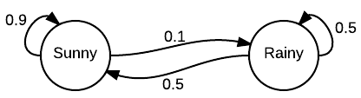
Markov Models
Markov Models model the probability of one state following another. (Assumption: only the previous state matters.)
Example: a simple weather model:

Slide 7
In Natural Language Processing, Markov Models can model how a word is pronounced as phones (“speech sounds”)
  State transition model, where each state is a phone
Probability of a path through the model is the product of the probabilities of the transitions

Slide 8
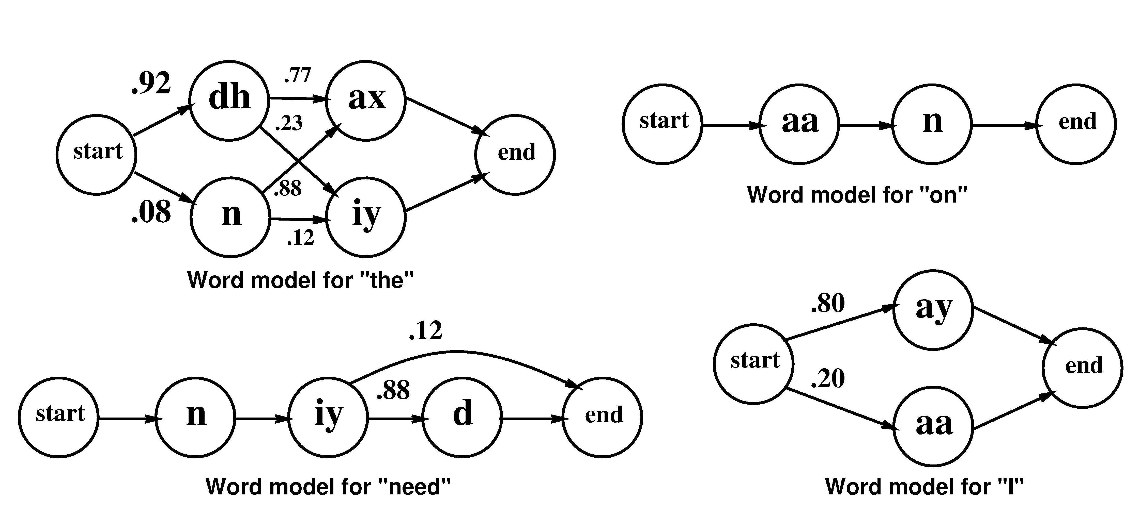
Markov models for word pronunciation

Slide 9
Pronunciation Example
Suppose this string of Phones has been recognized: [aa n iy dh ax]
(Assume we know this for sure)
Three different utterances (i.e., stings of words) may explain what was recognized:
I/[aa] need/[n iy] the/[dh ax]
I/[aa] the/[n iy] the/[dh ax]
On/[aa n] he/[iy] the/[dh ax]

Slide 10
Probabilities (based on the Markov Model)
Probabilities of paths:
  I/[aa] need/[n iy] the/[dh ax]
    .2 * .12 * .92*.77 = .017
  I/[aa] the/[n iy] the/[dh ax]
    .2 * .08 *.12 * .92*.77 = .001
  On/[aa n] he/[iy] the/[dh ax]
    1 * .1 * .92*.77 = .071

Slide 11
Ranked Probabilities
Ranked list of paths:
On he the (.071)
I need the (.017)
I the the (.001)
etc..
System would only keep top N

Slide 12
These probabilities can help a speech recognition system
Other information is needed as well:
  Probability of each phone
  Probability of each word
  Probability that one word follows another
  (Can “on he the” be part of an English sentence?)
More about this later.

