Slide 1
Questions
Have you studied databases previously?
Why did you select to study this course?
What would you like to know about data management/databases?

Slide 2
CS2015
Data Management
CS5097 / CS5098
Database Systems and Big Data
Nigel Beacham
n.beacham@abdn.ac.uk
Notes:
What will be covered in this lecture?
An overview of the course
An introduction to databases

Slide 3
Lectures
CS2015+CS5097
  Two lectures per week in New King’s 10
  @ 15:00 Hours on Tuesdays & Fridays
Course Duration
  12 weeks
22 lectures + 2 revision sessions
  In the revision classes we go through previous years’ exam papers
Textbook
  Database Systems by Connolly & Begg (4th/5th Editions)
  I refer to it as C&B

Slide 4
Practicals
CS2015
  One practical per week
    Thu 09:00-11:00 (Zoology G21)
    Fri 12:00-14:00 (MacRobert 117)
CS5097
  One practical per week
    Thu 15:00-17:00 (Edward Wright S84)
CS5098
  Undertake practicals in own time

Slide 5
Course Overview
Lectures
  4 Parts
Part 1
  Relational Model & SQL
Part 2
  Database Analysis & Design, ER Models, Methodology
Part 3
  Database Application Development using PHP, Java and Ruby
Part 4
  DBMS Internals and Current Applications

Slide 6
Assessment
One 2-hour exam in December (75%)
Assignments (25%)
  2 for CS2015
  1 for CS5097 / CS5098
An overall pass in the exam, and in the overall combination of exam and assignments is needed
In the event of re-sitting any of the assignments, students are responsibility for making arrangements in June

Slide 7
Introduction
Reading: C&B, Chap 1

Slide 8
In this lecture you will learn
What is data management?
What is a database?
File based systems & their disadvantages
Components of the DBMS environment
Advantages & disadvantages (?) of using DBMS
Notes:
What will be covered in the remainder of this lecture in terms of introducing you to databases?

Slide 9
What is Data Management?
“Data Management is a corporate service which helps with the provision of information services by controlling or co-ordinating the definitions and usage of reliable and relevant data.” (Gordon, 2013, p.57; BCS, 2015)
Data Administration
Corporate Data Modelling
Data Definition and Naming
Metadata
Data Quality
Data Accessibility
Database Administration
Technical standards
Physical database design
Management of DBMS software
Education and training
Performance Monitoring
Database Tuning
Repository Administration
Management and control of the software in which ‘information about information’ is stored, manipulated and defined
Repositories, data dictionaries, catalogs, directories
Repository features
Metadata models – conceptual model
CASE tools
This course focuses mainly on data and database administration
Notes:
Looks after data resource

Slide 10
Problems encountered without data Management
Data/information may not reside in a single organisational department
  The information systems within the enterprise cannot be interfaced
  Data is not shared between the information systems
  Communication breaks down and information gets lost
  Data is unnecessarily transcribed and rekeyed
  The wheel keeps being reinvented
  The competitive edge of the organisation is reduced
  Frustration sets in

Slide 11
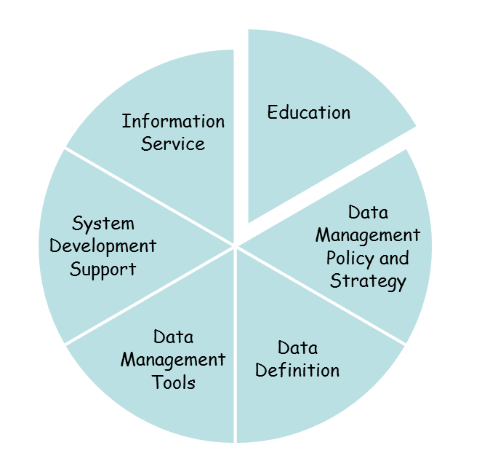
Data Management
Responsibilities
Activities
Strategically supports the corporate definition, management and use of business data
Operationally supports the development and maintenance of computerised information systems
Co-ordination
Facilitation

Slide 12
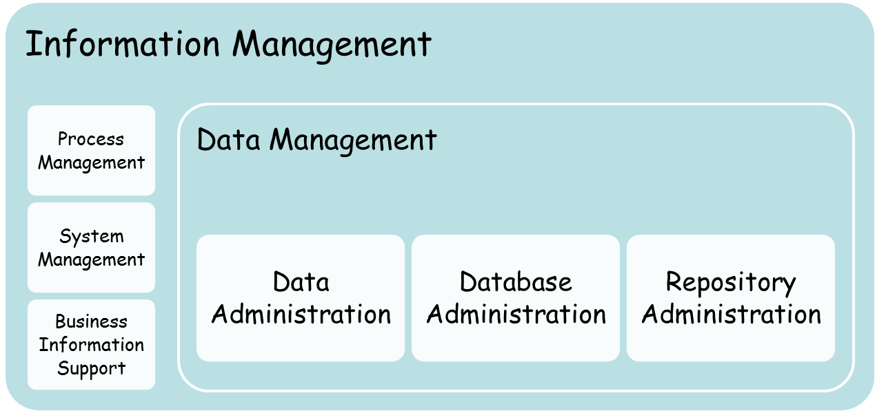
Relationship between data management and information management

Slide 13
Benefits of Data Management
Financial: cost saving, RoI
Availability of data
Data quality and reuse
Improved productivity, efficiency and effectiveness
Improving customer service
Improving competitive edge

Slide 14
Relationship between data management and enterprise architecture
Data management involves embracing the enterprise architecture
Understanding the elements that make up the organisation and how they interrelate
Framework for Enterprise Architecture
  by John Zachman (Aka the Zachman Framework)

Slide 15
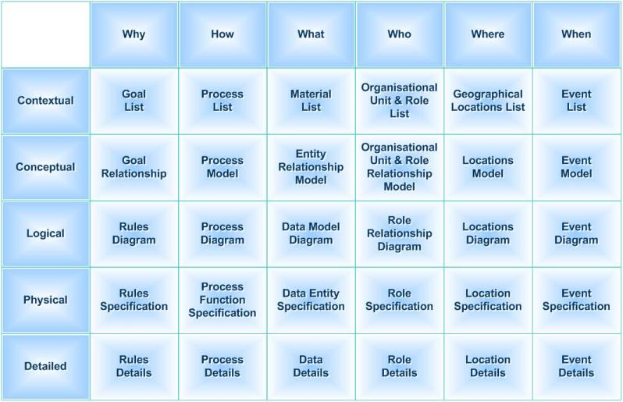
The Zachman Framework
The ‘what’ – inventory sets
The ‘how’ – process flows
The ‘where’ – distribution networks
The ‘who’ – responsibility assignments
The ‘when’ – timing cycles
The ‘why’ – motivation intentions
Central to this is the database…

Slide 16
The Big Idea -I
Consider a heap of coloured balls
No organization
No structured search possible for a specific coloured ball
Search inefficient
Note: Focus is on search/retrieval
Notes:
What is the main idea underpinning databases?

Slide 17
The Big Idea - II
Faster search possible by dividing the heap
Search fails to exploit the natural structure in the heap
Notes:
Beer in fridge/cupboard analogy.

Slide 18
The Big Idea - III
Balls organized into different colours
Natural structure exploited
Structured search possible
  Search also efficient
BIG IDEA ---- Organizing data based on the natural structure of the data for efficient search
Notes:
Organising new flat analogy.
What assumptions make this structure efficient?
Same size, shape, shade

Slide 19
What is a database?
Initial definition
  A collection of related data.
  (Not a collection of raw data)
We return to this definition many times during the course
We may add details to the initial definition
At the end of teaching,
  you give your own definition
    May be with more details

Slide 20
Why bother?
Libraries (Digital?)
  Aberdeen University Library Catalogue
Universities
  Student Record System of Aberdeen University
Flight & Holiday Booking
DNA & Genomics
GIS
…..
……
All major domains of human activity use database technology!!!
Hard to imagine modern world without database technology
Notes:
Where are databases used?
Facebook, Youtube, Skype ...

Slide 21
Need for Organizing Data
In all the above examples, data needs to be organised (structured)
  Organisation brings order from chaos
Organisation of data helps in accessing specific data items efficiently
  Accessing data items from unorganised data is inefficient
  Imagine searching for a specific book in a library with one large stack of all the books in the library
Databases are organised collection of related data!

Slide 22
What is a database? (2)
Database (DB)
  Collection/Repository of related data
  E.g. DreamHome2.mdb
Database Management System (DBMS)
  Software that manages and controls access to the database
  E.g. MSAccess
Database Application (DA)
  A program that interacts with the database at some point in its execution
  Using a query language (SQL)
  E.g. A Java or Php application on DreamHome database
Database system
  DAs+DBMS+DB
Notes:
What components make up a database?

Slide 23
Example Database Management Software
MSAccess – we use in this course
MySQL – freeware (Windows & Unix) – we use in this course
SQLite – freeware (Windows & Unix)
McKoi – freeware, Java based
Oracle
SQL Server – Microsoft database server
PostgreSQL
MongoDB, and CouchCD
….
Notes:
What examples of database management software is there?

Slide 24
File Based Systems
Data stored in files
Application programs work directly on files
Data defined separately in each program
Data processing (manipulation) takes place separately in each program
Data redundant across files
Program 1
Data Definition 1
Data Manipulation 1
File 1
Program 2
Data Definition 2
Data Manipulation 2
File 2
Program 3
Data Definition 3
Data Manipulation 3
File 3
Redundant data
Notes:
How was data originally organising?

Slide 25
Disadvantages of File-based Systems
Data Separation & isolation
Data duplication
Data dependence
Incompatible file formats
Fixed queries & proliferation of application programs
Program 1
Data Definition 1
Data Manipulation 1
File 1
Program 2
Data Definition 2
Data Manipulation 2
File 2
Program 3
Data Definition 3
Data Manipulation 3
File 3
Redundant data
Result:
Unhappy end-users and unhappy developers!!!
Unhappy system maintenance Staff.

Slide 26
Top Requirements
Data to be structured, defined and stored independent of application programs
  Data + metadata = database (another definition!)
Access and manipulation of data possible only through a common interface to all application programs
  DBMS offers the common interface

Slide 27
What is a database? (3)
Database (DB)
  Shared collection of logically related data and a description of this data
Database Management System (DBMS)
  Software that enables users to define, create, maintain and control access to the database

Slide 28
Components of the DBMS environment
Data
Hardware
Software
Procedures
People
Bridge
Machine
Human
Hardware
  Single PC
  A single mainframe
  Server-client models (2,3,4 tier architectures)
  Cloud-based models (virtual machines and DBaaS)

Slide 29
Components of the DBMS environment (2)
Software
  DBMS
  Network software
  Programming languages
Data
  Data Models (SQL and noSQL)
  Operational data
  Metadata
  System catalog

Slide 30
Components of the DBMS environment (3)
Procedures
  Log on to DBMS
  Start & Stop DBMS
People (Jobs for you?)
  Data & database administrators
  Database designers
  Application developers
  End-users: data analysts, data scientists, geologists, etc
Notes:
www.jobsite.co.uk/IT-Jobs‎
www.s1jobs.com/Find_Jobs_In_Aberdeen‎
www.londonjobs.co.uk/jobs/it/dba

Slide 31
Advantages of databases
Control of data redundancy
Data consistency
Improved security
Increased concurrency
Enforcement of standards
Improved backup and recovery
More in C&B section 1.6

Slide 32
Disadvantages
Complexity
Size
Higher impact of a failure
Performance
  Big Data
More in C&B section 1.6
Simple applications may not need DBMS at all
  Apply common sense!

Slide 33
Big Data
Databases often discussed alongside the concept of Big Data.
  Volume – amount of data
  Variety – multiple types of data
  Velocity – data produced at high rates
  Value – data perceived benefit
  Veracity – correctness of data assessment

Slide 34
Conclusion
Database - valuable shared resource in an organisation
Advantages in using DBMS in an application outweigh disadvantages
Database study involves
  Designing databases + using them in applications
  Generic functionality of the DBMS
Learn concepts in relation to a real DBMS, say MSAccess/MySQL.
MSAccess/MySQL stores database in files but offers tables to users
How is this done? – Relational Model

