Slide 1
SQL -I
Reading: C&B, Chaps 6, 7, 8 & 9

Slide 2
In this lecture you will learn
The basic concepts and principles of SQL
How to use SQL to perform basic database queries
The different components of SQL
How SQL can be described by a meta-language: Backus Normal Form (BNF)
The principles of Query By Example (QBE)

Slide 3
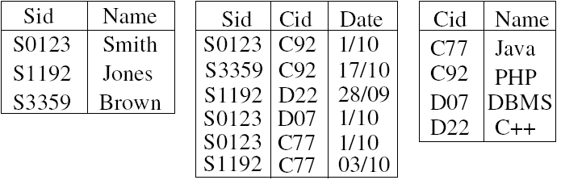
Relational Tables Can Answer
Many Queries
Student
Enrolment
Course
How many courses are there & what are their names?
Which students are enrolled for Java?
How many students take 3 or more courses?

Slide 4
SQL - Structured Query Language
SQL was developed at IBM around 1975...
Structured programming?
No! - Structured English (from ‘SEQUEL’)
SQL is a declarative language - says what not how
SQL is an abstract & portable interface to RDBMSs
Warning: different vendors have dialects & extensions
These notes & course text book: ANSI SQL
(ANSI = American National Standards Institute)
This course: Microsoft Access and MySQL

Slide 5
SQL Syntax
SQL uses English keywords & user-defined names
    CREATE TABLE Staff ( StaffNo INTEGER, Salary FLOAT,
    Lname VARCHAR(20) );
    INSERT INTO Staff VALUES (32, 25000.0, 'Smith');
By convention, keywords are upper-case
Text data is enclosed using single quotes (‘ ' ‘)
Round brackets (‘(‘) are used to group related items
Commas (‘,’) separate items in a list
Statements are terminated with a semicolon (‘;’)

Slide 6
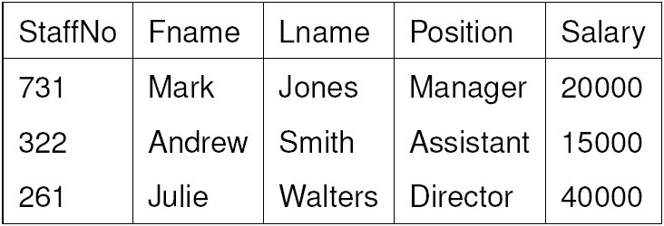
Simple Queries Using SELECT
The SELECT statement retrieves & formats data
SELECT is the most frequently used SQL statement
SELECT * FROM Staff;
Here, asterisk (‘*’) acts as a ‘wild card’ - all columns
By default, SELECT outputs all the rows in the table
Use “SELECT DISTINCT target_list FROM Staff;” for avoiding duplicates

Slide 7
SELECT
    SELECT target-list
    FROM relation-list
    WHERE qualification;
relation-list- A list of relation names.
target-list -A list of attributes of relations in relation-list
qualification -Comparisons (Attr op const or Attr1 op Attr2, where op is one of<,>,=,≠,<=,>=) combined using AND, OR and NOT.

Slide 8
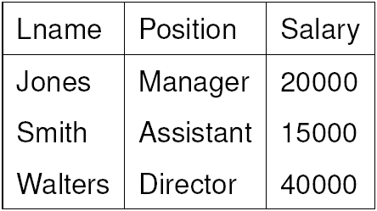
Selecting Specific Columns
Specific columns can be output by giving their names:
SELECT Lname, Position, Salary FROM Staff;
NB. must have a comma (‘,’) between column names
Can consider the output from SELECT as a new table

Slide 9
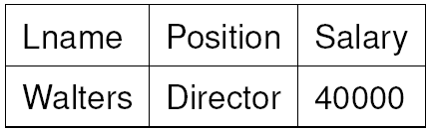
Selecting Specific Rows & Columns
Specific rows can be selected with a WHERE clause:
    SELECT Lname, Position, Salary
    FROM Staff
    WHERE Salary > 20000;
The symbol ‘>’ (greater than) is a comparison operator
Other comparison operators: <; =; <=; >=; ! =; <>
The condition ‘Salary > 20000’ is called a predicate
For each row, if predicate is true, row is output

Slide 10
Building Up Complex Predicates
Predicates evaluate to either true or false
Predicates can be combined using AND, OR, and NOT
Use brackets to avoid ambiguity
The next two statements are different:
    SELECT * FROM Staff WHERE
    (Position = 'Manager') OR
    (Position = 'Assistant' AND Salary > 10000);
    SELECT * FROM Staff WHERE
    (Position = 'Manager' OR Position = 'Assistant')
    AND NOT (Salary <= 10000);
In each case, whole WHERE clause is true or false

Slide 11
Other Types of Predicate
Other predicates include BETWEEN, IN, and LIKE
But they still evaluate to either true or false
  SELECT * FROM Staff
  WHERE
  (Salary BETWEEN 10000 AND 20000) AND
  (Position IN ('Manager', 'Assistant')) AND
  (Lname LIKE 'S%' OR Lname LIKE 'W____');
'%' matches zero or more characters
'_' matches exactly one character
NB. Some DMBSs use ‘*’ and ‘?’ for wildcards

Slide 12
SQL Terminology
SQL does not use formal relational terminology
Formal Informal (SQL)
Relation Table
Tuple Row
Attribute Column
Cardinality No. of rows
Degree No. of columns
Relationships Foreign keys
Constraints Assertions

Slide 13
SQL Components: DDL, DCL, & DML
SQL is a very large and powerful language, but every type of SQL statement falls within one of three main categories (or sub-languages):
Data Definition Language (DDL) for creating a DB
e.g. CREATE, DROP, ALTER
Data Control Language (DCL) for administering a DB
e.g. GRANT, DENY, USE
Data Manipulation Language (DML) to access a DB
e.g. SELECT, INSERT, UPDATE, DELETE

Slide 14
Describing SQL Syntax
Using BNF Notation
CB use a special ‘BNF’ notation to describe SQL syntax:
BNF (Backus-Normal form) is a meta language...
meta language: a language that describes a language
    SELECT [ DISTINCT | ALL ]
    { * | [ Colexpr [ AS Newcol ] ] [, ...] }
    FROM TableName [ Alias ] [, ...]
    [ WHERE Predicate ] [ GROUP BY Columnlist ]
    [ HAVING Predicate ] [ ORDER BY Columnlist ] [;]
[ ] optional;
{ } required;
| alternative;
... zero or more

Slide 15
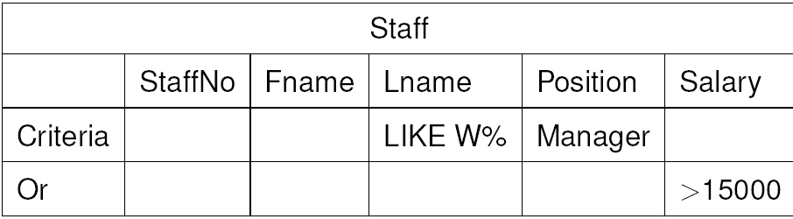
Query By Example (QBE)
Modern DBMSs often provide simple form-based methods of specifying queries (QBE). For example, MS-Access:
Generates the following SQL:
  SELECT * FROM Staff
  WHERE (Fname LIKE 'W%' AND Position = 'Manager')
  OR (Salary > 15000);

Slide 16
Conclusion
SQL is the standard query language for RDBMS
Three main categories of SQL
  DDL, Data Definition Language
  DCL, Data Control Language
  DML, Data Manipulation Language
SELECT belongs to DML
SELECT retrieves & displays data from the database
We continue to explore DML

