Slide 1
SQL - III
Reading: C&B, Chap 6, 7, 8 & 9

Slide 2
In this lecture you will learn
the concept of joining tables
why joins are central to relational database systems
how to specify joins in SQL
the different ways of joining tables
using table aliases & full column names in queries

Slide 3
Querying Multiple Tables
How do we list all the properties that a given client has viewed?
Could start with an example - e.g. client CR56 ...
PropertyForRent
PropertyNo | Street | City | Postcode | Type | Rooms | Rent | OwnerNo | StaffNo | BranchNo
PA14 | 16 Holhead | Aberdeen | AB7 5SU | House | 6 | 650 | CO46 | SA9 | B007
PG16 | 5 Novar Dr | Glasgow | G12 9AX | Flat | 4 | 450 | CO93 | SG14 | B003
PG21 | 18 Dale Rd | Glasgow | G12 | House | 5 | 600 | CO87 | SG37 | B003
PG36 | 2 Manor Rd | Glasgow | G32 4QX | Flat | 3 | 375 | CO93 | SG37 | B003
PG4 | 6 Lawrence St | Glasgow | G11 9QX | Flat | 3 | 350 | CO40 |  | B003
PL94 | 6 Argyll St | London | NW2 | Flat | 4 | 400 | CO87 | SL41 | B005
Viewing
ClientNo | PropertyNo | ViewDate | Comment
CR56 | PA14 | 24-May-01 | too small
CR56 | PG36 | 28-Apr-01
CR56 | PG4 | 26-May-01
CR62 | PA14 | 14-May-01 | no dining room
CR76 | PG4 | 20-Apr-01 | too remote
Client
ClientNo | Fname | Lname | TelNo | PrefType | MaxRent
CR56 | Aline | Stewart | 0141-848-1825 | Flat | 350
CR62 | Mary | Tregear | 01224-196720 | Flat | 600
CR74 | Mike | Ritchie | 01475-392178 | House | 750
CR76 | John | Kay | 0207-774-5632 | Flat | 425

Slide 4
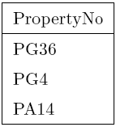
Property Query - First Attempt
First attempt: List the property numbers viewed by client number ‘CR56’:
    SELECT PropertyNo
    FROM Viewing
    WHERE ClientNo = 'CR56';
But we'd like to see the client name & property details
So we'll need to access Client and PropertyForRent for names etc...

Slide 5
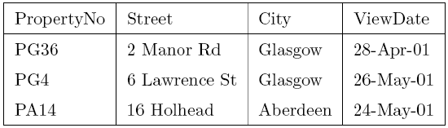
Property Query - Second Version
  SELECT Viewing.PropertyNo, Street, City, ViewDate
  FROM Viewing, PropertyForRent
  WHERE ClientNo = 'CR56'
  AND Viewing.PropertyNo = PropertyForRent.PropertyNo;
We now have two table names in the FROM clause
Note use of “Table.ColumnName" to avoid ambiguity in column names

Slide 6
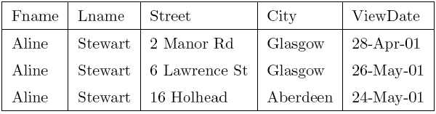
Property Query - Third Version
  SELECT Fname, Lname, Street, City, ViewDate
  FROM Viewing, PropertyForRent, Client
  WHERE Viewing.ClientNo = 'CR56'
  AND Viewing.PropertyNo = PropertyForRent.PropertyNo;
  AND Viewing.ClientNo = Client.ClientNo;
The two “AND" clauses are called join criteria

Slide 7
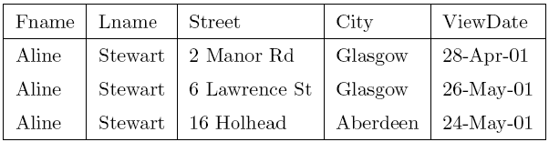
Property Query - Fourth Version
Users shouldn't have to know about internal keys...
  SELECT Fname, Lname, Street, City, ViewDate
  FROM Viewing, PropertyForRent, Client
  WHERE Fname = 'Aline' AND Lname = 'Stewart'
  AND Viewing.PropertyNo = PropertyForRent.PropertyNo;
  AND Viewing.ClientNo = Client.ClientNo;

Slide 8
Using Table Aliases
Table aliases can help reduce amount of typing
The following is identical to the previous query:
    SELECT C.Fname, C.Lname, P.Street, P.City, V.ViewDate
    FROM Viewing V, PropertyForRent P, Client C
    WHERE C.Fname = 'Aline' AND C.Lname = 'Stewart'
    AND V.PropertyNo = P.PropertyNo
    AND V.ClientNo = C.ClientNo;
Table aliases help reduce the risk of typing mistakes
But shouldn't the DBMS know how to match keys for us?

Slide 9
Natural Joins
Natural joins implement relationships in the Relational model
The DBMS will know which columns are key columns
The following is equivalent to the previous query:
    SELECT C.Fname, C.Lname, P.Street, P.City, V.ViewDate
    FROM Client C NATURAL JOIN
    (Viewing V NATURAL JOIN PropertyForRent P)
    WHERE C.Fname = 'Aline' AND C.Lname = 'Stewart';
Most DBMSs support 4-table joins, or more...

Slide 10
ANSI SQL Syntax for Joins
ANSI SQL allows joins to be written in different ways:
Natural joins:
  SELECT * FROM Left NATURAL JOIN Right;
  SELECT * FROM Left JOIN Right USING ColNam;
If not joining on keys, give join condition explicitly:
  SELECT * FROM Left JOIN Right
  ON Left.ColNam = Right.ColNam;
Which is best ? - Make up your own mind !!

Slide 11
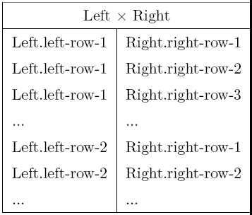
Cross Joins (Cartesian Products)
Cartesian Product: a join with no WHERE clause
    SELECT * FROM
    Left, Right;
ANSI SQL allows:
    SELECT * FROM
    Left CROSS JOIN Right;
Useful for:
  query optimisation
  data mining

Slide 12
Theta Joins
“Theta joins" have a more general WHERE predicate:
    SELECT L.*, R.*, ...
    FROM Left L, Right R
    WHERE L.LeftCol Θ R.Rightcol;
Θ may be one of =; ! =; <>; <; >; <=; >=
If Θ is =, its an equi join
If Θ is = and columns are key columns its a natural join
If all output columns are from one table, its a semi join

Slide 13
Example of a Theta Join
For all clients, list the properties that each client can afford to rent:
    SELECT C.ClientNo, P.PropertyNo
    FROM Client C, PropertyForRent P
    WHERE C.MaxRent >= P.rent;
The DBMS could implement theta joins by:
  First forming a cross join to give...
  An intermediate (Cartesian product) table..
  Then applying WHERE clause to find matching rows
  ...but there are more efficient ways...

Slide 14
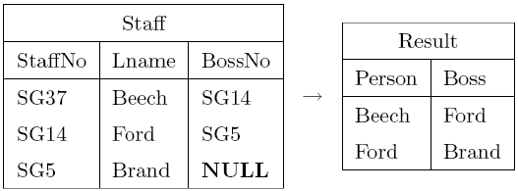
Self-Joins
Sometimes it is useful to join a table to itself (must use aliases)
      ALTER TABLE Staff ADD COLUMN BossNo CHAR(5);
      SELECT S.Lname AS Person, B.Lname as Boss
      FROM Staff S, Staff B
      WHERE S.BossNo = B.StaffNo;

Slide 15
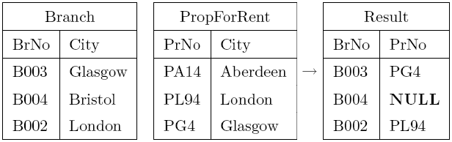
Outer Joins
(Selecting unmatched rows)
Example: List the branch offices and properties in the same city, along with any unmatched branches:
    SELECT B.BrNo, P.PropNo
    FROM Branch B LEFT JOIN PropForRent P
    ON B.City = P.City;
NB. Not all DBMSs (e.g. MS Access) support outer joins

Slide 16
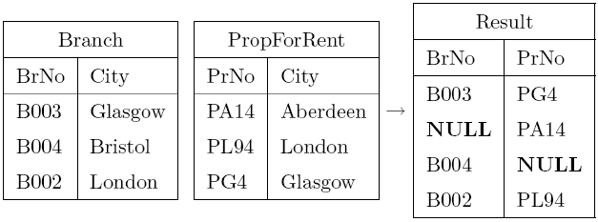
Right Outer Joins & Full Outer Joins
In a similar manner, can use RIGHT JOIN and FULL JOIN (meaning full outer join):
    SELECT B.BrNo, P.PropNo
    FROM Branch B FULL JOIN PropertyForRent P
    ON B.City = P.City;

Slide 17
Why So Many Types of Join ?
Theta join - a join using a simple WHERE predicate
Equi join - a special case of theta join (= predicate)
Natural join - special case of equi join (match keys)
Semi join - theta join that outputs from just one table
Self join - joining a table to itself
Outer join - a join that may include unmatched rows
cross join - Cartesian products (no predicates)
Question: Why do we need to distinguish so many different types of join ?
Answer: Queries with different joins are often optimised
differently...

