Slide 1
Database Design: ER Modelling
Reading: C&B, Chaps 10, 11 & 12

Slide 2
In this lecture you will learn
Database system development lifecycle
Phases of database design
Relational Database design
Introduction to ER Modelling

Slide 3
Database System Lifecycle
Database Planning – project planning
System definition – user views and context
Requirements collection and analysis
  Several fact-finding techniques (C&B, Chap 10)
Database design
DBMS selection (optional)
Application design
Prototyping (optional)
Implementation
Data conversion and loading
Testing
Operational maintenance

Slide 4
Database Design
Process of fitting a database solution to client’s requirements
Client’s requirements will never be mathematically ‘crisp’
So, not possible to fit a unique solution mathematically
Our approach
  use semi-formal methods to arrive at an initial design
  Use iterative refinement to improve the design
Design process is subjective and creative
  Each of us may propose a different design for the same client requirements

Slide 5
Phases of Database Design
Database design achieved in three phases
  Conceptual – model data independent of all physical considerations
  Logical – refine and map conceptual model onto relational model (or some other database model such as object-oriented )
  Physical – map logical model onto a specific DBMS (say, MySql)
In simple domains where we have good understanding of the domain data, we may not use the three phase method
  We open MSAccess (or any other RDBMS) and directly define tables and their links
For real world applications, you should use the three phase method
A good design facilitates efficient storage and retrieval of data

Slide 6
Relational Database Design
In this course, the logical design is based on relational model (see lecture 2)
This means, given a conceptual design of a domain (such as DreamHome) , logical design involves
  Designing a collection of connected (linked) tables in which the domain data is stored and
  The table design facilitates SQL to work with these tables
    Insert, update, delete and select operations must be efficiently run
In this course, we will focus on Conceptual and Logical phases of database design
  These two phases decide the relational table structure and the links among them

Slide 7
Database Design – DreamHome Example
Conceptual design - Modelling data in the domain (as shown in the slide #8)
  What are the individual data concepts?
    Staff – name, position etc
    Properties – address, rant etc
    Branches - address
    Clients – name, contact etc
  How are these items related?
    E.g. staff manage properties and
    staff work at a branch
Logical Design - Given the conceptual design, logical design involves (as shown in the slide #9)
  Designing individual tables such as Staff and Branch and
  Link these tables using foreign keys (to mark the relationships)
Physical Design – Given the logical design, physical design involves (as shown in the slide #9)
  Implementing the logical design in MSAccess (a specific RDBMS)

Slide 8
Conceptual Design of DreamHome
PropertyForRent
----------------------
PropertyNo
Branch
---------------
BranchNo
Owns
Owner
----------------
OwnerNo
ViewedBy
Client
---------------
ClientNo
Registration
Staff
---------------
StaffNo
Manages
Note: Many Details not shown to avoid clutter

Slide 9
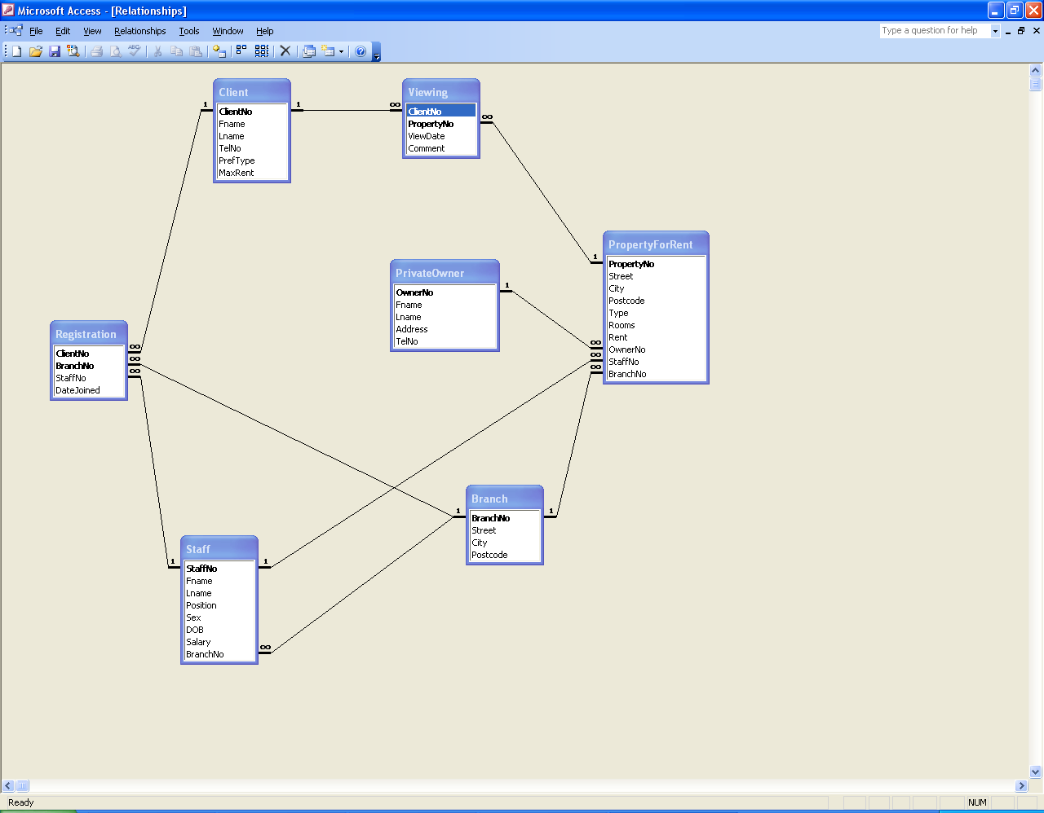
Logical (Relational) Design of DreamHome
Link (Relationship)
Table
Table

Slide 10
Observations from DreamHome Design
Two levels of design
  Conceptual design (slide #8)
  Logical (Relational) design (slide #9)
  Relational design uses information from conceptual design
    Without the information from conceptual level relational design is not possible
Tables at relational level are obtained from both entities and relationships (formally introduced later) at conceptual level
  Staff table derived from Staff Concept from conceptual design
  Viewing table derived from ViewedBy relationship from conceptual design
Links between tables at relational level are obtained from relationships at conceptual level

Slide 11
Conceptual Design
Model data independent of DBMS, application programs, programming languages, hardware platform etc.
We want to have a common understanding of how data is viewed and used by different people in client’s organization
Understanding the structure and meaning of data in the domain
  Each user’s perspective of the data
  Nature of the data itself, independent of its physical representations
  Use of data across user views
The output model may well be used for other purposes
  Such as offering a paper based data management!!!!
Conceptual design = ER Modelling

Slide 12
ER Modelling
Models a domain of discourse
Central Ideas
  Domains are made up of entities
  Relationships link associated Entities
  Entities and relationships have properties called attributes
  Certain attributes are special, call them primary keys and alternate keys
  Need integrity constraints to preserve domain consistency
Deliverables
  ER Models - documented diagrammatically
  Data dictionary
Documentation is an important component of ER modelling

Slide 13
Entity Type
A group of objects with the same properties, which are identified by the enterprise as having an independent existence
  not a formal definition
  Different designers may identify different entities
Entity Occurrence – a uniquely identifiable object of an entity type
Can have physical existence
  For example, Staff, Property, Customer
Can have conceptual existence
  For example, Viewing and Inspection

Slide 14
Entity type - Diagrammatic representation
A rectangle labelled with the name of the entity
  First letter of each word in the entity name is uppercase
    E.g., PropertyForRent
  Normally an entity type is named using a ‘noun’ or ‘noun phrase’
PropertyForRent

Slide 15
Relationship Types
A set of meaningful associations among entity types
For example, ‘Branch’ and ‘Staff’ can be associated with a relationship ‘Has’
Relationship occurrence – a uniquely identifiable association, which includes one occurrence from each participating entity type

Slide 16
Relationship type – diagrammatic representation
Shown as a line connecting the associated entity types, labelled with the name of the relationship
  First letter of each word in the entity name is uppercase
  Normally a relationship is named using a ‘verb’ or ‘verb group’
  The direction in which the relationship makes sense is marked using an ‘arrow’
Staff
Has
Branch
‘Branch has staff’

Slide 17
Degree of Relationship type
The number of participating entity types in a relationship
Relationships can be classified based on their degree into
  Binary – relationship with two participants
  Ternary – relationship with three participants
  Quaternary – relationship with four participants

Slide 18
Diagrammatic representation of relationships with degree > 2
A diamond is used to represent ternary and quaternary relationships
Staff
Registers
Branch
Client
‘Staff registers a client
at a branch’

Slide 19
Attributes
A property of an entity or a relationship type
For example, Staff has 4 attributes
  StaffNo
  Name
  Position
  Salary

Slide 20
Diagrammatic Representation of attributes
Entity rectangle is divided into two parts
  Upper part displays the entity name
  Lower part displays the list of attributes
  Normally an attribute is named using an ‘noun’ or ‘noun group’
Primary key should be the first in the list
Staff
StaffNo {PK}
Name
Position
Salary

Slide 21
Conclusion
Database design is an iterative process
ER Modelling is industry standard
Learning ER Modelling involves
  Learning to identify entities, relationships, attributes from requirements specification and other client supplied documents
  Documenting in a standard form for effective communication
More ER Modelling next week

