Slide 1
Database Design: ER Modelling (Continued)
Reading: C&B, Chaps 11,12&16

Slide 2
In this lecture you will learn
Structural constraints
Enhanced ER modelling
Step-by-step procedure for conceptual data modelling

Slide 3
Structural constraints
Apply on the entity types that participate in a relationship
Come from the real world constraints in client’s domain
We focus on binary relationships which have two participating entity types
Three types of binary relations
  one-to-one – 1:1
  one-to-many – 1:*
  many-to-many - *:*

Slide 4
Diagrammatic Representation of 1:1 relationships
For example, Staff Manages Branch
Meaning
  At least one and a maximum of one staff manages a branch
  A member of staff manages zero or one branch
Staff
Manages
Branch
1..1
0..1

Slide 5
Diagrammatic representation of 1:*
For example, Staff oversees PropertyForRent
Meaning
  At least zero and a maximum of one staff oversees a property
  A member of staff oversees zero or many properties
Staff
Oversees
PropertyForRent
0..1
0..*

Slide 6
Diagrammatic representation of *:*
For example, NewsPaper Advertises PropertyForRent
Meaning
  At least zero and a maximum of many newspapers advertise a property
  A newspaper advertises one or many properties
Newspaper
Advertises
PropertyForRent
0..*
1..*

Slide 7
Multiplicity Range – Min..Max
Used to specify the number of possible occurrences of each participating entity type in a relationship
Multiplicity range is for this specification has two parts
  Min
  Max
  For example, for a multiplicity range of 0..1
    Min = 0
    Max = 1
Max of a multiplicity range denotes Cardinality
Min of a multiplicity range denotes Participation

Slide 8
Enhanced ER (EER) Modelling
ER modelling does not capture all the semantics of client’s domain, such as
  ‘ISA’ (‘is a’) relationship or specialization-generalization
    ‘Manager’ entity type ‘is a’ subentity of ‘Staff’ entity
  ‘HASA’ (‘has a’) relationship or ‘is-part-of’ relationship or aggregation
    A relationship between the ‘whole’ and the ‘part’
    Branch (whole) Has Staff (part)
    Composition is a special form of aggregation – ‘part’ is strongly owned by the ‘whole’
Enhanced ER models represent the above relationships
  Therefore capture client’s domain more comprehensively

Slide 9
Diagrammatic Representation of ‘ISA’ relationship
Staff
staffNo {PK}
name
position
salary
Superclass
Subclass
{Optional, Or}
Specialization/generalization indicator
Constraints
Manager
Supervisor
mgrStartDate
bonus

Slide 10
Diagrammatic Representation
Aggregation
Composition Indicator
Staff
Has
Branch
staffNo
branchNo
Aggregation indicator
Part
Whole

Slide 11
Summary So far ….
ER modelling technique helps us to model data from any domain
The main components are
  Entities
  Relationships
  Attributes
  Multiplicity constraints
  Superclass-subclass relationships
  Diagrammatic notations for all the above
You will also learn some details about ER modelling in the practical
  Some aspects of ER Modelling such as relationship modelling are better learnt with examples
We need to now learn how to use this knowledge to actually model data from a particular domain
  We use a step-by-step procedure as described next
  This means we build EER models incrementally

Slide 12
Step-by-step procedure for conceptual design
Identify entity types
Identify relationship types
Identify and associate attributes with entity or relationship types
Determine attribute domains
Determine candidate, primary and alternate key attributes
Consider use of enhanced modelling concepts (optional)
Check model for redundancy
Validate conceptual model against user transactions
Review conceptual data model with user
We will focus on only some of these steps (see C&B for more)

Slide 13
Identify entity types
No well defined procedure
  Take a very selective view of the world
Determine the main concepts in the domain about which the database has to store data
In the user requirement specification, identify
  Nouns and noun phrases
  Places, people and concepts
  Objects with independent existence
  Watch out for synonyms and homonyms
Draw the entity types in the ER diagram
Document entity details in the data dictionary

Slide 14
Example
In the DreamHome domain the main concepts are:
  Property For Rent – the whole business revolves around this concept
  Client – once again an important concept for the business
  Owner of the property
  Staff and the Branches they manage

Slide 15
Identify relationship types
Determine the relationships among the entity types identified in the previous step
  Relationships may open up new entity types!!
In the user requirement specification, identify
  Verbs and verb groups (verbal expressions)
  First identify binary relationships
  Only then identify complex relationships
  Check the possibility of a relationship between each pair of entity types
    Time consuming but possible on smaller design problems
  Determine the structural constraints
Draw the relationship types in the ER diagram
Add information about structural constraints to the ER diagram
Document relationship details in the data dictionary

Slide 16
Specify Structural Constraints
A relationship has some participating entities
  E.g. Staff manage Branch has Staff and Branch as the participating entities
The main task in relationship specification is to specify structural constraints (min-max constraints) on the participating entities
  E.g. Many Staff might manage a Branch
These constraints specify how many instances of data from one participating entity correspond to one instance from the other participating entity
  E.g., One Branch may have many Staff

Slide 17
Identify and associate attributes (I)
For each entity/relationship identified in the previous steps
  Determine required information about that entity/relationship
  if an attribute is composite
    If the user wants to access parts of the composite attribute
      Represent it in terms of the constituent simple attributes
  If an attribute is multi-valued
    Model it as a separate entity at this stage Or
    Leave it alone at this stage - logical design process will anyway model it as a separate relation

Slide 18
Identify and associate attributes (II)
Alternatively make a list of attributes from user requirements specification
Tick them off the list as you associate them with an entity/relationship
When attributes appear to be associated with more than one entity/relationship, either
  have a potential relationship between the entity types
  Or have a case for applying generalization/specialization
Add attribute information to the ER diagram and data dictionary

Slide 19
Guidelines for identifying primary key
The candidate key with the minimal set of attributes
The candidate key that is least likely to have its values changed
The candidate key with fewest characters
The candidate key with smallest maximum values
The candidate key that is easiest to use from the user’s point of view

Slide 20
Putting it all together
So far we have learnt step-by-step procedure for collecting data models of components of the conceptual design
These component data models need to be put together into an ER diagram showing the overall data model for the domain
In the next slide we show one possible data model for the DreamHome domain.
  Please note that in the earlier lecture and the practical (practical 4) you will see several data models for the DreamHome domain
  Each of them may capture the domain requirements to a different degree of accuracy

Slide 21
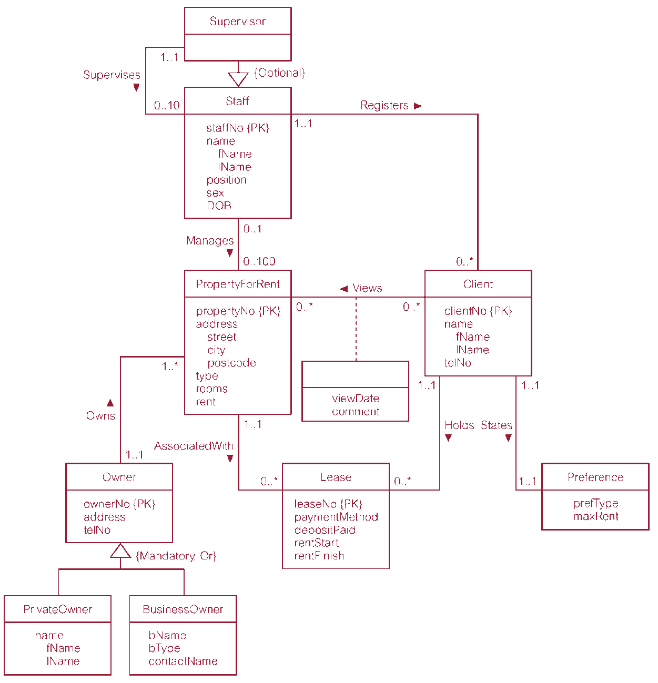
Conceptual Design of DreamHome

Slide 22
Transaction pathways
An approach to validate EER model
  by manually executing user specified transactions
The entities and relationships involved in the execution are directly marked on the EER diagram
  Not possible for large number of transactions – the diagram will become unreadable
Useful visualization showing
  areas of the diagram that are essential for transactions and
  areas of the diagram that are not required for transactions

Slide 23
Summary
Conceptual design yields an EER Model
EER Model
  is a high level description of data
  represent data semantics in a way that non-experts (client’s) can read them and validate them (hopefully!)
  is subjective – depends upon the selective view of the data taken by the designer
    Entity vs attribute dilemma, entity vs relationship dilemma, binary vs tertiary relationship dilemma and so on

