Slide 1
Logical Database Design
Reading: C&B, Chap 17

Slide 2
In this lecture you will learn
What is logical database design
Step-by-step procedure for logical database design
  Focusing mainly on making decisions about posting foreign keys in designed tables

Slide 3
Logical database design
Derive a logical model from the information represented in the ER model (conceptual model)
Validate the logical model to check if it fulfils client’s
  data and
  transaction requirements
We focus on one type of logical model which is relational model
  In this course, Logical model = relational model
Recall the notion of relational model from lecture 2
  Collection of connected tables

Slide 4
From ER Model to Relational Model
Our method of designing relational (logical) model uses information from ER Model
  We assume that ER modelling is performed before relational modelling
Informally, ER Model
  Partitions information in a domain into Entities (boxes) and attributes
  Links entities up into a network to reflect the relationships from the real world domain
  The network of entities represents the real world domain
Informally, relational model
  Partitions information into tables (relations)
  Links tables up into a network to reflect the relationships existing among data
  The network of tables store data from the real world domain
We can notice similarities between ER Models and Relational Models
  Entities correspond to Tables (relations)
  Network of entities correspond to network of tables
We exploit these similarities to carry out relational database design

Slide 5
Step-by-step procedure for Logical database design
Derive relations for logical data model
Validate relations using normalization
Validate relations against user transactions
Check integrity constraints
Review logical data model with user
Merge logical data models into global model (optional)
Check for future growth
We focus on the first two steps

Slide 6
Entities & their Attributes
Individual tables are derived from strong entities (entities with a clear Primary key)
Fields in the tables are derived from attributes associated with entities
  Define the data types of the fields
Define the primary key of the table
  Criteria discussed in the previous lecture
Foreign keys are decided later while modelling the relationships
  Not all tables (relations) have foreign keys
  At this stage, however, bear in mind that relation model is incomplete without deciding foreign keys

Slide 7
Example
Consider the Staff entity in the DreamHome domain
  Staff can be represented as a table at the relational level as
Staff (staffNo, fName, lName, Position)
Primary Key staffNo
Or
Staff
StaffNo {PK}
fName
lName
Position

Slide 8
Relationships and their Attributes
Modelling relationships at the relational (logical) level involves a good understanding of the nature of the relationships
Recalll that relationships can have different degrees – the number of entities participating in the relationship
  Binary relationships have two entities participating in the relationship
  Complex relationships have greater than two entities participating in the relationship
Binary relationships are modelled differently from complex relationships

Slide 9
Binary Relationships
Binary relationships can be
  One-to-one(1:1)
  One-to-many(1:*)
  Many-to-many(*:*)
Each of these is modelled differently
Understanding 1:* type is particularly important
  Many real world relationships are of type 1:*

Slide 10
One-to-many (1:*) relationships
These are the most common type of relationships
Also known as ‘parent:child’ relationship
  ‘One’ parent can have ‘many’ children
  The entity on the ‘One’ side of the relationship is known as the Parent entity
  The entity on the ‘many’ side is known as the Child entity
Our task: how 1:* relationship between two entities at ER Model level is represented in a relational model
  We assume that both the participating entities are modelled as tables ( as explained earlier)
  Do we make any changes to these tables to reflect the relationship between them?
    Yes, we use a foreign key to mark the relationship
  Recall that while modelling entities (as explained earlier) we have postponed foreign key decision
  We make foreign key decision while modelling 1:* relationship

Slide 11
Foreign Key Design
In a 1:* relationship
  Foreign key is designed as a column in the child table (table one the * side)
  Foreign key references the parent table (table on the 1 side)
In other words, when you post a foreign key to a table it means
  This table is the child table and
  For every row in the parent table, this table may have more than one (many) corresponding rows
Create a few rows of data in the tables participating in the 1:* relationship and check if the foreign key is acting as a link for information from the child table to the information from the parent table
  Example data is always useful in designing foreign keys

Slide 12
Example
Consider the 1:* relationship Oversees between Staff and PropertyForRent
In this case,
  Staff is the Parent entity
    Because it is on the ‘one’ side of the relationship
  PropertyForRent is the child entity
    Because it is one the ‘many’ side of the relationship
When we model this relationship at the relational level
  We assume that Staff and PropertyForRent are modelled as tables as discussed earlier
  We post a copy of the PrimaryKey, StaffNo from the Parent entity, Staff as a foreign key in the child entity,PropertyForRent
Our final tables are
  Staff(StaffNo, lName, fName, Position)
  Primary key StaffNo
  PropertyForRent(PropertyNo, Street, Town, StaffNo)
  Primary key ProperrtyNo
  Foreign key StaffNo references Staff(StaffNo)
Staff
Oversees
PropertyForRent
0..1
0..*

Slide 13
Many-to-many (*:*) Relationships
There are two methods to tackle *:* relationships
First method: At the ER level, replace the *:* relationship to equivalent 1:* relationships
  Then model the resulting 1:* relationships as explained earlier
  In this method *:* relationship is reduced to two equivalent parent:child relationships
Second method: Create a new table to represent the relationship
  We assume that the two entities participating in the relationship are already modelled as tables as explained earlier
  The third table is created to represent the relationship
Both methods result in similar solutions
  Three tables, where one of the tables (relationship table) links both the entity tables through foreign keys

Slide 14
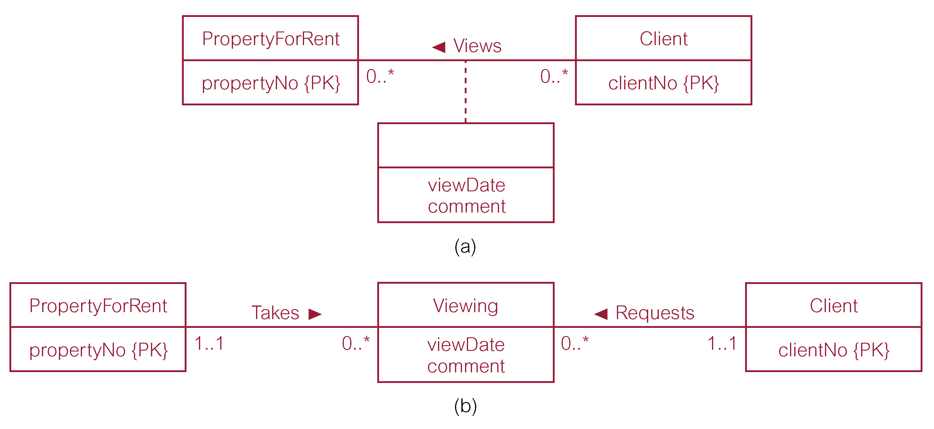
Example: First Method for modelling *:* relationship
(a) in the above figure shows the *:* views relationship between PropertyForRent and Client
(b) shows an equivalent ER model that creates
  Viewing as a new entity representing the relationship and
  Takes and Requests as two new relationships of the type 1:*
Now model Viewing (entity), Takes and Requests (1:* relationships) as explained earlier

Slide 15
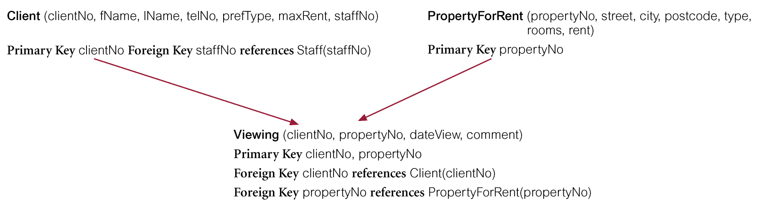
Example: Second Method for modelling *:* relationship
Here, the *:* relationship between Client and PropertyForRent is directly represented as a new table viewing
Primary key for the new entity includes the two foreign keys from the two participating entities
Note: Please check that both methods lead to the same tables

Slide 16
One-to-one (1:1) relationships
Generally, in relationship modelling we always identify the parent table
  Then post a copy of its primary key as the foreign key in the child table
In this case of 1:1, max (cardinality) constraints which are 1:1 do not help to identify the parent table
Therefore we use min (participation) constraints to identify the parent table
For example, we choose the entity with min value zero as the parent entity, if the other participating entity has min value of one
  Similar rules can be found in C&B (16.1) for other cases of modelling 1:1 relationships

Slide 17
Complex Relationships
Complex relationships too can be simplified into simpler 1:1 or 1:* relationships first and then modelled at the logical level
Alternatively, a new table can be created to represent a complex relationship and
Foreign keys are posted in the new table from all the participating entities

Slide 18
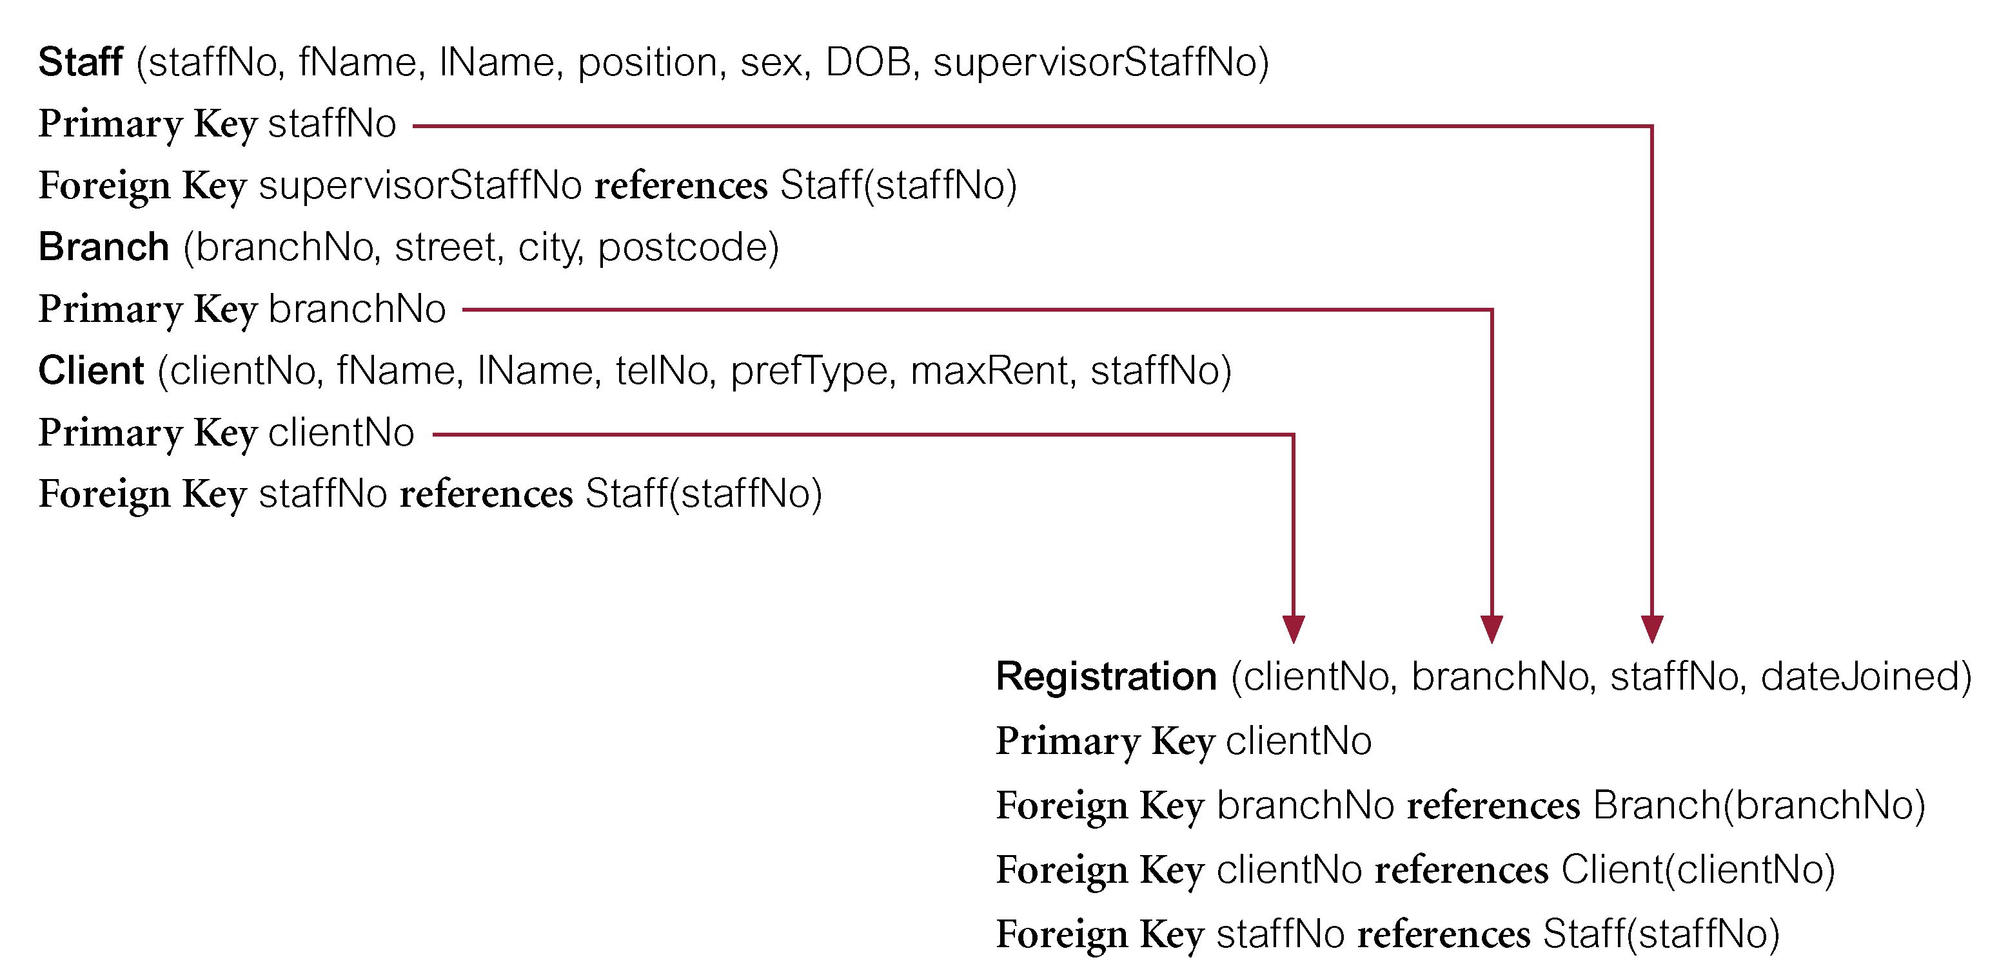
Example: Complex relationship
A new table Registration is created and Foreign keys are posted in the Registration table from all the participating entities

Slide 19
Superclass/subclass relationships
In modelling the previous cases of relationships we focused on identifying the parent table in the relationship
  Because its copy of the primary key is posted as the foreign key in the child table
Modelling superclass/subclass relationship is not about identifying foreign key
In this case, the focus is on deteriming the number of tables required to store the data corresponding to the classes and subclasses
We once again use constraints defined on the superclass/subclass relationships
  Please refer to C&B (16.1) for details

Slide 20
Conclusion
Mapping from conceptual model to logical model mainly involves
  Designing tables with primary keys
  And linking tables with foreign keys
Quality of the relations (tables) derived from ER models is unknown
We need notions that distinguish good designs from bad designs – Normalization!!

