Slide 1
Database Security Issues
Reading: CB, Ch 20

Slide 2
In this lecture you will learn
The value of maintaining a secure & reliable database
Some of the sources of risk (i.e. threats) to a database system
Some of the measures used to improve DBMS security
The special threats and counter-measures wrt web-based DBMSs

Slide 3
Data - Information - Is Valuable
Many enterprises depend on secure & reliable DBMSs:
  Banks, the stock exchange, airlines, hospitals, ...
DBMS systems may be at risk from situations such as:
  Theft, fraud
  Loss of confidentiality (business secrets) – loss of competitiveness
  Loss of privacy (personal information) – legal implications
  Loss of integrity – corrupted data
  Loss of availability
Insecure DBMS worse than having no DBMS at all
  Low staff and customer confidence
  High regulatory fines

Slide 4
Potential Sources of Risk - Threats
Examples of hardware & software threats are:
  Hardware - breakdown, theft, fire, flood, power loss...
  Software - bugs, unexpected features (includes OS)
  Communications - wiretapping, packet sniffers, packet loss
Probably the greatest threats are from people:
  Programmers - insecure code
  DBAs - trapdoors, fake accounts
  Users - mistakes, hacking, blackmail
Which group do you think poses the greatest threat?
Impact of an event is important but not the event’s occurrence probability
  Rare events may pose more risk!!!
Notes:
Activity: discuss types of threats, risks

Slide 5
Security risks
‘tailgating’
Doors being left open
Levering doors, cheap partition walls/skylights
Cheep alarm/monitoring systems/magnetic locks
Database intrusion

Slide 6
Common Security Measures
Authorization - privileges, views
Authentication – passwords
Verification - digital signatures/certificates
Encryption - public key / private key, secure sockets
Integrity – IEF (Integrity Enhancement Features), transactions
Backups - offsite backups, journaling, log files
RAID (Redundant Array of Independent Discs) discs - data duplication, “hot swap” discs
Physical - data centres, alarms, guards, UPS
Logical - firewalls, net proxies
Note: The security of a component is as good as the security of the weakest link in the whole system
Notes:
Activity: discuss how secure are passwords, pin numbers, finger prints?
Activity: missing audits

Slide 7
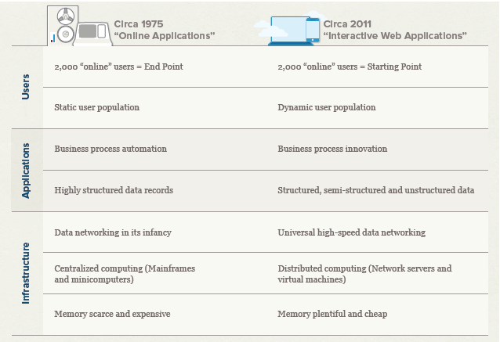
Interactive software has changed: implications for database security
Source: http://odbms.org/download/NoSQL-Whitepaper-1.pdf
Notes:
Also see http://www.couchbase.com/sites/default/files/uploads/all/whitepapers/NoSQL-Whitepaper.pdf

Slide 8
Interactive software has changed: implications for database security
That was 5 years ago
5 years is a long time in CS
Notes:
Also see http://www.couchbase.com/sites/default/files/uploads/all/whitepapers/NoSQL-Whitepaper.pdf

Slide 9
Encryption - Symmetric Keys
DES - Data Encryption Standard; 56-bit keys, fast but breakable
Symmetric Key: use same key to encrypt and decrypt...
This is OK if A and B are physically nearby
But on the internet, there's a serious problem!!
Key
Plain
Text
Encryption
Algorithm
Cypher
Text
Cypher Text
A
B
Key
???

Slide 10
Encryption - Private Key / Public Key
Asymetric encryption
  Public key encodes a message...
  Private key decodes it...
Above, A (sender) first asks B (receiver) for public key...
Then, A can encrypt message with B's public key
Rivest, Shamir, Adelman (RSA): slow but unbreakable
RSA - Uses massive prime numbers (128-bit keys)
PGP – “Pretty Good Privacy” combines DES + RSA
A’s Public Key
B’s Public Key
Cypher Text
A
B
B’s Public Key
B’s Private Key

Slide 11
Digital Signatures
Digital signatures (RSA in reverse):
  Establishes authenticity of a document
  "Hi, this message is in clear text but if
  anyone changes even a single byte, you will
  be able to tell that the message is not the
  original from the digital signature below,
  signed with my private key. Yours, D.“
  BEGIN SIGNATURE
  P4`341uy2rl34iut1lf,jbf,KPP98$\%\#!\$"BV!"X#
  END SIGNATURE
Problem: How can we verify authenticity of sender ??

Slide 12
Digital Certificates
Digital Certificates use a trusted third party called a “Certificating Authority” (CA).
If A & B both trust CA, then A & B can trust each other
Often used to set up secure connections: HTTPS, SSL
Once certificates exchanged, can then use RSA etc.
Certificating Authority
CertA
CertB
Trust
CertB
CertA
A
PubA
PubB
B

Slide 13
NSA Recommends for 2016
Algorithm | Usage
RSA 3072-bit or larger | Key Establishment, Digital Signature
Diffie-Hellman (DH) 3072-bit or larger | Key Establishment
ECDH with NIST P-384 | Key Establishment
ECDSA with NIST P-384 | Digital Signature
SHA-384 | Integrity
AES-256 | Confidentiality

Slide 14
Firewalls
The Internet
Firewalls block unauthorised external network access
Firewalls may limit access to the internet for ‘internal’ machines
Firewall
??
Internal Network
Internal
Client
Internal
Client
DBMS
Server

Slide 15
Example Firewall Architecture
The Internet
Bastions
Router
WWW
Mail
Proxy
Perimeter Network
Router
Internal Network
“Bastion Hosts” run web services etc. (liable to attack)
Routers connect networks...
Internal router is main “firewall”

Slide 16
Firewall Techniques
Use a proxy server to hide internal network addresses:
General guidelines:
  Disable all user accounts on all Bastion machines
  Preferably, run only one type of service on each Bastion machine
Software firewalls:
  Can have “all-software” firewalls (packet filters)
  Until MS-Blast virus, Microsoft shipped Windows-XP with firewall off by default!!
22.33.44.55
Proxy
SE.CR.ET.!!

Slide 17
Other security considerations (1)
SQL injection
  Example 1
    statement = "SELECT * FROM users WHERE name = '" + userName + "';“
    ' or '1'='1’ –- ‘
    SELECT * FROM users WHERE name = '' OR '1'='1' -- ';
  Example 2
    a';DROP TABLE users; SELECT * FROM userinfo WHERE 't' = 't
    SELECT * FROM users WHERE name = 'a';DROP TABLE users; SELECT * FROM userinfo WHERE 't' = 't';
  PHP’s mysql_query(); does not allow multiple statements
    $query = sprintf("SELECT * FROM `Users` WHERE UserName='%s' AND Password='%s'", mysql_real_escape_string($Username), mysql_real_escape_string($Password)); mysql_query($query);

Slide 18
4-tier Architectures
User Interface Layer
Business Access Layer
Data Access Layer (compiled routines)
  Statements
  Procedures
Business Object Layer

Slide 19
Other security considerations (2)
Databases within Cloud computing
  Main concerns
    Service providers
    Customers
  Infrastructure opens unique concerns
    Relationship between OS and hardware altered by virtualization layer

Slide 20
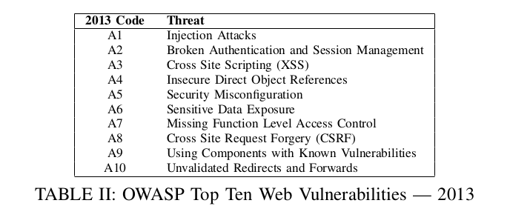
What is happening in the real world

Slide 21
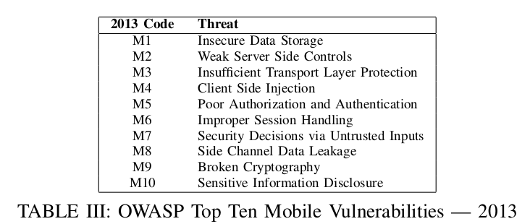
What is happening in the real world

Slide 22
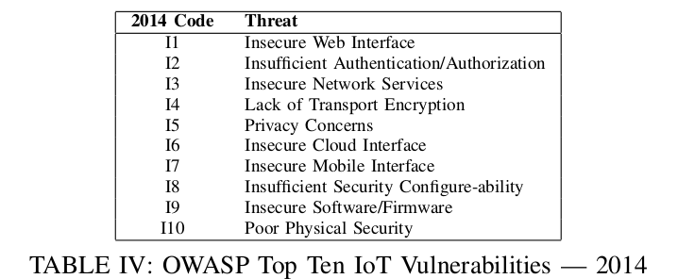
What is happening in the real world

Slide 23
Principle of least privilege
“The principle means giving a user account only those privileges which are essential to that user's work.”
(Source: http://en.wikipedia.org/wiki/Principle_of_least_privilege)
Social inclusion vs. Social exclusion

Slide 24
Summary
The best security comes from using multiple techniques:
  People - authorisation/authentication . .need-to-know.
  Physical - protect the hardware, RAID discs, backups
  Network - use firewalls, encryption
  Software – “good programming practice” main CS responsibility, use database activity monitoring (DAM)
For any given system:
  Consider the different sources of risk (threats)...
  Balance the cost of implementing security measures vs cost of any loss/recovery!!
  Review security regularly

