Slide 1
Query Processing
Reading: CB, Chaps 5 & 23

Slide 2
In this lecture you will learn
the basic concepts of Query Processing
how high level SQL queries are decomposed, analysed and executed
how to express basic SQL queries in Relational Algebra
why Relational Algebra is useful in query processing
the strategies query optimisers use to generate query execution plans

Slide 3
Query Processing Overview
Objective: Provide correct answer to query (almost) as efficiently as possible
Client
Server
SQL Query
Interpret Query
Metadata
Execute Query
Results
Tables
Indexes

Slide 4
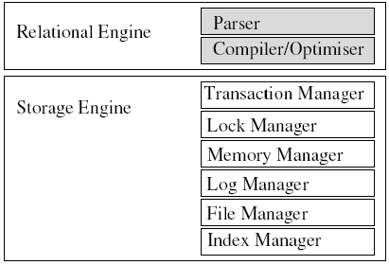
We Are Here!

Slide 5
Query Processing Operations
Query processing involves several operations:
  Lexical & syntactic analysis - transform SQL into an internal form
  Normalisation - collecting AND and OR predicates
  Semantic analysis - i.e. does the query make sense ?
  Simplification - e.g. remove common or redundant sub-expressions
  Generating an execution plan - query optimisation
  Executing the plan and returning results to the client
To describe most of these, we need to use Relational Algebra

Slide 6
Introducing Relational Algebra
What is relational algebra (RA) and why is it useful ?
  RA is a symbolic formal way of describing relational operations
  RA says how, as well as what (order is important)
  Can use re-write rules to simplify and optimise complex queries...
Maths example:
  a + bx + cx² + dx³; 3 adds, 3 multiplies, 2 powers;
  a + x(b + x(c + xd)); 3 adds, 3 multiplies.

Slide 7
Basic Relational Algebra Operators
The basic RA operators are:
  Selection σ; Projection π; Rename ρ
SQL: SELECT Lname FROM Staff
RA: π _{Lname} (Staff)
SQL: SELECT Lname AS Surname FROM Staff
RA: ρ_{Surname}(Lname) π _{Lname} (Staff)
SQL: SELECT Lname AS Surname FROM Staff WHERE Salary>1000
RA: ρ_{Surname}(Lname) π_{Lname} σ_{Salary>1000} (Staff)

Slide 8
Further Relational Algebra Notation
L R - natural join
L _{P} R - theta join with predicate P = L.a Θ R.b
L x R - Cartesian product
L U R - union
L ∩ R - intersection
P Q - conjunction (AND)
P Q - disjunction (OR)
~ P - negation (NOT)

Slide 9
Query Processing Example
Example: find all managers who work at a London Branch:
  SELECT * FROM Staff S, Branch B
  WHERE S.BrNo = B.BrNo
  AND S.Posn = 'Boss'
  AND B.City = 'London';
There are at least 3 ways of writing this in RA notation:
  σ S.Posn=‘Boss’ B.City=‘London’ S.BrNo=B.BrNo(SxB)
  σ S.Posn=‘Boss’ B.City=‘London’(S B)
  (σ _{S.Posn=‘Boss’}(S)) (σ _{B.City='London'}(B))
One of these will be the most efficient - but which??

Slide 10
Lexical & Syntactical Analysis &
Query Trees
Lexical & syntactical analysis involves:
  identifying keywords & literals
  identifying table names & aliases
  mapping aliases to table names
  identifying column names
  checking columns exist in tables
The output of this phase is a relational algebra tree (RAT)
Result
σ _{A^B^C}
X
S
B

Slide 11
Semantic Analysis
Does the query make sense?
  Is the query legal SQL?
  Is the RAT connected? - if not, query is incomplete!
Can the query be simplified? - for example:
  σ _{A^A}(R) = σ _{A}(R) (quite often with views)
  σ _{AvA}(R) = σ _{A}(R)
  σ _{A^~A}(R) = Empty set (no point executing)
  σ _{Av~A}(R) = R (tautology: always true)

Slide 12
Normalisation & Normal Forms
Normalisation re-writes the WHERE predicates as either:
  disjunctive normal form: σ_{(A^B)vC} = σ _{DvC}
  conjunctive normal form: σ_{(A^B)vC} = σ_{(AvC)^(BvC)} = σ _{D^E}
Why is this useful ? - sometimes a query might best be split into subqueries (remember set operations?):
Disjunctions suggest union:
σ _{AvB}(R) = σ _{A}(R) U σ _{B}(R)
Conjunctions suggest intersection:
σ _{A^B}(R) = σ _{A}(R) ∩ σ _{B}(R)

Slide 13
Some RA Equivalences Rules
(Re-Write Rules)
There are many equivalence rules (see CB p640-642). Here are a few:
σ _{A^B}(R) = σ _{A}(σ _{B}(R)) (cascade rule)
σ _{A}(σ _{B}(R)) = σ _{B}(σ _{A}(R)) (commutivity)
π _{A} π _{B}(R) = π _{A}(R) (if A is a subset of B)
σ _{P}(π _{A}(R)) = π _{A}(σ _{P}(R)) (if P uses cols in A)
σ _{P}(R x S) = R _{P} S (if P = L.a Θ R.b)
σ _{P}(R S) = σ _{P}(R) S (if P uses cols in R)
Usually, its ‘obvious’ which form is more efficient?

Slide 14
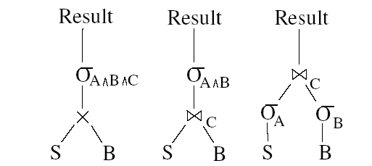
Generating Query Plans
Most RDBMSs generate candidate query plans by using RA re-write rules to generate alternate RATs and to move operations around each tree:
For complex queries, there may be a very large number of candidate plans...

Slide 15
Heuristic Query Optimisation Rules
To avoid considering all possible plans, many DBMSs use heuristic rules:
  keep together selections (σ ) on the same table
  perform selections as early as possible
  re-write selection on a cartesian product as a join
  perform “small joins” first
  keep together projections (π ) on the same relation
  apply projections as early as possible
  if duplicates are to be eliminated, use a sort algorithm

Slide 16
Cost-Based Query Optimisation
Remember, accessing disc blocks is expensive!
Ideally, the query optimiser should take into account:
  the size (cardinality) of each table
  which tables have indexes
  the type of each index - clustered, non-clustered
  which predicates can be evaluated using an index
  how much memory query will need - and for how long
  whether the query can be split over multiple CPUs

