Slide 1
File Organization & Indexing
Reading: C&B, Ch 18 & 23

Slide 2
In this lecture you will learn
How DBMS physically organizes data
Different file organizations or access methods
What is Indexing?
Different indexing methods
How to create indexes using SQL

Slide 3
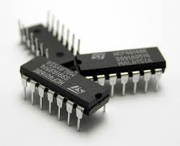
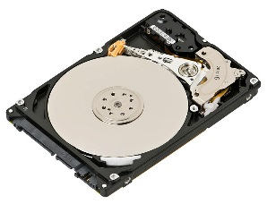
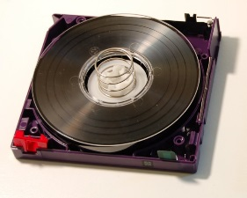
Introduction
DBMS has to store data somewhere
Choices:
  Main memory
    Expensive – compared to secondary and tertiary storage
    Fast – in memory operations are fast
    Volatile – not possible to save data from one run to its next
    Used for storing current data (10 GBs)
  Secondary storage (hard disk)
    Less expensive – compared to main memory
    Slower – compared to main memory, faster compared to tapes
    Persistent – data from one run can be saved to the disk to be used in the next run
    Used for storing the database (10 TBs, 2016)
  Tertiary storage (tapes)
    Cheapest
    Slowest – sequential data access
    Used for data archives (Sony 185 TB tapes, 2014)
Notes:
https://de.wikipedia.org/wiki/Linear_Tape_Open
https://simple.wikipedia.org/wiki/Integrated_circuit
https://en.wikipedia.org/wiki/Magnetic_tape_data_storage
https://en.wikipedia.org/wiki/Hard_disk_drive

Slide 4


Interior of ORACLE StorageTek tape library at NERSC (National Energy Research Scientific Computing Center, US)
Notes:
Source: https://www.nersc.gov/about/
Source: modified: 11-11-16, online: https://commons.wikimedia.org/wiki/File:Interior_of_StorageTek_tape_library_at_NERSC_(2).jpg

Slide 5
DBMS stores data on hard disks
This means that data needs to be
  read from the hard disk into memory (RAM)
  Written from the memory onto the hard disk
Because I/O disk operations are slow query performance depends upon how data is stored on hard disks
The lowest component of the DBMS performs storage management activities
Other DBMS components need not know how these low level activities are performed

Slide 6
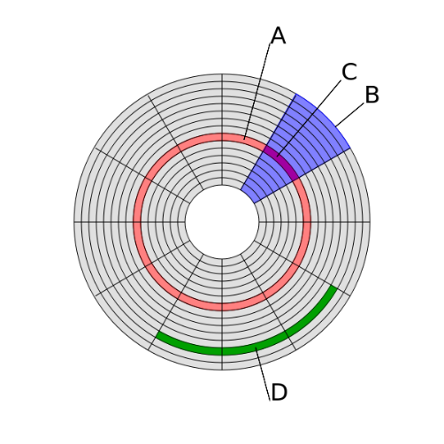
Basics of Data storage on hard disk
A disk is organized into a number of blocks or pages
  Track
  Sector
  Block
  Cluster
  Page
A page is the unit of exchange between the disk and the main memory
A collection of pages is known as a file
DBMS stores data in one or more files on the hard disk
E
File (KBs) = P1 + P2 + P3 + P4 + P5
MySQL File ranges from 8-64KBs
16KBs default database page size
P1
P2
P3
P5
P4
Notes:
Source: modified: 11-11-16, online: https://commons.wikimedia.org/wiki/File:Disk-structure.svg

Slide 7
Database Tables on Hard Disk
Database tables are made up of one or more tuples (rows)
Each tuple has one or more attributes
One or more tuples from a table are written into a page on the hard disk
  Larger tuples may need more than one page!
  Tuples on the disk are known as records
  Records are separated by record delimiter
  Attributes on the hard disk are known as fields
  Fields are separated by field delimiter

Slide 8
File Organization
The physical arrangement of data in a file into records and pages on the disk
File organization determines the set of access methods for
  Storing and retrieving records from a file
Therefore, ‘file organization’ synonymous with ‘access method’
We study three types of file organization
  Unordered or Heap files
  Ordered or sequential files
  Hash files
We examine each of them in terms of the operations we perform on the database
  Insert a new record
  Search for a record (or update a record)
  Delete a record

Slide 9
Unordered Or Heap File
Records are stored in the same order in which they are created
Insert operation
  Fast – because the incoming record is written at the end of the last page of the file
Search (or update) operation
  Slow – because linear search is performed on pages
Delete Operation
  Slow – because the record to be deleted is first searched for
  Deleting the record creates a hole in the page
  Periodic file compacting work required to reclaim the wasted space

Slide 10
Ordered or Sequential File
Records are sorted on the values of one or more fields
  Ordering field – the field on which the records are sorted
  Ordering key – the key of the file when it is used for record sorting
Search (or update) Operation
  Fast – because binary search is performed on sorted records
  Update the ordering field?
Delete Operation
  Fast – because searching the record is fast
  Periodic file compacting work is, of course, required
Insert Operation
  Poor – because if we insert the new record in the correct position we need to shift all the subsequent records in the file
  Alternatively an ‘overflow file’ is created which contains all the new records as a heap
  Periodically overflow file is merged with the main file
  If overflow file is created search and delete operations for records in the overflow file have to be linear!

Slide 11
Hash File
Is an array of buckets
  Given a record, r a hash function, h(r) computes the index of the bucket in which record r belongs
  h uses one or more fields in the record called hash fields
  Hash key - the key of the file when it is used by the hash function
Example hash function
  Assume that the staff last name is used as the hash field
  Assume also that the hash file size is 26 buckets - each bucket corresponding to each of the letters from the alphabet
  Then a hash function can be defined which computes the bucket address (index) based on the first letter in the last name.

Slide 12
Hash File (2)
Insert Operation
  Fast – because the hash function computes the index of the bucket to which the record belongs
    If that bucket is full you go to the next free one
Search Operation
  Fast – because the hash function computes the index of the bucket
    Performance may degrade if the record is not found in the bucket suggested by hash function
Delete Operation
  Fast – once again for the same reason of hashing function being able to locate the record quick

Slide 13
Indexing
Can we do anything else to improve query performance other than selecting a good file organization?
Yes, the answer lies in indexing
Index - a data structure that allows the DBMS to locate particular records in a file more quickly
  Very similar to the index at the end of a book to locate various topics covered in the book
Types of Index
  Primary index – one primary index per file
  Clustering index – one clustering index per file – data file is ordered on a non-key field and the index file is built on that non-key field
  Secondary index – many secondary indexes per file
Sparse index – has only some of the search key values in the file
Dense index – has an index corresponding to every search key value in the file

Slide 14
Primary Indexes
The data file is sequentially ordered on the key field
Index file stores all (dense) or some (sparse) values of the key field and the page number of the data file in which the corresponding record is stored
B002 | 1
B003 | 1
B004 | 2
B005 | 2
B007 | 3
Branch B002 record Branch B003 record
Branch B004 record Branch B005 record
Branch B007 record
1
Branch
2
BranchNo | Street | City | Postcode
B002 | 56 Clover Dr | London | NW10 6EU
B003 | 163 Main St | Glasgow | G11 9QX
B004 | 32 Manse Rd | Bristol | BS99 1NZ
B005 | 22 Deer Rd | London | SW1 4EH
B007 | 16 Argyll St | Aberdeen | AB2 3SU
3
4

Slide 15
Indexed Sequential Access Method
ISAM – Indexed sequential access method is based on primary index
Default access method or table type in MySQL, MyISAM is an extension of ISAM
Insert and delete operations disturb the sorting
  You need an overflow file which periodically needs to be merged with the main file

Slide 16
Secondary Indexes
An index file that uses a non primary field as an index e.g. City field in the branch table
They improve the performance of queries that use attributes other than the primary key
You can use a separate index for every attribute you wish to use in the WHERE clause of your select query
But there is the overhead of maintaining a large number of these indexes

Slide 17
Creating indexes in SQL
You can create an index for every table you create in SQL
For example
  CREATE INDEX branchNoIndex on branch(branchNo);
  CREATE INDEX numberCityIndex on branch(branchNo,city);
  DROP INDEX branchNoIndex;

Slide 18
Summary
File organization or access method determines the performance of search, insert and delete operations.
  Access methods are the primary means to achieve improved performance
Index structures help to improve the performance further
  More index structures in the next lecture

