Slide 1
Data Management
Data Warehousing
Notes:
Connolly & Begg (2010) 5th edition, chapter 9, business intelligence

Slide 2

What is data warehousing?
A technique used in business intelligence
Not just a large collection of data
Includes copied transactional data
Used to monitor and make strategic decisions
Aggregated or summarised data
Documentation about metadata

Slide 3

How data warehousing has changed?
Since 2001 the amount of data held in data warehouses has tripled every two years
Terabytes-sized databases now commonplace
Size, prevalence, scope and complex of such systems expanding
Available to internal and external users

Slide 4
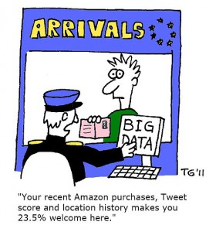
What are the benefits?
Potential high returns on investment
Competitive advantage
Increased productivity of corporate decision makers

Slide 5
What are the differences between OLTP systems and data warehousing?
CHARACTERISTICS | OLTP SYSTEMS | DATA WAREHOUSING SYSTEMS
Main purpose | Support operational processing | Support analytical processing
Data age | Current | Historic
Data latency | Real-time | Depends on length of cycle for data supplements to warehouse
Data granularity | Detailed data | Detailed data, lightly and highly summarised data
Data processing | Predictable pattern of data insertions, deletions, updates, and queries; High level of transaction throughput | Less predictable pattern of data queries; medium to low level of transaction throughput
Reporting | Predictable, one-dimensional, relatively static fixed reporting | Unpredictable, multidimensional, dynamic reporting
Users | Serves large number of operational users | Serves lower number of managerial users
Notes:
Online transaction processing (OLTP)

Slide 6

What does a data warehouse look like?
Sates Data Mart
Typical data warehouse architecture
ETL
Data Warehouse
Purchasing Data Mart
ETL
Human
Resources Data Mart
ETL
Subject-oriented, time-variant, non-volatile, integrated data
Notes:
Data Mart: A database that contains a subset of corporate data to support the analytical requirements of a particular business unit (such as the Sales department), or to support users who share the same requirements to analyse a particular business process (such as property sales).

Slide 7

What are Data Marts?
“A database that contains a subset of corporate data to support the analytical requirements of a particular business unit (such as the Sales department), or to support users who share the same requirements to analyse a particular business process (such as property sales).” (Connolly & Begg, 2010, p.1164)

Slide 8
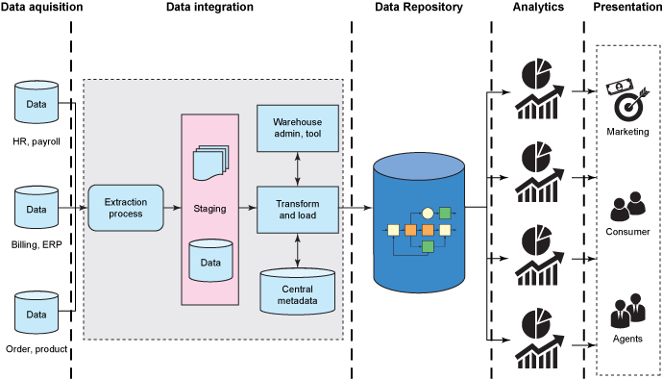
Data warehousing architecture: Supermarket

Slide 9
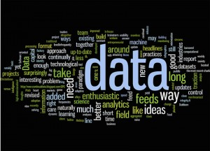
What would data be used for?
Comparing sales between stores
Comparing sales of own-brand products against branded products
Identify loan patterns for particular times of the year
Identify relationships between product purchases

Slide 10
How can data be visualised conceptually?
Multidimensional data model
Data can then be:
Used with standard reporting tools
Who … ?
What… ?
Queried using OLAP (online analytical processing) techniques: slice, dice, roll-up and drill-down
What if … ?
Why … ?
Subject to data mining
Unknown patterns
Store
Product
Time

Slide 11
How to model schema in a data warehouse: Dimensional Model?
Typical relational schema (also known as star schema)
PRODUCT-DIMENSION
product-id
description
brand
category
TIME-DIMENSION
time-id
day-of-week
mouth
quarter
year
holiday-flag
SALES-FACT
time-id
product-id
store-id
sold-units
sold-value
cost-value
M..1
1..M
STORE-DIMENSION
store-id
store-name
address
Floor-plan-type
M..1
Notes:
DMs are different to ER Models (see C&B, 2010, p.1181)

Slide 12
How to model schema in a data warehouse: ER Model?
Snowflake schema
BRAND-DIMENSION
id
name
PRODUCT-DIMENSION
product-id
description
brand
category
M..1
TIME-DIMENSION
time-id
day-of-week
mouth
quarter
year
holiday-flag
SALES-FACT
time-id
product-id
store-id
sold-units
sold-value
cost-value
M..1
M..1
CATEGORY-DIMENSION
id
designation
1..M
STORE-DIMENSION
store-id
store-name
address
Floor-plan-type
M..1

Slide 13
How to model schema in a data warehouse: ER Model?
TIME-DIMENSION
time-id
day-of-week
mouth
quarter
year
holiday-flag
Galaxy schema
STOCK-FACT
time-id
product-id
on-hand-units
on-hand-sales-value
on-hand-sales-cost-value
SALES-FACT
time-id
product-id
store-id
sold-units
sold-value
cost-value
M..1
1..M
STORE-DIMENSION
store-id
store-name
address
Floor-plan-type
1..M
PRODUCT-DIMENSION
product-id
description
brand
category
1..M
M..1

Slide 14
What are the main differences between DMs and ERMs?
ERM
DM
Designed for OLTP
Identifying entities and their relationship
Predictive data retrieval
Transactions made very simple and deterministic
Designed for data warehousing
Identifying facts
Intuitive, high-performance retrieval
Supports ad hoc end-user queries

Slide 15

How to create a dimensional model?
Step 1: Select business process
Step 2: declare grain
Step 3: choose dimensions
Step 4: identify facts
Step 5: identify all dimensional attributes for the dimensional model

Slide 16

What are some of the problems with data warehousing?
Underestimation of resources for data ETL
Hidden problems with source systems
Required data not captured
Increased end-user demands
Data homogenization
High demand for resources
Data ownership
High maintenance
Log-duration projects
Complexity of integration

Slide 17
What are some specific ETL problems?
Batch-oriented (i.e. not timely)
Scan for changes (i.e. performance hit)
Date columns (i.e. intrusive)

Slide 18

Summary
What impact can big data have on data warehousing?

