Slide 1
K-Means clustering variants and improvements
Stefan Sebastian 242

Slide 2
Overview
K-Means classic algorithm
Improvements: computation time, seed selection
Variants: Bisecting K-means, Genetic Algorithms
Conclusions

Slide 3
K-Means
Unsupervised learning, clustering algorithm
Clustering = organize objects into natural clusters
K-Means is old but still popular because of its simplicity, efficiency and proven success

Slide 4
K-means : classic algorithm
Given N points, with D features, finds K clusters
Select an initial partition
Repeat 3 and 4 until a termination condition
Assign each point to the closest center
Update cluster centers based on the new assignment

Slide 5
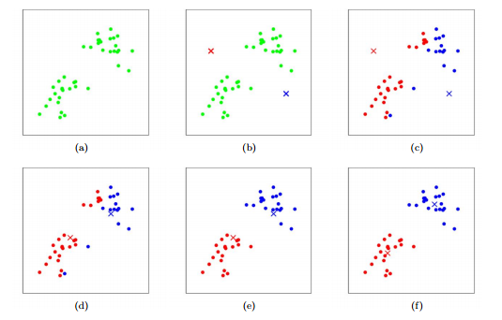
K-means: visual example

Slide 6
Improvements
Optimization of different aspects of the classic algorithm
Computation speedup
Seed selection optimization

Slide 7
1.1. Enhanced K-means published 2006, Fahim et al.
Memorize the distance between each point and the cluster centers
At every iteration, if the distance to the new cluster mean is smaller => keeps the point in the assigned cluster
Optimization for large values of K

Slide 8

1.2. MapReduce K-Means
Framework for processing large datsets over a cluster of computing nodes
Popular in the Big Data community, with the Hadoop implementation
Models problems as a combination of map and reduce functions

Slide 9
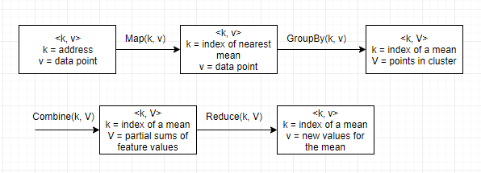
1.2. MapReduce K-Means published in 2009, by W.Zhao, H. Ma, Q. He
Data is stored in <key, value> pairs on a dfs
Stores current centers in global variable

