Slide 1
K-Means clustering variants and improvements
Stefan Sebastian 242

Slide 2
Overview
K-Means classic algorithm
Improvements: computation time, seed selection
Variants: Bisecting K-means, Genetic Algorithms
Conclusions

Slide 3
K-Means
Unsupervised learning, clustering algorithm
Clustering = organize objects into natural clusters
K-Means is old but still popular because of its simplicity, efficiency and proven success

Slide 4
K-means : classic algorithm
Given N points, with D features, finds K clusters
Select an initial partition
Repeat 3 and 4 until a termination condition
Assign each point to the closest center
Update cluster centers based on the new assignment

Slide 5
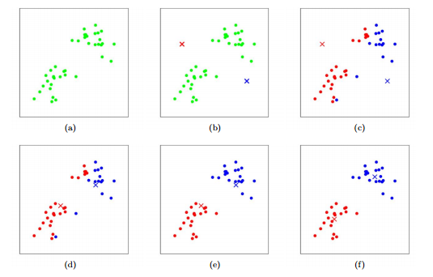
K-means: visual example

Slide 6
Improvements
Optimization of different aspects of the classic algorithm
Computation speedup
Seed selection optimization

Slide 7
1.1. Enhanced K-means 2006, Fahim, Salem, Torkey and Ramadan
Memorize the distance between each point and the cluster centers
At every iteration, if the distance to the new cluster mean is smaller => keeps the point in the assigned cluster
Optimization for large values of K

Slide 8

1.2. MapReduce K-Means
Framework for processing large datsets over a cluster of computing nodes
Popular in the Big Data community, with the Hadoop implementation
Models problems as a combination of map and reduce functions

Slide 9
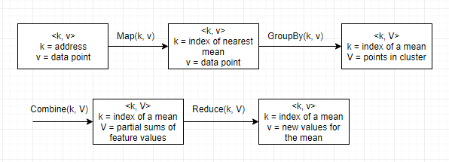
1.2. MapReduce K-Means 2009, W.Zhao, H. Ma, Q. He
Data is stored in <key, value> pairs on a dfs
Stores current centers in global variable

Slide 10
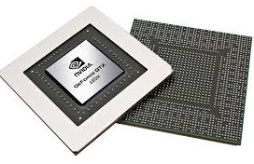
1.3. GPU K-Means
GPU = special circuits designed for computer graphics and image processing
Efficient at doing a simple operation over a large batch of data
Can have thousands of threads

Slide 11
1.3. GPU K-means published 2010, Li et al.
Distance calculation: either dispatch each point to a thread or represent as matrixes and process in tiles data[n][d], centroid[d][k], result[n][k]
Update means: divide and conquer; split data into M groups where M is the number of multiprocessors; reduce each group, split again until the dataset is < M

Slide 12
2.1. Sort and split heuristic 2010, Madhu and Pathakota
Transform negative features by subtracting the minimum attribute value
Sort all points by distance to origin
Partition data into k equal sets
Choose the middle point from each set as a seed

Slide 13
2.2. K-d trees
Data structure for organizing points in k-dimensional space
Built by recursively splitting the original dataset across a dimension
A bounding box can be calculated in each subtree, to help with density estimations

Slide 14
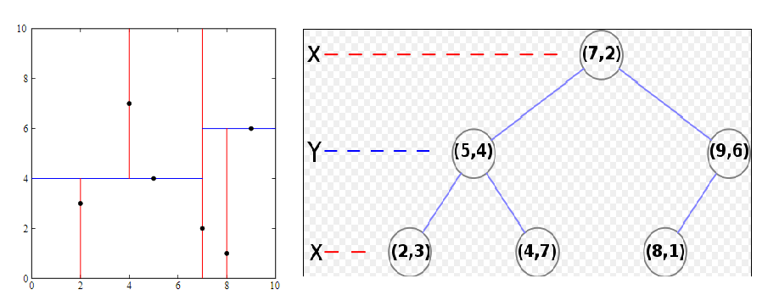
2.2. K-d trees

Slide 15
2.2. K-d trees 2007, Redmond and Heneghan
While building the tree: split over the largest dimension, leafs contain n/10k points
Create density estimation for each leaf as : nr points / volume of bounding box
Heuristic : choose means from buckets with large densities, separated by a reasonable distance

Slide 16
Variants
Different approaches for the classic algorithm
Bisecting K-Means
GA K-Means

Slide 17
1. Bisecting K-Means 2000, Steinbach, Karypis and Kumar
Can perform both flat and hierarchical clustering
At each iteration splits the dataset into 2 by applying the basic algorithm
Repeats until k clusters have been found
More efficient when k is large, tends to produce balanced clusters

Slide 18
2. Genetic Algorithms
Metaheuristic search method inspired by nature
Models solution as chromosomes and scores them with a function called fitness
Random mutations of solution can escape local optima

Slide 19
2.1. KGA-clustering 2002, Maulik and Bandiopadhyay
Chromosome: array of cluster centers
Fitness: distortion
Crossover: single point
Mutation: a random feature is updated with a fixed probability
For each chromosome: decode, update means, apply crossover and mutation, add to next generation if fitness is good

Slide 20
2.2. IGKM 2006, Guo, Liu, Gao and Zhu
Chromosomes also contain a value for k
Fitness: (1/k) * (E1/Ek) * Dk
Ek = distortion for k clusters
Dk = maximum distance between 2 cluster centers
Penalizes large k, increases for compact and separated clusters

Slide 21
Conclusions
K-Means can handle just about any dataset
Remains popular : around 30.000 results on Google Scholar each year

