Slide 1
Clustering beer text reviews using the K-means algorithm
Stefan Seastian 242

Slide 2
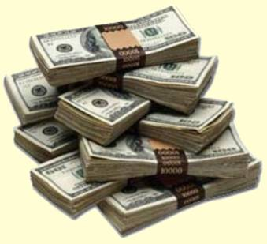
Motivation
Beer is the most popular alcoholic drink
Global beer market is huge (~600$ billion)
Data about consumer needs => useful for beer marketing

Slide 3
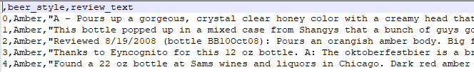
Proposed experiment
Extract information from beer text reviews using unsupervised learning (clustering)
Analyze resulting clusters and correlation with initial beer styles
Sample experiment data

Slide 4
Related work
Text clustering
Anna Huang 2008, comparison of distance measures over tf-idf features
Hu et al 2009, enrich document information by using Wikipedia category data
Review analysis
Iacob and Harrison 2013, extracts feature requests from app reviews, using linguistic rules

Slide 5
Related work
Experiments on beer datasets
Braun and Timpe 2015, predict score based on text review, using SVM on bag of words model
McAuley and Leskovec 2013, recommender system that adapts to user experience; experience label is learned by model using rating and timestamp data

Slide 6
Dataset
Started from 500k reviews from the BeerAdvocate website
Reduced number of different styles by cutting those with few reviews, mapping others to parent style
Select an equal distribution for each style
Final count: 9500 per style, 85500 in total

Slide 7
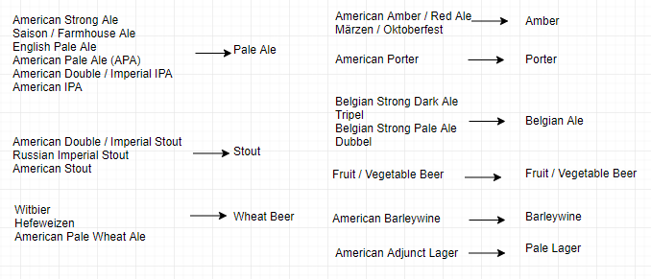
Style mapping (using taxonomy published by BussinessInsider)

Slide 8
Model overview
Use text review data from BeerAdvocate
Extract features with tf-idf vectorizer
Apply K-means with random seeds and k-d tree seeds
Analyze cluster results

Slide 9

Model overview
Operations over the initial dataset

Slide 10
Technologies used
Python programming language
Clustering algorithms implemented from scratch
Pandas for data analysis
Nltk for tokenizing and stemming
Scikit learn for tf-idf vectorizer
Matplotlib and Seaborn for plotting

Slide 11
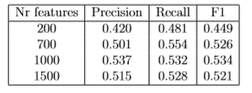
Model parameters
K = nr of clusters = 9 (number of distinct beer styles)
Number of features = 1000 (determined experimentally)
Initialization : random seeds 0.53 F1 score, k-d trees 0.47 F1 score

Slide 12
Evaluation
Correlation between initial beer styles and the clusters found within the dataset
Confusion matrix : (x, y) = how many times a point of x has been misclassified as y
Precision and recall are calculated for each row, then an average is taken

Slide 13
Results
Multilabel classification score
Mean precision | 0.537
Mean recall | 0.532
F1 score | 0.534

Slide 14
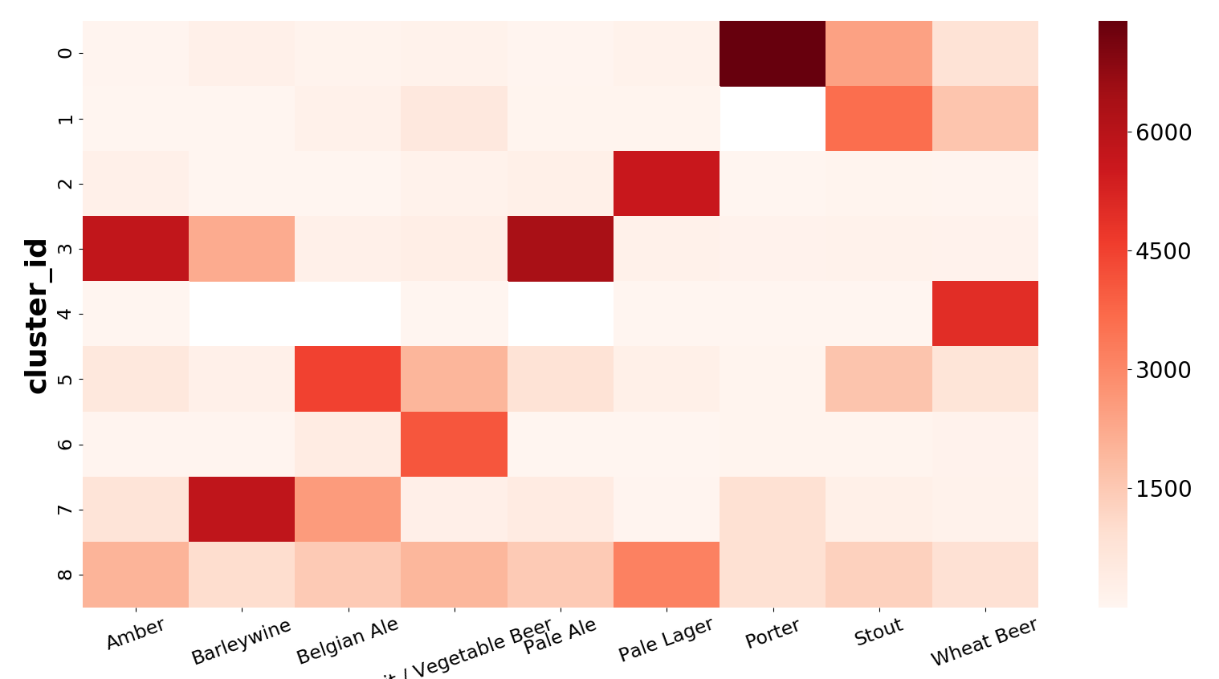
Results Heatmap

Slide 15
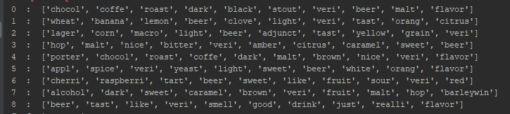
Results best rated words per cluster
Obs. Cluster 8 contains common words for
all reviews : beer, taste, smell, drink, flavour

Slide 16
Conclusions
As expected, clusters were formed around similar beer styles
The most important words for each cluster contain relevant characteristics
Further improvements: more data, computation time optimizations

