Slide 1
Face recognition using Local Binary Patterns Histograms
Stefan Sebastian 252 HPC

Slide 2
The task performed
Face recognition : find characteristics which describe specific faces
Match an input face with images of the same person
Not face detection

Slide 3
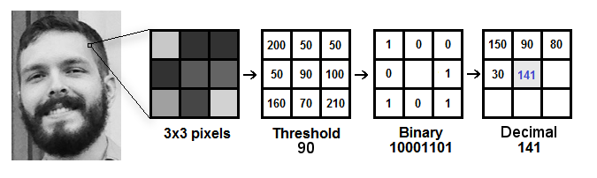
Local Binary Patterns
First described in the 90’s [1][2]
Used as a (local) texture descriptor
Computes for each pixel the relative grey-level relationship to its neighbours
Source: https://towardsdatascience.com/face-recognition-how-lbph-works-90ec258c3d6b

Slide 4
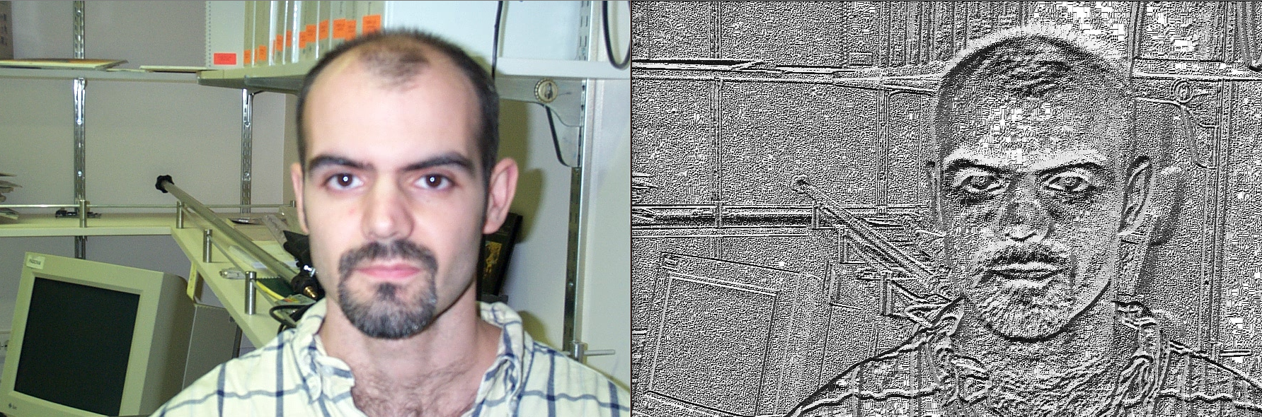
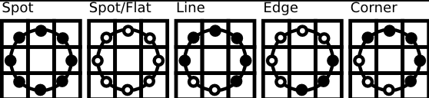
Applying LBP
Information extracted by the LBP descriptor
Source: https://docs.opencv.org/2.4/modules/contrib/doc/facerec/facerec_tutorial.html#local-binary-patterns-histograms

Slide 5
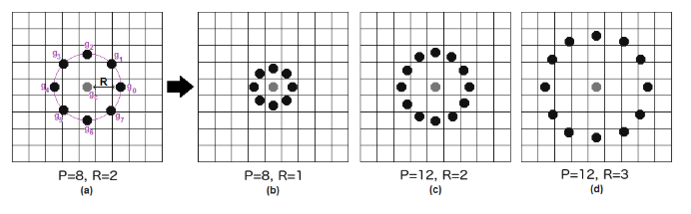
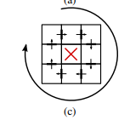
LBP Extensions
Circular LBP
Transition LBP
- Encodes relationship between neighbouring pixels
Volume LBP
- Texture described as (X, Y, T) where T is the time coordinate

Slide 6
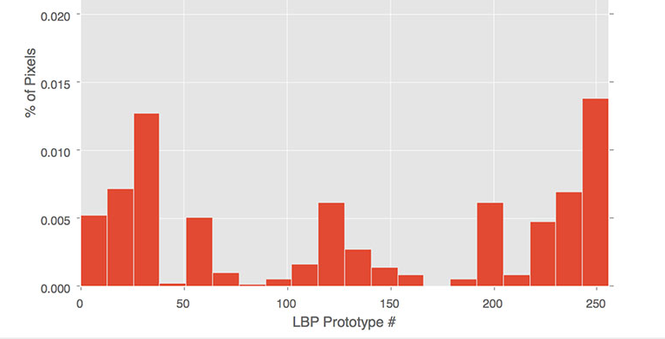
Face Recognition with LBP Histograms
Described by Ahonen et al, 2004 [4]
a histogram over the LBP values contains information about the distribution of : edges, spots, flat ares over the image
Source: https://www.pyimagesearch.com/wp-content/uploads/2015/12/lbp_256bin_histogram.jpg

Slide 7
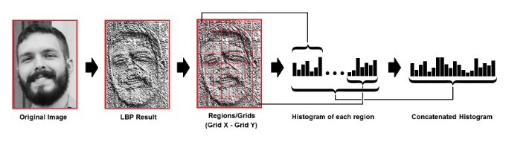
Include spatial information : divide initial image into a grid, compute histograms, then concatenate them
Source: https://towardsdatascience.com/face-recognition-how-lbph-works-90ec258c3d6b

Slide 8

Face recognition
After applying LBP Histograms on test image and database images compare them using a distance metric
E.g. Euclidean distance between them

Slide 9
Latest research
Implementation on a SoC (Zync-7030); 8.6ms time with 79% accuracy [5]
Median LBPH, replaces all pixels with neighbourhood gray median, to deal with varying illumination; accuracy increase by 4% [6]
Mobile app with computational offloading on a cloud server; uses Haar detector and sends a cropped/resized face to the server[7]

Slide 10
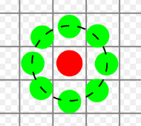
Practical application
Implemented LBP, each pixel compared with its nearest neighbours
Used Euclidean distance to compute histogram distances
Picked the 3 closest images from the database

Slide 11
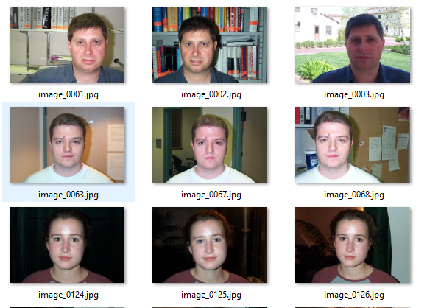
Dataset
Frontal Face Dataset provided by Caltech
442 images, 17 people, 896 x 592 pixels, under different lighting/expressions/backgrounds

Slide 12
References
[1] Dong-chen He and Li Wang, "Texture Unit, Texture Spectrum, And Texture Analysis," in IEEE Transactions on Geoscience and Remote Sensing, vol. 28, no. 4, pp. 509-512, July 1990
[2] T. Ojala, M. Pietikainen and D. Harwood, "Performance evaluation of texture measures with classification based on Kullback discrimination of distributions," Proceedings of 12th International Conference on Pattern Recognition, Jerusalem, Israel, 1994, pp. 582-585 vol.1.
[3] https://towardsdatascience.com/face-recognition-how-lbph-works-90ec258c3d6b
[4] Ahonen, T., Hadid, A., and Pietikainen, M. Face Recognition with Local Binary Patterns. Computer Vision - ECCV 2004 (2004), 469–481.
[5] N. Stekas and D. v. d. Heuvel, "Face Recognition Using Local Binary Patterns Histograms (LBPH) on an FPGA-Based System on Chip (SoC)," 2016 IEEE International Parallel and Distributed Processing Symposium Workshops (IPDPSW), Chicago, IL, 2016, pp. 300-304.
[6] X. Zhao and C. Wei, "A real-time face recognition system based on the improved LBPH algorithm," 2017 IEEE 2nd International Conference on Signal and Image Processing (ICSIP), Singapore, 2017, pp. 72-76.
[7] G. Hassan and K. Elgazzar, "The case of face recognition on mobile devices," 2016 IEEE Wireless Communications and Networking Conference, Doha, 2016, pp. 1-6.

