Slide 1
Face recognition using Local Binary Patterns Histograms
Stefan Sebastian 252 HPC

Slide 2
The task performed
Face recognition : find characteristics which describe specific faces
Match an input face with images of the same person
Not face detection

Slide 3
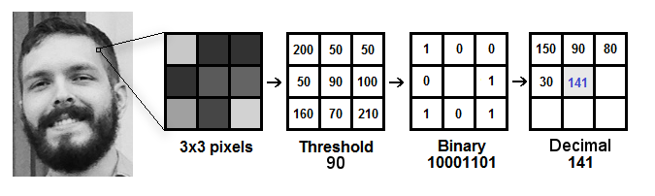
Local Binary Patterns
First described in the 90’s
Used as a (local) texture descriptor
Computes for each pixel the relative grey-level relationship to its neighbours
Source: https://towardsdatascience.com/face-recognition-how-lbph-works-90ec258c3d6b

Slide 4
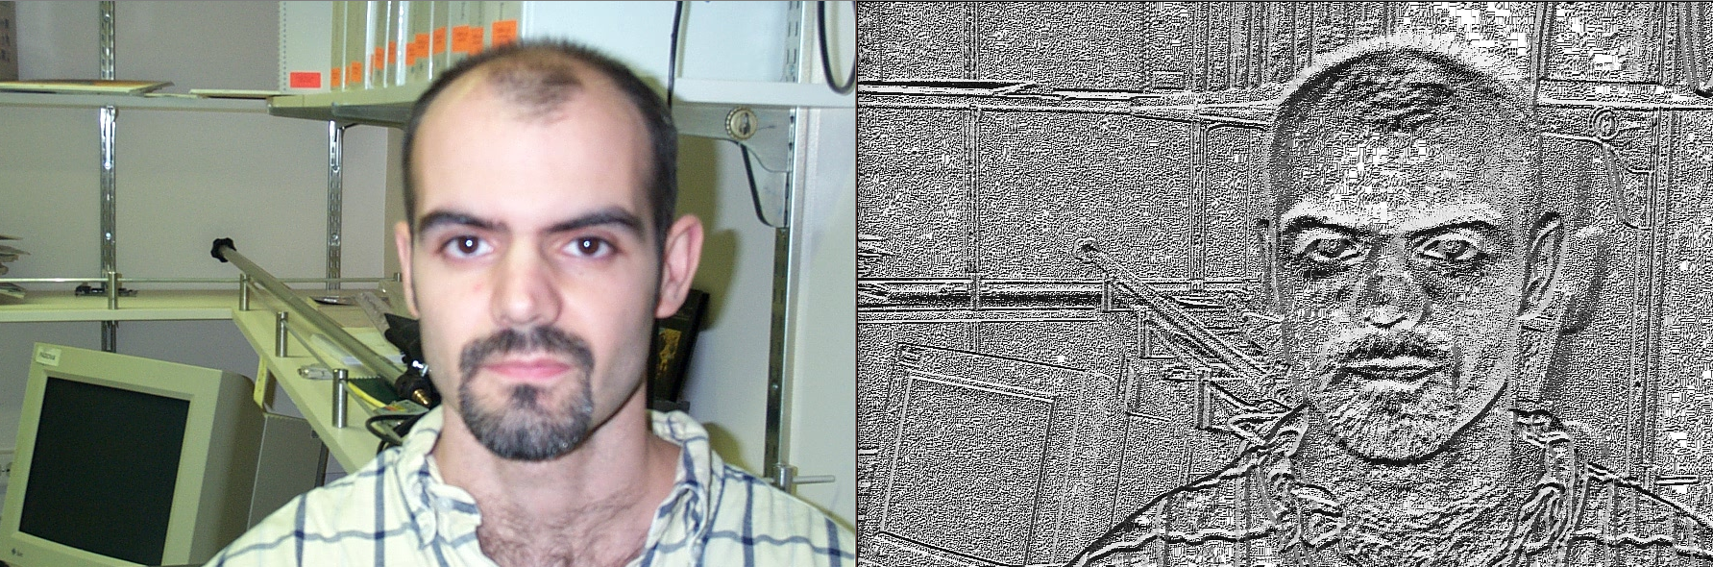
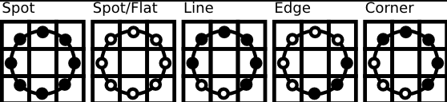
Applying LBP
Information extracted by the LBP descriptor
Source: https://docs.opencv.org/2.4/modules/contrib/doc/facerec/facerec_tutorial.html#local-binary-patterns-histograms

Slide 5
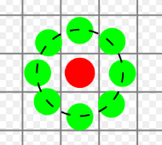
Practical application
Implemented LBP, each pixel compared with its nearest neighbours
Used Euclidean distance to compute histogram distances
Picked the 3 closest images from the database

Slide 6
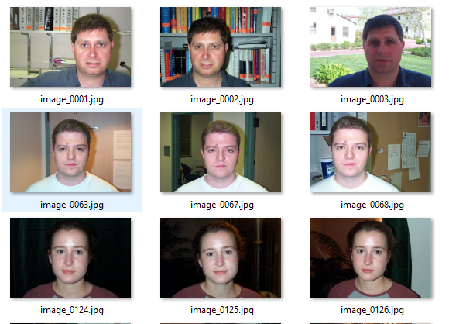
Dataset
Subset of the Frontal Face Dataset provided by Caltech
54 images, 17 people, 896 x 592 pixels, under different lighting/expressions/backgrounds

