Slide 1
Automatic skin detection in images
Stefan Sebastian 235

Slide 2
Introduction
Identifying pixels/regions that correspond to human skin
Challenges: color(varies among races), brightness, false positives (leather, wood, sand, etc)

Slide 3
Motivation
Intermediary step for more complex detectors: face, hands, etc
Human-Computer Interaction (computers recognizing gestures or reactions)

Slide 4


Applications
Detecting anchorpersons in talk shows
Pornographic content filtering

Slide 5
Skin detection by color
Thresholding
Identifying threshold and rules on the pixel’s values in a color space, for example :
(R > 220), (G > 210), (B > 170), |R − G| ≤ 15, (R>B), (G>B)
The rules can also be learned by an algorithm: e.g. Evolutionary algorithms, Constructive induction

Slide 6
Bayesian methods
Using Bayes’ Theorem
P(skin|p) = P(p|skin)*P(skin)/P(p)
p – probability of finding the current pixel
skin – probability of observing a skin pixel
Results depend on overlap of skin, non-skin pixels in training dataset

Slide 7
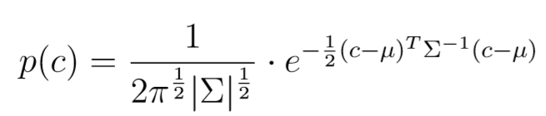
Gaussian models
Model skin distribution using Gaussian density functions
c – color vector
∑ - covariance matrix
μ – mean vector
∑ and μ are calculated on the skin color samples

Slide 8
Skin texture analysis
Haralick’s features
Method of represnting texture information: Gray Level Co-Occurrence Matrix
Haralick’s features are metrices calculated over the GLCM of an image
Can be used as input for a classifier such as: ANN, SVM

Slide 9
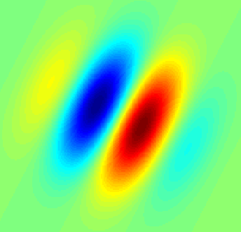
Gabor wavelet transforms
Filters that analyze orientation and frequency
Example of a 2d filter:
Many vision scientists claim that this representation is closest to that of the human visual system

Slide 10
Image segmentation
Used in recent research in skin detection
Skin tends to appear in regions as opposed to scattered individual pixels
Clustering algorithms
Input: pixel features (RGB) and position (x,y)

Slide 11
Methods for image segmentation
SLIC – adaptation of K-means that avoids placing centroids on edges or noisy pixels
Quick-shift
fast clustering algorithm
regions’ size and shape can be controlled

Slide 12
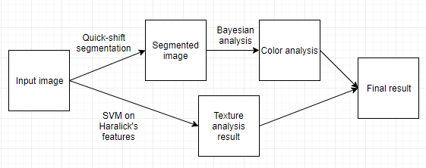
Proposed model
result

Slide 13
Results on the Compaq skin dataset
TPR | FPR | Model
81.59% | 21.26% | My model
90% | 14.2% | Bayesian model (Jones and Rehg)
90% | 30% | Gaussian model (Lee and Yoo)
94.7% | 30.2% | YI’Q’ threshold (Brand and Mason)
91.17% | 13.12% | Segmentation+Bayes (Poudel and Zhang)
80% | 9.5% | Mixture of Gaussians (Jones and Rehg)

Slide 14
Conclusions
Outdated datasets
Most models only take into account the color feature => lots of false positives

