Slide 1
Scala
Asynchronous and parallel programming

Slide 2
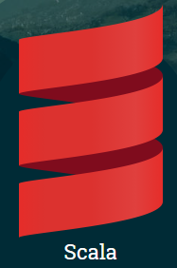
The Scala programming language
Multi-paradigm
Works well with other languages
Specific tools for parallel and concurrent code: actors & futures

Slide 3
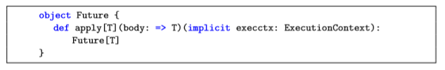
Futures and Promises
Concise way of writing asynchronous code
Future[T] = container type, encapsulates an eventual value of type T
Companion object for creating Futures

Slide 4
Execution context
Similar to Java Executors
Default implementation in scala.concurrent package ExecutionContext.global
Parallelism level = number of threads managed by it

Slide 5
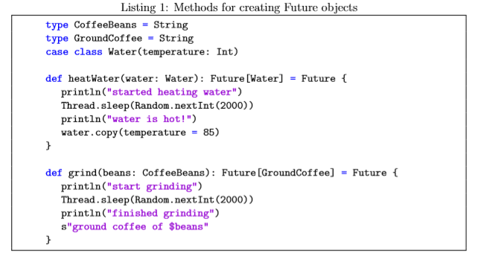
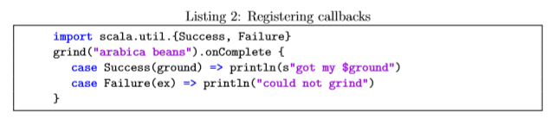
The body of the computation is contained in braces.
Calling the functions returns a Future value for which the ExecutionContext will assign a thread.
The result can be processed by adding a callback to the Future value.

Slide 6

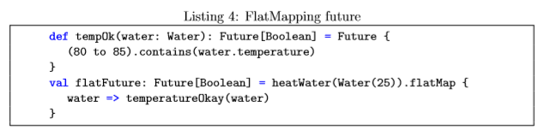
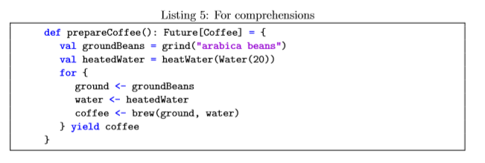
Mapping Futures
Mapped function executes as soon as Future[Water] is completed
Flat map from Future[Future[T]] to Future[T]
Concise way of composing multiple Futures

Slide 7
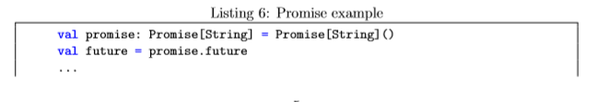
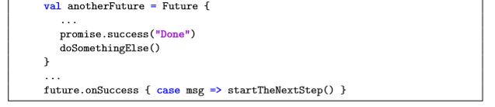
Promise
Companion type for Future

Slide 8
Comparison with other languages
Java Future – very limited, requires polling
Java FutureTask – can’t handle exceptions in an elegant manner
Javascript – a bit more verbose than for-comprehensions

Slide 9
The Actor Model
Computational model designed to deal with concurrency at a high level of abstraction
Message passing concurrency model
Actor = building block
Actors send and receive messages

Slide 10
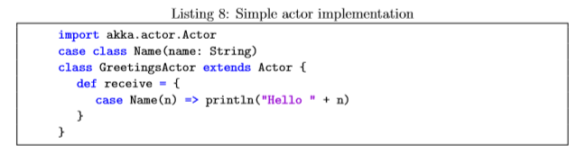
Actor model in Scala
Since 2.10 uses by default the Akka library
Actors can send an receive messages
Send message to actor : actor ! message

Slide 11
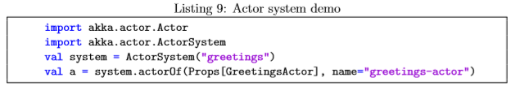
Actor Systems
Create the required infrastructure for running actors
Heavyweight structures, usually one per application module
Can be destroyed using the ‘shutdown’ method

Slide 12
ActorRef = reference to an actor, returned by the actor system
Can’t access the actor directly
Serializable => can be sent to other nodes
Message dispatcher = handles sending and receiving messages
Backed by a thread pool
A single thread always executes a given actor

Slide 13
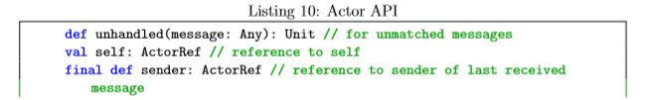
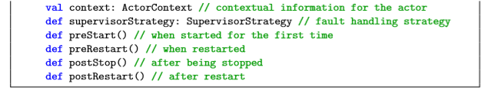
Supervision hierarchy = each actor is a supervisor to its children
Non-defensive programming
A supervisor is responsible for starting, stopping and monitoring its children

Slide 14
Advantages and disadvantages
No shared mutable state
No need for locks => better performance, no deadlocks
Non shared memory model
Handles errors gracefully
Can’t handle transactions
Hard to debug => time cost

Slide 15
Comparison with Erlang
Erlang offers full isolation including heap and garbage collection
Scala allows the programmer to customize the scheduler
OTP allows for hot swapping of code, JVM can’t change method signatures only their content
Scala can be integrated with the entire Java ecosystem

Slide 16
Actor model application example
Wordcount

