Slide 1
Chapter 9 Objects and Classes

Slide 2

Motivations
After learning the preceding chapters, you are capable of solving many programming problems using selections, loops, methods, and arrays.
However, these Java features are not sufficient for developing large scale software systems (and GUI).
Suppose you want to develop a graphical user interface as shown below. How do you program it?

Slide 3




OUR TASK: creating software..
Complex Real World Tasks
Computer Assisted surgery
Curiosity(rover)
Super Tool (dumb?)
Two States - [0/1]- ??
electron
.. that runs on a computer to do some real world task..
Footer Text

Slide 4
From Real World Tasks to Objects
Complex Real World Tasks
System Analysis
System Design
Software Requirement Engineering
Software Design
Classes
Object Interactions
UI
ERD & DB
etc…
Footer Text

Slide 5
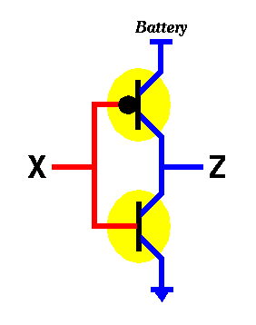



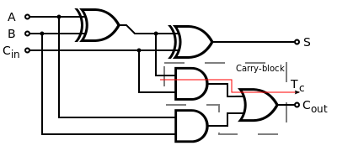
From bits to Objects
NOT
0 | ?
1 | ?
Bits
Truth-tables
Transistors
Gates
Adders, etc…
All leads to Machine Language…
Examples: MIPS, ARM, x86, ….
Footer Text

Slide 6
From bits to Objects
From
Machine Language (001000 01000 00000 0000000000000101)
Assembly Language (addi $8, $0, 5)
High level Languages ( x = 5;)
Object Oriented Languages
Components
Frameworks
Footer Text

Slide 7
High-Level Languages
Operations:
totalCost = saleCost + tax;
Data Abstractions:
int x = 1; // 4 bytes
System.out.println(Integer.MAX_VALUE); // 2147483647
System.out.println(Integer.MAX_VALUE + 1); ???
Control Abstractions (e.g. to beep 10 times)
for (int i=0; i <10; i++) { beep; }
Modular Abstraction (e.g. to create a square function):
int square(int x) { return x * x; }
System.out.println(square(5));
But, need translators ( ???, ???)
Footer Text

Slide 8
OO Languages
All advantages of Structured Languages plus
Encapsulation
Inheritance
Polymorphism
CLASSES, OBJECTS, INTERACTIONS
Footer Text

Slide 9
Objectives
To describe objects and classes, and use classes to model objects (§9.2).
To use UML graphical notation to describe classes and objects (§9.2).
To demonstrate how to define classes and create objects (§9.3).
To create objects using constructors (§9.4).
To access objects via object reference variables (§9.5).
To define a reference variable using a reference type (§9.5.1).
To access an object’s data and methods using the object member access operator (.) (§9.5.2).
To define data fields of reference types and assign default values for an object’s data fields (§9.5.3).
To distinguish between object reference variables and primitive data type variables (§9.5.4).
To use the Java library classes Date, Random, and Point2D (§9.6).
To distinguish between instance and static variables and methods (§9.7).
To define private data fields with appropriate get and set methods (§9.8).
To encapsulate data fields to make classes easy to maintain (§9.9).
To develop methods with object arguments and differentiate between primitive-type arguments and object-type arguments (§9.10).
To store and process objects in arrays (§9.11).
To create immutable objects from immutable classes to protect the contents of objects (§9.12).
To determine the scope of variables in the context of a class (§9.13).
To use the keyword this to refer to the calling object itself (§9.14).

Slide 10
OO Programming Concepts
OOP involves programming using objects.
An object represents an entity in the real world that can be distinctly identified.
E.g. a student, a loan, a circle, a button,
An object has a unique identity, state, and behaviors.
The state of an object consists of a set of data fields (also known as properties) with their current values.
The behavior of an object is defined by a set of methods.

Slide 11
Circle Objects
All have a common property, radius (with different values).
For all of these objects area can be calculated using the
same method (area = 2 * PI * radius).
All are CIRCLES.

Slide 12
Classes
Classes are templates that define objects of the same type.
A Java class uses variables to define data fields and methods to define behaviors.
Additionally, a class provides a special type of methods, known as constructors,
used to construct objects of that class.

Slide 13
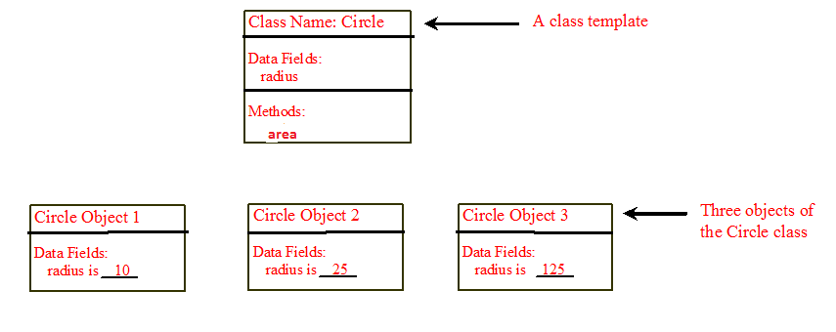
Objects- Instances of Classes
An object has both a state and behavior.
state defines the object,
behavior defines what the object does.

Slide 14
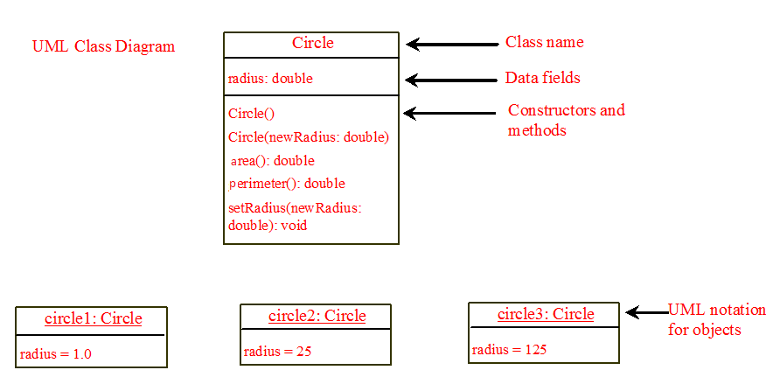
UML Class Diagram

Slide 15
Example: Circle
OPEN Eclipse & Create a Project (say Shape)
Create a Package (say Shapes1)
Create a Class named Circle in this package.
Include code for Circle Class (next slide)
Create a Class TestShape (on the same package)
Include code for testCircle( ) method (slide 17) & call it in main()

Slide 16
Circle Class
public class Circle {
private double radius;
public Circle(double radi){
radius = radi;
}
public double diameter(){
return 2* radius;
}
public double perimeter(){
return 2* Math.PI * radius;
}
Data field
constructor
method
method
Note that the keyword static is not used

Slide 17
CLASS as a TYPE
If compiled, it will create a user-defined type (e.g Circle).
  A meta object will be created (Circle object – study later)
To use this user-defined type,
We have to declare a variable of this type
Circle circle1;
And then, create the variable using new (will use the constructor- see slides 26)
  circle1 = new Circle(5.0);
  OR combine both ; Circle circle1 = new Circle(5.0);

Slide 18
Test Class
public class TestShape {
public static void testCircle() {
Scanner scan1= new Scanner(System.in);
System.out.println("Give the radius of the circle:");
double radius = scan1.nextDouble();
Circle circle1 = new Circle(radius); //constructs circle1
System.out.printf("The diameter of the circle is: %.2f %n" , circle1.diameter());
System.out.printf("The perimeter of the circle is: %.2f %n", circle1.perimeter());
// can we print circle1.area()?
scan1.close();
}
public static void main(String[] args) {
testCircle();
}

Slide 19
some more methods to Circle
To return area of the circle
To check whether another circle is equal to the current circle (this)
  public boolean equal(Circle c)
To check whether another circle is larger than the current circle (this)
  public boolean larger(Circle c)

Slide 20
SET and GET methods
Recommended to declare Data Fields as PRIVATE (why ? – later )
PRIVATE members can be accessed only by the methods in the same class.
Therefore, you have to provide PUBLIC Methods to access these PRIVATE Data Fields
Example: private radius;

Slide 21
Circle (cont.)
public int getRadius(){
return radius;
}
public void setRadius(int radi){
radius= radi;
}
public double area(){
return Math.PI * *
}
radius
Radius;
public boolean isEqualTo(Circle C){
return (this.radius ==C.radius);
}
public boolean larger(Circle C){
return (this.radius < C.radius);
}

Slide 22
Test Class (cont.)
public class Test {
public static void testCircle() {
//continue from previous
System.out.printf("The area of the circle is: %.2f %n" , circle1.area());
System.out.println("Give the radius of another circle:");
radius = scan1.nextDouble();
Circle circle2 = new Circle(radius);
if (circle1.isEqualTo(circle2)) // or circle2.isEqualTo(circle1)
System.out.println(“Circles are equal");
else
System.out.println(“Circles are NOT equal");
//NOTE: check circle1.equals(circle2) ??
}
public static void main(String[] args) {
testCircle();
}

Slide 23
Rectangle Class
Write Rectangular class
Include suitable data fields (?, ?)
Include area(), perimeter(), etc..
Write a method (say testRectangular() ) in the Test class to test it.

Slide 24
Triangle Class
Write Triangular class
Include suitable data fields (??)
Include area(), perimeter(), etc..
Write a method testTriangular() in the Test class.

Slide 25
UML
Class Diagram

Slide 26
UML Class Diagram

Slide 27
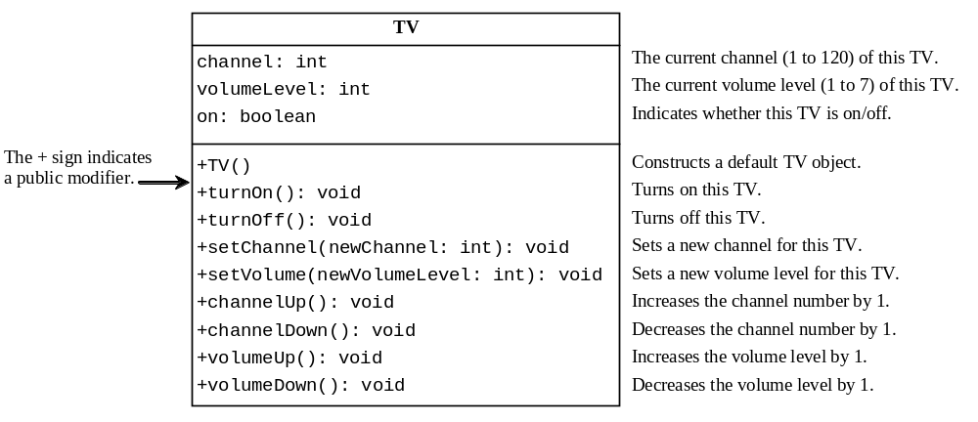
Example: Defining Classes and Creating Objects
TV
TestTV
Run

Slide 28
CONSTRUCTORS

Slide 29
Constructors
Constructors are a special kind of methods that are invoked to construct objects.
private double radius;
//construct a circle with default radius 0.0
public Circle() {
}
//construct a circle with given radius
public Circle(double newRadius) {
radius = newRadius;
}

Slide 30
Constructors, cont.
Constructors must have the same name as the class itself.
Constructors do not have a return type—not even void.
Constructors are invoked using the new operator when an object is created.
Constructors play the role of initializing objects.
Constructors are usually overloaded (?)

Slide 31
Default Constructor
A constructor with no parameters is referred to as a no-arg constructor.
A class may be defined without constructors.
In this case, a no-arg constructor with an empty body is implicitly defined in the class.
  This constructor is called a default constructor
  provided automatically only if no constructors are explicitly defined in the class.
If you include your own constructor, JAVA assumes, you do not want to include no-arg empty-body constructor [if you need this, you have to explicitly include it]

Slide 32
Creating Objects Using Constructors
new ClassName();
Example:
new Circle();
new Circle(5.0);

Slide 33


Check- which pair will not compile?
public class Circle {
private double radius;
// NO EXPLICIT CONSTRUCTOR
}
public class Circle {
private double radius;
public Circle(double radi){
radius=radi;
}
}

Slide 34

Check- which pair will not compile?
public class Circle {
private double radius;
public Circle(double radi){
radius=radi;
}
public Circle(){
}
}

Slide 35
CONSTRUCTING
Objects
public class Circle {
private double radius;
public Circle(double radi){
radius=radi;
}
//default circle with radius 1.0
public Circle(){
radius = 1.0
}
}
public class Circle {
private double radius = 1.0;
public Circle(double radi){
radius=radi;
}
//default circle with radius 1.0
public Circle(){
}
}
public class Circle {
private double radius;
public Circle(double radi){
radius=radi;
}
// circle with default radius 0.0
public Circle(){
}
}

Slide 36
Declaring Object Reference Variables
To reference an object, assign the object to a reference variable.
To declare a reference variable, use the syntax:
ClassName objectRefVar;
Example:
Circle myCircle;

Slide 37
Declaring/Creating Objects in a Single Step
ClassName objectRefVar = new ClassName();
Example:
Circle myCircle = new Circle();
Assign object reference
Create an object
public class Circle {
private double radius = 1.0; // if not initialized, java will assign 0.0
public Circle(double radi){
radius=radi;
}
public Circle(){
}
}

Slide 38
Trace Code
animation
Declare myCircle
Circle myCircle = new Circle(5.0);
Circle yourCircle = new Circle();
myCircle
no value
public class Circle {
private double radius = 1.0; // if not initialized, java will assign 0.0
public Circle(double radi){
radius=radi;
}
public Circle(){
}
}

Slide 39

Trace Code, cont.
animation
Circle myCircle = new Circle(5.0);
Circle yourCircle = new Circle();
myCircle
no value
public class Circle {
private double radius = 1.0;
public Circle(double radi){
radius=radi;
}
public Circle(){
}
}
Create a circle

Slide 40
Trace Code, cont.
animation
Circle myCircle = new Circle(5.0);
Circle yourCircle = new Circle();
myCircle
reference value
Assign object reference to myCircle
public class Circle {
private double radius = 1.0;
public Circle(double radi){
radius=radi;
}
public Circle(){
}
}

Slide 41
Trace Code, cont.
animation
Circle myCircle = new Circle(5.0);
Circle yourCircle = new Circle();
myCircle
reference value
public class Circle {
private double radius = 1.0;
public Circle(double radi){
radius=radi;
}
public Circle(){
}
}
yourCircle
no value
Declare yourCircle

Slide 42
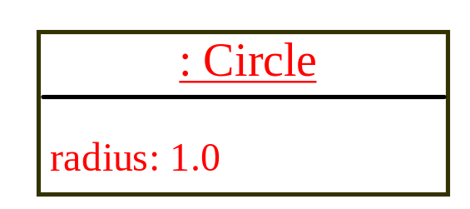
Trace Code, cont.
animation
Circle myCircle = new Circle(5.0);
Circle yourCircle = new Circle();
myCircle
reference value
public class Circle {
private double radius = 1.0;
public Circle(double radi){
radius=radi;
}
public Circle(){
}
}
yourCircle
no value
Create a new Circle object

Slide 43

Trace Code, cont.
animation
Circle myCircle = new Circle(5.0);
Circle yourCircle = new Circle();
myCircle
reference value
public class Circle {
private double radius = 1.0;
public Circle(double radi){
radius=radi;
}
public Circle(){
}
}
yourCircle
reference value
Assign object reference to yourCircle

Slide 44
Accessing Object’s Members
Referencing the object’s data directly: // NOT GOOD
objectRefVar.data // if data is private
e.g., myCircle.radius // if radius is public
GOOD practice is: declare radius as private,
and provide public methods to SET and GET radius
Invoking the object’s method:
objectRefVar.methodName(arguments)
e.g., myCircle.area()
e.g., myCircle.setRadius()

Slide 45

Trace Code, cont.
animation
Circle myCircle = new Circle(5.0);
Circle yourCircle = new Circle();
myCircle
reference value
yourCircle.setRadius(100.0);
public void setRadius(int radi){
radius= radi;
}
yourCircle
reference value
Change radius in yourCircle

Slide 46
Default Values
Data Fields (declared in class outside methods)
Vs
Local Variables (declared inside methods)

Slide 47
Default Values for Data Fields
If a data field is not initialized, Java will initialize them with default values.
null for a reference type,
  e.g. int[] A; Circle circle1;
0 for a numeric type,
  e.g. int A; double B;
false for a boolean type,
  e.g. boolean A;
'\u0000' for a char type.
  char A;

Slide 48
The null Value
If a data field of a reference type does not reference any object, the data field holds a special literal value, null.
For example, consider the following Student class. It contains three Primitive Data Fields and two Reference Data Fields.
public class Student {
String name; // name has default value null
Date dateOFbirth ; // dateOFbirth will be null
int age; // age has default value 0
boolean isScienceMajor; // isScienceMajor has default value false
char gender; // c has default value '\u0000'
}

Slide 49
public class Student {
String name; // name has default value null
Date dateOFbirth ; // import Date; dateOFbirth will be null
int age; // age has default value 0
boolean isScienceMajor; // isScienceMajor has default value false
char gender; // c has default value '\u0000'
}
public static void main(String[] args) {
Student1 s1 = new Student1();
System.out.printf("%s %s %d %b %c", s1.name, s1.dateOFbirth, s1.age, s1.isLocal,s1.gender);
}
null null 0 false
But, what if we declare a local variable without
Any initial value in main() and try to print it?

Slide 50
No Default Values for Local Variables
Java will not assign a default value to a local variable inside a method.
public class Test {
public static void main(String[] args) {
int x; // x has no default value
String y; // y has no default value
System.out.println("x is " + x);
System.out.println("y is " + y);
}
}
Compile error: variable not initialized

Slide 51
Comparing and Copying
Primitive Data Types
Vs
Reference Types (e.g. Objects)

Slide 52
Comparing Objects
What will be printed?
Circle circle1 = new Circle(5.0);
Circle circle2 = new Circle(5.0);
System.out.printf( “%b %b %b”,
(circle1 == circle2),
circle1.equal(circle2), //java supplies this circle.isEqualTo(circle2)); // our method
// false false true
circle2 = circle1; // old circle2 will become garbage in heap;
System.out.printf("%b %b %b",
(circle1 == circle2), circle1.equals(circle2), circle1.isEqualTo(circle2));
// true true true

Slide 53

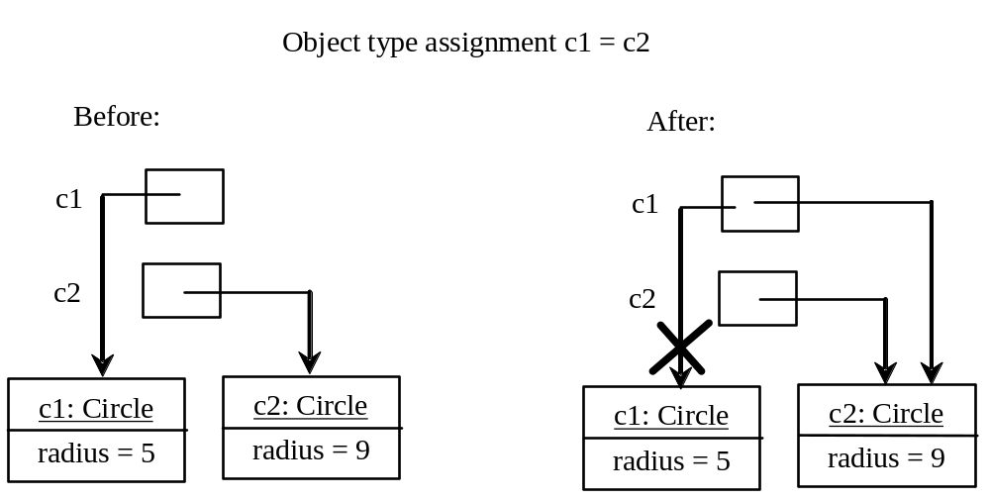
Copying Variables of Primitive Data Types and Object Types

Slide 54

Differences between Variables of
Primitive Data Types and Object Types
What will be printed?
Circle c1 = new Circle(5.0);
Circle c2 = new Circle(4.0);
c2 = c1; // old c2 is garbage
c1. setRadius(3.0)
print c2.radius();
int i = 1;
int j = i;
i = 3;
print j

Slide 55
Garbage & Garbage Collection
See previous slide,
after c1 = c2,
c1 and c2 points to the same object.
The object previously referenced by c1 is no longer referenced.
This object is known as garbage.
Garbage is automatically collected by JVM.

Slide 56
TIP: Garbage Collection
If an object is no longer needed,
you can explicitly assign null to a reference variable for the object.
The JVM will automatically collect the space if the object is not referenced by any variable.
Circle c1 = new Circle(5.0);
c1 = null // old c1 is garbage

Slide 57
CLASSES in Java Built-in Libraries examples:
Date in java.util
Point2D in javafx.geometry
Random in java.util
[Math.random() is limited – it is a static method in Math class- just returns a random number x, 0.0 ≤ x < 1.0]

Slide 58

The Date Class
Java provides a system-independent encapsulation of date and time in the java.util.Date class. You can use the Date class to create an instance for the current date and time and use its toString method to return the date and time as a string.

Slide 59
The Date Class Example
For example, the following code
  java.util.Date date = new java.util.Date();
  System.out.println(date.toString());
displays a string like Sun Mar 09 13:50:19 EST 2003.

Slide 60

The Random Class
You have used Math.random() to obtain a random double value between 0.0 and 1.0 (excluding 1.0). A more useful random number generator is provided in the java.util.Random class.

Slide 61
The Random Class Example
If two Random objects have the same seed, they will generate identical sequences of numbers. For example, the following code creates two Random objects with the same seed 3.
Random random1 = new Random(3);
System.out.print("From random1: ");
for (int i = 0; i < 10; i++)
System.out.print(random1.nextInt(1000) + " ");
Random random2 = new Random(3);
System.out.print("\nFrom random2: ");
for (int i = 0; i < 10; i++)
System.out.print(random2.nextInt(1000) + " ");
From random1: 734 660 210 581 128 202 549 564 459 961
From random2: 734 660 210 581 128 202 549 564 459 961

Slide 62
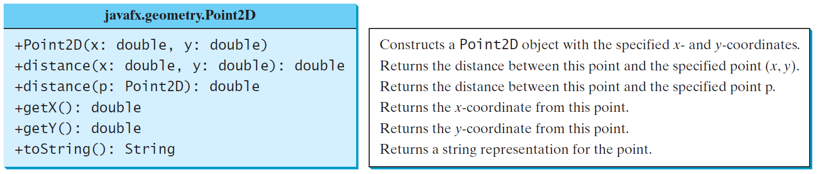
The Point2D Class
Java API has a conveninent Point2D class in the javafx.geometry package for representing a point in a two-dimensional plane.
TestPoint2D
Run

Slide 63
CLASS (STATIC) members
Vs
OBJECT (INSTANCE) members

Slide 64
Static Variables, Constants, and Methods
Static variables are shared by all the instances of the class.
  e.g. private static int count; // counts number of objects
Static methods are not tied to a specific object.
  e.g. public static getCount(); // to return the count
Static constants are final variables shared by all the instances of the class.
  Suppose Math.PI is not available, in Circle class we should include: private static final double PI = 3.237

Slide 65
Instance
Variables, and Methods
Instance variables belong to a specific instance
  e.g. private double radius;
Instance methods are invoked by an instance of the class
  e.g. public double area()
Instance Constant is same as Class Constant( but wastes memory)
  Use static followed by final instead of just final

Slide 66
Examples: STATIC Constants, Variables & Methods
package Shape;
public class Circle {
private double radius;
static final double PI = 3.27; // this.PI can be used in calculations
private static int count = 0;
public Circle(double radi){
radius=radi;
count++;
}
public Circle() {
count++;
}
public static int count(){
return count;
}
private static void testStatic(){
//java automatically creates a meta object Circle. No need to construct using new
System.out.println("The PI value used in Circle class is " + Circle.PI); // note: new is not used
System.out.println("The number of circles constructed is " + Circle.count());
Circle c1 = new Circle(5.0);
Circle c2 = new Circle(6.0);
System.out.println("The number of circles constructed is " + Circle.count());
}

Slide 67
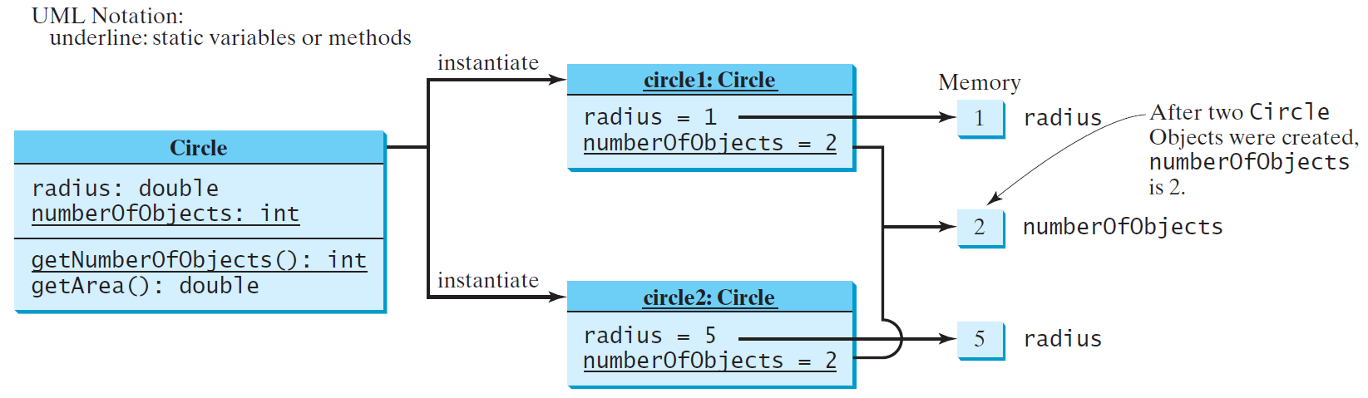
Static Variables, Constants, and Methods, cont.

Slide 68
Example of
Using Instance and Class Variables and Method
Objective: Demonstrate the roles of instance and class variables and their uses. This example adds a class variable numberOfObjects to track the number of Circle objects created.
CircleWithStaticMembers
TestCircleWithStaticMembers
Run

Slide 69
VISIBILITY and ACCESS MODIFIERS
PUBLIC
PROTECTED
PRIVATE
What is Default?

Slide 70
ACCESS Modifiers
public
The class, data, or method is visible to any class in ANY PACKAGE.
private
The data or methods can be accessed only by the declaring class. The get and set methods are used to read and modify private properties.
DEFUALT : By default, the class, variable, or method can be accessed by any class in the same PACKEAGE. It is a limited PUBLIC

Slide 71

The private modifier restricts access to within a class, the default modifier restricts access to within a package, and the public modifier enables unrestricted access.

Slide 72

The default modifier on a class restricts access to within a package, and the public modifier enables unrestricted access.

Slide 73
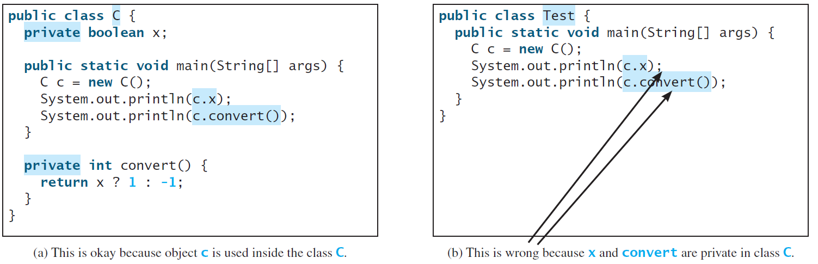
NOTE
An object cannot access its private members, if the object is used in an object of some other class as shown in (b).
It is OK, however, if the object is declared in its own class, as shown in (a).

Slide 74
ENCAPSULATION
Data Fields & Methods Together
PRIVATE Data Fields[also some PRIVATE Methods](hiding)
PUBLIC methods (interface)

Slide 75
Why Data Fields Should Be private?
To protect data.
To make code easy to maintain.

Slide 76

Example of
Data Field Encapsulation
CircleWithPrivateDataFields
TestCircleWithPrivateDataFields
Run

Slide 77
OBJECTS as
Method’s Parameters
Java pass arguments by value only.

Slide 78
Pass By Value
Java pass arguments by value only
  That is, a local copy is made in the stack area for the method
  If a variable of primitive data type is passed there will be no side effect.
  If a variable of reference type (e.g. an object) is passed, there may be side effects.

Slide 79
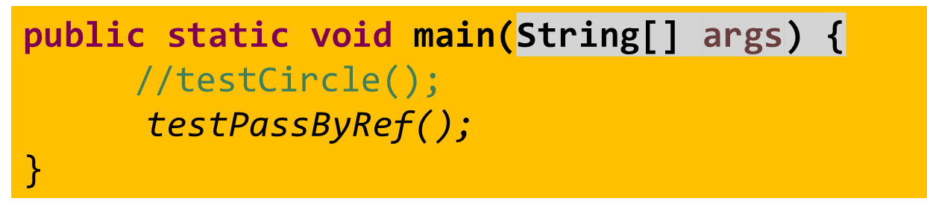
//include in Test
private static void mulBy3(double x, Circle c1){
x = x * 3;
c1.setRadius(x);
}
public static void testPassByRef() {
double x = 3.0;
Circle c1 = new Circle(x);
mulBy3(x, c1);
System.out.printf("%f %f", x , c1.getRadius());
}
3.000000 15.000000

Slide 80
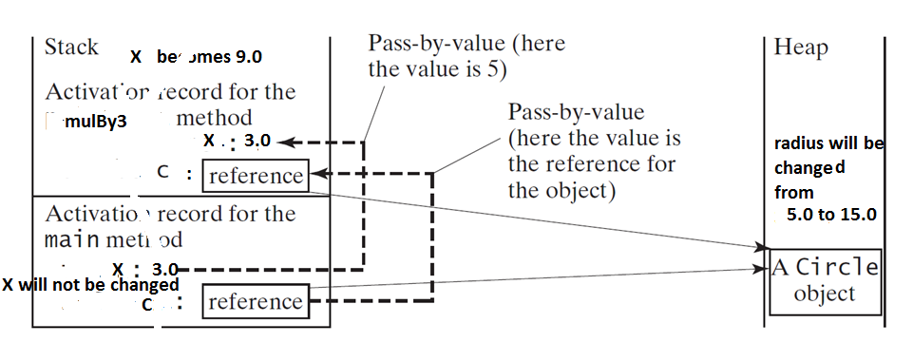
Pass by Value
Primitive Vs Reference

Slide 81
Passing Objects to Methods
Passing by value for primitive type value (the value is passed to the parameter)
Passing by value for reference type value (the value is the reference to the object)
TestPassObject
Run

Slide 82
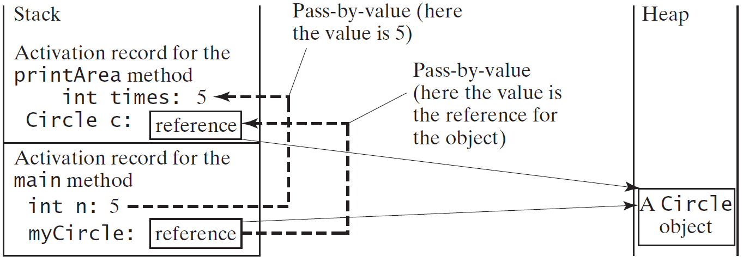
Passing Objects to Methods, cont.

Slide 83

Array of Objects
Circle[] circleArray = new Circle[10];
circleArray[0] = new Circle(5.0);
circleArray[1] = new Circle(3.0);
TWO LEVELS OF REFERENCING

Slide 84
Array of Objects
Circle[] circleArray = new Circle[10];
An array of objects is actually an array of reference variables. circleArray[1].getArea() involves two levels of referencing.
circleArray references to the entire array. circleArray[0] references to the first Circle object in the array.

Slide 85
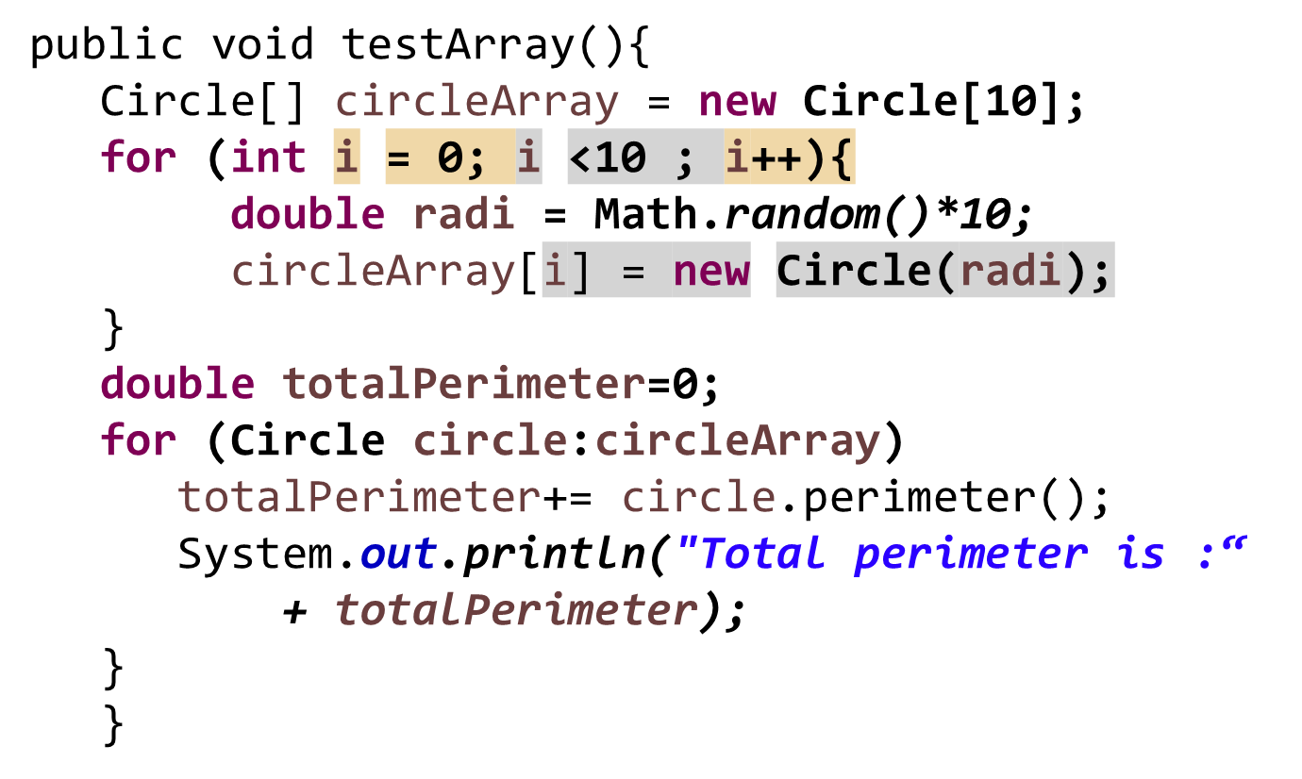
Array of Objects- Example
Create 10 circles with random radius and calculate the total perimeter.

Slide 86
Array of Objects- Example
TotalArea
Run

Slide 87
Mutable
Vs
Immutable

Slide 88
Immutable Objects and Classes
If the contents of an object cannot be changed once the object is created, the object is called an immutable object and its class is called an immutable class.
If you delete the set method in the Circle class the class would be immutable because radius is private and cannot be changed without a set method.
A class with all private data fields and without mutators is not necessarily immutable. For example, the Student class (next slide) has all private data fields and no mutators, but it is mutable.

Slide 89
Immutable objects/classes
Only constructors modify the data fields.
Once constructed its state (data fields) cannot be changed
All data fields should be private
No mutator methods included (e.g. setRadius())
A data field may be a reference to an object- if so, that object should be mutable

Slide 90
Example
public class BirthDate {
private int year;
private int month;
private int day;
public BirthDate(int newYear,
int newMonth, int newDay) {
year = newYear;
month = newMonth;
day = newDay;
}
public void setYear(int newYear) {
year = newYear;
}
}
public class Student {
private int id;
private BirthDate birthDate;
public Student(int ssn,
int year, int month, int day) {
id = ssn;
birthDate = new BirthDate(year, month, day);
}
public int getId() {
return id;
}
public BirthDate getBirthDate() {
return birthDate;
}
}
public class Test {
public static void main(String[] args) {
Student student = new Student(111223333, 1970, 5, 3);
BirthDate date = student.getBirthDate();
date.setYear(2010); // Now the student birth year is changed!
}
}

Slide 91
What Class is Immutable?
For a class to be immutable, it must mark all data fields
private and provide no mutator methods and no accessor methods that would return a reference to a mutable data field object.
Student class is not mutable, because it includes a method getBirthDate() that returns the reference to a mutable data field object birthDate. The object birthdate is mutable because one of its data field year can be modified by the method setYear()

Slide 92
SCOPE of the Variables

Slide 93
Scope of Variables
The scope of data field (instance and static variables) is the entire class. They can be declared anywhere inside a class.
  Java provides a default initial value
The scope of a local variable starts from its declaration and continues to the end of the block that contains the variable.
  A local variable must be initialized explicitly before it can be used.

Slide 94
this refers to the current object
public boolean isEqualTo(Circle c){
return (this.radius == c.radius);
}

Slide 95
The this Keyword
The this keyword is the name of a reference that refers to an object itself. One common use of the this keyword is reference a class’s hidden data fields.
Another common use of the this keyword to enable a constructor to invoke another constructor of the same class.

Slide 96

Reference the Hidden Data Fields

Slide 97

Calling Overloaded Constructor

Slide 98
Book Exercises
TRY at least
9.1, 9.7, 9.10 & 9.11

