Slide 1
In this course, we will study HW & SW interface
Introduction to CSC 2250
We studied Java (to write SW)
What is HW & SW interface- why we need to study?
Chapter 1 — Computer Abstractions and Technology — <number>

Slide 2
Check the answers & Explain why?
Try in Java
System.out.print('0'); → 0
System.out.print('0'+ 0); → 48
System.out.print('0' + '0’); → 96
System.out.print("0"+ '0’); → 00
System.out.print((1+2 == 3)); → true
System.out.print((0.1+0.2 == 0.3)); → ??
System.out.print(Byte.SIZE); → 8
Byte x = Byte.MAX_VALUE;
System.out.print(x); → 127
System.out.print(++x); → ??
Try in JavaScript using alert - try above also (first six)
alert(9999999999999999+1); → adds 1
alert(9999999999999999-1); → ??
Chapter 1 — Computer Abstractions and Technology — <number>
Notes:
Java treats '0' as a numeric char code → arithmetic results like 48, 96.
JavaScript treats '0' as a string → concatenation results like "00".
For big numbers, Javascript loses precision after 15–16 digits, so +1 and -1 appear unchanged.
Morgan Kaufmann Publishers
Chapter 1 — Computer Abstractions and Technology

Slide 3
Topics of course
Basics of computer system
  Types, components, memory hierarchy
  fetch-exec cycle, clock time, performance
How data represented?
  Digitization-Unsigned Integers
  Integer Reps , Real – FLP Reps
Machine & Assembly Language
  MIPS- R/I/J Types
  SPIM
Chapter 1 — Computer Abstractions and Technology — <number>

Slide 4
Topics- Chapter 1
History, Revolution- Calculator to AI & IoT
Types of computers: Super to Mobile
System: HW, SW, Processes, People
HW: Mother Board, I/O, Storage, Net
Mother Board: CPU, RAM, ROM,…
CPU: Cores: ALU, Register, Control, L1-Cache; L2- Cache
Memory Hierarchy: Cloud-Local Drive-RAM-Cache-Register
SW: Application SW & System SW (OS, compilers, device drivers,…)
HW & SW Interface: ISA and Machine Language
Computer Organization and Architecture
Fetch-Execute Cycle
Memory Allocation
Performance
Chapter 1 — Computer Abstractions and Technology — <number>

Slide 5
Ch1 some review questions
What is the difference between Servers and Workstations?
Differentiate System Software and Application Software.
What is WSC? What is SaaS?
One of the eight great ideas discussed in chapter 1 is “make common case fast” . Explain.
What are the main components of a computer system?
What are the main components of a CPU?
What is Fetch-Execute Cycle?
What is ISA?
Give wireless LAN and wireless WAN protocols (one each).
What is CPU clock time?
Which metric is better to measure performance of an application, throughput or response time?
What are the factors affects the performance of a program?
Chapter 1 — Computer Abstractions and Technology — <number>

Slide 6
The Computer Revolution
§1.1 Introduction
Progress in computer technology
  Underpinned by Moore’s Law
Makes novel applications feasible
  Computers in automobiles
  Cell phones
  Human genome project
  World Wide Web
  Search Engines
Computers are pervasive
Chapter 1 — Computer Abstractions and Technology — <number>
Notes:
Morgan Kaufmann Publishers
Chapter 1 — Computer Abstractions and Technology
Moore's Law is the observation that the number of transistors on a microchip doubles approximately every two years. This trend has historically driven exponential increases in computing power and reductions in the cost of computing.
Pervasive : All over the place

Slide 7
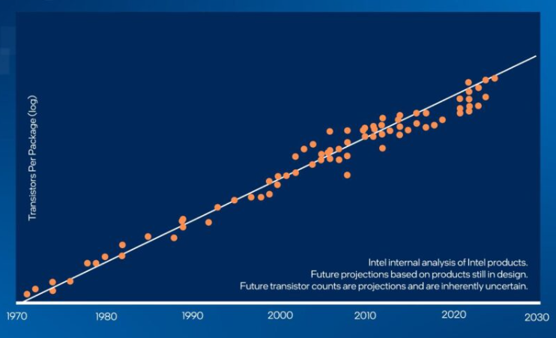
Moore’s Law
§1.1 Introduction
Chapter 1 — Computer Abstractions and Technology — <number>
Notes:
Morgan Kaufmann Publishers
Chapter 1 — Computer Abstractions and Technology
Moore's Law is the observation that the number of transistors on a microchip doubles approximately every two years. This trend has historically driven exponential increases in computing power and reductions in the cost of computing.
Moore’s Law made each new generation of a single computer cheaper, faster, and more powerful
A transistor = a tiny on/off switch inside a computer chip.
The more transistors → the faster and more powerful the computer.
the Intel Core i7 chip has billions of transistors packed inside.

Slide 8
Classes of Computers-1
Personal computers
  General purpose, variety of software
  Subject to cost/performance tradeoff
Server computers
  Network based
  High capacity, performance, reliability
  Range from small servers to building sized
Chapter 1 — Computer Abstractions and Technology — <number>
Notes:
Morgan Kaufmann Publishers
Chapter 1 — Computer Abstractions and Technology
A laptop or desktop you use at home or in your office vs. A machine in a data center that hosts services for many users.
log into Canvas or Google Classroom → that’s being handled by server computers.
Type your homework on your personal laptop → that’s your personal computer.
When you log in, your request goes to the Canvas servers (hosted by Instructure, often on AWS cloud).The servers authenticate your identity with your university’s system (Single Sign-On / Identity Provider).
The server then delivers your course data, assignments, and materials to your browser.

Slide 9
Classes of Computers-2
Supercomputers
  High-end scientific and engineering calculations
  Highest capability but represent a small fraction of the overall computer market
Embedded computers
  Hidden as components of systems
  Stringent power/performance/cost constraints
Chapter 1 — Computer Abstractions and Technology — <number>
Notes:
Frontier (Oak Ridge National Laboratory, USA)
Currently one of the fastest supercomputers in the world.
Capable of over 1 exaflop (1 quintillion calculations per second).
Used for climate change modeling, nuclear simulations, medical research, and AI training.
Fugaku (Japan) — used for drug discovery, weather forecasting, and COVID-19 research.
Embedded Computer Examples
Automobiles: Microcontrollers in the airbag system or engine control unit (ECU).
Consumer Electronics: The chip inside a washing machine that controls wash cycles.
Healthcare Devices: Embedded processors in pacemakers or insulin pumps.
IoT Devices: Smart thermostats (e.g., Nest) or Amazon Echo use embedded systems.
Morgan Kaufmann Publishers
Chapter 1 — Computer Abstractions and Technology

Slide 10
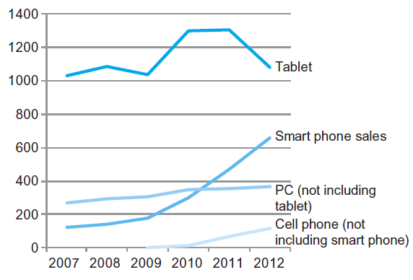
The PostPC Era
Chapter 1 — Computer Abstractions and Technology — <number>
Notes:
Morgan Kaufmann Publishers
Chapter 1 — Computer Abstractions and Technology

Slide 11
The PostPC Era
Personal Mobile Device (PMD)
  Battery operated
  Connects to the Internet
  Hundreds of dollars
  Smart phones, tablets, electronic glasses
Cloud computing
  Warehouse Scale Computers (WSC)
  Software as a Service (SaaS)
  Portion of software run on a PMD and a portion run in the Cloud
  Amazon and Google
Chapter 1 — Computer Abstractions and Technology — <number>
Notes:
Software as a Service (SaaS) is a cloud computing model where software applications are delivered over the internet on a subscription basis. Instead of installing and maintaining software on individual computers, users access it through a web browser
Morgan Kaufmann Publishers
Chapter 1 — Computer Abstractions and Technology

Slide 12

Technology Trends
Electronics technology continues to evolve
  Increased capacity and performance
  Reduced cost
§1.5 Technologies for Building Processors and Memory
DRAM capacity
Year | Technology | Relative performance/cost
1951 | Vacuum tube | 1
1965 | Transistor | 35
1975 | Integrated circuit (IC) | 900
1995 | Very large scale IC (VLSI) | 2,400,000
2013 | Ultra large scale IC | 250,000,000,000
Chapter 1 — Computer Abstractions and Technology — <number>
Notes:
Morgan Kaufmann Publishers
Chapter 1 — Computer Abstractions and Technology

Slide 13


Networks
Communication, resource sharing, nonlocal access
Local area network (LAN): Ethernet
Wide area network (WAN): the Internet
Wireless network: WiFi, Bluetooth
Chapter 1 — Computer Abstractions and Technology — <number>
Notes:
Morgan Kaufmann Publishers
Chapter 1 — Computer Abstractions and Technology

Slide 14
What You Will Learn
How programs are translated into the machine language
  And how the hardware executes them
The hardware/software interface
What determines program performance
  And how it can be improved
How hardware designers improve performance
What is parallel processing
Chapter 1 — Computer Abstractions and Technology — <number>
Notes:
Morgan Kaufmann Publishers
Chapter 1 — Computer Abstractions and Technology

Slide 15








Design Tradeoffs- Eight Great Ideas
Design for Moore’s Law
Use abstraction to simplify design
Make the common case fast
Performance via parallelism
Performance via pipelining
Performance via prediction
Hierarchy of memories
Dependability via redundancy
§1.2 Eight Great Ideas in Computer Architecture
Chapter 1 — Computer Abstractions and Technology — <number>

Slide 16

Below Your Program
Application software
  Written in high-level language
System software
  Compiler: translates HLL code to machine code
  Operating System: service code
    Handling input/output
    Managing memory and storage
    Scheduling tasks & sharing resources
Hardware
  Processor, memory, I/O controllers
§1.3 Below Your Program
Chapter 1 — Computer Abstractions and Technology — <number>
Notes:
Morgan Kaufmann Publishers
Chapter 1 — Computer Abstractions and Technology
1. Hardware (Innermost Layer)
This is the physical part of the computer:
CPU, RAM, Hard Disk, Monitor, Keyboard, etc.
Hardware cannot do anything by itself — it needs software to tell it what to do.
2. Systems Software (Middle Layer)
This is the bridge between hardware and applications.
The most important system software is the Operating System (OS) (like Windows, Linux, macOS).
Other system programs include device drivers, utilities, and compilers.
Functions:
Manages hardware (CPU, memory, input/output devices).
Provides services for applications to run.
Ensures that multiple applications can work together smoothly.
3. Applications Software (Outermost Layer)
These are the programs that users interact with directly.
Examples: Word processors, browsers, games, mobile apps, etc.
Applications rely on the system software to communicate with the hardware.
How They Work Together
A user clicks in an Application (like MS Word).
The application makes a request to the System Software (the OS).
The system software translates this request into instructions that the Hardware understands.
Example: Saving a document → Word (application) → OS (system software) → Hard disk (hardware).

Slide 17

Levels of Program Code
High-level language
  Level of abstraction closer to problem domain
  Provides for productivity and portability
Assembly language
  Textual representation of instructions
Hardware representation
  Binary digits (bits)
  Encoded instructions and data
Chapter 1 — Computer Abstractions and Technology — <number>
Notes:
Morgan Kaufmann Publishers
Chapter 1 — Computer Abstractions and Technology
MIPS = Millions of Instructions Per Second
It is a measure of the execution speed of a computer or processor ; how many machine instructions it can execute in one second.

Slide 18

HW- Components of a Computer
Same components for
all kinds of computer
  Desktop, server,
  embedded
Input/output includes
  User-interface devices
    Display, keyboard, mouse
  Storage devices
    Hard disk, CD/DVD, flash
  Network adapters
    For communicating with other computers
§1.4 Under the Covers
The BIG Picture
Chapter 1 — Computer Abstractions and Technology — <number>
Notes:
Morgan Kaufmann Publishers
Chapter 1 — Computer Abstractions and Technology

Slide 19
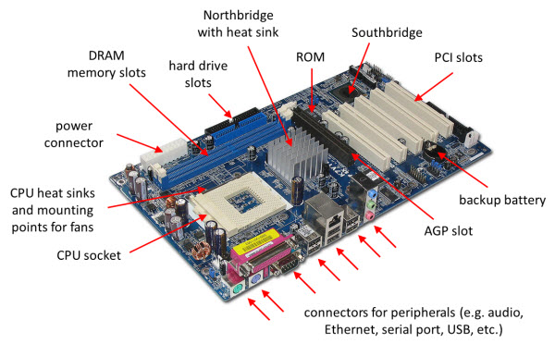
Inside the Box (Mother Board)
https://study.com/academy/lesson/what-is-a-motherboard-definition-function-diagram.html
Chapter 1 — Computer Abstractions and Technology — <number>
Notes:
Morgan Kaufmann Publishers
Chapter 1 — Computer Abstractions and Technology

Slide 20
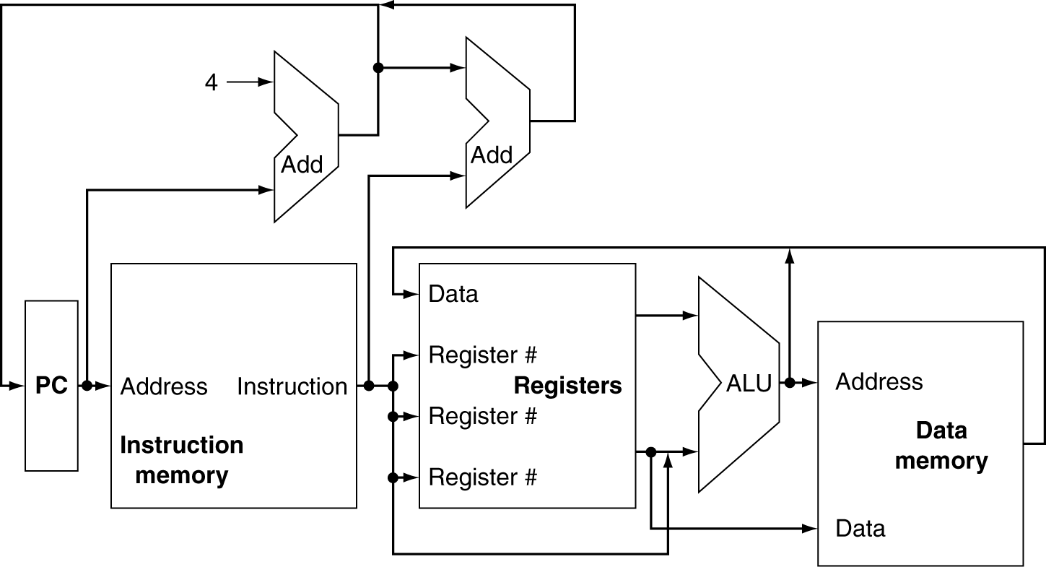
CPU & ideal RAM Overview
NOTE: RAM are CPU are on the mother board connected by FSB. There is no separate RAM for Data & Instruction.
Chapter 4 — The Processor — <number>
Notes:
Morgan Kaufmann Publishers
Chapter 4 — The Processor
instruction memory = where program code is stored.
Registers = small, fast storage inside CPU for immediate use.
Address = numeric identifier of where instructions/data live in memory.
Step 1: Fetch Instruction
The Instruction Memory holds the program instructions.
In this step, the CPU fetches (retrieves) the next instruction from Instruction Memory (usually using the Program Counter to track the address of the instruction).
The instruction is then placed in the Instruction Register (IR).
Step 2: Decode Instruction
The Control Unit takes the instruction from the IR and decodes it.
Decoding means interpreting what type of operation it is (e.g., arithmetic, logic, memory access, or control/branch).
The CPU identifies:
The operation (opcode)
The operands (registers, memory addresses, or immediate values)
Step 3: Fetch Operands
Once the instruction is decoded, the CPU needs the data (operands) to execute it.
Operands may come from:
Registers (fast, small storage inside CPU)
Memory (if the instruction needs external data)
At this step, the required operands are fetched and placed in the CPU registers for execution.
Step 4: Execute Instruction
The ALU (Arithmetic Logic Unit) or another execution unit performs the operation defined by the instruction.
Example:
Arithmetic (e.g., ADD R1, R2)
Logical (e.g., AND R1, R2)
Data transfer (e.g., LOAD, STORE)
Control (e.g., JUMP, BRANCH)
After execution, the result is written back either to a register or to memory.
In machine-level terms, this represents an arithmetic instruction:
Operands: A and B (values in registers or memory)
Operation: + (addition)
Result: stored in C (a register or memory location)

Slide 21
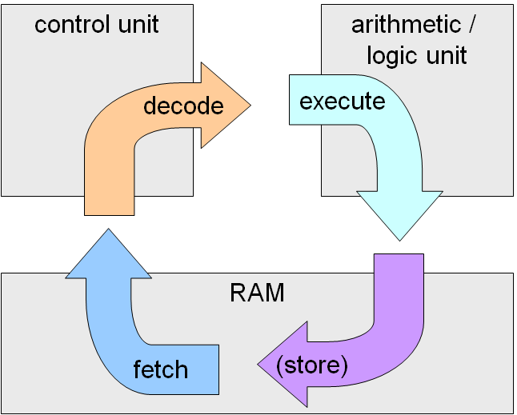
FETCH-EXECUTE CYCLE
Chapter 1 — Computer Abstractions and Technology — <number>
Notes:
Central processing unit (CPU): That portion of a computer that fetches and executes instructions.
It consists of an ALU, a control unit, and registers. In a system with a single processing unit, it is
often simply referred to as a processor.
Control unit: Controls the operation of the CPU and hence the computer.
Arithmetic and logic unit (ALU): Performs the computer’s data processing functions.
Registers: Provides storage internal to the CPU.
CPU interconnection: Some mechanism that provides for communication among the control unit,
ALU, and registers.
1. Fetch (Blue Arrow → from RAM to CPU)
The CPU retrieves (fetches) the next instruction from RAM (main memory).
This instruction is loaded into the Instruction Register so it can be processed.
The Program Counter (PC) keeps track of which instruction to fetch.
2. Decode (Orange Arrow → Control Unit)
The Control Unit (CU) reads the fetched instruction.
It decodes the instruction — i.e., interprets what the operation means:
What action needs to be performed (add, subtract, load, jump, etc.).
Which operands are involved (registers or memory addresses).
3. Execute (Light Blue Arrow → ALU)
The decoded instruction is carried out in the Arithmetic/Logic Unit (ALU) or by other CPU components.
Example:
Arithmetic (e.g., addition, subtraction)
Logic (e.g., comparison, AND/OR)
Data movement (e.g., load/store)
Control flow (e.g., jump/branch)
4. Store (Purple Arrow → Back to RAM)
If the instruction produces a result (e.g., the sum of two numbers), it is stored:
Either back into RAM (main memory)
Or into a CPU register for quick access in the next instructions.
Morgan Kaufmann Publishers
Chapter 1 — Computer Abstractions and Technology

Slide 22
Inside the Processor (CPU)
Datapath: performs operations on data
Control: sequences datapath, memory, ...
Registrar
Cache memory
  Small fast SRAM memory for immediate access to data
Chapter 1 — Computer Abstractions and Technology — <number>
Notes:
Morgan Kaufmann Publishers
Chapter 1 — Computer Abstractions and Technology

Slide 23
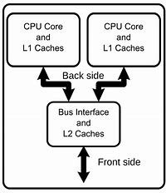
Inside the Processor (CPU)
Dual Core
Chapter 1 — Computer Abstractions and Technology — <number>
Notes:
Morgan Kaufmann Publishers
Chapter 1 — Computer Abstractions and Technology
1. CPU Core and L1 Cache
Each CPU core has its own L1 cache (Level 1 cache).
L1 cache is the smallest and fastest type of cache memory, located inside the CPU core.
It stores very frequently used data and instructions so the core doesn’t have to go to slower memory (RAM).
Typically split into L1 instruction cache (I-cache) and L1 data cache (D-cache).
Bus Interface and L2 Cache
The L2 cache is larger but slower than L1.
It acts as a shared cache between multiple CPU cores (in this figure, 2 cores share the same L2).
The Bus Interface Unit (BIU) manages data transfers between:
CPU cores/L1 caches
L2 cache
The front side bus (which connects to main memory and other system components).

Slide 24
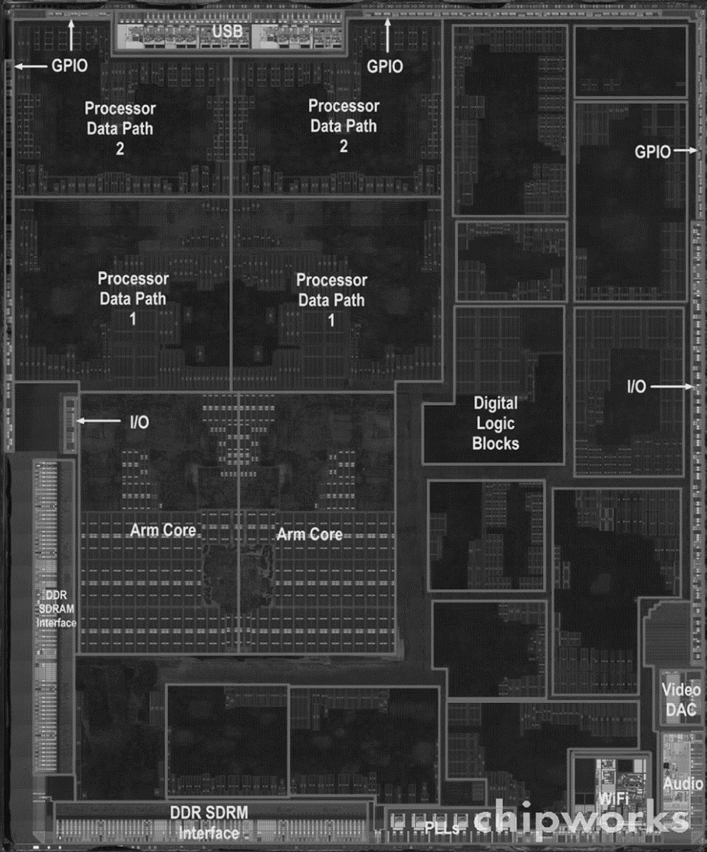
Inside the Processor (CPU)
Apple A5
Chapter 1 — Computer Abstractions and Technology — <number>
Notes:
Morgan Kaufmann Publishers
Chapter 1 — Computer Abstractions and Technology

Slide 25
Semiconductor Technology
Silicon: semiconductor
Add materials to transform properties:
  Conductors
  Insulators
  Switch
Chapter 1 — Computer Abstractions and Technology — <number>

Slide 26

Manufacturing ICs
Yield: proportion of working dies per wafer
Chapter 1 — Computer Abstractions and Technology — <number>
Notes:
Morgan Kaufmann Publishers
Chapter 1 — Computer Abstractions and Technology

Slide 27

Intel Core i7 Wafer
300mm wafer, 280 chips, 32nm technology
Each chip is 20.7 x 10.5 mm
Chapter 1 — Computer Abstractions and Technology — <number>
Notes:
Morgan Kaufmann Publishers
Chapter 1 — Computer Abstractions and Technology

Slide 28

Integrated Circuit Cost
Nonlinear relation to area and defect rate
  Wafer cost and area are fixed
  Defect rate determined by manufacturing process
  Die area determined by architecture and circuit design
Chapter 1 — Computer Abstractions and Technology — <number>
Notes:
Morgan Kaufmann Publishers
Chapter 1 — Computer Abstractions and Technology

Slide 29
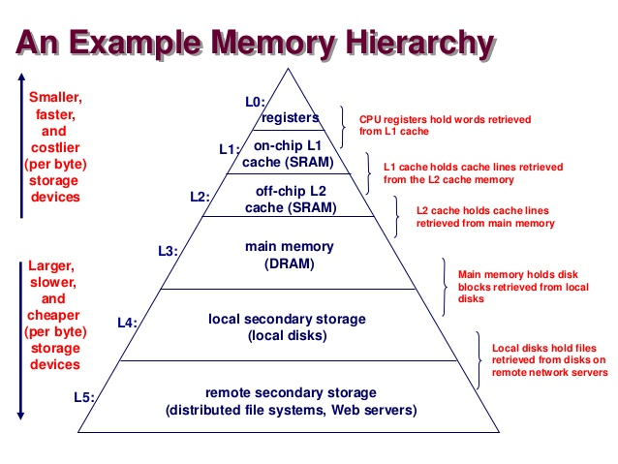
Chapter 1 — Computer Abstractions and Technology — <number>

Slide 30




A Safe Place for Data
Volatile main memory
  Loses instructions and data when power off
Non-volatile secondary memory
  Magnetic disk
  Flash memory
  Optical disk (CDROM, DVD)
Chapter 1 — Computer Abstractions and Technology — <number>
Notes:
Morgan Kaufmann Publishers
Chapter 1 — Computer Abstractions and Technology

Slide 31
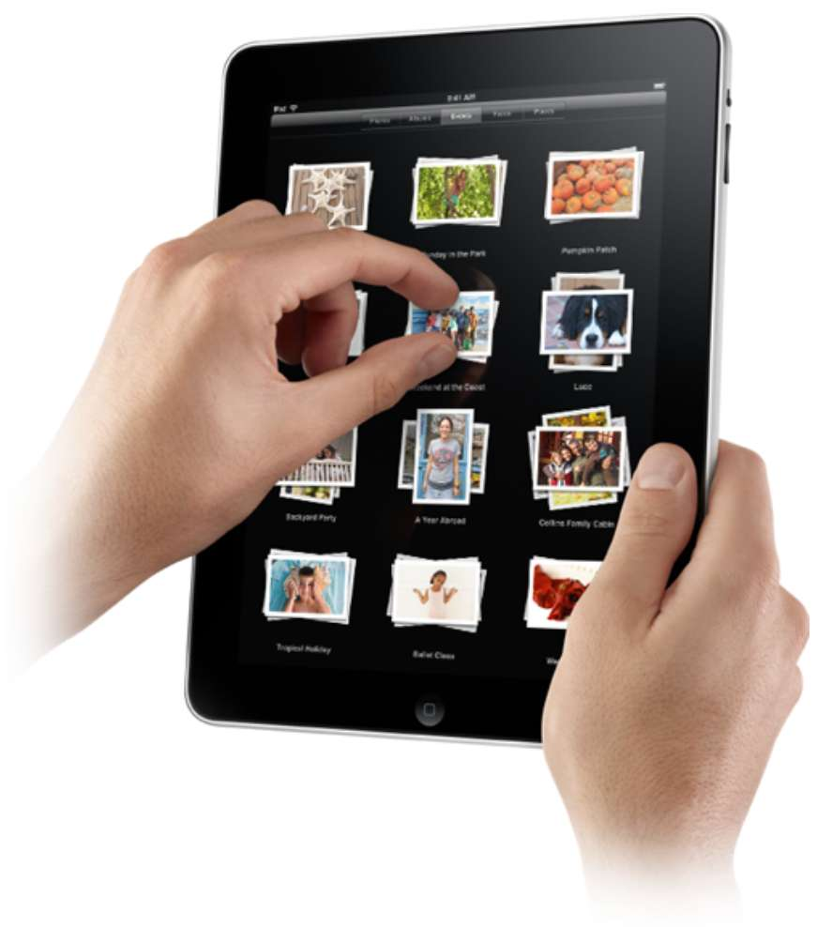
Touchscreen
PostPC device
Supersedes keyboard and mouse
Resistive and Capacitive types
  Most tablets, smart phones use capacitive
  Capacitive allows multiple touches simultaneously
Chapter 1 — Computer Abstractions and Technology — <number>
Notes:
Morgan Kaufmann Publishers
Chapter 1 — Computer Abstractions and Technology

Slide 32

Through the Looking Glass
LCD screen: picture elements (pixels)
  Mirrors content of frame buffer memory
Chapter 1 — Computer Abstractions and Technology — <number>
Notes:
Morgan Kaufmann Publishers
Chapter 1 — Computer Abstractions and Technology

Slide 33
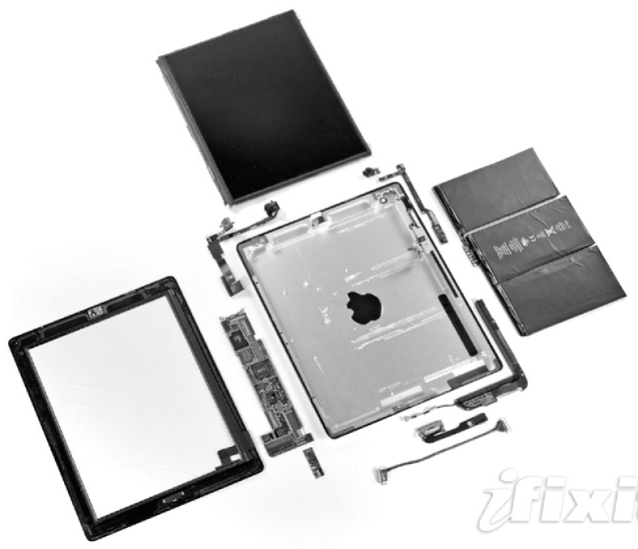
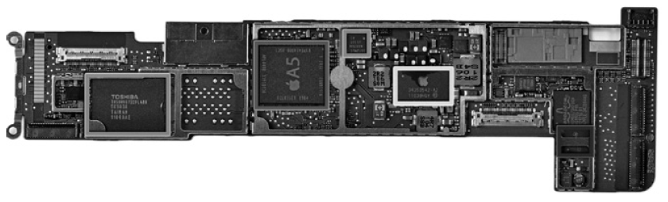
Opening the Box
Capacitive multitouch LCD screen
3.8 V, 25 Watt-hour battery
Computer board
Chapter 1 — Computer Abstractions and Technology — <number>
Notes:
Morgan Kaufmann Publishers
Chapter 1 — Computer Abstractions and Technology

Slide 34
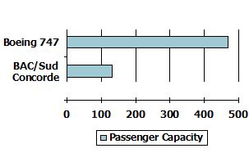
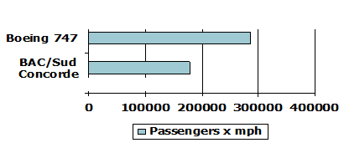
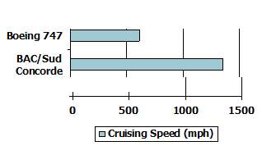
Performance (Speed Vs Tput)
§1.6 Performance
Which airplane has the best performance?
Which is better?
Server or Workstation ?
Chapter 1 — Computer Abstractions and Technology — <number>
Notes:
Morgan Kaufmann Publishers
Chapter 1 — Computer Abstractions and Technology

Slide 35
Response Time Vs Throughput
Response time [ Time / Task ]
  How long it takes to do a task
Throughput [ Task / Time ]
  Total work done per unit time
    e.g., tasks/transactions/… per hour
How response time and throughput affected by
  Replacing the processor with a faster version?
  Adding more processors (if not parallel) ?
We’ll focus on response time (speed) for now…
Chapter 1 — Computer Abstractions and Technology — <number>
Notes:
Morgan Kaufmann Publishers
Chapter 1 — Computer Abstractions and Technology

Slide 36
Performance – Response Time/ Speed
Algorithm
  Determines number of operations executed
Programming language, compiler, architecture
  Determine number of machine instructions executed per operation
Processor and memory system
  Determine how fast instructions are executed
I/O system (including OS)
  Determines how fast I/O operations are executed
Chapter 1 — Computer Abstractions and Technology — <number>
Notes:
Morgan Kaufmann Publishers
Chapter 1 — Computer Abstractions and Technology

Slide 37

Performance and Exec Time
Which is better A or B? time to run program
  10s on A, 15s on B
  Execution Time_{B} / Execution Time_{A}
  = 15s / 10s = 1.5
  So A is 1.5 times faster than B
Define Performance = 1/Execution Time
“X is n time faster than Y”
Chapter 1 — Computer Abstractions and Technology — <number>
Notes:
Morgan Kaufmann Publishers
Chapter 1 — Computer Abstractions and Technology

Slide 38

Uniprocessor Performance
§1.8 The Sea Change: The Switch to Multiprocessors
Constrained by power, instruction-level parallelism, memory latency
How do you compare performance? See SPEC?
https://en.wikipedia.org/wiki/Comparison_of_instruction_set_architectures
Notes:
Morgan Kaufmann Publishers
Chapter 1 — Computer Abstractions and Technology

Slide 39
Measuring Execution Time
Elapsed time
  Total response time, including all aspects
    Processing, I/O, OS overhead, idle time
  Determines system performance
We focus on CPU time
  Time spent processing a given job
    Discounts I/O time, other jobs’ shares
  Comprises user & system CPU time
  Different programs are affected differently by CPU and system performance
Chapter 1 — Computer Abstractions and Technology — <number>
Notes:
Morgan Kaufmann Publishers
Chapter 1 — Computer Abstractions and Technology

Slide 40
CPU Clocking
Operation of digital hardware governed by a constant-rate clock
Clock period
Clock (cycles)
Data transfer
and computation
Update state
Clock frequency (rate): cycles per second
  e.g., 4.0GHz = 4000MHz = 4.0×10⁹Hz
Clock period: duration of a clock cycle
  e.g., 250ps = 0.25ns = 250×10^{–12}s
Chapter 1 — Computer Abstractions and Technology — <number>
Notes:
Morgan Kaufmann Publishers
Chapter 1 — Computer Abstractions and Technology

Slide 41

CPU Time
Performance improved by
  Reducing number of clock cycles
  Increasing clock rate
  Hardware designer must often trade off clock rate against cycle count
Chapter 1 — Computer Abstractions and Technology — <number>
Notes:
Morgan Kaufmann Publishers
Chapter 1 — Computer Abstractions and Technology

Slide 42
Compare
Which computer is faster?
i7 - 2.5 GHz
Atom – 3 GHz
Price
Performance
Chapter 1 — Computer Abstractions and Technology — <number>

Slide 43
Compare
A program P1 has 1000 instructions, and P2 has 2000 instructions.
Which is faster?
x = 2 *x + 1;
A[1]= 1;
Usually different instruction classes take different numbers of cycles.
For example,
Adding – 1 cycle
Multi
Chapter 1 — Computer Abstractions and Technology — <number>

Slide 44
https://en.wikipedia.org/wiki/Cycles_per_instruction
For the multi-cycle MIPS,
there are five types of instructions:
Load (5 cycles)
Store (4 cycles)
R-type (4 cycles)
Branch (3 cycles)
Jump (3 cycles)
If a program has:
50% load instructions, 25% store instructions
15% R-type instructions, 8% branch instructions
2% jump instructions, then, the CPI is:
Chapter 1 — Computer Abstractions and Technology — <number>

Slide 45

Instruction Count and CPI
Instruction Count for a program
  Determined by program, ISA and compiler
Average CPI
  Determined by CPU hardware
  If different instructions have different CPI
    Average CPI affected by instruction mix
Chapter 1 — Computer Abstractions and Technology — <number>
Notes:
Morgan Kaufmann Publishers
Chapter 1 — Computer Abstractions and Technology

Slide 46

CPI Example
Computer A: Cycle Time = 250ps, CPI = 2.0
Computer B: Cycle Time = 500ps, CPI = 1.2
Same ISA
Which is faster (same program) , by how much?
A is faster…
…by this much
Chapter 1 — Computer Abstractions and Technology — <number>
Notes:
Morgan Kaufmann Publishers
Chapter 1 — Computer Abstractions and Technology

Slide 47


CPI in More Detail
If different instruction classes take different numbers of cycles
Weighted average CPI
Relative frequency
Chapter 1 — Computer Abstractions and Technology — <number>
Notes:
Morgan Kaufmann Publishers
Chapter 1 — Computer Abstractions and Technology

Slide 48
CPI Example
Alternative compiled code sequences using instructions in classes A, B, C
Class | A | B | C
CPI for class | 1 | 2 | 3
IC in sequence 1 | 2 | 1 | 2
IC in sequence 2 | 4 | 1 | 1
Sequence 1: IC = 5
  Clock Cycles
  = 2×1 + 1×2 + 2×3
  = 10
  Avg. CPI = 10/5 = 2.0
Sequence 2: IC = 6
  Clock Cycles
  = 4×1 + 1×2 + 1×3
  = 9
  Avg. CPI = 9/6 = 1.5
Chapter 1 — Computer Abstractions and Technology — <number>
Notes:
Morgan Kaufmann Publishers
Chapter 1 — Computer Abstractions and Technology

Slide 49

Performance Summary
The BIG Picture
Performance depends on
  Algorithm: affects IC, possibly CPI
  Programming language: affects IC, CPI
  Compiler: affects IC, CPI
  Instruction set architecture: affects IC, CPI, T_{c}
Chapter 1 — Computer Abstractions and Technology — <number>
Notes:
Morgan Kaufmann Publishers
Chapter 1 — Computer Abstractions and Technology

Slide 50
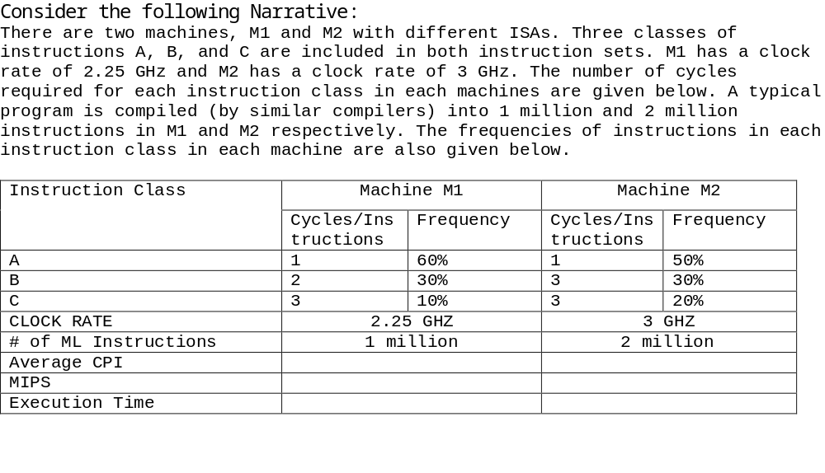
Find Average CPIs, MIPS ratio & Exec time ratio?
Which is faster, M1 or M2?
Chapter 1 — Computer Abstractions and Technology — <number>

Slide 51
Multiprocessors
Multicore microprocessors
  More than one processor per chip
Requires explicitly parallel programming
  Compare with instruction level parallelism
    Hardware executes multiple instructions at once
    Hidden from the programmer
  Hard to do
    Programming for performance
    Load balancing
    Optimizing communication and synchronization
Chapter 1 — Computer Abstractions and Technology — <number>
Notes:
Morgan Kaufmann Publishers
Chapter 1 — Computer Abstractions and Technology

Slide 52

SPEC CPU Benchmark
Programs used to measure performance
  Supposedly typical of actual workload
Standard Performance Evaluation Corp (SPEC)
  Develops benchmarks for CPU, I/O, Web, …
SPEC CPU2006
  Elapsed time to execute a selection of programs
    Negligible I/O, so focuses on CPU performance
  Normalize relative to reference machine
  Summarize as geometric mean of performance ratios
    CINT2006 (integer) and CFP2006 (floating-point)
Chapter 1 — Computer Abstractions and Technology — <number>
Notes:
Morgan Kaufmann Publishers
Chapter 1 — Computer Abstractions and Technology

Slide 53

CINT2006 for Intel Core i7 920
https://www.spec.org/cpu2006/CINT2006/
Chapter 1 — Computer Abstractions and Technology — <number>
Notes:
Morgan Kaufmann Publishers
Chapter 1 — Computer Abstractions and Technology

Slide 54

Power Trends
§1.7 The Power Wall
In CMOS IC technology
×30
5V → 1V
×1000
Chapter 1 — Computer Abstractions and Technology — <number>
Notes:
Morgan Kaufmann Publishers
Chapter 1 — Computer Abstractions and Technology

Slide 55

Reducing Power
Suppose a new CPU has
  85% of capacitive load of old CPU
  15% voltage and 15% frequency reduction
The power wall
  We can’t reduce voltage further
  We can’t remove more heat
How else can we improve performance?
Chapter 1 — Computer Abstractions and Technology — <number>
Notes:
Morgan Kaufmann Publishers
Chapter 1 — Computer Abstractions and Technology

Slide 56

SPEC Power Benchmark
Power consumption of server at different workload levels
  Performance: ssj_ops/sec
  Power: Watts (Joules/sec)
Chapter 1 — Computer Abstractions and Technology — <number>
Notes:
Morgan Kaufmann Publishers
Chapter 1 — Computer Abstractions and Technology

Slide 57
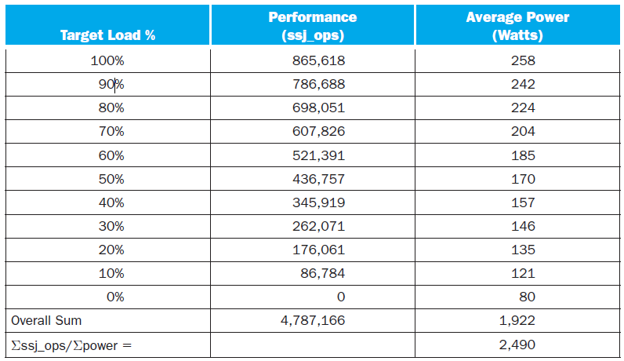
SPECpower_ssj2008 for Xeon X5650
Chapter 1 — Computer Abstractions and Technology — <number>
Notes:
Morgan Kaufmann Publishers
Chapter 1 — Computer Abstractions and Technology

Slide 58


Pitfall: Amdahl’s Law
Improving an aspect of a computer and expecting a proportional improvement in overall performance
§1.10 Fallacies and Pitfalls
Example: multiply accounts for 80s/100s
  How much improvement in multiply performance to get 5× overall?
  Can’t be done!
Corollary: make the common case fast
Chapter 1 — Computer Abstractions and Technology — <number>
Notes:
Morgan Kaufmann Publishers
Chapter 1 — Computer Abstractions and Technology

Slide 59
Fallacy: Low Power at Idle
Look back at i7 power benchmark
  At 100% load: 258W
  At 50% load: 170W (66%)
  At 10% load: 121W (47%)
Google data center
  Mostly operates at 10% – 50% load
  At 100% load less than 1% of the time
Consider designing processors to make power proportional to load
Chapter 1 — Computer Abstractions and Technology — <number>
Notes:
Morgan Kaufmann Publishers
Chapter 1 — Computer Abstractions and Technology

Slide 60

Pitfall: MIPS as a Performance Metric
MIPS: Millions of Instructions Per Second
  Doesn’t account for
    Differences in ISAs between computers
    Differences in complexity between instructions
  CPI varies between programs on a given CPU
Chapter 1 — Computer Abstractions and Technology — <number>
Notes:
Morgan Kaufmann Publishers
Chapter 1 — Computer Abstractions and Technology

Slide 61
Next – Abstractions & ISA
The BIG Picture
Abstraction helps us deal with complexity
  Hide lower-level detail
Instruction set architecture (ISA)
  The hardware/software interface
Application binary interface
  The ISA plus system software interface
Implementation
  The details underlying and interface
Chapter 1 — Computer Abstractions and Technology — <number>
Notes:
Morgan Kaufmann Publishers
Chapter 1 — Computer Abstractions and Technology

Slide 62
Concluding Remarks
Cost/performance is improving
  Due to underlying technology development
Hierarchical layers of abstraction
  In both hardware and software
Instruction set architecture
  The hardware/software interface
Execution time: the best performance measure
Power is a limiting factor
  Use parallelism to improve performance
§1.9 Concluding Remarks
Chapter 1 — Computer Abstractions and Technology — <number>
Notes:
Morgan Kaufmann Publishers
Chapter 1 — Computer Abstractions and Technology

Slide 63

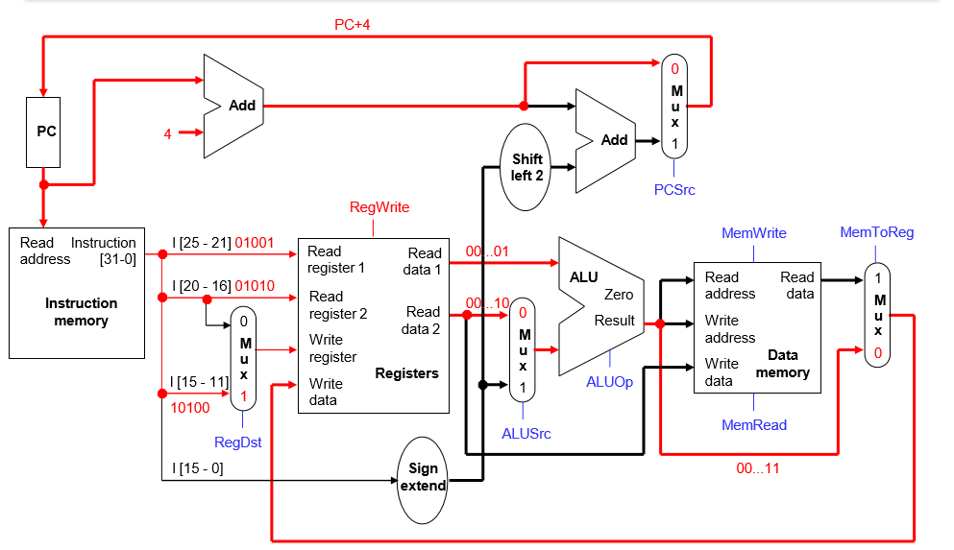
Compare ADD Vs LW
Chapter 1 — Computer Abstractions and Technology — <number>

