Slide 1
Chapter 2
Instructions: Language of the Computer

Slide 2
Instruction Set
§2.1 Introduction
The repertoire of instructions of a computer
Different computers have different Instruction sets
But with many aspects in common
Early computers had very simple instruction sets
Simplified implementation
Many modern computers also have simple instruction sets

Slide 3
ISA - what it includes?
Instruction Set and Instruction Formats
Modes of Addressing
Accessing Data Items and Instructions
Exceptional Conditions handling
Characteristics and Choreography of principle functional units (ALU, Registers, RAM etc.)
Information flows between such components and the control logic of such information flows
Register Transfer Language (RTL) Description

Slide 4
Example ISAs
Digital Alpha (v1, v3) 1992-97
HP PA-RISC (v1.1, v2.0) 1986-96
Sun Sparc (v8, v9) 1987-95
SGI MIPS (MIPS I, II, III, IV, V) 1986-96
Intel (8086,80286,80386, 1978- 80486,P-P4, MMX,
Celeron, Ppro, Xeon,
IA-32, IA-64, I7)
We will focus on MIPS ISA

Slide 5
ISA - Design Issues
Can it be implemented? Cost and time?
Can it be programmed? Ease of compilation?
Instruction length /program length in memory?
Number of instructions need to be executed?
How many clocks required per instruction?
Bytes flow from Main memory to CPU?
NOTE: this also depends on instructions set, processor organization, and
compilation techniques.

Slide 6
The MIPS Instruction Set
Used as the example throughout the book
Stanford MIPS commercialized by MIPS Technologies (www.mips.com)
Large share of embedded core market
Applications in consumer electronics, network/storage equipment, cameras, printers, …
Typical of many modern ISAs
ARM
See MIPS Reference Data tear-out card, and Appendixes B and E

Slide 7
MIPS ISA
ISA is an abstraction of Machine code- it is the Language of the Machine
More primitive than higher level languages e.g. no sophisticated control flow and very restrictive instructions
MIPS is similar to other architectures developed since the 1980's
MIPS is used by NEC, Nintendo, Silicon Graphics, Sony , AMD
Goal: maximize performance, minimize cost,
reduce design time

Slide 8
MIPS- special features
MIPS is a RISC, a compact and simple ISA
Instruction length is fixed - 32 bits
Simple Instruction Formats- 3 Types [ R-I-J formats]
Register file is small- 32 32-bit GPR
Reg-Reg 3 address arithmetic format
Only LW and SW can access main memory
LW and SW has only base+displace address
Simple Branching (bne and beq only)
Delayed Branch etc.
Simple Implementation ➔ low power, less heat

Slide 9
Typical Machine Operations
Data Movement
Load (from memory)
Store (to memory)
memory-to-memory move
register-to-register move
input (from I/O device)
output (to I/O device)
push, pop (to/from stack)
Arithmetic
integer (binary + decimal) or FP
Add, Subtract, Multiply, Divide
Shift
shift left/right, rotate left/right
Logical
not, and, or, set, clear
Control (Jump/Branch)
unconditional, conditional
Subroutine Linkage
call, return
Interrupt
trap, return
Synchronization
test & set (atomic r-m-w)
String
search, translate
Graphics (MMX)
parallel subword ops (4 16bit add)

Slide 10
Typical Top 10 Instructions

Slide 11
Main Machine Instructions
Support at least these simple but more frequent instructions in ISA, since they will dominate the number of instructions executed:
add, subtract
load, store
move register-register
and
shift
compare equal, compare not equal
branch, jump
call & return

Slide 12
R[rd] ⬅ R[rt] op R[rs]
R – Format
Instructions
Arithmetic: ADD, SUB, ..
Logical: AND, OR, …
Other: SLT, ……

Slide 13
Arithmetic Operations
MIPS Assembly code
Add and subtract, three operands
Two sources and one destination
add a, b, c # a gets b + c
All arithmetic operations have this form
Design Principle 1: Simplicity favors regularity
Regularity makes implementation simpler
Simplicity enables higher performance at lower cost
§2.2 Operations of the Computer Hardware

Slide 14
Arithmetic Example
C code:
f = (g + h) - (i + j);
MIPS Assembly code:
add t0, g, h # temp t0 = g + h add t1, i, j # temp t1 = i + j sub f, t0, t1 # f = t0 - t1

Slide 15
MIPS ISA - ADD
Example: C code: A = B + C
MIPS Assembly add A, B, C
-No variable names in Machine Code
- Assembler associate registers with variables, A in $s0, …
MIPS ISA: add $s0, $s1, $s2
MIPS Machine Code:
0000010001100101000000000100000
000000
10001
10010
10000
00000
100000
A- $S0 or $16

Slide 16
R-type - ADD
C code: A = B + C
MIPS code: add $rd, $rs, $rt
ADD
Assume
B and C are already loaded into $rs and $rt respt.
The result B+C will be stored into $rd
Registers
ADD-32
Control
fields
000000
rs
rt
rd
-
100000
bits
6
5
5
5
5
6

Slide 17
Simplicity favors regularity !
All MIPS instruction are 32 bits long
MIPS have only 3 instruction formats
All operands are registers (GPRs) or immediate values
Operand order is fixed (destination last)

Slide 18
General Purpose Registers (GPR)
All machines use GPR Since 1975
Registers are in chip - faster than memory
Flexible for a compiler to use - even in parallel
e.g., (A*B) – (C*D) – (E*F) do multiplies in any order
Memory traffic is reduced- program is sped up
Code density improves - named with fewer bits
Spilling- if it can’t hold all variables,
‘spilled’ to main memory (eg. array, fn call]
°
•
-

Slide 19
MIPS: Software conventions for Registers
0 zero constant 0
1 at reserved for assembler
2 v0 expression evaluation &
3 v1 function results
4 a0 arguments
5 a1
6 a2
7 a3
8 t0 temporary: caller saves
. . . (callee can clobber)
15 t7
16 s0 callee saves
. . . (caller can clobber)
23 s7
24 t8 temporary (cont’d)
25 t9
26 k0 reserved for OS kernel
27 k1
28 gp Pointer to global area
29 sp Stack pointer
30 fp frame pointer
31 ra Return Address (HW)
In ISA-Registers will be indicated by
$0 (or $zero) , $1 [or $at], and so on..

Slide 20
Smaller is faster !
Only 32 registers provided.
This decrease complexity of the design
increase execution time
only 5 bits are needed for naming them
MIPS Registers are pre-allocated for different tasks
E.g $0=0,
$1 – for assembler, etc.

Slide 21
The Constant Zero
MIPS register 0 ($zero) is the constant 0
Cannot be overwritten
Useful for common operations
E.g. 1: move between registers
add $t2, $s1, $zero (R[t2] ← R[s1])
move $t2, $zero (assembly)
E.g.2: to load immediate value in a register
ori $t1, $0, 5 ( R[t1] ← 5 )
li $t1, 5 (assembly)

Slide 22
MIPS R-format Instructions
op
rs
rt
rd
shamt
funct
6 bits
5 bits
5 bits
5 bits
5 bits
6 bits
Instruction fields
op: operation code (opcode)
rs: first source register number
rt: second source register number
rd: destination register number
shamt: shift amount (00000 for now)
funct: function code (extends opcode)

Slide 23
R-format Example
op
rs
rt
rd
shamt
funct
6 bits
5 bits
5 bits
5 bits
5 bits
6 bits
add $t0, $s1, $s2
special
$s1
$s2
$t0
0
add
0
17
18
8
0
32
000000
10001
10010
01000
00000
100000
000000 – Distinguishes R-Type from other types
10001100100100000000100000₂ = 02324020₁₆

Slide 24
R-type – ADD & SUB
C code: A = B + C
MIPS code: add $16, $17, $18
fields
0
17
18
16
-
32
bits
6
5
5
5
5
6
MIPS Machine Code :
000000
10001
10010
10000
00000
100000
For all arithmetic operation op-code is zero.
For subtraction, function code is 34
000000
10001
10010
10000
00000
100010
+ and - differs only on one bit- easy for implementation

Slide 25
RTL – Register Transfer Language
add $rd, $rs, $rt
R[rd] ⬅ R[rt] + R[rs]

Slide 26
R-type - Arithmetic
C code: A = B op C
MIPS code: op $rd, $rs, $rt
ADD-?? SUB-??
Registers
ADD-32 SUB-34
Control
fields
000000
rs
rt
rd
-
fnCode
bits
6
5
5
5
5
6

Slide 27
R-Type: Logical Operations
Instructions for bitwise manipulation
§2.6 Logical Operations
Operation | C | Java | MIPS
Shift left | << | << | sll
Shift right | >> | >>> | srl
Bitwise AND | & | & | and
Bitwise OR | | | | | or
Bitwise NOT | ~ | ~ | nor
Useful for extracting and inserting groups of bits in a word

Slide 28
Shift: Logical (SLL & SRL)
op
rs
rt
rd
shamt
funct
6 bits
5 bits
5 bits
5 bits
5 bits
6 bits
shamt: how many positions to shift
Shift left logical ($rs not used)
Shift left and fill with 0 bits
sll by i bits multiplies by 2^{i}
Shift right logical
Shift right and fill with 0 bits
srl by i bits divides by 2^{i} (unsigned only)

Slide 29
Shift: Arithmetic (SRA only)
op
rs
rt
rd
shamt
funct
6 bits
5 bits
5 bits
5 bits
5 bits
6 bits
Arithmetic shift is relevant when shifting 2’s compliment numbers right only.
SRA : Shift right arithmetic- MSBs will be filled with the sign bits- not zeros [divides by 2i
Shift right and fill with MSB bit
There is no SLA in MIPS
Overflow possible

Slide 30
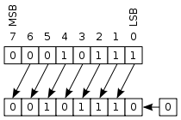
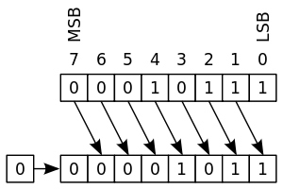
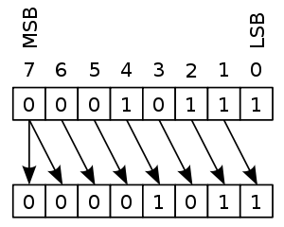
Shift- Logical Vs Arithmetic
SLL
SRL
SLA
SRA
not available
sign-bit will be lost

Slide 31
More on Shift
sll Shift left logical by a constant number of bits (immediate value)
sllv Shift left logical by a variable number of bits
srl Shift right logical by a constant number of bits
srlv Shift right logical by a variable number of bits
sra Shift right arithmetic by a constant number of bits
srav Shift right arithmetic by a variable number of bits
sll $rd, $rt, shift_amt ($rs not used)
sllv $rd, $rt, $rs ($rs has the shift amount)
srl $rd, $rt, shift_amt
srlv $rd, $rt, $rs
sra $rd, $rt, shift_amt (arithmetic shift- sign?)
srav $rd, $rt, $rs

Slide 32
Shift
representations for bitshift logical operators.
Instruction | B₃₁₋₂₆ | B₂₅₋₂₁ | B₂₀₋₁₆ | B₁₅₋₁₁ | B₁₀₋₆ | B₅₋₀
 | opcode | register s | register t | register d | shift amount | function
sll $rd, $rt, shift_amt | 000 000 (SPECIAL) | unused | - | - | shift_amt | 000 000
sllv $rd, $rt, $rs | 000 000 (SPECIAL) | - | - | - | 00000 | 000 100
srl $rd, $rt, <shift_amt> | 000 000 (SPECIAL) | unused | - | - | shift_amt | 000 010
srlv $rd, $rt, $rs | 000 000 (SPECIAL) | - | - | - | 00000 | 000 110
sra $rd, $rt, <shift_amt> | 000 000 (SPECIAL) | unused | - | - | shift_amt | 000 011
srav $rd, $rt, $rs | 000 000 (SPECIAL) | - | - | - | 00000 | 000 111

Slide 33
AND Operations
Useful to mask bits in a word
Select some bits, clear others to 0
and $t0, $t1, $t2
$t2
0000 0000 0000 0000 0000 1101 1100 0000
$t1
0000 0000 0000 0000 0011 1100 0000 0000
$t0
0000 0000 0000 0000 0000 1100 0000 0000

Slide 34
OR Operations
Useful to include bits in a word
Set some bits to 1, leave others unchanged
or $t0, $t1, $t2
$t2
0000 0000 0000 0000 0000 1101 1100 0000
$t1
0000 0000 0000 0000 0011 1100 0000 0000
$t0
0000 0000 0000 0000 0011 1101 1100 0000

Slide 35
NOT Operations
Useful to invert bits in a word
Change 0 to 1, and 1 to 0
MIPS has NOR 3-operand instruction
a NOR b == NOT ( a OR b )
nor $t0, $t1, $zero
Register 0: always read as zero
$t1
0000 0000 0000 0000 0011 1100 0000 0000
$t0
1111 1111 1111 1111 1100 0011 1111 1111

Slide 36
R- Format: ISA encoding Examples
add $16,$2,$15
sub $16,$2,$15
and $16,$2,$15
or $16,$2,$15
sllv $16,$2,$15
srlv $16,$2,$15
slt $16,$2,$15
addu $16,$2,$15
add
0
2
15
16
0
32
sub
0
2
15
16
0
34
and
0
2
15
16
0
36
or
0
2
15
16
0
shl
0
2
15
16
shr
0
2
15
16
add and sub differ only by one bit

Slide 37
R-type - General
ADD-? ADDU - ? SUB-? AND-? OR - ?
C code: A = B op C
MIPS code: op $rd, $rs, $rt
SLT - ?
Registers
Control
fields
000000
rs
rt
rd
?
fnCode
bits
6
5
5
5
5
6

Slide 38
I- Format
Instructions
Immediate Value Included
In the statement.
Data Transfer: LW, SW
Arithmetic with Immediate: addI, …
Conditional Branching
Do-While Loop

Slide 39
Immediate
Arithmetic

Slide 40
Immediate Operands
Design Principle 3: Make common case fast
Small constants are common (e.g. for loop)
Immediate operand avoids a load instruction
Constant data specified in an instruction
addi $s3, $s3, 4
No subtract immediate instruction
Just use a negative constant
addi $s2, $s1, -1

Slide 41
Immediate Arithmetic
addi $rd, $rs, $rt
Can we use R-format?
fields
op
rs
rt
rd
shamt
funct
bits
6
5
5
5
5
6
op field is special purpose and already allocated
funct code depend on op field - may be reallocated
To keep R- format, I may get maximum 6 bits only
Immediate value +/- 32 is NOT SUFFICIENT

Slide 42
MIPS I-format Instructions
op
rs
rt
I- constant (or address)
6 bits
5 bits
5 bits
16 bits
Design Principle 4: Good design demands good compromises
Compromise uniqueness- introduce a new type
Different formats complicate decoding,
but allow 32-bit instructions uniformly
Keep formats as similar as possible
Immediate arithmetic and load/store instructions
rt: destination or source register number
Constant: Represented as a 16-bit 2’s complement
Range of I is –2¹⁵ to +2¹⁵ – 1
(next) Address: offset added to base address in rs

Slide 43
Logical Immediate Operations
Instructions for bitwise manipulation
§2.6 Logical Operations
Operation | C | Java | MIPS
Bitwise AND | & | & | andi
Bitwise OR | | | | | ori
Bitwise XOR | ~ | ~ | xori
ori $16, $0, 5 (what will happen?)
li $16, 5 (is this pseudo?)

Slide 44
DATA TRANFER

Slide 45
Memory Operands
Main memory used for composite data
Arrays, structures, dynamic data
To apply arithmetic operations
Load values from memory into registers
Store result from register to memory
Memory is byte addressed
Each address identifies an 8-bit byte
Words are aligned in memory
Address must be a multiple of 4
MIPS is Big Endian
Most-significant byte at the least address of a word
c.f. Little Endian: least-significant byte at least address

Slide 46
Memory Organization
Viewed as a large, single-dimension array.
A memory address is an index
into the array
"Byte addressing" means that the
index points to a byte of memory.
MIPS words are 32 bit long
MIPS can address 2³² bytes
or 2³⁰ words (what are 2 lsb’s ?]
0
8 bits of data
1
8 bits of data
2
8 bits of data
3
8 bits of data
4
8 bits of data
5
8 bits of data
6
8 bits of data
0
32 bits of data
4
32 bits of data
Alignment: require that objects fall on
address that is multiple of their size.
Can’t address in middle.
Always MIPS address has two zero lsb
8
32 bits of data
...
12
32 bits of data
...

Slide 47
Registers vs. Memory
Registers are faster to access than memory
Operating on memory data requires loads and stores
More instructions to be executed
Compiler must use registers for variables as much as possible
Only spill to memory for less frequently used variables
Register optimization is important!

Slide 48
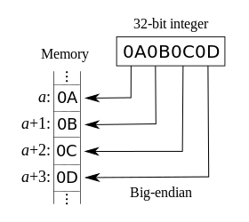
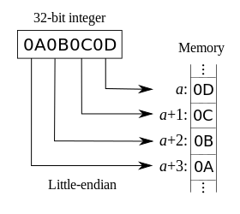
Big Vs Little Endian
MIPS & Networks use Big Endian
Similar to Left to Right reading
Intel- X86 use Little Endian
LLL rule : Little-Low-Least
Example: 0000 1010 0000 1011 0000 1100 0000 1101

Slide 49
Memory Operand Example 1
C code: g = h + A[8];
g in $s1, h in $s2, base address of A in $s3
Compiled MIPS code:
Index 8 requires offset of 32
4 bytes per word
lw $t0, 32($s3) # load word add $s1, $s2, $t0
offset
base register

Slide 50
Memory Operand Example 2
C code:
A[12] = h + A[8];
h in $s2, base address of A in $s3
Compiled MIPS code:
Index 8 requires offset of 32
lw $t0, 32($s3) # load word add $t0, $s2, $t0 sw $t0, 48($s3) # store word

Slide 51
Data Transfer Instructions
General format - LOAD WORD lw rt , offset(rs)
effect is rt ⬅ mem [rs + offset]
General format - STORE WORD sw rt , offset(rs)
effect is mem [rs + offset] ⬅ rt
Store word is destination first ?
where rs contain base address, and
offset is an immediate value
C code: A[8] = A[8]+ h; h is in $s2 MIPS code: lw $t0, 32($s3) ; A’s base in $s3 add $t0, $s2, $t0 ; h is in $s2 sw $t0, 32($s3)

Slide 52
Data Transfer Instructions
Only two types of Data transfer (Mem ←→Reg]
Only two (Load / Store] can access main memory.
Use only one addressing mode, base+offset
lw rt, I(rs)
I- format is used.
sw rt, I(rs)
fields
op
rs
rt
I
bits
6
5
5
16
OP-codes; lw: 35, sw:35+8
Why not R-format? I may get max 6 bits only
Array size 64 is not sufficient for programs
I-format is good- it allows 16 bits for offset

Slide 53
LW & SW: Example-3
Compiler already placed the value k in $5 and
array v’s start address on $4
add $8,$5,$5
add $8,$8,$8
add $8,$4,$8
lw $16, 4($8)
sw $16, 0($8)
v[k] = v[k+1];
First two instructions calculates 4 * k (in R[8]).
Next, v[k]’s position is calculated; v + 4k (in R[8])
Next, load word from v[k+1] to R[16].
Next, store word from R[16] to v[k]
Write MIPS codes; op-codes; lw: 35, sw:35 +8
op
rs
rt
I
6
5
5
16

Slide 54
LW & SW: Example- 4: SWAP
Compiler already placed the value k in $5 and
array v’s start address on $4
add $8,$5,$5
add $8,$8,$8
add $8,$4,$8
lw $15, 0($8)
lw $16, 4($8)
sw $16, 0($8)
sw $15, 4($8)
int temp;
temp = v[k];
v[k] = v[k+1];
v[k+1] = temp;
Compiler allocates space for the variable temp in
register 15

Slide 55
I-format ISA encoding
lw $15, 20 ($2)
sw $15, 20 ($2)
addi $15, $2, 20
add $16,$2,$15
sub $16,$2,$15
lw and sw differ only by one bit
lw
35
2
15
20
sw
43
2
15
20
addi
8
2
15
20
add
0
2
15
16
0
32
sub
0
2
15
16
0
34
lw
100011
00010
011111
0000000000010100
sw
101011
00010
01111
0000000000010100
addi
001100
00010
01111
0000000000010100
add
000000
00010
01111
10000
00000
100000
sub
000000
00010
01111
10000
00000
100010

Slide 56
CONDITIONAL
BRANCING

Slide 57
Basic Blocks
A basic block is a sequence of instructions with
No embedded branches (except at end)
No branch targets (except at beginning)
A compiler identifies basic blocks for optimization
An advanced processor can accelerate execution of basic blocks

Slide 58
Stored Program Concept & Conditional Branch & PC & IR
Instructions are 32 – bits binary encoded numbers
Programs are stored in memory — to be read or written just like data
A special register PC contains the address of the next instruction-usually the next one to the current being executed (PC ← PC+4]
A special register IR contains the current instruction being executed (not always)
A branch instruction may change PC, PC ← PC + ?
Branch gives the power and challenge.

Slide 59
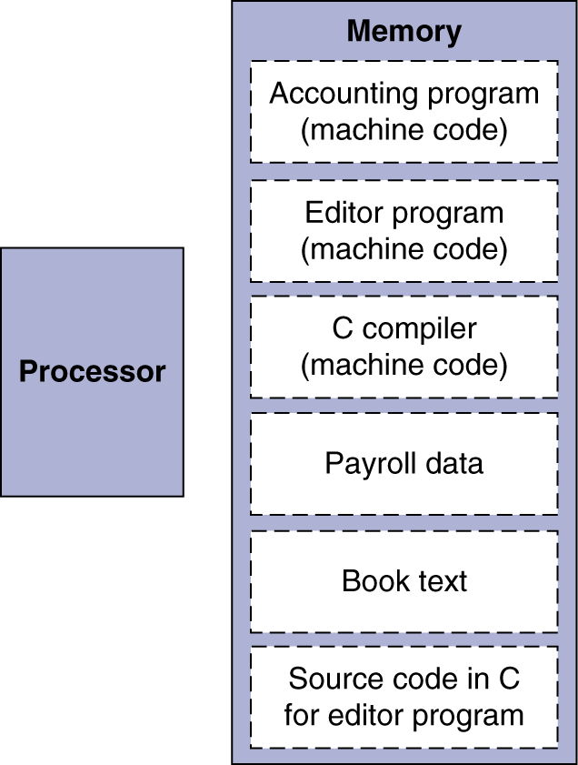
Stored Program Computers
The BIG Picture
Instructions represented in binary, just like data
Instructions and data stored in memory
Programs can operate on programs
e.g., compilers, linkers, …
Binary compatibility allows compiled programs to work on different computers
Standardized ISAs

Slide 60
Fetch & Execute Cycle
PC gives address of next instruction
Instructions are fetched and put into a special register IR
And then PC←PC+4
Bits in the register IR "control" the subsequent actions.
A branch or jump instruction may change PC again
Fetch the “next” instruction (address of it is in PC now] and continue
New PC value
4
+
Memory
instruction
address
IR
PC
A Multi-Cycle Scenario!
In single cycle- only one clock tick to write, IR is not necessary

Slide 61
Conditional Branch
Instructions are 32– bits binary encoded numbers
Programs are stored in memory — to be read or written just like data
A special register PC contains the address of the next instruction-usually the next one to the current being executed (PC ← PC+4]
A special register IR contains the current instruction being executed (not always)
A branch instruction may change PC, PC ← PC + ?
Branch gives the power and challenge

Slide 62
Branch - BEQ
If-else ?
28
add Rb Rb Rb
If (A != B) A ← A + B; B ← 2 * B;
24
add Ra Ra Rb
20
beq Ra Rb 2
Suppose A = 1 , B = 3
and A is in Ra and B is in Rb
PC
+2*4
20
+4
IR
beq Ra Rb 2
CTRL
ALU
Ra
00000..0000000001
Rb
00000--0000000011
Ra = Rb ?

Slide 63
conditional branch- BNQ & BEQ
bne $t0, $t1, offset
if ($t0!=$t1) pc←pc+4*offset
beq $t0, $t1, offset
if ($t0=$t1) pc←pc+4*offset
offset is an immediate +/- value which gives a PC relative word distance
Cannot do IF- ELSE now ? : Need to study J

Slide 64
Encoding - Conditional branch
Research shows conditional branch jumps only small distance related to current instruction position
PC related 16 bit immediate is sufficient for this
Therefore, I-type format can be used
Instructions are words- word distance is used
Should jump both sides- 2’s compliment number format used
bne $t0, $t1, 20
beq $t0, $t1, 20
bne
05
2
3
20
beq
04
2
3
20
bne
000101
00010
00011
0000000000010100
beq
000100
00010
00011
0000000000010100

Slide 65
Encoding -Example
If (A != B) A ← A + B; B ← 2 * B;
28
add $8 $8 $8
24
add $7 $7 $8
20
beq $7 $8 2
Suppose A is in $7 and B is in $8
add
000000
01000
01000
01000
000000
010000
add
000000
00111
00111
01000
00000
010000
beq
000100
00111
01000
000000000000010
MIPS- Assembly
bne $7, $8, Label
add $7, $7, $8 Label:
add $8, $8, $8

Slide 66
MIPS- Assembler use LABELS
score = 0 answer =3 stAnswer =4
If (answer == stAnswer) score +=4
.globl main
.data
.text
main:
ori $t0, $0, 0
ori $t1 $0, 4
ori $t2, $0, 2
bne $t1, $t2, SKIP
addi $t0, $t0, 4
SKIP:
move $t4, $t0
bne $t1, $t2, 2
addi $t0, $t0, 4
move $t4, $t0
bne $t1, $t2, 8 ??

Slide 67
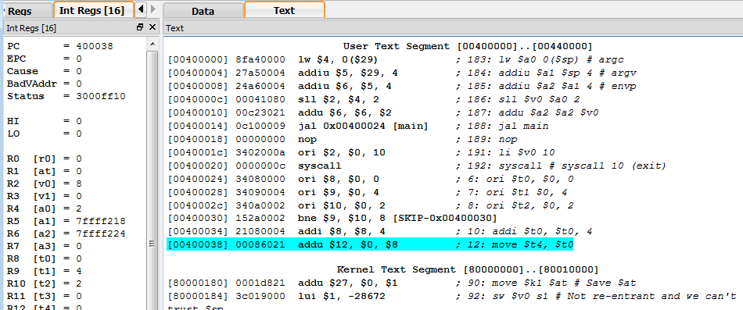
.globl main.
main:
ori $t0, $0, 0
ori $t1 $0, 4
ori $t2, $0, 2
bne $t1, $t2, SKIP
addi $t0, $t0, 4
SKIP:
move $t4, $t0
Check PC
Check Registers
Check MIPS ISA
Check MIPS ML, and in Hex
Check SPIM code
Check for psuedo codes.

Slide 68
Can we do IF_ELSE now?
score = 0 answer =3 stAnswer =4
If (answer == stAnswer) score +=4 else score -= 2;
.globl main
.data
.text
main:
ori $t0, $0, 0
ori $t1 $0, 4
ori $t2, $0, 2
bne $t1, $t2, SKIP
addi $t0, $t0, 4
SKIP:
addi $t0, $t0, -2 ???
bne $t1, $t2, 2
addi $t0, $t0, 4
addi $t0, $t0, -2 ???
Cannot do IF- ELSE now - why? : Need to study J

Slide 69
Encoding -Example
Suppose the address A1 is in PC now. The current state of the register is given on the left. What will be the state of the register when PC is A1 + 12
$8
00000000000000000000000000000001
$7
00000000000000000000000000000001
$6
00000000000000000000000000000011
A1+8
000000 01000 01000 01000 00000 100000
A1+4
000000 00111 00111 00111 00000 100000
A1
000100 00111 01000 0000000000000010
PC
$8
??
A1
$7
??
$6
??

Slide 70
Loop – Do While
S← 0
Finally, what will be in $s0?
addi $t0, $0, 5
addi $s0, $0, 0
add $s0, $s0, $t0
addi $t0, $t0, -1
bne $t0, $0, -2
t ← 5
S ← S + t
N
t ← t - 1
t = 0 ?
Y

Slide 71
Loop – Do While: FACT
S ← ?
Calculate 5!, and
leave it in $s0?
addi $t0, $0, 5
addi $s0, $0, ?
??? $s0, $s0, $t0
addi $t0, $t0, -1
bne $t0, $0, -2
t ← 5
S ← ???
N
t ← t - 1
t = 0 ?
Y

Slide 72
J- Format
Instructions
Unconditional Jumping
& IF- THEN- ELSE
& While-Do
& proc call

Slide 73
Unconditional jump – J Format
Research shows unconditional branch jumps far distances. 16 bit offset is not sufficient
Another compromise- a new format (j-format] is introduced- opcode differentiates all 3 formats
J-format
02
j address
000010
00000000000000000000010101
6
26
Address in j is an immediate word address-
So two 0’s should be added in last.
Yet first four bites are borrowed from PC.
Only can jump to part of RAM related to PC.

Slide 74
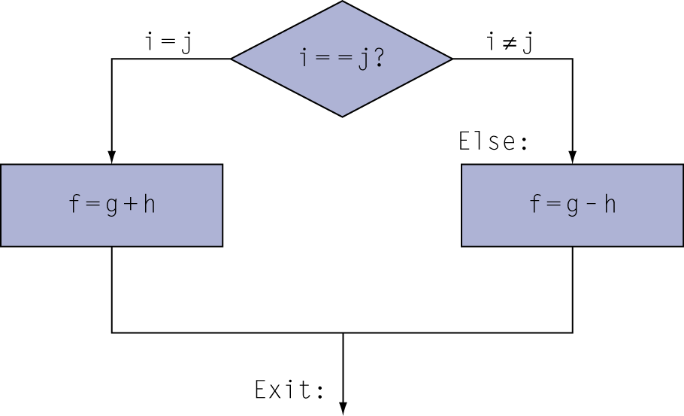
MIPS ISA : If-Else
if (i==j) f = g+h; else f = g-h; g = h
f, g, j in $s0, $s1, …$s4
i== j ?
ELSE
f = g + h
pc ← pc + 3 * 4
J ?
bne $s3, $s4, 3 add $s0, $s1, $s2 j ?? [PC + 8] sub $s0, $s1, $s2 add $s1, $s2, $0
pc ← pc + 2 * 4
f = g - h
g = h
J – need to give almost the full address- only the first 4 bits of PC is used + last 00. 26 + 4 + 2 : bne?
00010110011101000000000000000110 00000010000100011001000000010000 000010??????????????????????????0000001000010001100100000001001000000010000100000000000000010000
00010110011101000000000000000110 00000010000100011001000000010000 000010000000000000000000000000100000001000010001100100000001001000000010000100000000000000010000

Slide 75
MIPS Assembly: If-Else
i== j ?
C code:
if (i==j) f = g+h; else f = g-h; g = h
f, g, … in $s0, $s1, …
Compiled MIPS code:
bne $s3, $s4, Else add $s0, $s1, $s2 j Exit Else: sub $s0, $s1, $s2 Exit: add $s1, 4S2, $0…
f = g + h
Assembler calculates addresses
J exit
ELSE
f = g - h
EXIT
g = h
bne $s3, $s4, 3 add $s0, $s1, $s2 j ?? sub $s0, $s1, $s2 add $s1, $s2, $0

Slide 76
Challenge
if (A ==B) AND (B==C) // Try OR also
code = 1
else
code = 2
Draw flow graph.
Assume A, B, C are in $t0, $t1, $t2,
Put the code in $t3

Slide 77
LOOP with Unconditional jump
beq $s4, $s5, 3 add $s4, $s4, $s5 j ?? sub $s0, $s1, $s2 add $s1, $s2, $0
Example loop:
while ( i !=j )
i=i+j;
loop: beq $s4, $s5, exit; add $s4, $s4, $s5 j loop exit:
i== j ?
LOOP
i= i+j
J - 2
EXIT

Slide 78
LOOP – WHILE DO
beq $s4, $s5, 3 add $s4, $s4, $s5 j ??
Example loop:
while ( i !=j )
i=i+j;
i== j ?
LOOP
00010110100101010000000000000110 00000010100101001010100000010000 000010 ????
i= i+j
J - 2
EXIT

Slide 79
Loop Example
C code:
while (save[i] == k) i += 1;
i in $s3, k in $s5, address of save in $s6
Compiled MIPS code:
Loop: sll $t1, $s3, 2 add $t1, $t1, $s6 lw $t0, 0($t1) bne $t0, $s5, Exit addi $s3, $s3, 1 j Loop Exit: …

Slide 80
Loop – While Do : eg. FACT
Calculate 5!, and put it in $s0?
addi $t0, $0, 5
addi $s0, $0, ?
Loop:
beq $t0, $0, endLoop
mul $s0, $s0, $t0
addi $t0, $t0, -1
j Loop
endLoop:

Slide 81
BLT, BGT ? use SLT
Set result to 1 if a condition is true
Otherwise, set to 0
slt rd, rs, rt
if (rs < rt) rd = 1; else rd = 0;
slti rt, rs, constant
if (rs < constant) rt = 1; else rt = 0;
Use in combination with beq, bne
slt $t0, $s1, $s2 # if ($s1 < $s2) bne $t0, $zero, L # branch to L

Slide 82
BLT & BGT are Pseudo codes
Why not blt, bge, etc in MIPS ISA?
Hardware for <, ≥, … slower than =, ≠
Combining with branch involves more work per instruction, requiring a slower clock
All instructions penalized!
beq and bne are the common case
This is a good design compromise
BLT - assembler convert it to SLT and BEQ
$1 is used by the assembler to store SLT result
Similarly BGE

Slide 83
BLT- Branch if Less Than & BGT
blt $8, $9, label
translates to
slt $1, $8, $9
bne $1, $0, label
bgt $8, $9, label
translates to
slt $1, $8, $9
bne $1, $0, label
BLE- Branch if Less than Equal to & BGE (check whether the opposite is not true)
ble $8, $9, label
translates to
slt $1, $9, $8
beq $1, $0, label
bge $8, $9, label
translates to
slt $1, $9, $8
beq $1, $0, label

Slide 84
Signed vs. Unsigned SLT
Signed comparison: slt, slti
Unsigned comparison: sltu, sltui
Example
$s0 = 1111 1111 1111 1111 1111 1111 1111 1111
$s1 = 0000 0000 0000 0000 0000 0000 0000 0001
slt $t0, $s0, $s1 # signed
–1 < +1 ⇒ $t0 = 1
sltu $t0, $s0, $s1 # unsigned
+4,294,967,295 > +1 ⇒ $t0 = 0

Slide 85
PROCEDURE

Slide 86
Procedure Calling
Steps required
Place parameters in registers
Transfer control to procedure
Acquire storage for procedure
Perform procedure’s operations
Place result in register for caller
Return to place of call
§2.8 Supporting Procedures in Computer Hardware

Slide 87
Register Usage
$a0 – $a3: arguments (reg’s 4 – 7)
$v0, $v1: result values (reg’s 2 and 3)
$t0 – $t9: temporaries
Can be overwritten by callee
$s0 – $s7: saved
Must be saved/restored by callee
$gp: global pointer for static data (reg 28)
$sp: stack pointer (reg 29)
$fp: frame pointer (reg 30)
$ra: return address (reg 31)

Slide 88
Procedure Call Instructions
Procedure call: jump and link (2 tasks)
jal ProcedureLabel
Address of following instruction put in $ra
$ra ← PC + 4
Jumps to target address
PC ← Label
Procedure return: jump register
jr $ra
Copies $ra to program counter
[ j Can also be used for computed jumps]
e.g., for case/switch statements

Slide 89
Add first n numbers (say n = 100)
.globl main
.data
.text
main:
addi $t0 , $0, 100 # $t0 <-- 100 ; used as n?
addi $t1, $0, 0 # $t1 <-- 0 ; used as count, may count downwords
addi $s0 , $0, 0 # $s0 <-- 0 ; used as intermediate sum
loop:
addi $t1, $t1, 1 # count++
add $s0, $s0, $t1 # sum += count
bne $t1, $t0, loop # if (count != 100) branch to loop
# to print sum (in $s0)
move $a0, $s0 # move the answer to $a0
li $v0, 1 # to print the bits in $a0 as integer
syscall
# to exit
li $v0, 10
syscall

Slide 90
Add first n numbers (say n = 100)
JAVA PROGRAM, using a separate method
public void main {
int n = 100;
int m = addUpTo(n);
print(m);
}
private int addUpTo(int n) {
int sum = 0;
do {
sum = sum + n;
n--;
} while ( n != 100)
return sum;
}

Slide 91
Add first n numbers (say n = 100)
main:
addi $t0 , $0, 100 # $t1 <-- 100 ; used as n
move $a0, $t0 # to pass n as the parameter
jal addUpTo
# to print sum (in $s0)
move $a0, $s0 # move the answer to $a0
li $v0, 1 # to print the bits in $a0 as integer
syscall
# to exit
li $v0, 10
syscall
addUpTo:
move $t0, $a0 # may avoid two moves $a0 <- $t0, $t0 <- $a0
addi $t1 , $0, 0 # $t1 <-- 0 ; used as count
addi $s0 , $0, 0 # $s0 <-- 0 ; used as intermediate sum
loop:
addi $t1, $t1, 1 # count++
add $s0, $s0, $t1 # sum += count
bne $t1, $t0, loop # if (count != 100) branch to loop
move $v0, $s0 # return answer in $v0
jr $ra

Slide 92
find max(x,y) (say x = 10, y = 5)
JAVA PROGRAM to find max of two
public void main {
int x = 10, y =5;
int z = max(x, y);
print(z);
}
private int max(int x, int y) {
if (x > y)
return x
else
return y
}

Slide 93
max
main: # program to print max of two numbers
addi $t0 , $0, 10 # $t1 <- 10 used as x
addi $t1 , $0, 5 # $t1 <- 5 used as y
move $a0, $t0
move $a1, $t1
jal max
# to print max(x,y) (returned in $v0)
move $a0, $v0 # move the answer to $a0
li $v0, 1 # to print the bits in $a0 as integer
syscall
# to exit
---
max:
move $t0, $a0 # may avoid two moves $a0 <- $t0, $t0 <- $a0
move $t1, $a1 # may avoid these two moves also
bgt $t0, $t1, if # if x > y goto if
move $v0, $t1 # else return y
j endIF
if:
move $v0, $t0 # return x
endIF:
jr $ra

Slide 94
Revisit: FACT
Calculate 5!, and put it in $s0?
addi $t0, $0, 5
addi $s0, $0, ?
Loop:
beq $t0, $0, endLoop
mul $s0, $s0, $t0
addi $t0, $t0, -1
j Loop
endLoop:
int n = 5; int f = 1; while (n != 0) {
f = f * n–-
}

Slide 95
Leaf Procedure - fact
int fact(int n) { int f=1; while (n != 0){
f = f * n-- ;
} return f; }
Argument n in $a0
Call jal fact
Result in $v0

Slide 96
FACT as Leaf Procedure
Calculate 5!, and put it in $s0?
addi $t0, $0, 5
move $a0, $t0 # need not to save any $t’s
jal FACT
move $s0, $v0
FACT:
addi $s0, $0, 1 # need not to save any $s’s, or $a0
Loop:
beq $a0, $0, endLoop
mul $s0, $s0, $t0
addi $a0, $a0, -1
j Loop
endLoop:
move $v0, $s0 # need not to save the $ra / jal is not called
jr $ra

Slide 97
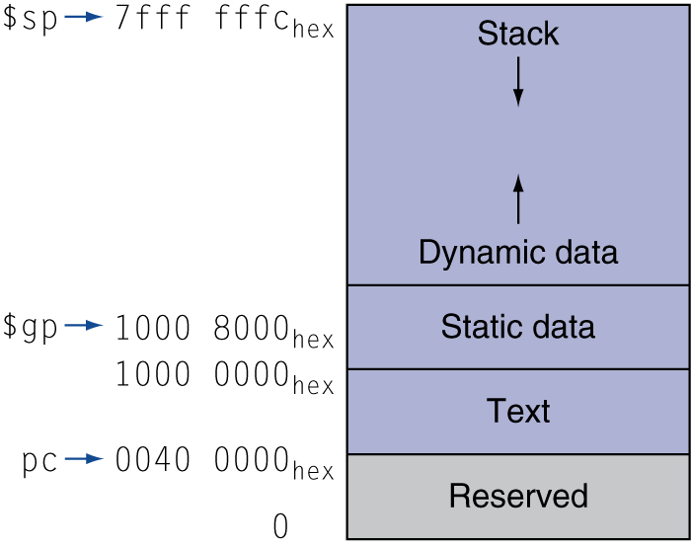
Memory Layout
Text: program code
Static data: global variables
e.g., static variables in C, constant arrays and strings
$gp initialized to address allowing ±offsets into this segment
Dynamic data: heap
E.g., malloc in C, new in Java
Stack: automatic storage

Slide 98
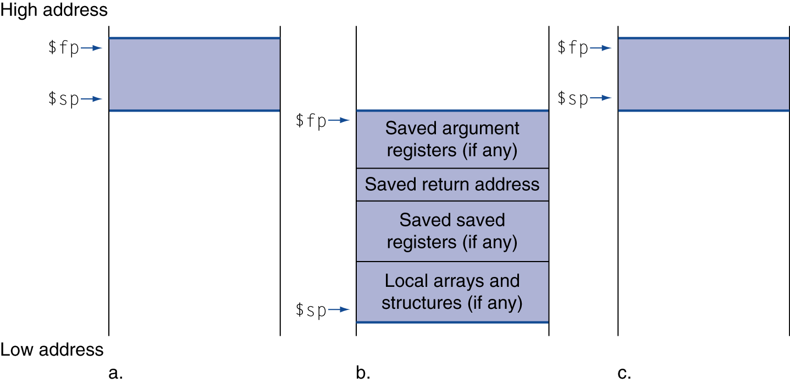
Local Data on the Stack
Local data allocated by callee
e.g., C automatic variables
Procedure frame (activation record)
Used by some compilers to manage stack storage

Slide 99
Leaf Procedure Example
int leaf_example (int g, h, i, j) { int f; f = (g + h) - (i + j); return f; }
Arguments g, …, j in $a0, …, $a3
Call jal leaf
f in $s0 (hence, need to save $s0 on stack)
Do calculation
Restore $s0
return
Result in $v0

Slide 100
Leaf- Procedure Example
Complete!

Slide 101
Non-Leaf Procedures
Procedures that call other procedures
For nested call, caller needs to save on the stack:
Its return address
Any arguments and temporaries needed after the call
Restore from the stack after the call

Slide 102
Non-Leaf Procedure Example
assign n: make sure n >= 0
call fact(n);
int fact (int n) { int f = 1; if (n = 0) return f; else return n * fact(n - 1); }
Argument n in $a0
Result in $v0

Slide 103
Non-Leaf: FACT recursive
fact: bne $a0, $0, L1 # test for n = 0 addi $v0, $zero, 1 # if so, result is 1 addi $sp, $sp, 8 # pop 2 items from stack jr $ra # and return L1: #else prepare for recursive call
addi $sp, $sp, -8 # adjust stack for 2 items sw $ra, 4($sp) # save return address sw $a0, 0($sp) # save argument addi $a0, $a0, -1 # decrement n jal fact # recursive call (fact (n-1) lw $a0, 0($sp) # restore original n lw $ra, 4($sp) # restore return address addi $sp, $sp, 8 # pop 2 items from stack mul $v0, $a0, $v0 # multiply to get result jr $ra # and return

Slide 104
SPIM System Call Codes
Service | Code (put in $v0) | Arguments | Result
print_int | 1 | $a0=integer
print_float | 2 | $f12=float
print_double | 3 | $f12=double
print_string | 4 | $a0=addr. of string
read_int | 5 |  | int in $v0
read_float | 6 |  | float in $f0
read_double | 7 |  | double in $f0
read_string | 8 | $a0=buffer, $a1=length
sbrk | 9 | $a0=amount | addr in $v0
exit | 10

Slide 105
Character Data
Byte-encoded character sets
ASCII: 128 characters
95 graphic, 33 control
Latin-1: 256 characters
ASCII, +96 more graphic characters
Unicode: 32-bit character set
Used in Java, C++ wide characters, …
Most of the world’s alphabets, plus symbols
UTF-8, UTF-16: variable-length encodings
§2.9 Communicating with People

Slide 106
Byte/Halfword Operations
Could use bitwise operations
MIPS byte/halfword load/store
String processing is a common case
lb rt, offset(rs) lh rt, offset(rs)
Sign extend to 32 bits in rt
lbu rt, offset(rs) lhu rt, offset(rs)
Zero extend to 32 bits in rt
sb rt, offset(rs) sh rt, offset(rs)
Store just rightmost byte/halfword

Slide 107
32-bit Constants
Most constants are small
16-bit immediate is sufficient
For the occasional 32-bit constant
lui rt, constant
Copies 16-bit constant to left 16 bits of rt
Clears right 16 bits of rt to 0
§2.10 MIPS Addressing for 32-Bit Immediates and Addresses
lhi $s0, 61
0000 0000 0111 1101 0000 0000 0000 0000
ori $s0, $s0, 2304
0000 0000 0111 1101 0000 1001 0000 0000

Slide 108
Branch Addressing
Branch instructions specify
Opcode, two registers, target address
Most branch targets are near branch
Forward or backward
op
rs
rt
constant or address
6 bits
5 bits
5 bits
16 bits
PC-relative addressing
Target address = PC + offset × 4
PC already incremented by 4 by this time

Slide 109
Jump Addressing
Jump (j and jal) targets could be anywhere in text segment
Encode full address in instruction
op
address
6 bits
26 bits
(Pseudo)Direct jump addressing
Target address = PC_{31…28} : (address × 4)

Slide 110
Target Addressing Example
Loop code from earlier example
Assume Loop at location 80000
Loop: sll $t1, $s3, 2 | 80000 | 0 | 0 | 19 | 9 | 4 | 0
add $t1, $t1, $s6 | 80004 | 0 | 9 | 22 | 9 | 0 | 32
lw $t0, 0($t1) | 80008 | 35 | 9 | 8 | 0
bne $t0, $s5, Exit | 80012 | 5 | 8 | 21 | 2
addi $s3, $s3, 1 | 80016 | 8 | 19 | 19 | 1
j Loop | 80020 | 2 | 20000
Exit: … | 80024

Slide 111
Branching Far Away
If branch target is too far to encode with 16-bit offset, assembler rewrites the code
Example
beq $s0,$s1, L1
↓
bne $s0,$s1, L2 j L1 L2: …

Slide 112
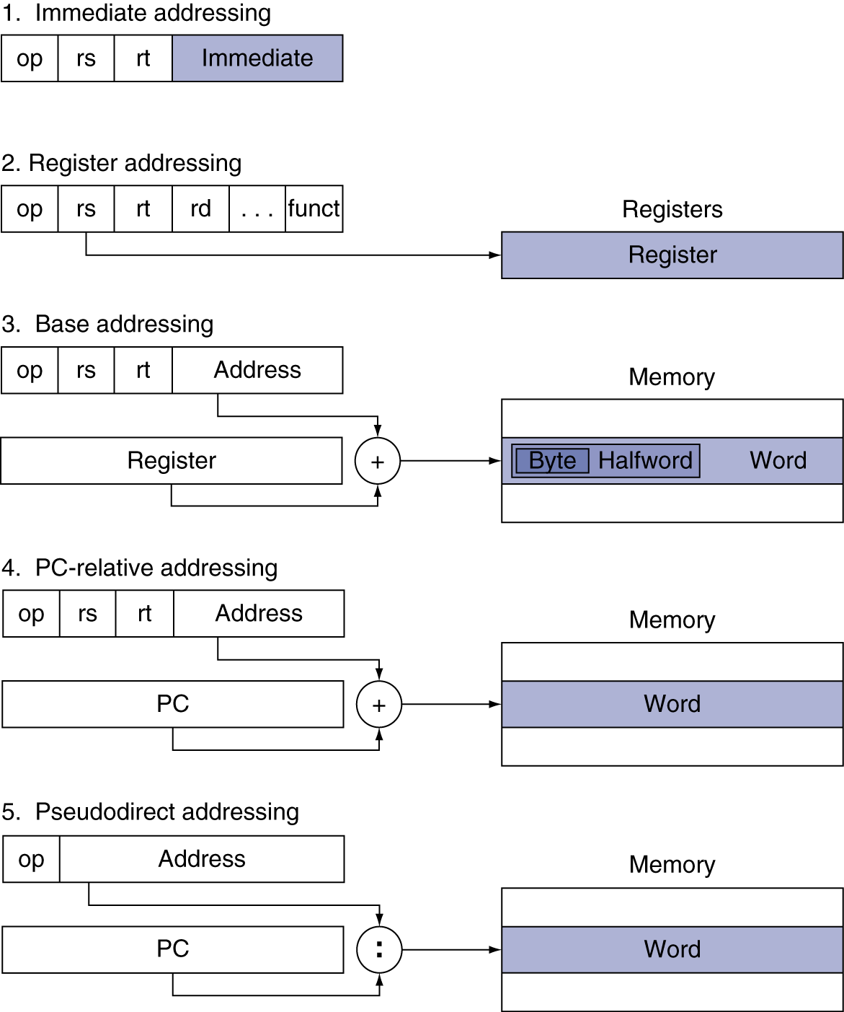
Addressing Mode Summary

Slide 113
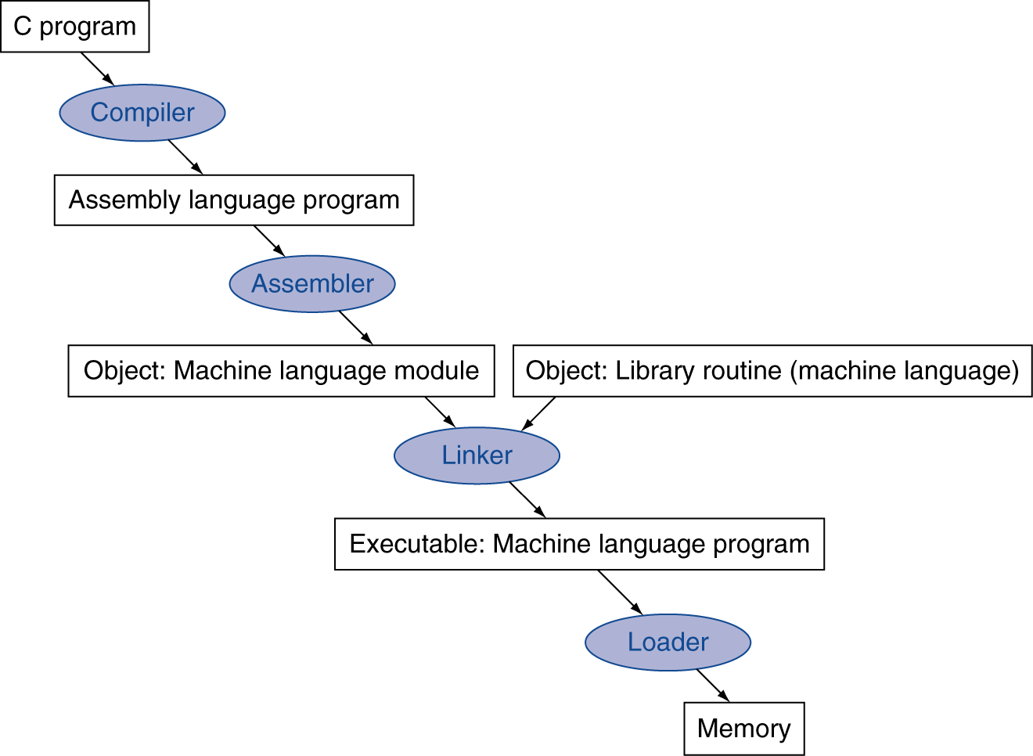
Translation and Startup
Many compilers produce object modules directly
§2.12 Translating and Starting a Program
Static linking

Slide 114
Assembler Pseudoinstructions
Most assembler instructions represent machine instructions one-to-one
Pseudoinstructions: figments of the assembler’s imagination
move $t0, $t1 → add $t0, $zero, $t1
blt $t0, $t1, L → slt $at, $t0, $t1 bne $at, $zero, L
$at (register 1): assembler temporary

Slide 115
Producing an Object Module
Assembler (or compiler) translates program into machine instructions
Provides information for building a complete program from the pieces
Header: described contents of object module
Text segment: translated instructions
Static data segment: data allocated for the life of the program
Relocation info: for contents that depend on absolute location of loaded program
Symbol table: global definitions and external refs
Debug info: for associating with source code

Slide 116
Linking Object Modules
Produces an executable image
1. Merges segments
2. Resolve labels (determine their addresses)
3. Patch location-dependent and external refs
Could leave location dependencies for fixing by a relocating loader
But with virtual memory, no need to do this
Program can be loaded into absolute location in virtual memory space

Slide 117
Loading a Program
Load from image file on disk into memory
1. Read header to determine segment sizes
2. Create virtual address space
3. Copy text and initialized data into memory
Or set page table entries so they can be faulted in
4. Set up arguments on stack
5. Initialize registers (including $sp, $fp, $gp)
6. Jump to startup routine
Copies arguments to $a0, … and calls main
When main returns, do exit syscall

Slide 118
Dynamic Linking
Only link/load library procedure when it is called
Requires procedure code to be relocatable
Avoids image bloat caused by static linking of all (transitively) referenced libraries
Automatically picks up new library versions

Slide 119
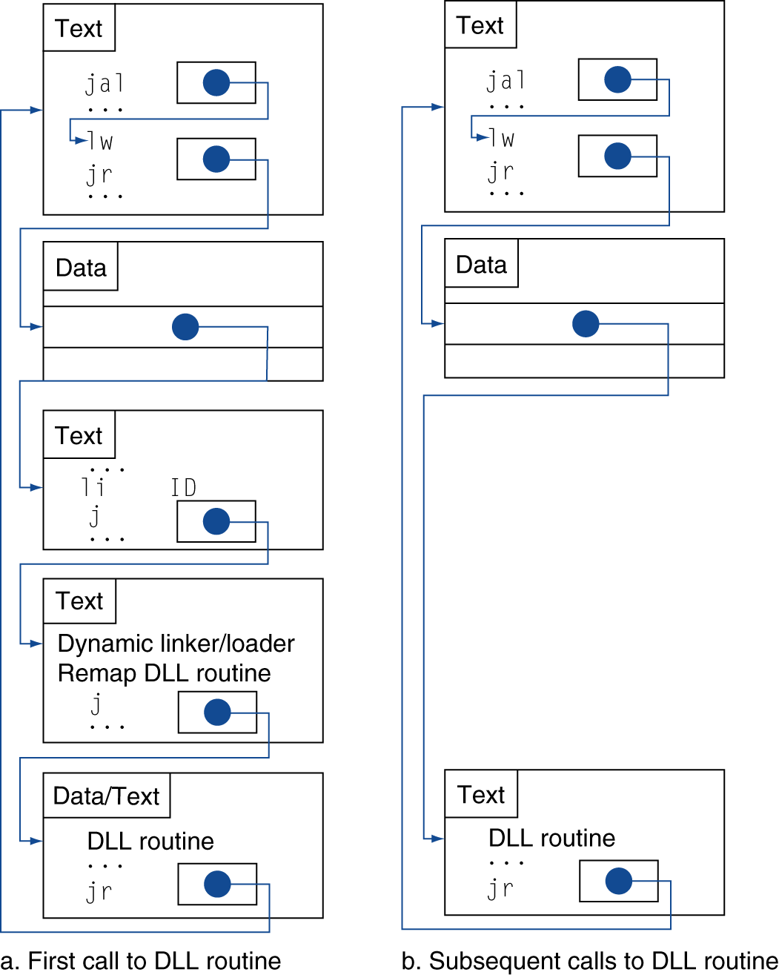
Lazy Linkage
Indirection table
Stub: Loads routine ID, Jump to linker/loader
Linker/loader code
Dynamically mapped code

Slide 120
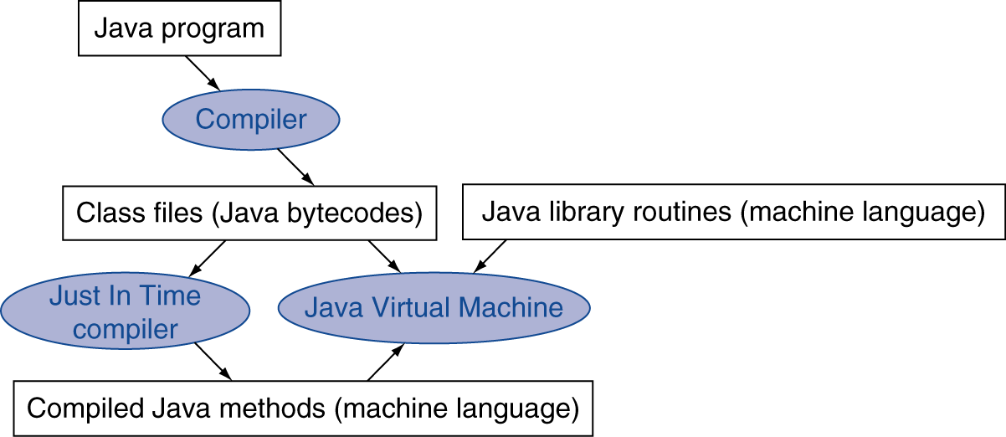
Starting Java Applications
Simple portable instruction set for the JVM
Compiles bytecodes of “hot” methods into native code for host machine
Interprets bytecodes

Slide 121
Effect of Compiler Optimization
Compiled with gcc for Pentium 4 under Linux

Slide 122
Effect of Language and Algorithm

Slide 123
Lessons Learnt
Instruction count and CPI are not good performance indicators in isolation
Compiler optimizations are sensitive to the algorithm
Java/JIT compiled code is significantly faster than JVM interpreted
Comparable to optimized C in some cases
Nothing can fix a dumb algorithm!

Slide 124
CAN SKIP THE REST

Slide 125
Arrays vs. Pointers
Array indexing involves
Multiplying index by element size
Adding to array base address
Pointers correspond directly to memory addresses
Can avoid indexing complexity
§2.14 Arrays versus Pointers

Slide 126
Example: Clearing and Array
clear1(int array[], int size) { int i; for (i = 0; i < size; i += 1) array[i] = 0; } | clear2(int *array, int size) { int *p; for (p = &array[0]; p < &array[size]; p = p + 1) *p = 0; }
move $t0,$zero # i = 0 loop1: sll $t1,$t0,2 # $t1 = i * 4 add $t2,$a0,$t1 # $t2 = # &array[i] sw $zero, 0($t2) # array[i] = 0 addi $t0,$t0,1 # i = i + 1 slt $t3,$t0,$a1 # $t3 = # (i < size) bne $t3,$zero,loop1 # if (…) # goto loop1 | move $t0,$a0 # p = & array[0] sll $t1,$a1,2 # $t1 = size * 4 add $t2,$a0,$t1 # $t2 = # &array[size] loop2: sw $zero,0($t0) # Memory[p] = 0 addi $t0,$t0,4 # p = p + 4 slt $t3,$t0,$t2 # $t3 = #(p<&array[size]) bne $t3,$zero,loop2 # if (…) # goto loop2

Slide 127
Comparison of Array vs. Ptr
Multiply “strength reduced” to shift
Array version requires shift to be inside loop
Part of index calculation for incremented i
c.f. incrementing pointer
Compiler can achieve same effect as manual use of pointers
Induction variable elimination
Better to make program clearer and safer

Slide 128
ARM & MIPS Similarities
ARM: the most popular embedded core
Similar basic set of instructions to MIPS
§2.16 Real Stuff: ARM Instructions
 | ARM | MIPS
Date announced | 1985 | 1985
Instruction size | 32 bits | 32 bits
Address space | 32-bit flat | 32-bit flat
Data alignment | Aligned | Aligned
Data addressing modes | 9 | 3
Registers | 15 × 32-bit | 31 × 32-bit
Input/output | Memory mapped | Memory mapped

Slide 129
Compare and Branch in ARM
Uses condition codes for result of an arithmetic/logical instruction
Negative, zero, carry, overflow
Compare instructions to set condition codes without keeping the result
Each instruction can be conditional
Top 4 bits of instruction word: condition value
Can avoid branches over single instructions

Slide 130
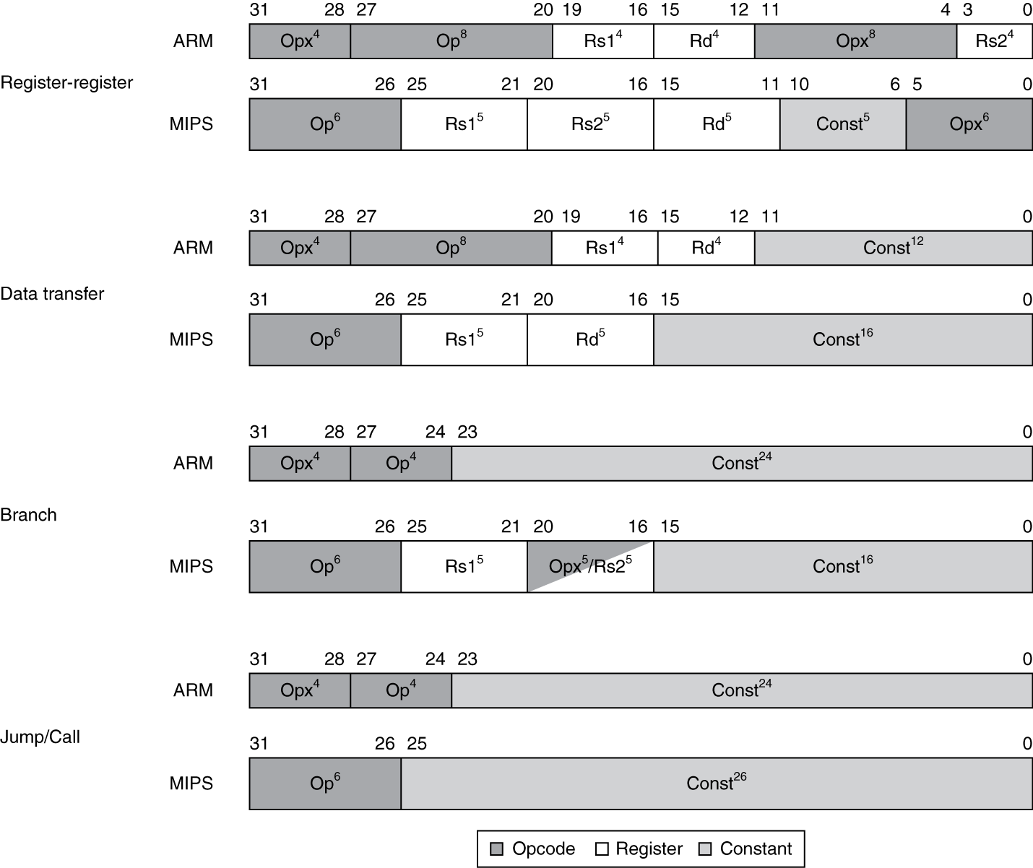
Instruction Encoding

Slide 131
The Intel x86 ISA
Evolution with backward compatibility
8080 (1974): 8-bit microprocessor
Accumulator, plus 3 index-register pairs
8086 (1978): 16-bit extension to 8080
Complex instruction set (CISC)
8087 (1980): floating-point coprocessor
Adds FP instructions and register stack
80286 (1982): 24-bit addresses, MMU
Segmented memory mapping and protection
80386 (1985): 32-bit extension (now IA-32)
Additional addressing modes and operations
Paged memory mapping as well as segments
§2.17 Real Stuff: x86 Instructions

Slide 132
The Intel x86 ISA
Further evolution…
i486 (1989): pipelined, on-chip caches and FPU
Compatible competitors: AMD, Cyrix, …
Pentium (1993): superscalar, 64-bit datapath
Later versions added MMX (Multi-Media eXtension) instructions
The infamous FDIV bug
Pentium Pro (1995), Pentium II (1997)
New microarchitecture (see Colwell, The Pentium Chronicles)
Pentium III (1999)
Added SSE (Streaming SIMD Extensions) and associated registers
Pentium 4 (2001)
New microarchitecture
Added SSE2 instructions

Slide 133
The Intel x86 ISA
And further…
AMD64 (2003): extended architecture to 64 bits
EM64T – Extended Memory 64 Technology (2004)
AMD64 adopted by Intel (with refinements)
Added SSE3 instructions
Intel Core (2006)
Added SSE4 instructions, virtual machine support
AMD64 (announced 2007): SSE5 instructions
Intel declined to follow, instead…
Advanced Vector Extension (announced 2008)
Longer SSE registers, more instructions
If Intel didn’t extend with compatibility, its competitors would!
Technical elegance ≠ market success

Slide 134
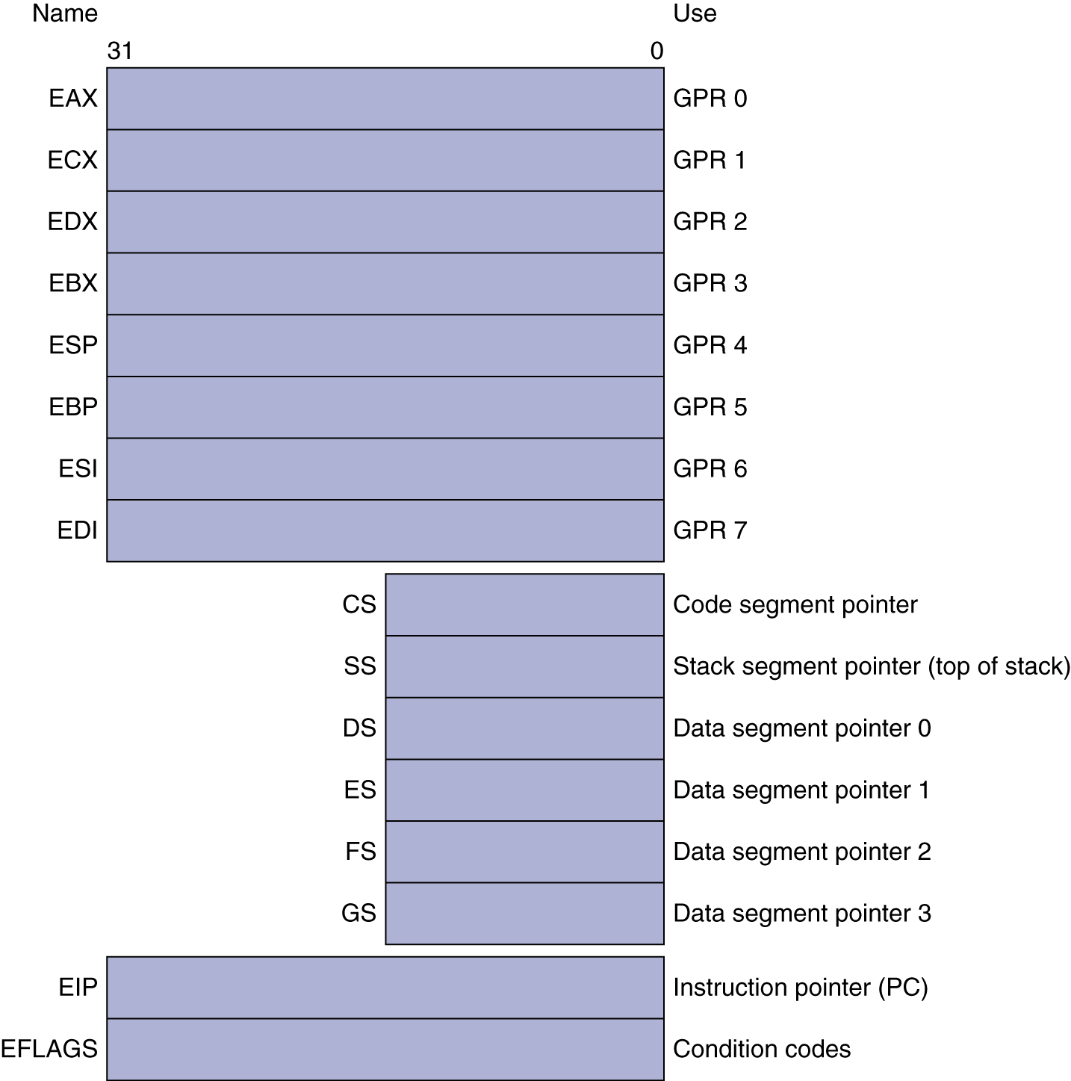
Basic x86 Registers

Slide 135
Basic x86 Addressing Modes
Two operands per instruction
Source/dest operand | Second source operand
Register | Register
Register | Immediate
Register | Memory
Memory | Register
Memory | Immediate
Memory addressing modes
Address in register
Address = R_{base} + displacement
Address = R_{base} + 2^{scale} × R_{index} (scale = 0, 1, 2, or 3)
Address = R_{base} + 2^{scale} × R_{index} + displacement

Slide 136
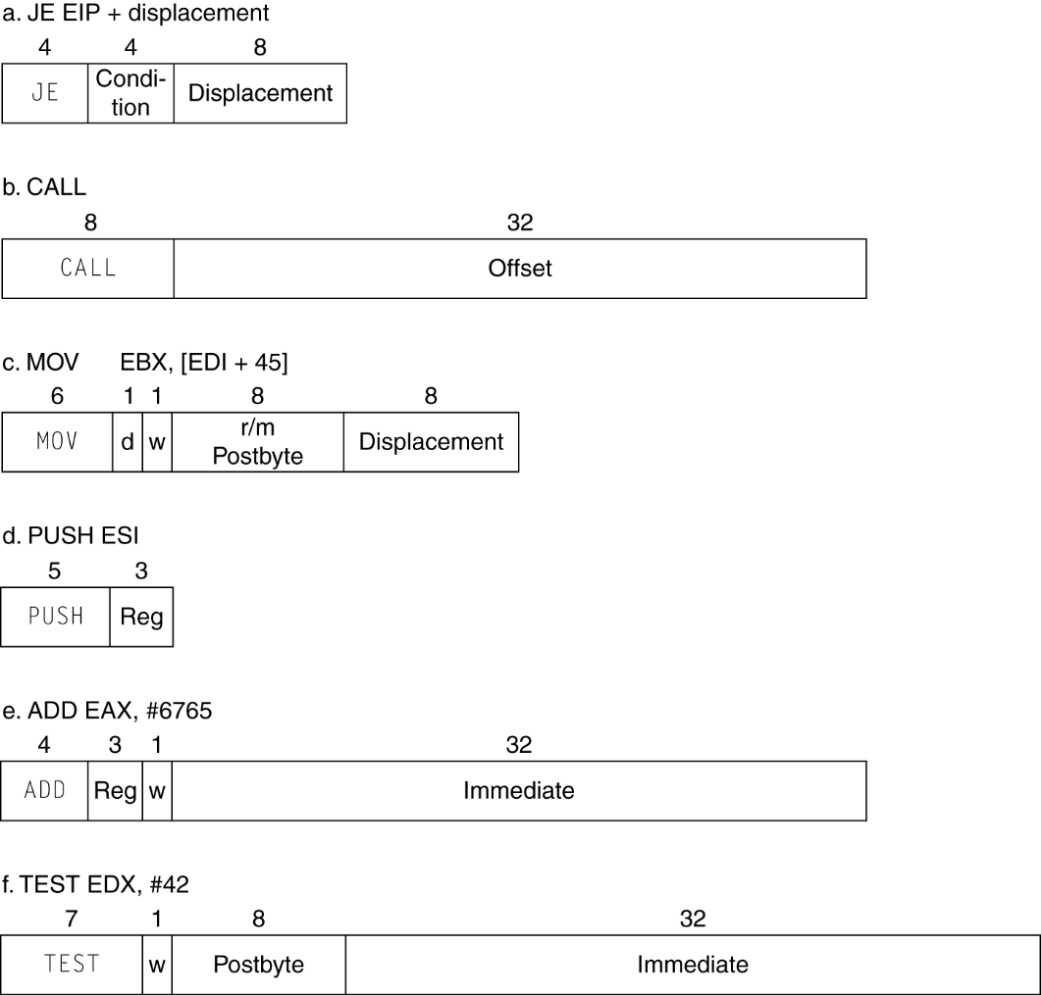
x86 Instruction Encoding
Variable length encoding
Postfix bytes specify addressing mode
Prefix bytes modify operation
Operand length, repetition, locking, …

Slide 137
Implementing IA-32
Complex instruction set makes implementation difficult
Hardware translates instructions to simpler microoperations
Simple instructions: 1–1
Complex instructions: 1–many
Microengine similar to RISC
Market share makes this economically viable
Comparable performance to RISC
Compilers avoid complex instructions

Slide 138
ARM v8 Instructions
In moving to 64-bit, ARM did a complete overhaul
ARM v8 resembles MIPS
Changes from v7:
No conditional execution field
Immediate field is 12-bit constant
Dropped load/store multiple
PC is no longer a GPR
GPR set expanded to 32
Addressing modes work for all word sizes
Divide instruction
Branch if equal/branch if not equal instructions
§2.18 Real Stuff: ARM v8 (64-bit) Instructions

Slide 139
Fallacies
Powerful instruction ⇒ higher performance
Fewer instructions required
But complex instructions are hard to implement
May slow down all instructions, including simple ones
Compilers are good at making fast code from simple instructions
Use assembly code for high performance
But modern compilers are better at dealing with modern processors
More lines of code ⇒ more errors and less productivity
§2.19 Fallacies and Pitfalls

Slide 140
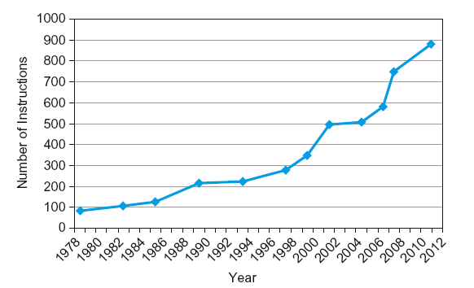
Fallacies
Backward compatibility ⇒ instruction set doesn’t change
But they do accrete more instructions
x86 instruction set

Slide 141
Pitfalls
Sequential words are not at sequential addresses
Increment by 4, not by 1!
Keeping a pointer to an automatic variable after procedure returns
e.g., passing pointer back via an argument
Pointer becomes invalid when stack popped

Slide 142
Concluding Remarks
Design principles
1. Simplicity favors regularity
2. Smaller is faster
3. Make the common case fast
4. Good design demands good compromises
Layers of software/hardware
Compiler, assembler, hardware
MIPS: typical of RISC ISAs
c.f. x86
§2.20 Concluding Remarks

Slide 143
Concluding Remarks
Measure MIPS instruction executions in benchmark programs
Consider making the common case fast
Consider compromises
Instruction class | MIPS examples | SPEC2006 Int | SPEC2006 FP
Arithmetic | add, sub, addi | 16% | 48%
Data transfer | lw, sw, lb, lbu, lh, lhu, sb, lui | 35% | 36%
Logical | and, or, nor, andi, ori, sll, srl | 12% | 4%
Cond. Branch | beq, bne, slt, slti, sltiu | 34% | 8%
Jump | j, jr, jal | 2% | 0%

Slide 144
String Copy Example
C code (naïve):
Null-terminated string
void strcpy (char x[], char y[]) { int i; i = 0; while ((x[i]=y[i])!='\0') i += 1; }
Addresses of x, y in $a0, $a1
i in $s0

Slide 145
String Copy Example
MIPS code:
strcpy: addi $sp, $sp, -4 # adjust stack for 1 item sw $s0, 0($sp) # save $s0 add $s0, $zero, $zero # i = 0 L1: add $t1, $s0, $a1 # addr of y[i] in $t1 lbu $t2, 0($t1) # $t2 = y[i] add $t3, $s0, $a0 # addr of x[i] in $t3 sb $t2, 0($t3) # x[i] = y[i] beq $t2, $zero, L2 # exit loop if y[i] == 0 addi $s0, $s0, 1 # i = i + 1 j L1 # next iteration of loop L2: lw $s0, 0($sp) # restore saved $s0 addi $sp, $sp, 4 # pop 1 item from stack jr $ra # and return

Slide 146
C Sort Example
Illustrates use of assembly instructions for a C bubble sort function
Swap procedure (leaf)
void swap(int v[], int k) { int temp; temp = v[k]; v[k] = v[k+1]; v[k+1] = temp; }
v in $a0, k in $a1, temp in $t0
§2.13 A C Sort Example to Put It All Together

Slide 147
The Procedure Swap
swap: sll $t1, $a1, 2 # $t1 = k * 4
add $t1, $a0, $t1 # $t1 = v+(k*4)
# (address of v[k])
lw $t0, 0($t1) # $t0 (temp) = v[k]
lw $t2, 4($t1) # $t2 = v[k+1]
sw $t2, 0($t1) # v[k] = $t2 (v[k+1])
sw $t0, 4($t1) # v[k+1] = $t0 (temp)
jr $ra # return to calling routine

Slide 148
The Sort Procedure in C
Non-leaf (calls swap)
void sort (int v[], int n)
{
int i, j;
for (i = 0; i < n; i += 1) {
for (j = i – 1;
j >= 0 && v[j] > v[j + 1];
j -= 1) {
swap(v,j);
}
}
}
v in $a0, k in $a1, i in $s0, j in $s1

Slide 149
The Procedure Body
move $s2, $a0 # save $a0 into $s2
move $s3, $a1 # save $a1 into $s3
move $s0, $zero # i = 0
for1tst: slt $t0, $s0, $s3 # $t0 = 0 if $s0 ≥ $s3 (i ≥ n)
beq $t0, $zero, exit1 # go to exit1 if $s0 ≥ $s3 (i ≥ n)
addi $s1, $s0, –1 # j = i – 1
for2tst: slti $t0, $s1, 0 # $t0 = 1 if $s1 < 0 (j < 0)
bne $t0, $zero, exit2 # go to exit2 if $s1 < 0 (j < 0)
sll $t1, $s1, 2 # $t1 = j * 4
add $t2, $s2, $t1 # $t2 = v + (j * 4)
lw $t3, 0($t2) # $t3 = v[j]
lw $t4, 4($t2) # $t4 = v[j + 1]
slt $t0, $t4, $t3 # $t0 = 0 if $t4 ≥ $t3
beq $t0, $zero, exit2 # go to exit2 if $t4 ≥ $t3
move $a0, $s2 # 1st param of swap is v (old $a0)
move $a1, $s1 # 2nd param of swap is j
jal swap # call swap procedure
addi $s1, $s1, –1 # j –= 1
j for2tst # jump to test of inner loop
exit2: addi $s0, $s0, 1 # i += 1
j for1tst # jump to test of outer loop
Move params
Outer loop
Inner loop
Pass params & call
Inner loop
Outer loop

Slide 150
The Full Procedure
sort: addi $sp,$sp, –20 # make room on stack for 5 registers
sw $ra, 16($sp) # save $ra on stack
sw $s3,12($sp) # save $s3 on stack
sw $s2, 8($sp) # save $s2 on stack
sw $s1, 4($sp) # save $s1 on stack
sw $s0, 0($sp) # save $s0 on stack
… # procedure body
…
exit1: lw $s0, 0($sp) # restore $s0 from stack
lw $s1, 4($sp) # restore $s1 from stack
lw $s2, 8($sp) # restore $s2 from stack
lw $s3,12($sp) # restore $s3 from stack
lw $ra,16($sp) # restore $ra from stack
addi $sp,$sp, 20 # restore stack pointer
jr $ra # return to calling routine

Slide 151
Synchronization
Two processors sharing an area of memory
P1 writes, then P2 reads
Data race if P1 and P2 don’t synchronize
Result depends of order of accesses
Hardware support required
Atomic read/write memory operation
No other access to the location allowed between the read and write
Could be a single instruction
E.g., atomic swap of register ↔ memory
Or an atomic pair of instructions
§2.11 Parallelism and Instructions: Synchronization

Slide 152
Synchronization in MIPS
Load linked: ll rt, offset(rs)
Store conditional: sc rt, offset(rs)
Succeeds if location not changed since the ll
Returns 1 in rt
Fails if location is changed
Returns 0 in rt
Example: atomic swap (to test/set lock variable)
try: add $t0,$zero,$s4 ;copy exchange value
ll $t1,0($s1) ;load linked
sc $t0,0($s1) ;store conditional
beq $t0,$zero,try ;branch store fails
add $s4,$zero,$t1 ;put load value in $s4

