Slide 1
Smart Manufacturing Pilot Use Case 2: Threat Detection & Isolation
Notes:
After UC1 where we saw how easy it is to setup new manufacturing machines, connect them, collect their data – thanks to 5GTANGO’s SP and our developed flexible NSs + FMP
→ UC2: Machines are running & data being collected → avoid attacker to connect to our NS (read/write data)

Slide 2
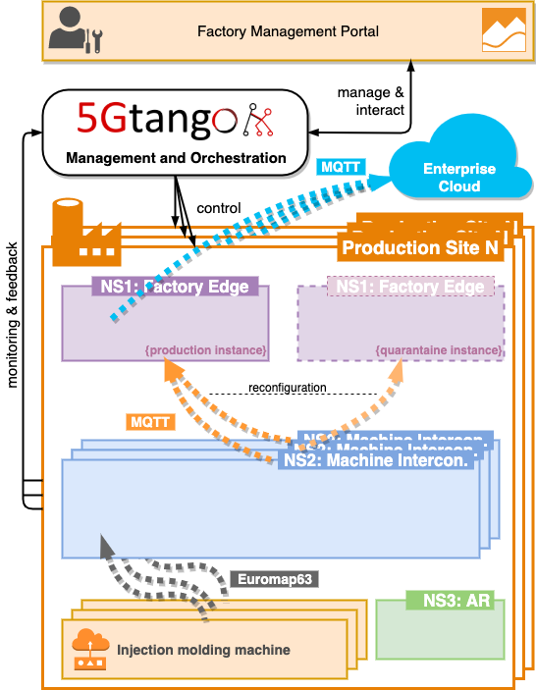
High-Level Architecture: Normal Production
Intrusion!
Notes:
Normal production: Machine → NS2 → NS1 → Cloud
Intrusion: Ensure no malicious data is sent to NS1 and cloud
But also don’t throw data away → analyze, debug, maybe merge later

Slide 3
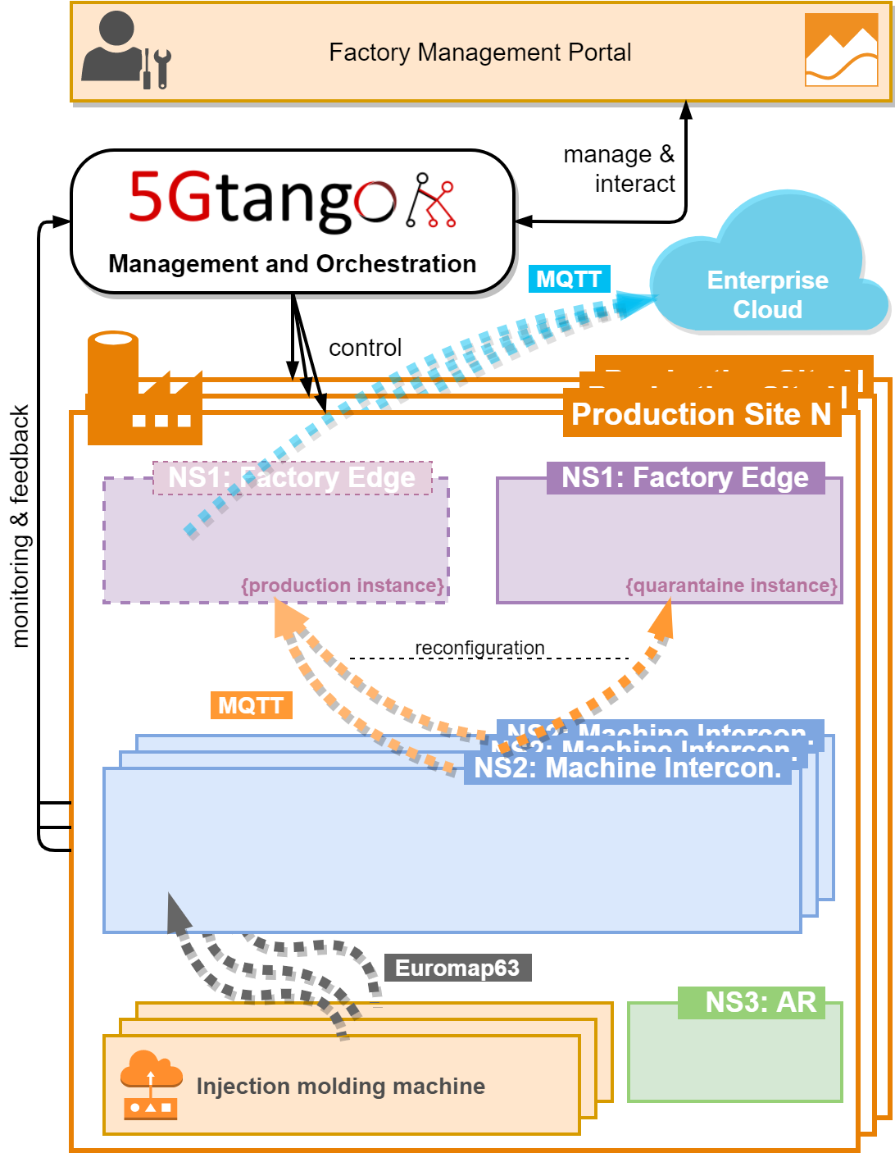
High-Level Architecture: Intrusion
Intrusion!
Notes:
What we did:
IDS in each NS2 to detect if someone unauthorized tries to connect
Quarantine NS1 (shadow copy)
NS2 sends intrusion event to monitoring → MANO → reconfig → send to NS1-q
→ data separated → threat contained → data still available for analysis

Slide 4
Details: Intrusion Detection & Reconfiguration
5GTANGO Service Platform
FSM (MDC)
SSM (NS2)
Reconf.
Task
(MDC)
Reconf.
Event
Reconf.
Result
(MDC)
Reconf.
Event
Reconf.
Event
(MDC)
Policy Manager
Alarm Trigger
Monitoring Manager
FLM
SLM
Reconf.
Trigger
Reconfigure MDC CNF
NS2: Machine Interconnection
IDS
(Suricata + ELK)
MDC
Machine Data
Intrusion!
IDS Alarm Metric
to NS1 (Production)
to NS1 (Quarantine)
Notes:
Realize flexible, automated detection & reconfig via 5GTANGO MANO → multiple advanced components play together
Start: NS2 (IDS, MDC) → NS1
Powerful → could also be used for more complex attacks/actions based on monitoring data

Slide 5
Demo Steps
Starting point:
Normal & Quarantine NS1 running
NS2 running and machine connected, sending data
Intrusion attempt by outside attacker
IDS notices intrusion and triggers alert
NS2 is reconfigured to send data into quarantine NS1

Slide 6
Details: Intrusion Detection & Reconfiguration
5GTANGO Service Platform
FSM (MDC)
SSM (NS2)
Reconf.
Task
(MDC)
Reconf.
Event
Reconf.
Result
(MDC)
Reconf.
Event
Reconf.
Event
(MDC)
Policy Manager
Alarm Trigger
Monitoring Manager
FLM
SLM
Reconf.
Trigger
Reconfigure MDC CNF
NS2: Machine Interconnection
IDS
(Suricata + ELK)
MDC
Machine Data
Intrusion!
IDS Alarm Metric
to NS1 (Production)
to NS1 (Quarantine)

Slide 7
Thanks!

