Slide 1
Smart Manufacturing Pilot Use Case 2: Threat Detection & Isolation
Notes:
After UC1 where we saw how easy it is to setup new manufacturing machines, connect them, collect their data – thanks to 5GTANGO’s SP and our developed flexible NSs + FMP
→ UC2: Machines are running & data being collected → avoid attacker to connect to our NS (read/write data)

Slide 2
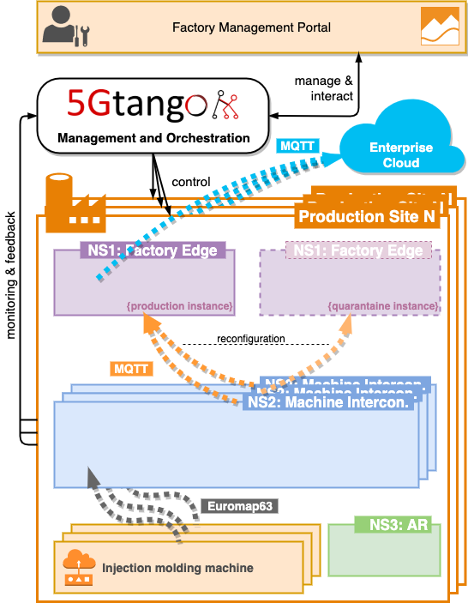
High-Level Architecture: Normal Production
Notes:
Normal production

Slide 3
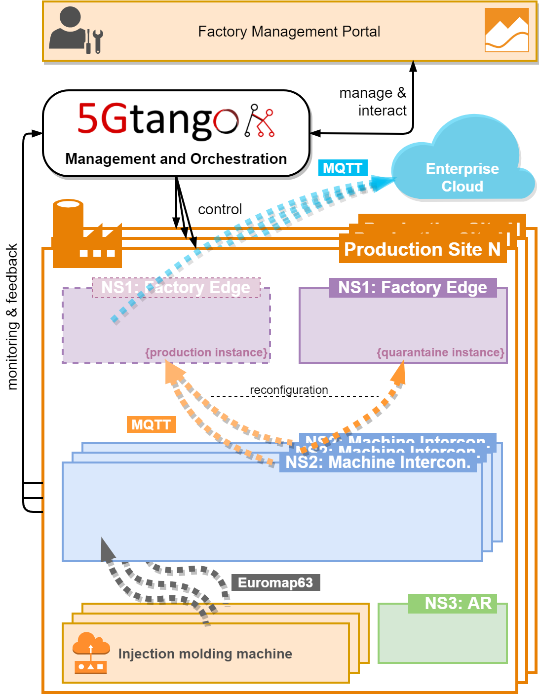
High-Level Architecture: Intrusion
Intrusion!
Notes:
Example Intrusion: Attacker tries to connect to Samba share in NS2 (to read/write data)

Slide 4
UC2 Demo workflow
Starting point:
Normal & Quarantine NS1 running
NS2 running and machine connected, sending data
Manual isolation:
Use FMP to manually isolate machine and send data to quarantine NS1
De-isolate and send data back to normal NS1
Automatic threat detection & isolation:
Intrusion attempt by outside attacker
IDS notices intrusion and triggers alert
NS2 is reconfigured to send data into quarantine NS1

Slide 5
Demo time!
Preparation: Starting IMMS, receiving data

Slide 6
Demo time!
Manual isolation/deisolation with FMP

Slide 7
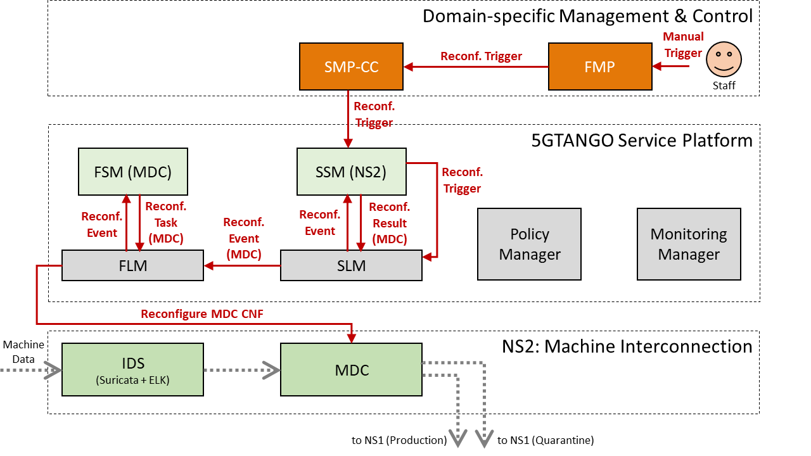
Manual Reconfiguration

Slide 8
Manual Isolation
Manual isolation of machine via FMP

Slide 9
Manual Deisolation
Manual deisolation of machine via FMP

Slide 10
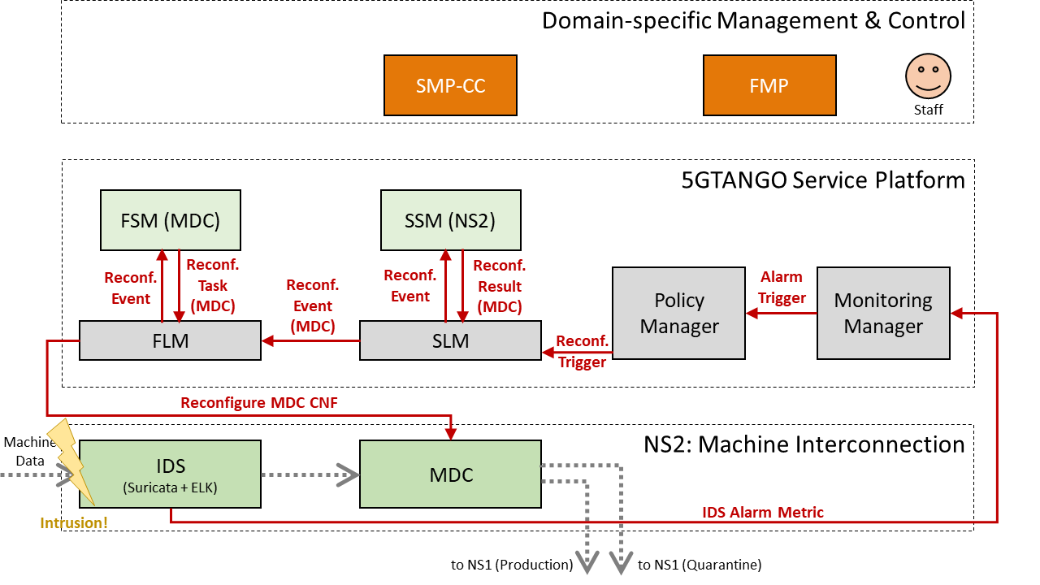
Automatic Reconfiguration

Slide 11
Demo time!
Starting point: Machine data arriving in normal NS1

Slide 12
Intrusion attempt by attacker

Slide 13
IDS Detects Intrusion
Intrusion attempt shown in IDS logs

Slide 14
Alert triggered
Alert triggered through IDS, monitoring system, policies

Slide 15
NS2 reconfigured
To send data to quarantine NS1

Slide 16
Thanks!

