Slide 1
Slower processing leads to bottleneck in maintenance
Non-efficient switching

Slide 2
RT
Maintenance (Ter)
Cognitive load (1 – Ter/RT)
RT
Maintenance (Ter)
Cognitive load (1 – Ter/RT)

Slide 3
Operation Span - Standard

Slide 4
K

Slide 5
10 + 5 = 16
True
False

Slide 6
J

Slide 7
6 – 3 = 3
True
False

Slide 8
…..

Slide 9
F
H
J
K
L
N
P
Q
R
S
T
V
Backspace
Continue

Slide 10
Operation Span - Adapted

Slide 11
K

Slide 12
K

Slide 13
K
10 + 5 = 13
True
False

Slide 14
K

Slide 15
K
J

Slide 16
K
6 – 3 = 3
True
False

Slide 17
…..

Slide 18
F
H
J
K
L
N
P
Q
R
S
T
V
Backspace
Continue

Slide 19
Symmetry Span - Standard

Slide 21
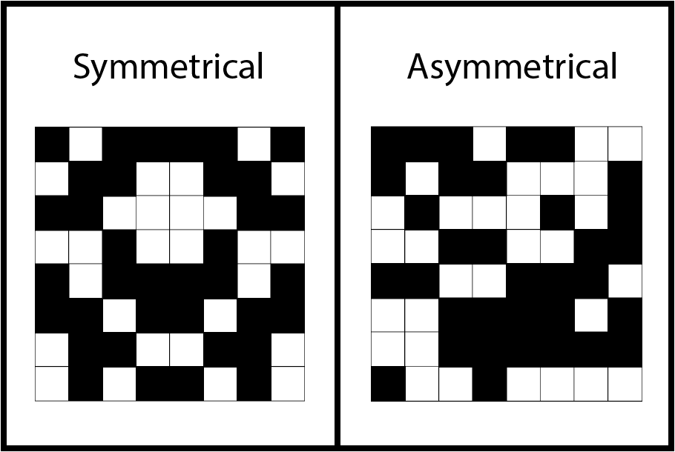
Symmetric
Asymmetric

Slide 23
Symmetric
Asymmetric

Slide 25
…..

Slide 26
1
3
2

Slide 27
Symmetry Span - Adapted

Slide 30
Symmetric Asymmetric

Slide 31
Symmetric Asymmetric

Slide 34
Symmetric Asymmetric

Slide 35
Symmetric Asymmetric

Slide 36
…..

Slide 37
2
1

