Slide 1
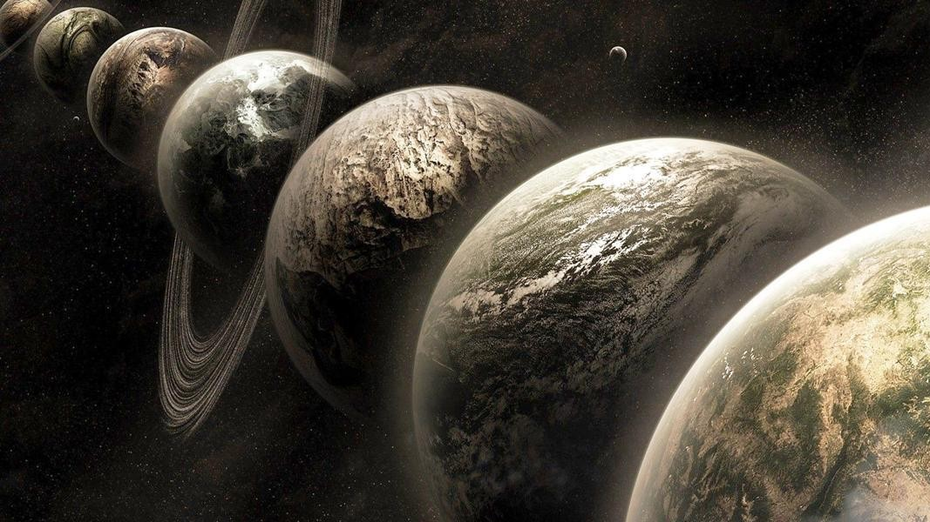
Multiverse Analysis: Being transparent about subjective decisions in data analysis

Slide 2
Overview of Workshop
Time | Topic
1.00pm – 1.30pm | Introduction to Multiverse Analysis
1.30pm – 2.15pm | Exercise: identifying (non)-arbitrary decisions
2.15pm – 2.30pm | Discuss exercise
2.30pm – 3.00pm | Demo of the Multitool R package

Slide 3

Garden of Forking Paths

Slide 4

Garden of Forking Paths Datasets
Results
Log
Exclude
…
Transform?
…
None
Raw Data
…
Multiverse
All possible versions of dataset
Outliers?
…
Log
…
Transform?
Include
…
None
…
Notes:
Researchers must make many decisions.

Slide 5


Cherry Picking
Pigeonholes
⚠️

Slide 6



Cherry Picking
Selectively reporting the analysis that shows your preferred result
Pigeonholes
Becoming constrained by overly rigid analysis criteria
😬
😎
😬
😎
🤔
😬

Slide 7

Transparently and systematically analyze the whole multiverse
Transparency reduces cherry-picking
Systematically handling decisions reduces pigeonholing
Assess robustness and increase efficient use of resources
Orben & Przybylski (2019a) Nature Human Behaviour
Orben & Przybylski (2019b) Psychological Science
Steegen et al. (2015) Perspectives on Psychological Science
Simonsohn et al. (2020) Nature Human Behaviour

Slide 8
Non-Arbitrary
Some alternatives better than others
Arbitrary
Equally defensible alternatives
👎
👍
👎
Lower quality measurement.
data points that lower reliability/validity; individual indicators vs. composite measures.
👎
Different effects.
E.g., two- vs. three-way interactions; different sets of covariates.
Is iterating over model specifications ever justified?
👎
Low power/precision.
Decisions leading to sample sizes < required power.
Del Giudice et al. (2021) Advances in Methods and Practices in Psychological Science
Notes:
Measurement nonequivalence: examples: including data points that decrease the reliability/validity if Ivs/DVs; Using individual indicators instead of composite measures
Effect nonequivalence: The logic of multiverse-style methods rests on the assumption that the effect of interest remains the same across the specifications included in a single analysis. Examples: Adding two- and three-way interactions to the multiverse specification; include different sets of covariates (ceases to be logically and/or statistically equivalent); may predictably add bias to (or remove from) the estimate of the effect of interest).
Power/precision nonequivalence: Examples: Some decisions leading to much smaller sample sizes, especially below required power cut-off.

Slide 9



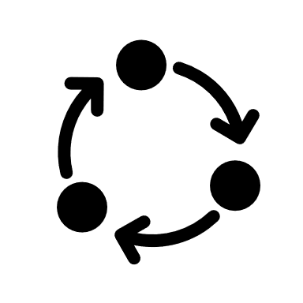



Multiverse Analysis
1. Identify arbitrary decisions
Arbitrary!
Non-Arbitrary
2. Build multiverse datasets
3. Analyze multiverse with the same model
Non-Arbitrary
Non-Arbitrary
4. Compile and display results
…
Notes:
The main danger of multiverse-style methods lies in their potential for combinatorial explosion. Just a few decisions incorrectly treated as arbitrary can quickly explode the size of the multiverse, drowning reasonable effect estimates in a sea of unjustified alternatives. A single decision node with two alternatives doubles the number of specifications. Five binary decision nodes expand the multiverse by a factor of 32. If one alternative is justifiable over the other in each case, the region defined by justified choices ends up occupying just 3% of the total multiverse. If the decision nodes involve three alternatives each, the corresponding figure is 0.4%. With so many individual effects within the multiverse, researchers may find it easier to characterize the distribution of effects with simple summary statistics, such as a median or mean effect size. But when the proportion of effects that best estimate the effect of interest is very small, the central tendency of effects can become misleading or virtually meaningless.

Slide 10
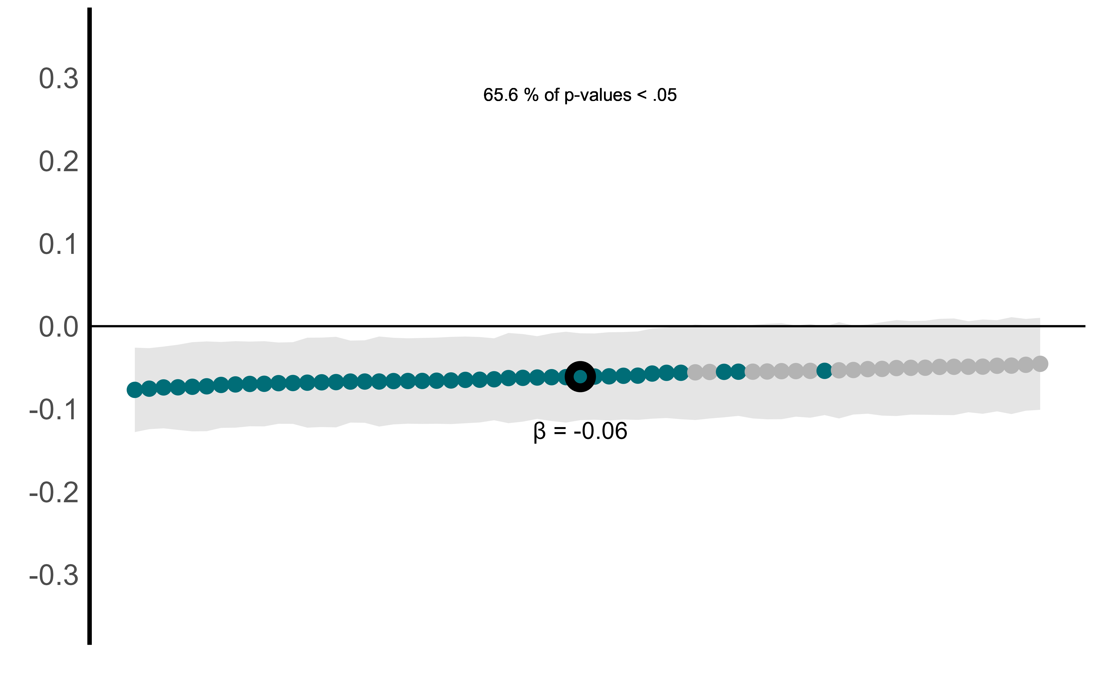
Visualizing the multiverse
Effect Curve Plot

Slide 11
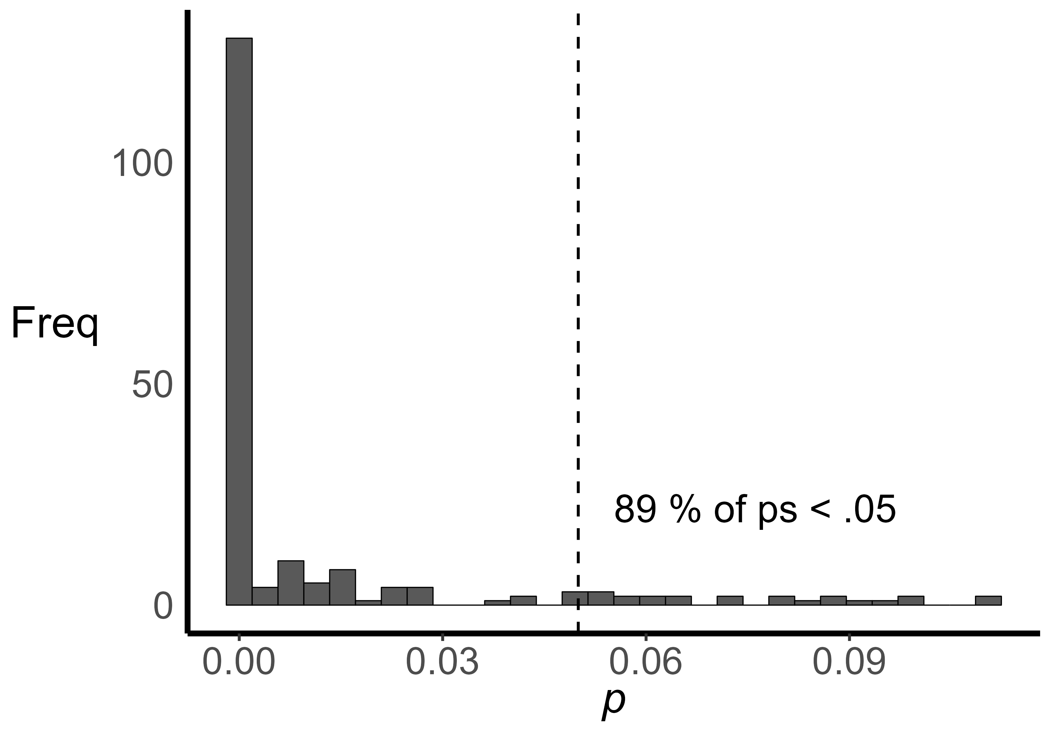
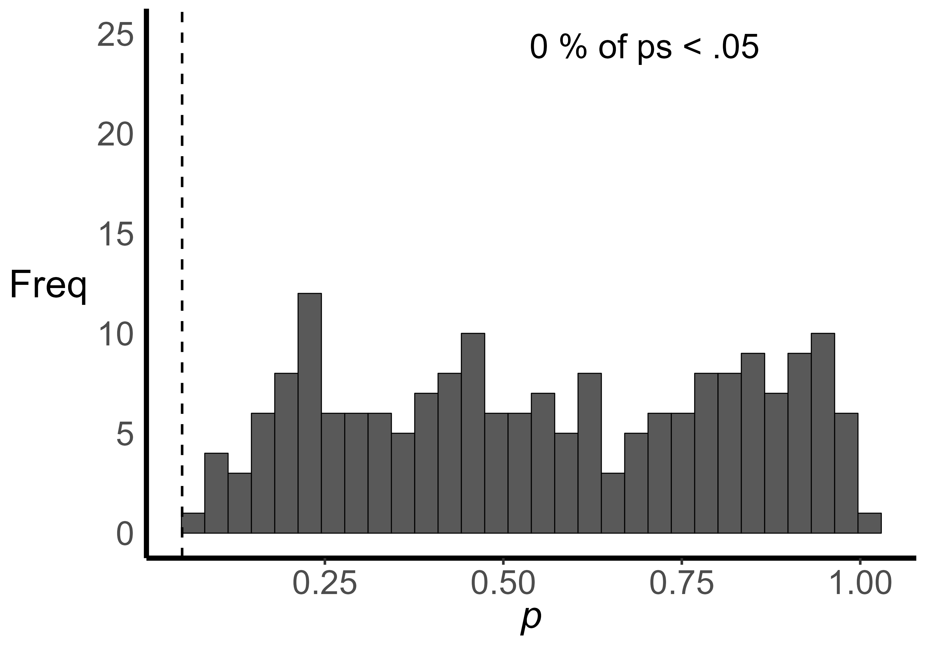
Visualizing the multiverse
p-distribution Plot

Slide 12
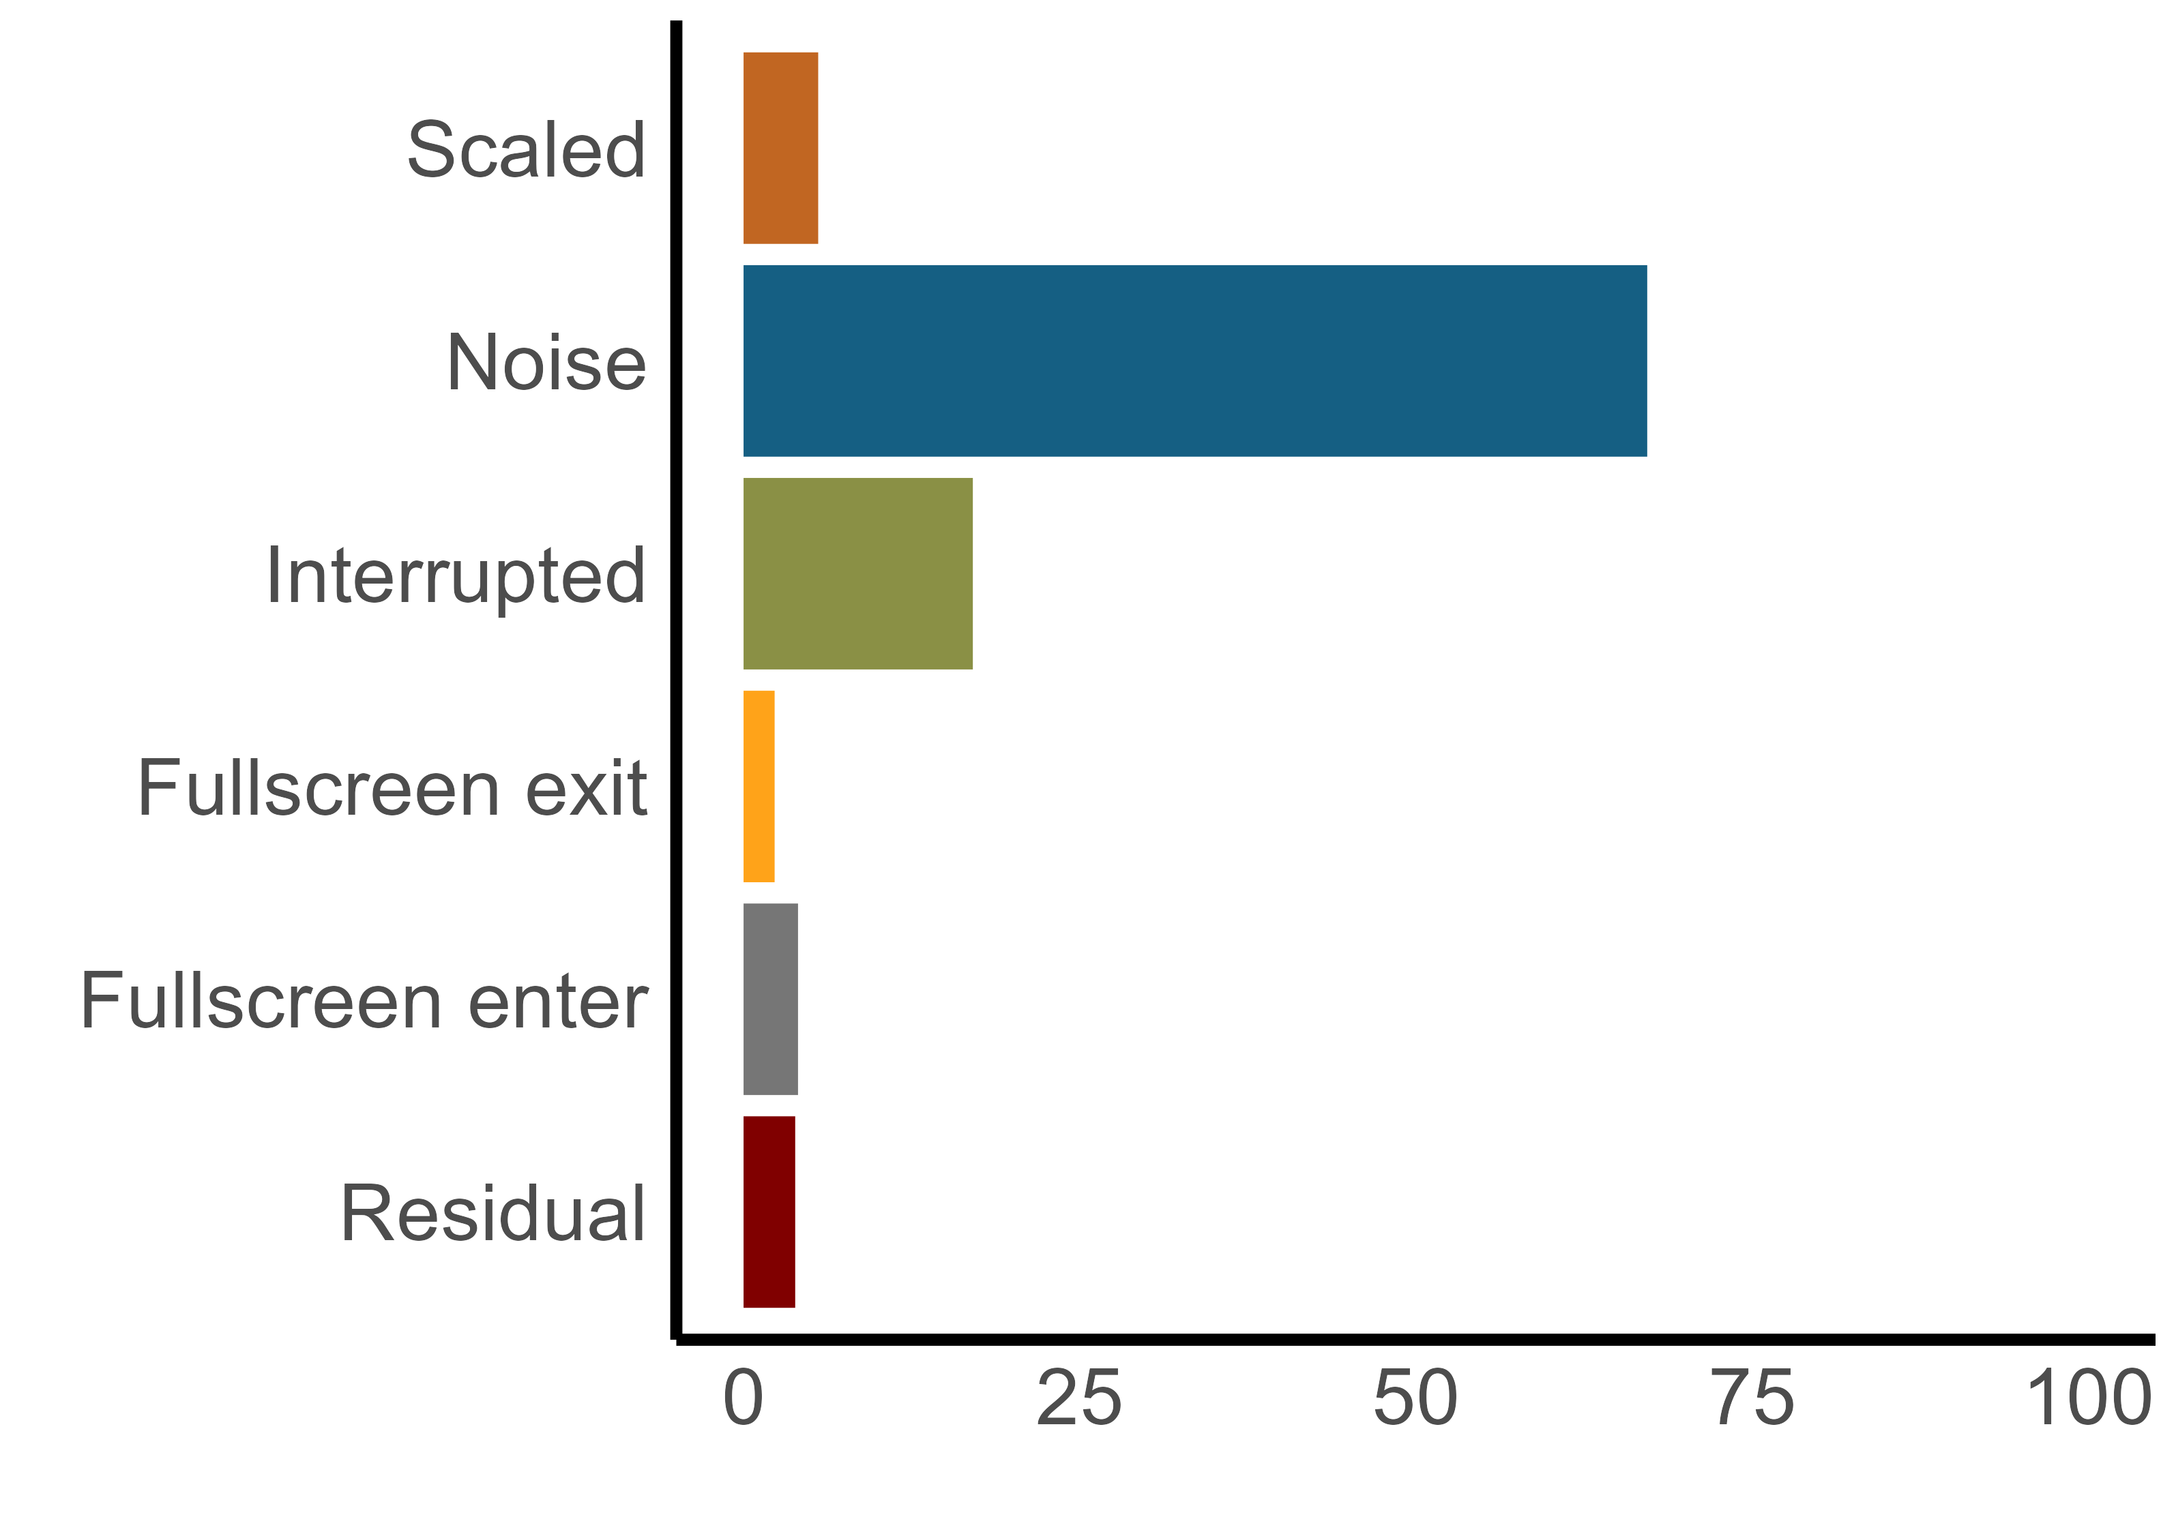
Visualizing the multiverse
% Explained variance
[specification grid; TBD]

Slide 13
Interpreting the multiverse
No single “best practice” procedure exists yet.
Compare results to a null-model using bootstrapping or reshuffling
See Simonsohn et al. (2020; Nat. Hum. Beh.)
Compare sample sizes under different specifications
Did some decisions yield insufficient power?
Compare descriptive statistics under different specifications
E.g., correlations between key variables; reliability (Cronbach’s alpha; split-half, …); model assumptions

Slide 14
Promise and challenges
⚠️
Only use with arbitrary data processing decisions
Ask yourself:
Does my analysis always test the same question?
Promise
Powerful exploratory tool
Can be used with any statistical procedure (for programmers: it’s just a loop!)
Provides new guidelines for data decisions
Come with some pretty cool plots 🤓
Challenges:
What’s arbitrary?
How should we draw inferences from a multiverse analysis?

Slide 15
In this demo, we will use data that I collected online using Prolific. One question in the study was whether people who report more exposure to violence during childhood would process information in their environment more holistically instead of focusing more on individual details. To this end, participants filled out questionnaires asking about their exposure to neighborhood violence prior to age 12, and performedThe data were collected online. Of course, this meant that we had less control over people's testing environments. We did not know how this would affect our results? Should we exclude people who reported very noisy environments? What about people who

Slide 16

Want to try it yourself?
https://ethan-young.github.io/multitool/

Slide 17
Multiverse resources
Conceptual Papers:
Steegen, S., Tuerlinckx, F., Gelman, A., & Vanpaemel, W. (2016). Increasing Transparency Through a Multiverse Analysis. Perspectives on Psychological Science, 11(5), 702–712. https://doi.org/10.1177/1745691616658637
Del Giudice, M., & Gangestad, S. W. (2021). A Traveler’s Guide to the Multiverse: Promises, Pitfalls, and a Framework for the Evaluation of Analytic Decisions. Advances in Methods and Practices in Psychological Science. https://doi.org/10.1177/2515245920954925
Simonsohn, U., Simmons, J. P., & Nelson, L. D. (2020). Specification curve analysis. Nature Human Behaviour, 4(11), 1208–1214. https://doi.org/10.1038/s41562-020-0912-z
Patel, C. J., Burford, B., & Ioannidis, J. P. A. (2015). Assessment of vibration of effects due to model specification can demonstrate the instability of observational associations. Journal of Clinical Epidemiology, 68(9), 1046–1058. https://doi.org/10.1016/j.jclinepi.2015.05.029
Muñoz, J., & Young, C. (2018). We Ran 9 Billion Regressions: Eliminating False Positives through Computational Model Robustness. Sociological Methodology, 48(1), 1–33. https://doi.org/10.1177/0081175018777988
Lundberg, I., Johnson, R., & Stewart, B. (2020, January 7). What is Your Estimand? Defining the Target Quantity Connects Statistical Evidence to Theory. https://doi.org/10.31235/osf.io/ba67n
Empirical examples
Orben, A., Dienlin, T., & Przybylski, A. K. (2019). Social media’s enduring effect on adolescent life satisfaction. Proceedings of the National Academy of Sciences of the United States of America, 116(21), 10226–10228. https://doi.org/10.1073/pnas.1902058116
Orben, A., & Przybylski, A. K. (2019a). The association between adolescent well-being and digital technology use. Nature Human Behaviour, 3(2), 173–182. https://doi.org/10.1038/s41562-018-0506-1
Orben, A., & Przybylski, A. K. (2019b). Screens, Teens, and Psychological Well-Being: Evidence From Three Time-Use-Diary Studies. Psychological Science, 30(5), 682–696. https://doi.org/10.1177/0956797619830329
Heyman, T., & vanpaemel, w. (2020, July 14). Multiverse analyses in the classroom. https://doi.org/10.31234/osf.io/4eh6b
Young, E.S., Frankenhuis, W.E., DelPriore, D.J., & Ellis, B.J. (2022). Hidden talents in context: Cognitive performance with abstract versus ecological stimuli among adversity- exposed youth. Child Development, 93(5), 1-18. https://doi.org/10.1111/cdev.13766
Blog Posts
100% CI: http://www.the100.ci/2021/03/07/mulltiverse-analysis/
Ethan Young: https://www.ethan-young.com/code/multiverse/
R packages:
multitool https://ethan-young.github.io/multitool/
specr https://philippmasur.de/2020/01/02/how-to-do-specification-curve-analyses-in-r-introducing-specr/

Slide 18
Exercises
Exercise 1: Detect and solve ambiguities in preregistrations
Groups of 2 - 3
Exercise 2: Identify the multiverse of decisions for your own project (present or past)
Solo (You may also collaborate with others)

