Slide 1
ASTROCIZE
Team super solution

Slide 2
AGENDA
Adapting a new type of gym equipment in space station
Product details
Modification and adjusting for using in space
Exercise routine
Virtual reality

Slide 3
ASTROCIZE ELITE
Specifications:
Product Dimensions: 63 x 82 x 154 cm ;
Maximum Weight Capacity: 250 lbs;
Product Weight: 29 kg ;
Product Cost : £62- £ 100;

Slide 4
Modification and adjusting for using in space
X-trace universal binding
Adjustable resistance/pedals/seat
Adding new type of exercise to Astrocize elite (Back Workout Exercise)

Slide 5
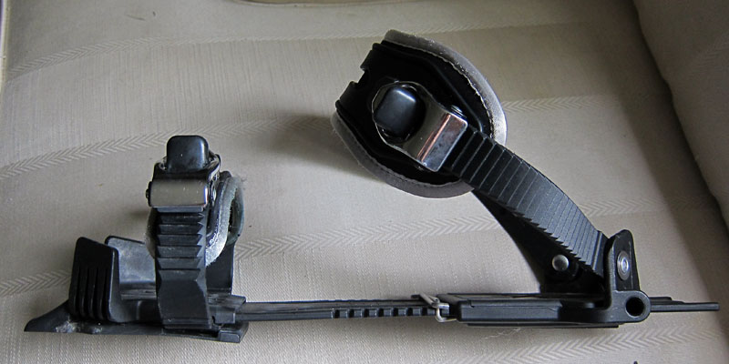
X-TRACE UNIVERSAL BINDING
Universal
Easily adjustable
Stability and control
Prize : 40€

Slide 6
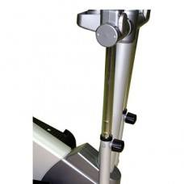
ADJUSTABLE RESISTANCE PEDALS
Manual resistance
Adjustable seat
Adjustable pedals

Slide 8
EXERCISE ROUTINE
30-minute workout
Transitions from forward to backward motion change the muscle focus

Slide 9
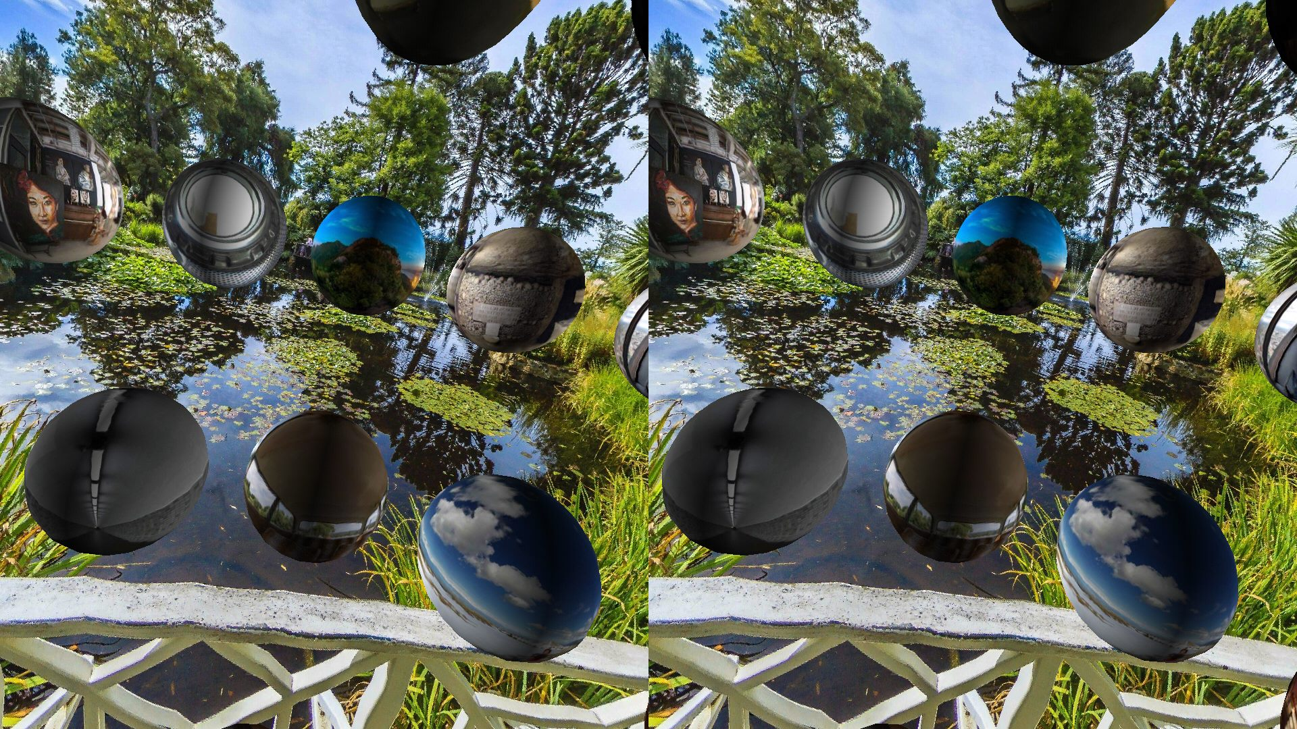
Virtual reality
Orbulus is a must-have VR smartphone app, allowing you to explore everywhere from the Sydney Opera House to Paris at night.

Slide 10
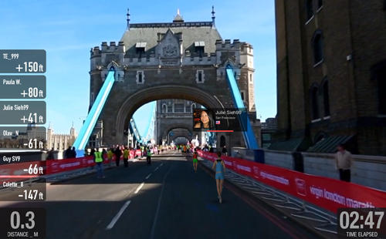
The Digital Virgin Money London Marathon
1.Installation only to your iPad or iPhone, , a version on Android is under development;
2.RunSocial App and the Digital Virgin Money London Marathon Showcase video – free;

Slide 11
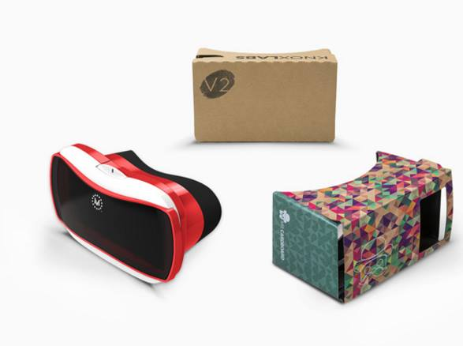
1.Available to iOS developers 2.the button inside the new headset works with any phone 3.headsets from just £3

Slide 12
Step 1
Combination of Physical activity and Virtual reality
Step 2
Gamification
Step 3
Competitivity
Physical activity
All of that integrated the space station

Slide 13


