Slide 1
Twitter Mutual Friends Searcher
Checking six degrees of separation theory
By Mykola Stefaniv

Slide 2
What are six degrees of separation?
In a nutshell, every two people have “friend of a friend” chain, which has no more than 6 steps. This theory appeared, when globalization started, but there was no way to check it because of lack of technology and small amount of interested people. I am going to try to find some information about it by creating a Python program and using Twitter.

Slide 3
Goals and scope of the search
It is impossible to check the theory this way, because of inaccuracy of ‘friend’ connections shown on Twitter (I chose this social network because it is both popular and has information about ‘friends’ easily accessible).
This program is more for my own interest, to see connections between people because time it takes to find all “friends-of-friends” grows exponentially with each step.
But I think this coursework gave me priceless experience in programming, working with information from the Internet, and visualizing information.
It was pretty interesting.

Slide 4
Main features
Show tree with given user as root and their friends as children (height of the tree given in settings).
Show image of connections between two people using “friend-of-friend” chains (maximum height of tree of each person is specified) or absence of such connections.

Slide 5
Side features (settings, cache, and help)
Settings:
Allow users to change parameters like maximum depth of trees, cache usage, graphical representation of trees and connections, and other minor ones.
Save settings in a separate file and load them when the program starts.
Cache:
Because of long time of searching for friends, be able to record information about ‘friend’ trees into a separate file so that exiting the program won’t erase information, collected for such a long time.
Help:
Option, allowing users to get information about all features of the program and how to activate them.

Slide 6
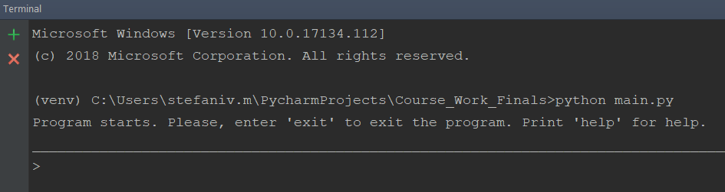
Interface of the program
Program has command line interface. Each command does not influence next one (there is no ‘menu’ scheme). It is shown how to enter ‘help’ menu on start of the program for the user to quickly find all the commands.

Slide 7
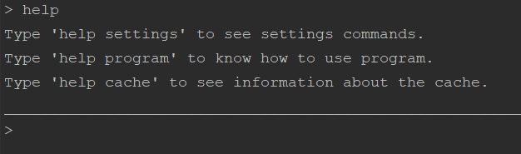
Help menu options
Show how to get information about main features, settings, and cache.

Slide 8
Different sections of ‘help’ menu
They illustrate usage of the program most accurately. That’s why I will show them in next slides – so that they are easier to see.

Slide 9
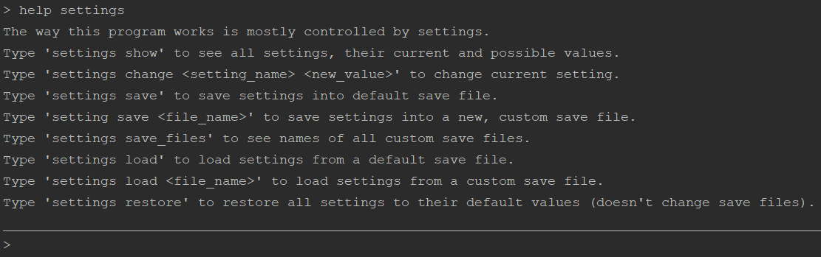
‘help settings’

Slide 10
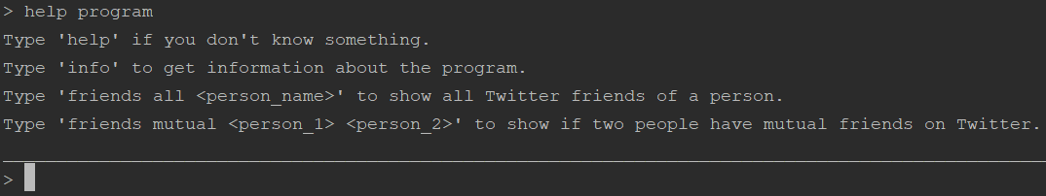
‘help program’

Slide 11
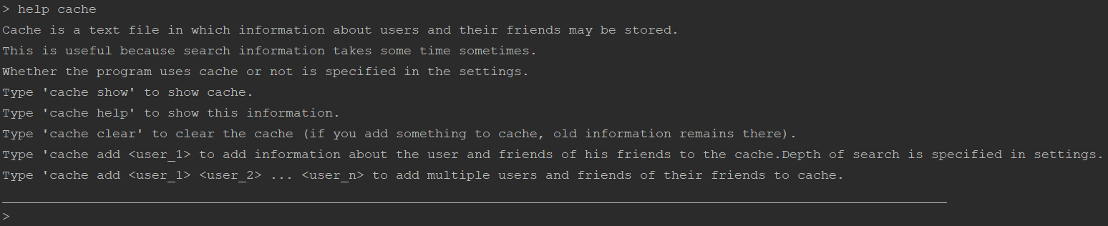
‘help cache’

Slide 12
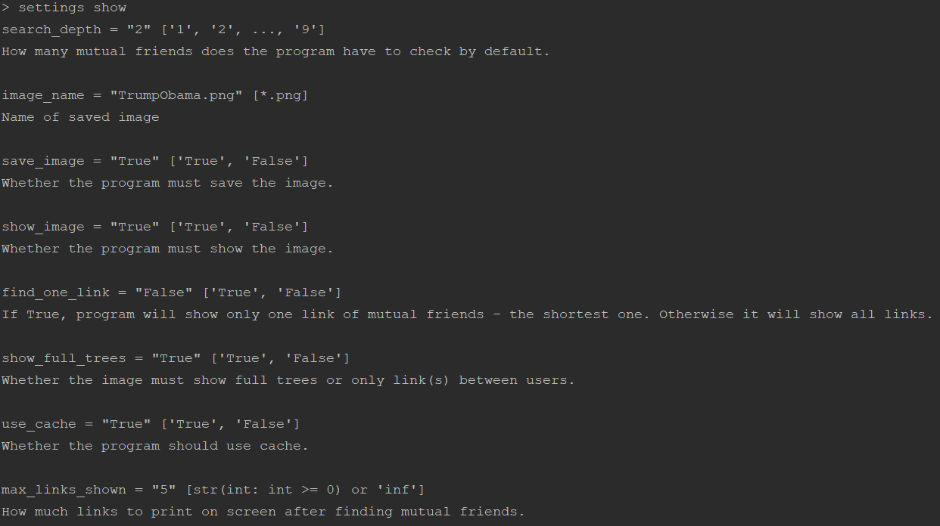
All settings and their descriptions

Slide 13
Usage example #1
Caching information about Donald Trump ‘friends-of-friends’ tree with height 3:
Doing the same for Hillary Clinton:

Slide 14

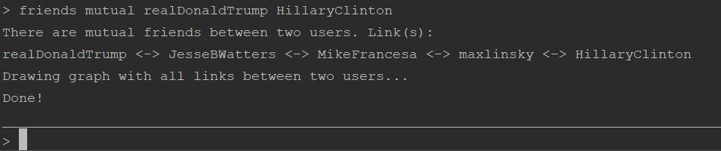
Usage example #2
Changing ‘use_cache’ setting with command:
Checking if Donald Trump and Hillary Clinton have mutual friends using trees with search depth 3 (I changed few settings for this):

Slide 15
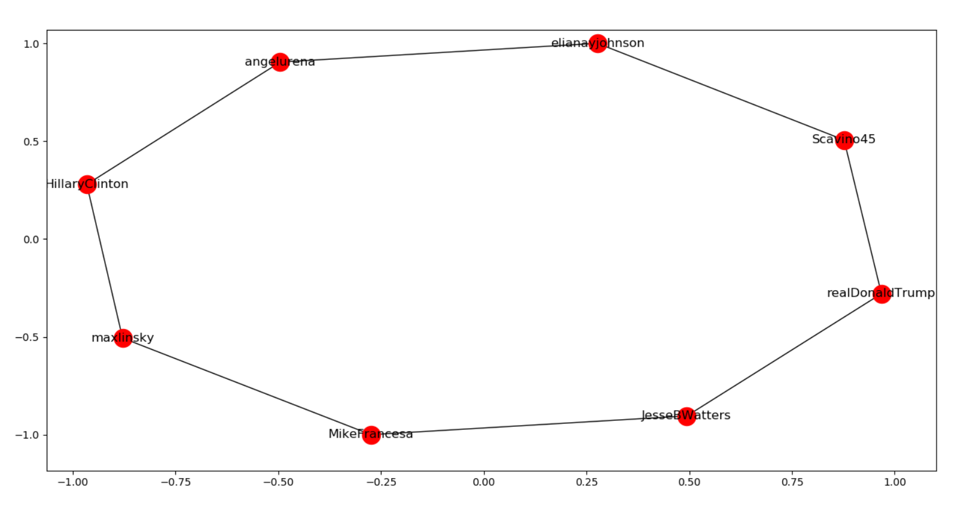
Resulting graph (I changed some settings again):

Slide 16
Conclusions
I don’t think this program is that useful.
But I got priceless experience from working on it.
I now see lots of mistakes I did (like hard-coding some features).
Sometimes watching at results of this program is interesting.
Stuff I used:
Python 3
Python modules: tweepy, networkx

