Slide 1
Melbourne Housing
Marginean Tudor (511)
Negulescu Stefan (511)

Slide 2
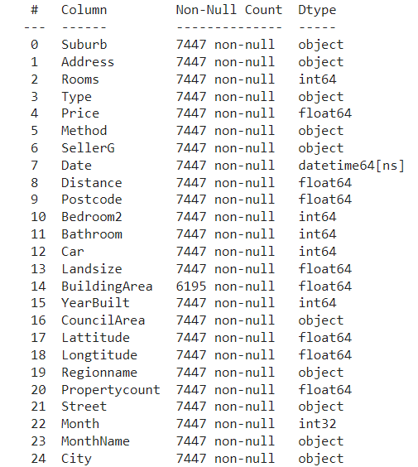
Dataset overview
The Melbourne housing dataset contains detailed real estate information from Melbourne between January 2016 and December 2017, including attributes like suburb, address, number of rooms, property type, price, sale method, and seller.

Slide 3
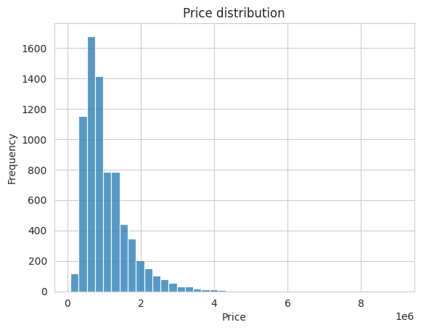
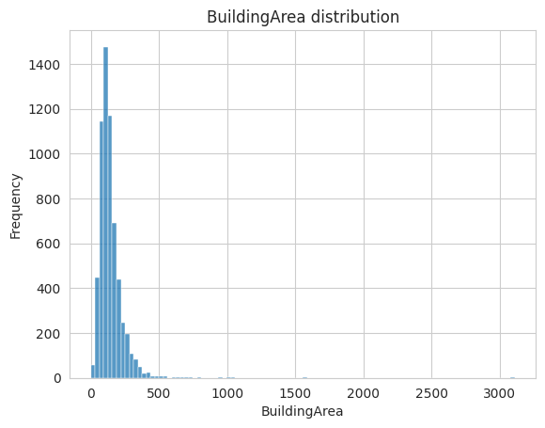
Average Price
1M$
Average Building Size
141m²

Slide 4
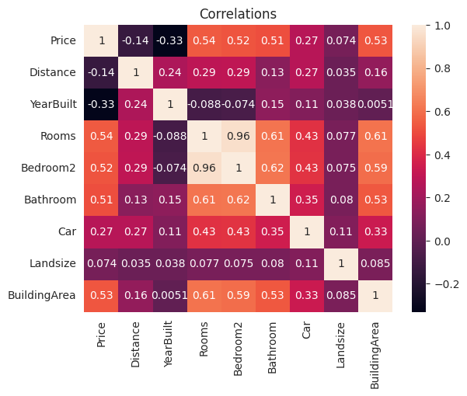
Moderate positive correlation between Price and BuildingArea & Number of rooms.
Weak negative correlation between Price and YearBuilt & Distance

Slide 5
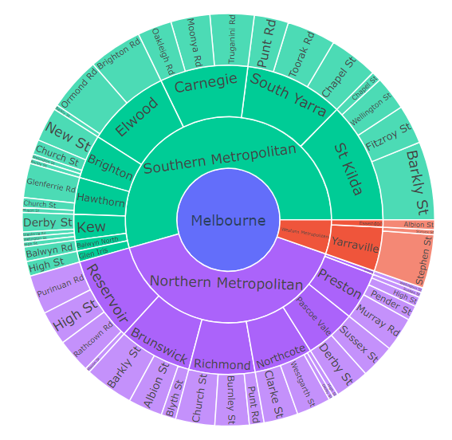
Geographic analysis
Properties are divided in regions, suburbs, and streets

Slide 6
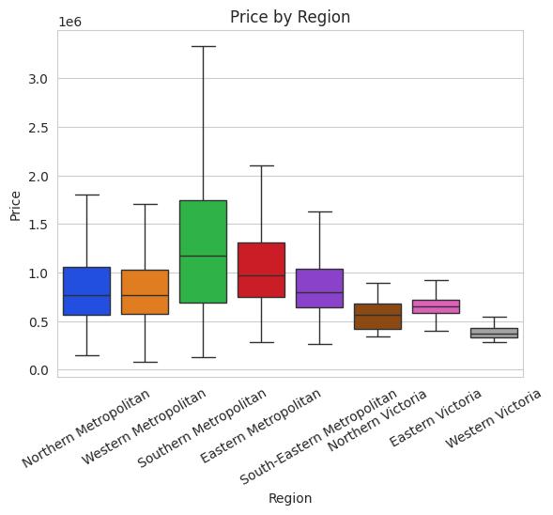
The Southern Metropolitan Region is the most expensive one, while Western Victoria is the cheapest.

Slide 7
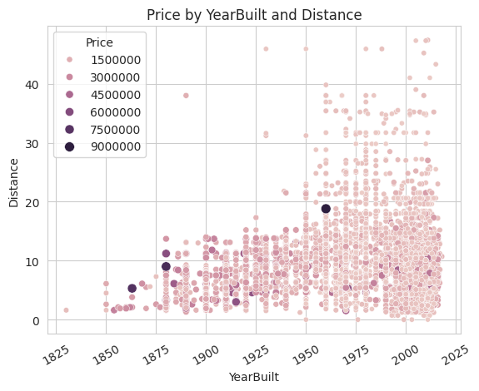
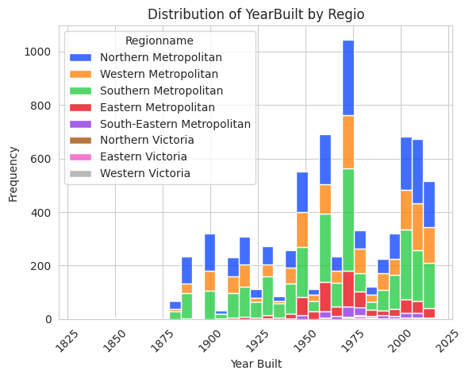
The majority of the properties are built after 1950 in 3 main regions, namely Northern, Western, and Southern Metropolitan areas.
Most of the old buildings are relatively closer to the center and implicitly more expensive than the newer ones. New building are located at a larger distance with respect to the center.

Slide 8
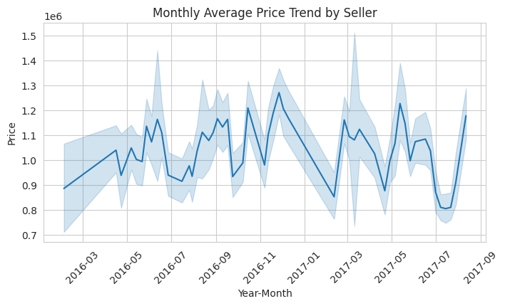
Temporal analysis

Slide 9
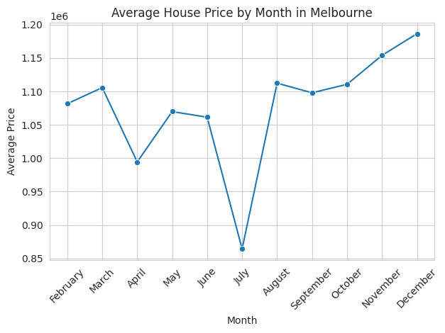
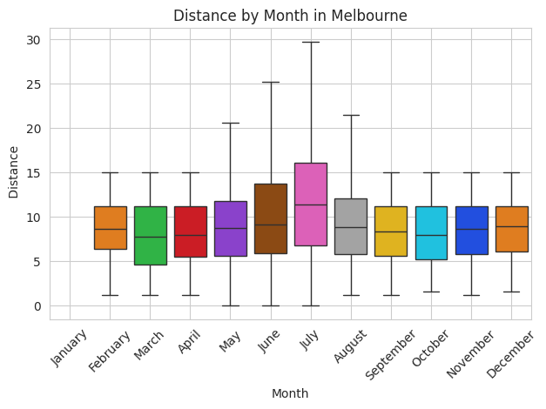
The average housing price in July is below average.
This could be due to the fact that in July, more properties located far from the city center were put on sale

Slide 10
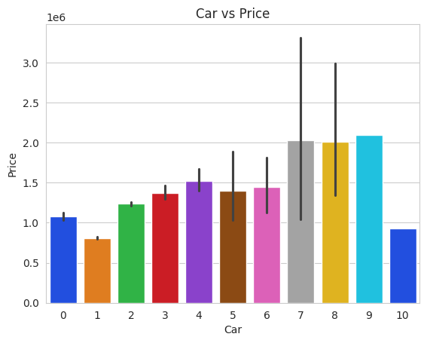
Property characteristics
Typically, the price increases with the number of parking spaces, but an unusual trend appears when there are 10 parking spaces.

Slide 11
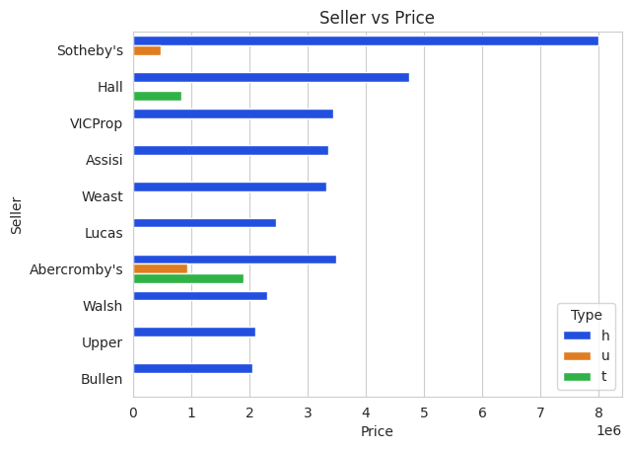
Seller analysis
Top 10 sellers make most of their money from house selling

