Slide 1
New York State Public Schools Graduation Rates: Predicting Success
Stefano Bastianelli, Brooke Brehm, Derek Caramella, Miguel Novo Villar, & Kenzie Potter

Slide 2

Agenda
Introduce Vision & Goals
Exhibit Data Model
Display Data Visualizations
Discuss Data Preprocessing
Describe Model Performance
Propose Future Enhancements

Slide 3

Introduction
Qualified teachers directly impact educational outcomes [2]
Teacher experience, income, & standardized tests shaped the educational landscape & affected learning conditions
Identifying patterns can help policy makers update requirements and allocate resources more efficiently

Slide 4

Goals
Is there a change in marginal graduate rate gain from incremental government funding?
Does the quality of teachers & principals impact graduation rate?
How can educational resources be better allocated?

Slide 5
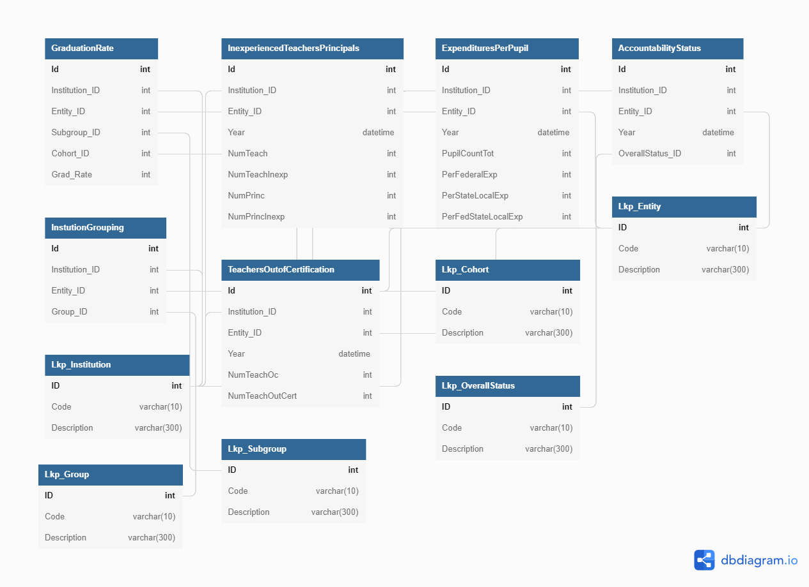
Data Model

Slide 6
Data Model
Fact Tables
Dimension Tables
Graduation Rate
Inexperienced Teachers and Principal
Expenditures per Pupil
Accountability Status
Institution Grouping
Teachers Teaching Out of Certification
Lkp_Cohort
Lkp_Entity
Lkp_Instituion
Lkp_Group
Lkp_Subgroup
Lkp_OverallStatus

Slide 7
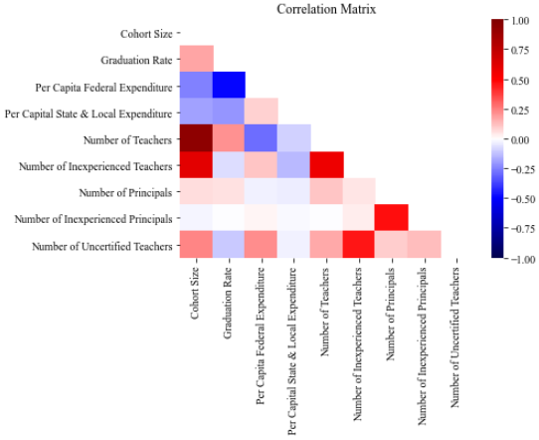
Correlation Matrix
Positive Correlations
Number of teachers & cohort size
Number of inexperienced teachers & cohort size
Number of inexperienced teachers & number of teachers
Number of inexperienced teachers & Number of uncertified teachers
Number of inexperienced principals & number of principals
Negative Correlations
Per capita federal expenditure & cohort size
Per capita federal expenditure & Number of teachers

Slide 8
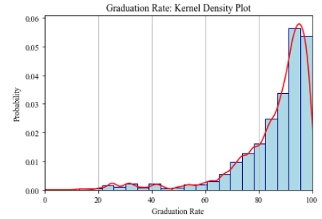
Graduation Rate Distribution
Heavily left (negatively) skewed
Mean < Median < Mode
Mode at roughly 95-100% graduation rate

Slide 9
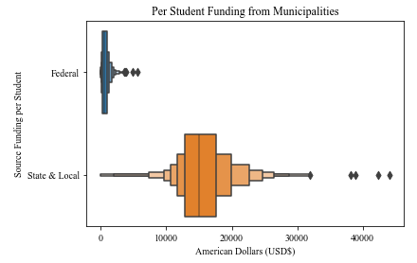
Per Student Funding from Municipalities
State & Local municipalities dominate funding for schools
Average State & Local funding between $10,000 to $20,000 per student
Federal funding is less than $10,000 per capita

Slide 10
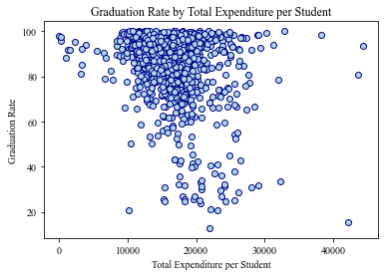
Graduation Rate by Funding
Most budgets $10,000-$30,000 per student
$0-$10,000 has a graduation rate between roughly 80 & 100 percent
Most densely grouped at 60 to 100 percent graduation rate
$30,000-$40,000 per student does not seem to drastically improve graduation rates
Potential low graduation rate outliers

Slide 11
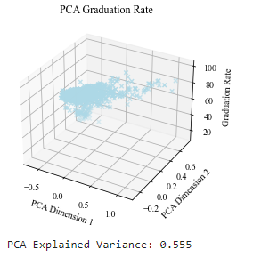
PCA of Graduation Rate
Graduation rates condensed around 80%
Explained variance: 55.5%

Slide 12
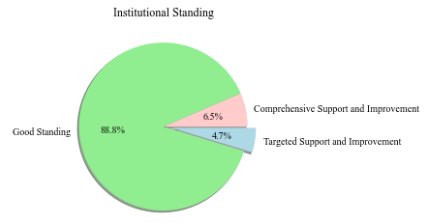
Institutional Standing Imbalance
Schools primarily in good standing
No closing schools
~11% currently receiving support & improvement

Slide 13
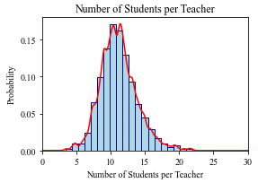
Students per Teacher
Mode
10 students per teacher
Minimum
3 students per teacher
Maximum
22 students per teacher

Slide 14
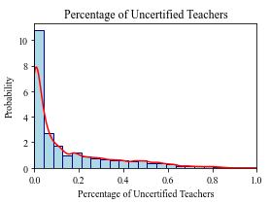
Uncertified Teachers Composition
Mode: No uncertified teachers
More likely to have 0%-20% of teachers in a school teaching outside of their certification
Few schools have 60% or more teachers outside of certification

Slide 15
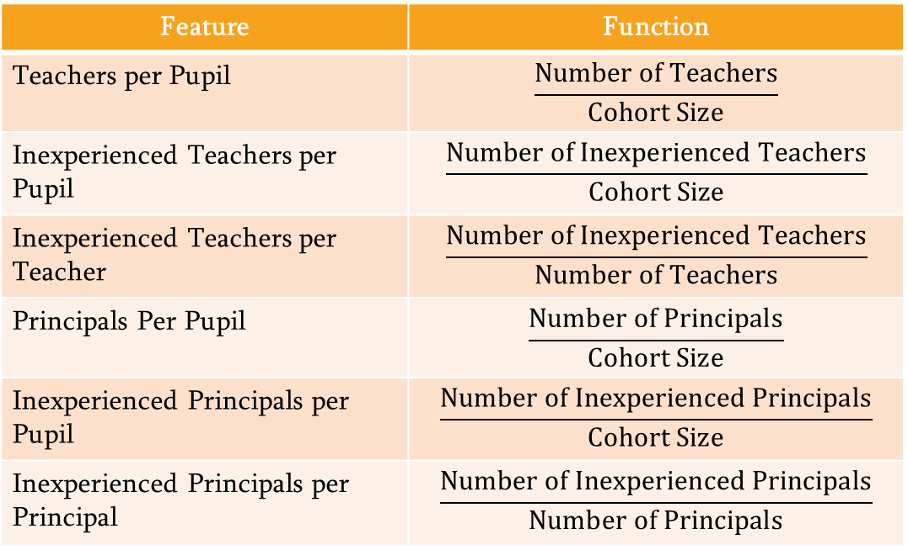
Model Pipeline: Feature Engineering
Feature | Function
Teachers per Pupil | $$\frac{Number of Teachers}{Cohort Size}$$
Inexperienced Teachers per Pupil | $$\frac{Number of Inexperienced Teachers}{Cohort Size}$$
Inexperienced Teachers per Teacher | $$\frac{Number of Inexperienced Teachers}{Number of Teachers}$$
Principals Per Pupil | $$\frac{Number of Principals}{Cohort Size}$$
Inexperienced Principals per Pupil | $$\frac{Number of Inexperienced Principals}{Cohort Size}$$
Inexperienced Principals per Principal | $$\frac{Number of Inexperienced Principals}{Number of Principals}$$

Slide 16
Model Pipeline: Feature Preprocessing
One Hot Encoding
Min Max Scaler
Overall Status
Good Standing
Potential Target District
Potential Target Support & Improvement
Target Support & Improvement
Potential Comprehensive Support & Improvement (CSI)
Comprehensive Support & Improvement
Closing School
Cohort Size
Federal Expenditure per Student
State & Local Expenditure per Student
Teachers per Pupil
Inexperienced Teachers per Pupil
Inexperienced Teachers per Teacher
Principals per Pupil
Inexperienced Principals per Pupil
Inexperienced Principals per Principal

Slide 17
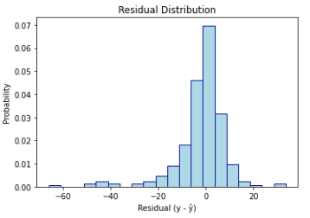


Model Performance
Metric | Elastic Net | SVR | Bayesian Ridge | AdaBoost Regressor | Random Forest Regressior | Neural Network
Maximum Error | 48.865 | 66.081 | 45.522 | 65.827 | 58.585 | 60.66
Mean Absolute Error | 7.422 | 6.571 | 7.383 | 7.582 | 6.41 | 7.393
Mean Squared Error | 119.415 | 115.972 | 118.08 | 118.254 | 94.777 | 126.727
Median Squared Error | 5.147 | 3.863 | 5.072 | 5.971 | 4.12 | 4.619
Models Subject to Exhaustive Grid Search
Left (negatively) skewed
SVR mispredicts underperforming schools (graduation rate < 50%)

Slide 18
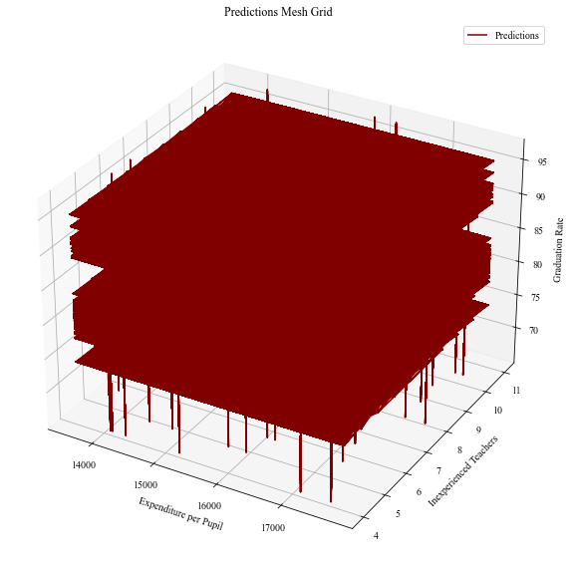
Mesh Grid
Sample Size: 20,000
Samples span feature space domain
Axes:
X: Expenditure per Pupil
Y: Inexperienced Teachers
Z: Graduation Rate
Analysis
Distinct stacked hyperplanes
No clear relationship exists

Slide 19
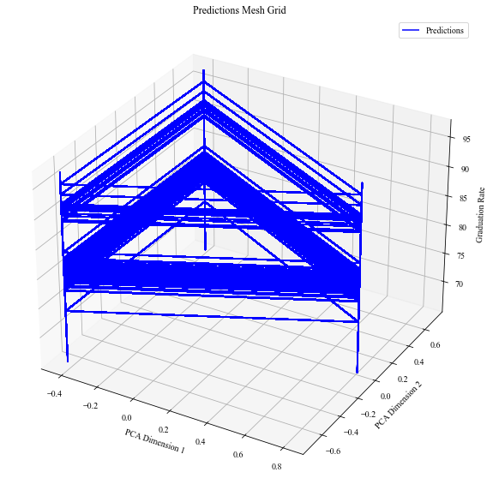
PCA Mesh Grid
Triangular, stacked structure
Explained Variance: 93.5%
Outer Pillars
Unobserved Features
District employment rates
District GDP
District crime rate
Optimal points exist

Slide 20
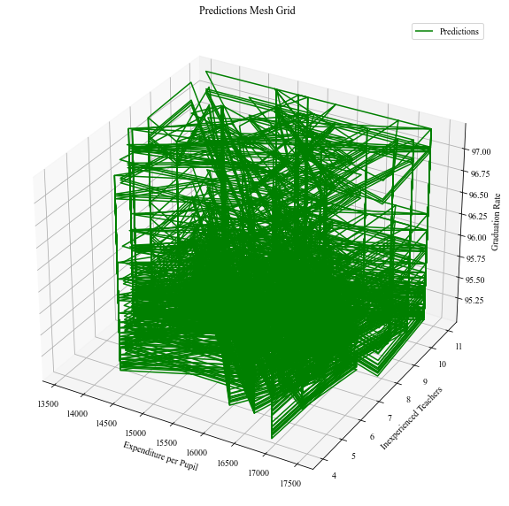
Cross Section Mesh Grid
Mesh Grid Subsection
95.25 to 100 Percent
No clear relationship exists between Expenditure per Pupil & Inexperienced Teacher

Slide 21

Optimal Combinations
Total Funding per Student | Teachers per Pupil | Teacher per Inexperienced Teacher | Number of Principals | Overall Status | Predicted Graduation Rate
$13,580 | 5 | 6 | 1 | Good Standing | 96.5
$15,600 | 5 | 8 | 1 | Good Standing | 97.2
$16,810 | 5 | 10 | 1 | Good Standing | 97.0
$17,280 | 5 | 7 | 1 | Good Standing | 97.0
$17,340 | 5 | 6 | 1 | Good Standing | 97.0

Slide 22
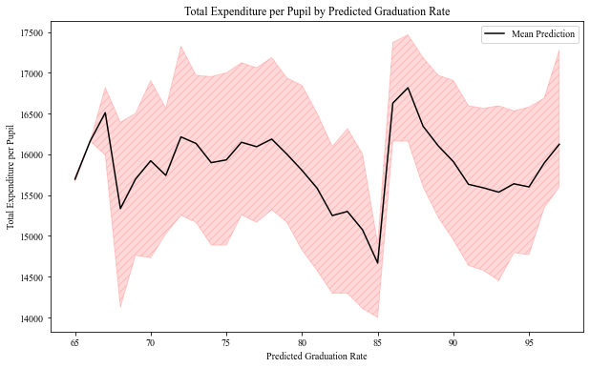
Total Expenditure per Pupil by Graduation Rate
X Axis
Decile Predicted Graduation Rate
Y Axis
Total Expenditure per Pupil
Black Line
Mean Total Expenditure per Pupil
Red Shading
Total Expenditure per Pupil 95% confidence quantile
Analysis
Total Expenditure per Pupil does not exhibit diminish returns

Slide 23
Results
Is there a change in marginal graduate rate gain from incremental government funding?
No
Does the quality of teachers & principals impact graduation rate?
Yes
How can educational resources be better allocated?
Quality teachers with adequate funding

Slide 24

An eye to the Future
Use results to inform schools on the impacts of funding, teacher experience, & certification on overall graduation rates
Continue with new additional data
Expand analysis to other states
Compare & contrast different states

Slide 25
References
“2020: NY State - Report Card: NYSED Data Site,” data.nysed.gov. [Online]. Available: https://data.nysed.gov/
D. Boyd, H. Lankford, S. Loeb, J. Rockoff, and J. Wyckoff, “The narrowing gap in New York City teacher qualifications and its implications for student achievement in high-poverty schools,” Journal of Policy Analysis and Management, vol. 27, no. 4, pp. 793–818, 2008.
NYSED Knowledge, Skill, Opportunity. New York State Education Department [Online]. Available: http://www.nysed.gov/.
NYS Schools Logo. New York State Education Department [Online]. Available: http://www.nysed.gov/.
“Teaching and Educational Leadership Standards,” New York State Education Department. [Online]. Available: http://www.nysed.gov/.

