Slide 1
DESIGN DOCUMENT
Boriero Stefano Brunitti Simone

Slide 2
OVERVIEW

Slide 3
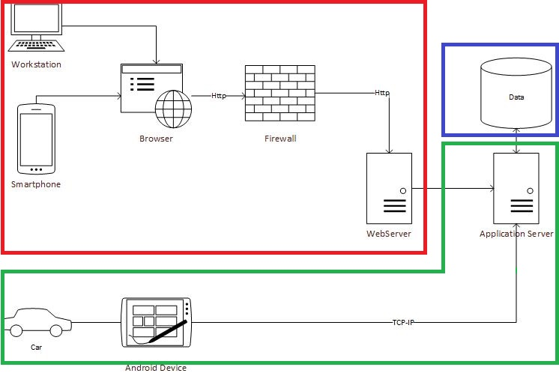
LEGEND:
Presentation Tier
Business Tier
Data Tier

Slide 4
Business Logic Partition
API Server
Account Management
Reservation Management
Fleet Management
CarApplication
Data Collection and Analysis
Ride Monitoring
Rule Infraction Detection and Notification

Slide 5
DEPLOYMENT VIEW

Slide 6
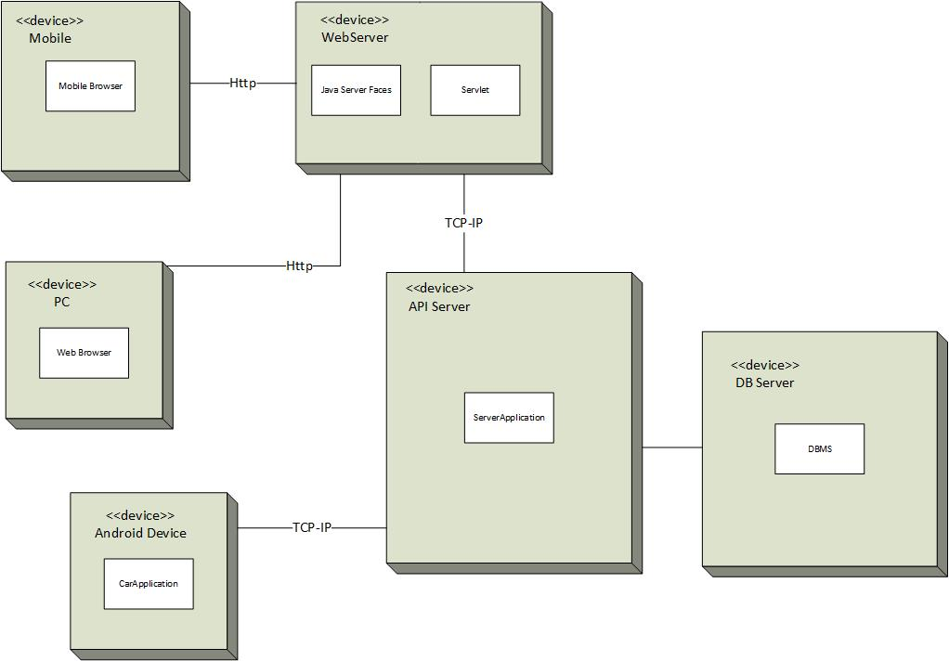
COMMUNICATION
CHANNELS
HTTP between webApplication and webServer
TCP-IP between carApplication and APIServer

Slide 7
General Architecture
Three Tier architecture with distributed logic
Client-server for the interaction between the web application and the central system
Event based paradigm for the interaction between the vehicles and the central system
JEE to develop our system

Slide 8
Advantages of using JEE
Develop a reliable system in a faster time using consolidated practices
Reflect the component-based style of our architecture using Java Beans
JPA (Java Persistance API) to manage the persistence in our system

Slide 9
Google Maps API
It interacts directly with the application to display useful maps used by the user to access PowerEnJoy services

Slide 10
Component Based
Component-based advantages :
Divide workloads
Easily scalable

