Slide 1
OVERVIEW

Slide 2
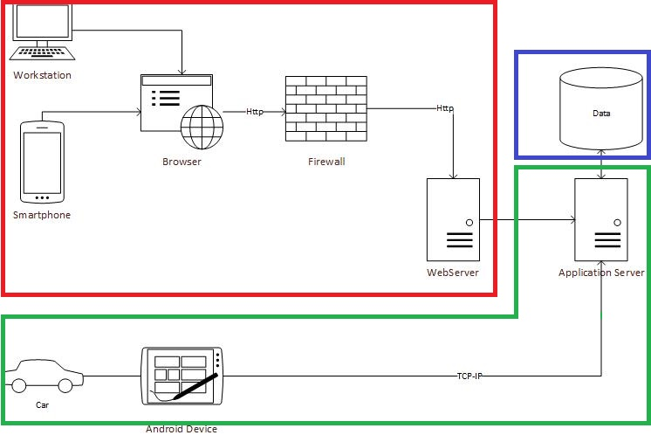
LEGEND:
Presentation Tier
Business Tier
Data Tier

Slide 3
Business Logic Partition
API Server
Account Managment
Reservation Managment
Fleet Managment
CarApplication
Data Collection and Analysis
Ride Monitoring
Rule Infraction Detection and Notification

Slide 4
DEPLOYMENT VIEW

Slide 5
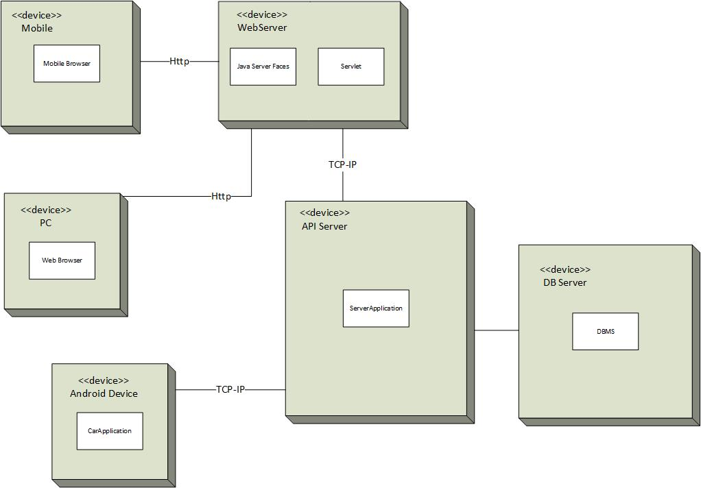
COMMUNICATION
CHANNELS
HTTP between webApplication and webServer
TCP-IP between carApplication and APIServer

