Slide 1
A New Distributed Protocol for Consensus of Discrete-Time Systems
Filippo Cacace, Mattia Mattioni, Salvatore Monaco, Dorothée Normand-Cyrot
European Journal of Control, 2023
https://doi.org/10.1016/j.ejcon.2023.100833
Felli Stefano - 1896877
Control of Autonomous Multi-Agent System – Multi-Robot Systems Module
Sapienza University of Rome

Slide 2
Table of contents
Introduction
Problem statement
Proposed centralized protocol
Distributed implementation
Simulation results
Conclusions and future works

Slide 3
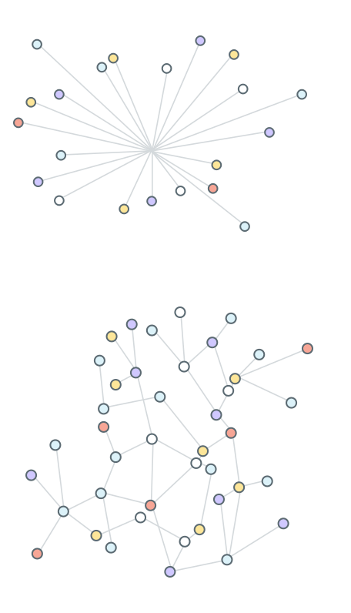
Introduction
Consensus protocol: drives the dynamics of multi-agent systems in an efficient and secure way to a common behaviour.
Centralized protocol [Fig. 1]: fast convergence for small systems.
Distributed protocol [Fig. 2]: more scalable for large networks.
Fig. 1: Centralized protocol
Multi-Robot Systems presentation – Felli Stefano
Fig. 2: Distributed protocol

Slide 4

Problem statement
Problem formulation
Motivation
N-agents system modeled as a graph $ℊ=\left(𝒱,ℰ\right).$
Each vertex i $∈𝒱$ models an agent. Set of neighbors is $N_{i}=\left\{j∈𝒱 \right| (j,i)∈ℰ\}$
Dynamics of agents: $x_{i}\left(t+1\right)=x_{i}\left(t\right)+u_{i}(t)$
Standard local controls: ${ u}_{i}\left(t\right)=−κ\sum_{j∈N_{i}}{(x_{i}\left(t\right)−x_{j}\left(t\right))}$, $κ>0$
Standard vector control: $u\left(t\right)= −κLx(t),$ where $L∈ℝ^{N×N}$ is the Laplatian matrix
Network dynamics: $x\left(t+1\right)=A(κ)x\left(t\right), A(κ)=\left(I−κL\right)$
Multi-Robot Systems presentation – Felli Stefano

Slide 5
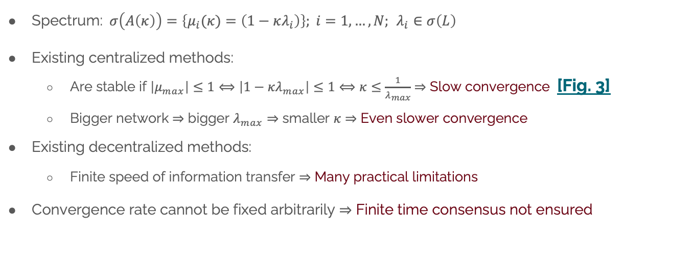
Problem statement
Problem formulation
Motivation
Spectrum:$σ\left(A\left(κ\right)\right)=\left\{μ_{i}(κ)=\left(1−κλ_{i}\right)\right\}; i=1,…,N;$ $λ_{i}∈σ\left(L\right)$
Existing centralized methods:
Are stable if $\left|μ_{max}\right|≤1⟺\left|1−κλ_{max}\right|≤1⟺κ≤\frac{1}{λ_{max}}$ $⇒$ Slow convergence [Fig. 3]
Bigger network $⇒$ bigger $λ_{max}⇒$ smaller $κ⇒$ Even slower convergence
Existing decentralized methods:
Finite speed of information transfer $⇒$ Many practical limitations
Convergence rate cannot be fixed arbitrarily $⇒$ Finite time consensus not ensured
Multi-Robot Systems presentation – Felli Stefano

Slide 6
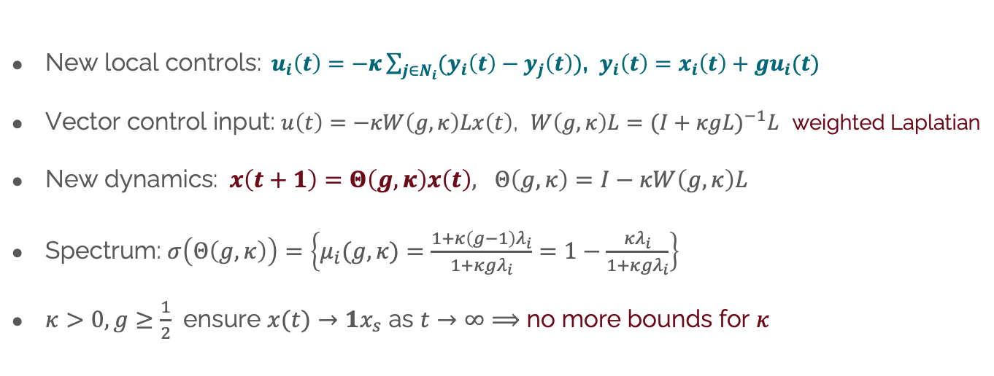
Proposed centralized protocol
New control input
Recalls
New local controls:${ u}_{i}\left(t\right)=−κ\sum_{j∈N_{i}}{(y_{i}\left(t\right)−y_{j}\left(t\right))}$, $y_{i}\left(t\right)=x_{i}\left(t\right)+gu_{i}(t)$
Vector control input: $u\left(t\right)=−κW\left(g,κ\right)Lx\left(t\right)$, $W\left(g,κ\right)L=(I+κgL)^{−1}L$ weighted Laplatian
New dynamics: $x\left(t+1\right)=Θ\left(g,κ\right)x\left(t\right), Θ\left(g,κ\right)=I−κW\left(g,κ\right)L$
Spectrum: $σ\left(Θ\left(g,κ\right)\right)=\left\{μ_{i}(g,κ)=\frac{1+κ\left(g−1\right)λ_{i}}{1+κ{gλ}_{i}}=1−\frac{κλ_{i}}{1+κ{gλ}_{i}}\right\}$
$κ>0,g≥\frac{1}{2}$ ensure $x(t)→1x_{s}$ as $t→∞⟹$ no more bounds for $κ$
Multi-Robot Systems presentation – Felli Stefano

Slide 7
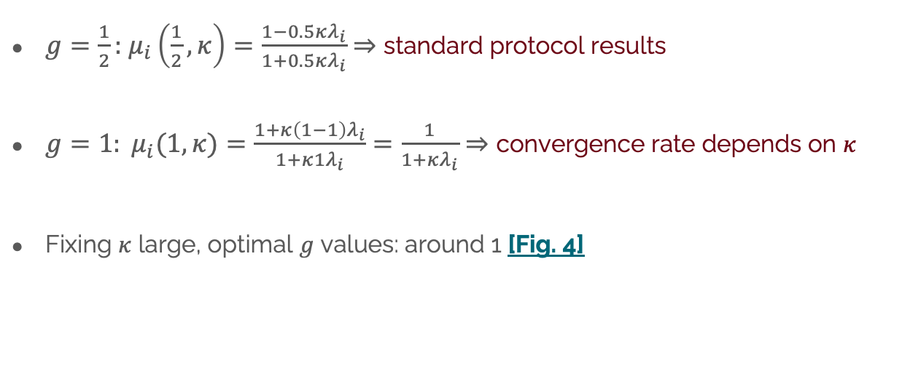
Proposed centralized protocol
New control input
$g=\frac{1}{2}:$ $μ_{i}\left(\frac{1}{2},κ\right)=\frac{1−0.5κλ_{i}}{1+0.5κλ_{i}}$ $⇒$ standard protocol results
$g=1: μ_{i}(1,κ)=$ $\frac{1+κ\left(1−1\right)λ_{i}}{1+κ{1λ}_{i}}=\frac{1}{1+κλ_{i}}⇒$ convergence rate depends on $κ$
Fixing $κ$ large, optimal $g$ values: around 1 [Fig. 4]
Recalls
Multi-Robot Systems presentation – Felli Stefano

Slide 8
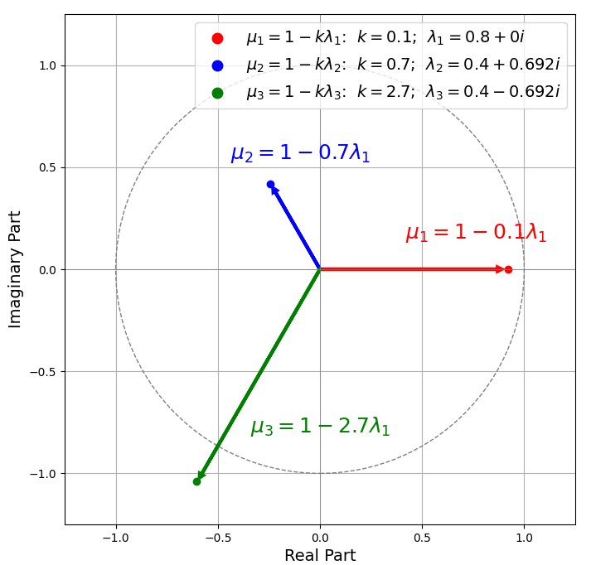
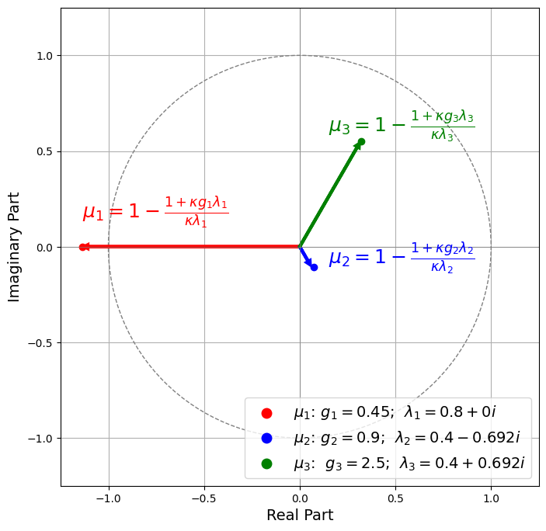


Eigenvalues plots
Fig. 3: Eigenvalues with standard protocol for $κ$varying
Fig. 4: New protocol eigenvalues, with fixed $κ=70$ and varying $g$
Multi-Robot Systems presentation – Felli Stefano

Slide 9
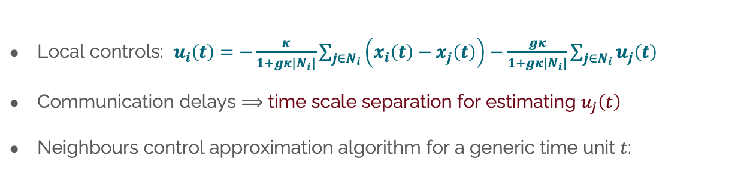
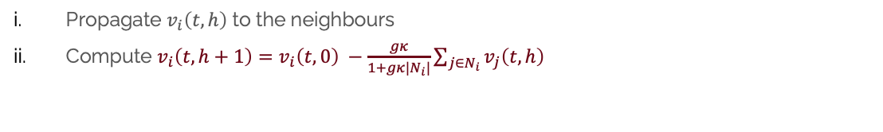
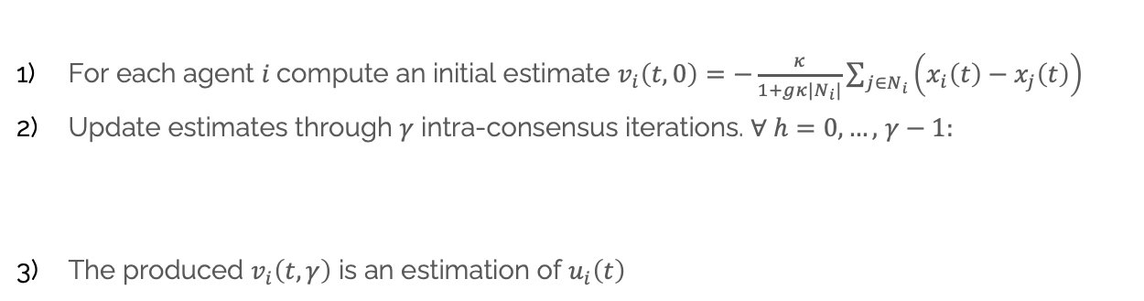
Distributed implementation
Control estimation
Local controls: $u_{i}\left(t\right)=−\frac{κ}{1+gκ|N_{i}|}\sum_{j∈N_{i}}{\left(x_{i}\left(t\right)−x_{j}\left(t\right)\right)−\frac{gκ}{1+gκ|N_{i}|}}\sum_{j∈N_{i}}{u_{j}\left(t\right)}$
Communication delays $⟹$ time scale separation for estimating $u_{j}\left(t\right)$
Neighbours control approximation algorithm for a generic time unit $t$:
Results
For each agent $i$compute an initial estimate $v_{i}\left(t,0\right)=$ $−\frac{κ}{1+gκ|N_{i}|}\sum_{j∈N_{i}}{\left(x_{i}\left(t\right)−x_{j}\left(t\right)\right)}$
Update estimates through $γ$ intra-consensus iterations. $∀ h=0,…,$ $γ−1:$
The produced $v_{i}\left(t,γ\right)$ is an estimation of $u_{i}\left(t\right)$
Propagate $v_{i}\left(t,h\right)$ to the neighbours
Compute $v_{i}\left(t,h+1\right)=$ $v_{i}\left(t,0\right) −\frac{gκ}{1+gκ|N_{i}|}\sum_{j∈N_{i}}{v_{j}\left(t,h\right)}$
Multi-Robot Systems presentation – Felli Stefano

Slide 10
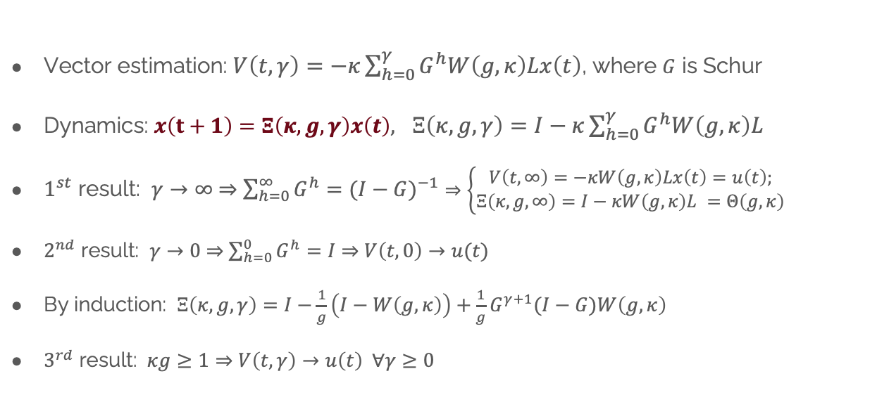
Distributed implementation
Control estimation
Vector estimation: $V\left(t,γ\right)=−κ\sum_{h=0}^{γ}{G^{h}W\left(g,κ\right)Lx\left(t\right)}$, where $G$ is Schur
Dynamics: $x\left(t+1\right)=Ξ\left(κ,g,γ\right)x\left(t\right),$ $Ξ\left(κ,g,γ\right)=I−κ\sum_{h=0}^{γ}{G^{h}W\left(g,κ\right)L}$
$1^{st}$ result: $γ→∞$ $⇒$ $\sum_{h=0}^{∞}{G^{h}}=(I−G)^{−1}$ $⇒\left\{\begin{aligned}V\left(t,∞\right)=−κW\left(g,κ\right)Lx\left(t\right)=u\left(t\right); \\ Ξ\left(κ,g,∞\right)=I−κW\left(g,κ\right)L =Θ\left(g,κ\right)\end{aligned}\right.$
$2^{nd}$ result: $γ→0$ $⇒$ $\sum_{h=0}^{0}{G^{h}}=I$ $⇒$ $V\left(t,0\right)→u(t)$
By induction: $Ξ\left(κ,g,γ\right)=I−\frac{1}{g}\left(I−W\left(g,κ\right)\right)+\frac{1}{g}G^{γ+1}(I−G)W\left(g,κ\right)$
$3^{rd}$ result: $κg≥1⇒$ $V\left(t,γ\right)→u\left(t\right) ∀γ≥0$
Results
Multi-Robot Systems presentation – Felli Stefano

Slide 11
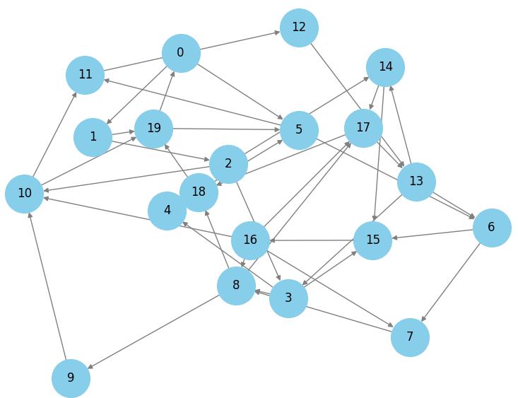
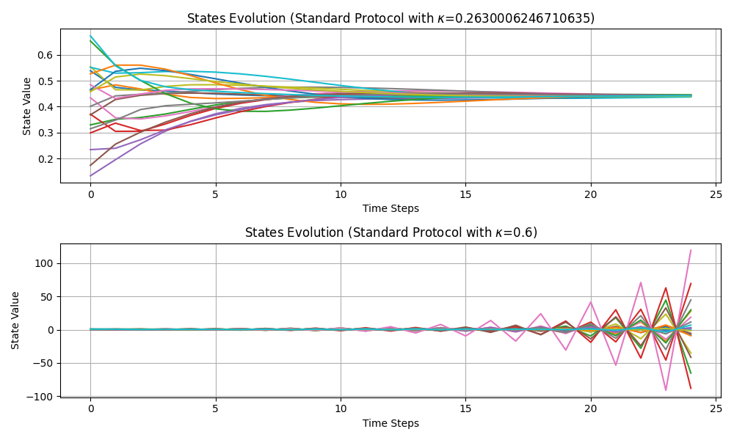
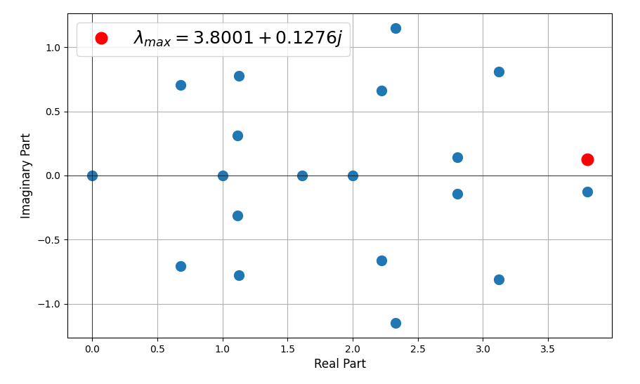



Simulation Results
Fig. 6: Standard Algorithm, by varying $κ.$ Convergence is ensured for values up to $κ=\frac{1}{{|λ}_{max⁡}|}≈\frac{1}{3..8022}=0.263$
Fig. 5: Strongly connected di-graph with $N=20$ agents and $λ_{max}=3.8001+0.12j$
Multi-Robot Systems presentation – Felli Stefano

Slide 12
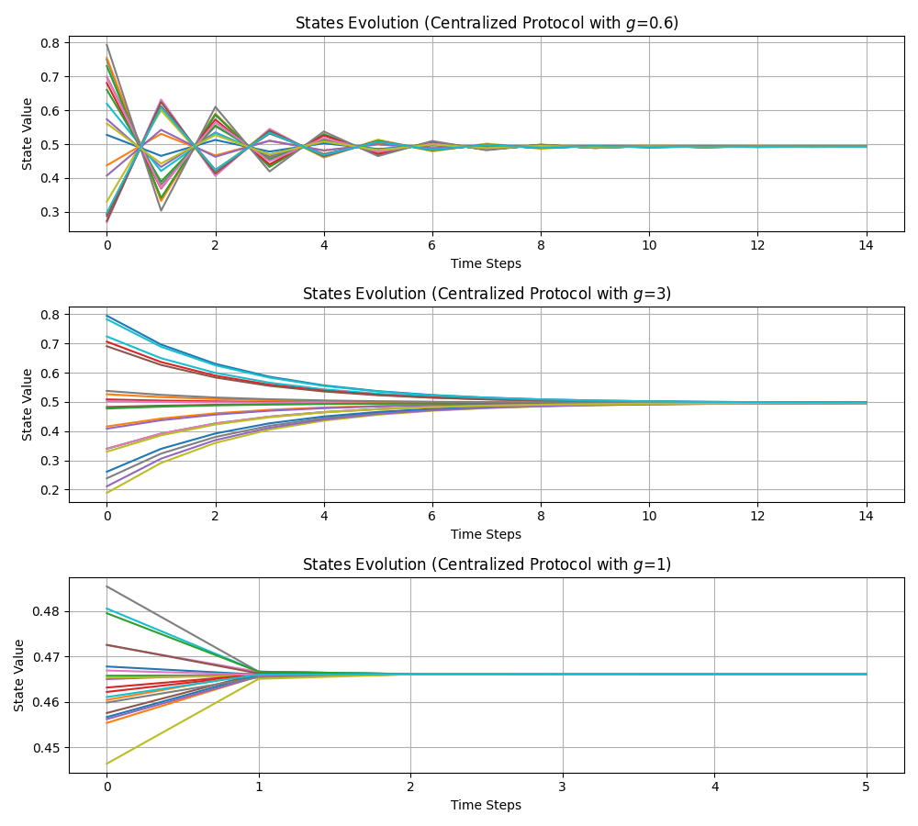
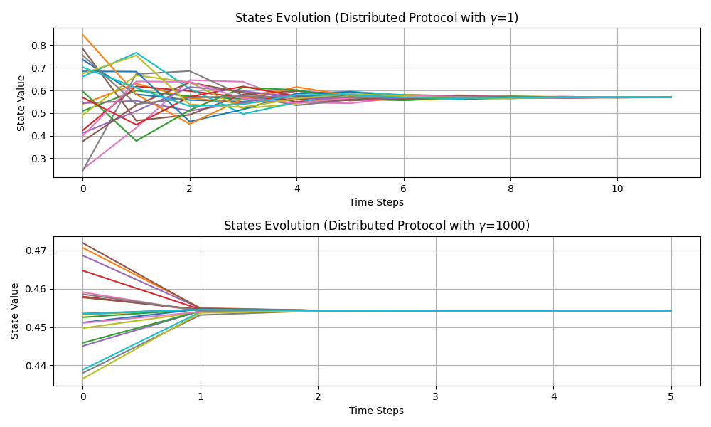


Simulation Results
Fig. 8: Distributed Algorithm by varying parameter $γ$, with fixed $κ=20$ and $g=1$
Fig. 7: Centralized Algorithm by varying parameter $g$, with fixed $κ=20$
Multi-Robot Systems presentation – Felli Stefano

Slide 13
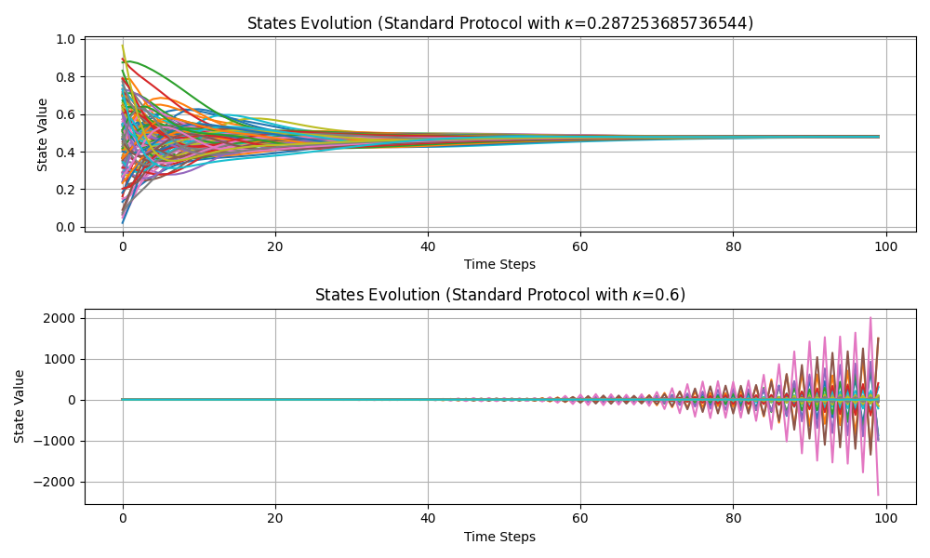
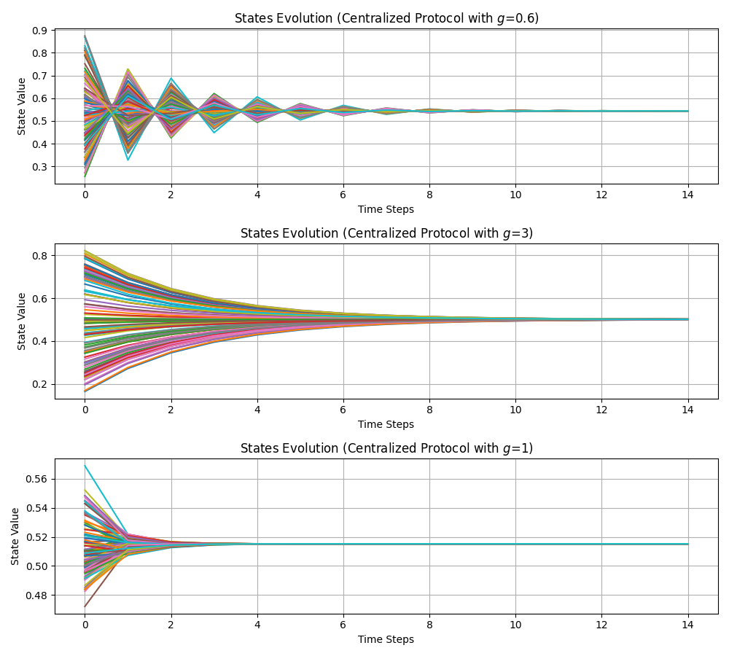
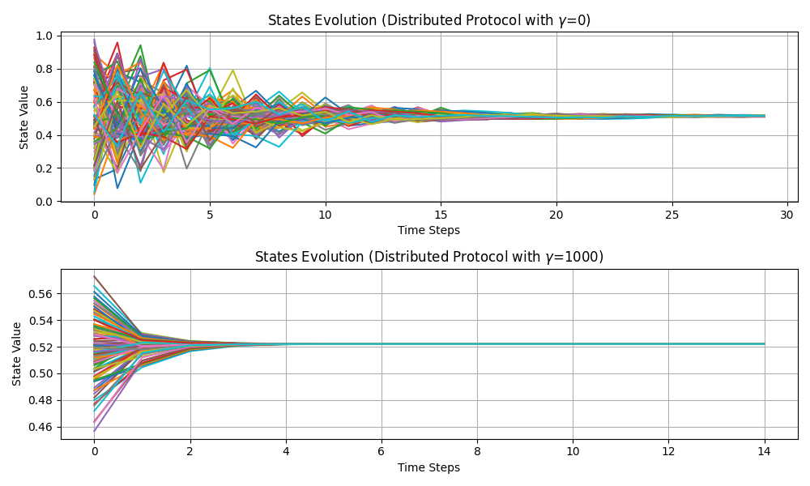

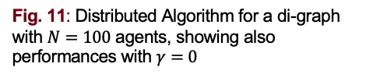

Simulation Results - Bigger $ℊ$
Fig. 9: Standard Algorithm for a di-graph with $N=100$ agents and $λ_{max}=3.843+0j$
Fig. 11: Distributed Algorithm for a di-graph with $N=100$ agents, showing also performances with $γ=0$
Fig. 10: Centralized Algorithm for a di-graph with $N=100$ agents
Multi-Robot Systems presentation – Felli Stefano

Slide 14
Thank you for the attention!
All My work and Simulations can be found on my GitHub Repo:
https://github.com/StefanoF00/CAMS_distributed_protocol.git

