Slide 1
A New Distributed Protocol for Consensus of Discrete-Time Systems
Filippo Cacace, Mattia Mattioni, Salvatore Monaco, Dorothée Normand-Cyrot
European Journal of Control, 2023
https://doi.org/10.1016/j.ejcon.2023.100833
Felli Stefano - 1896877
Control of Autonomous Multi-Agent System – Multi-Robot Systems Module
Sapienza University of Rome
Notes:
Good morning.
Today, I will be presenting the research paper titled 'A New Distributed Protocol for Consensus of Discrete-Time Systems.'
This work is authored by Filippo Cacace, Mattia Mattioni, Salvatore Monaco, and Dorothée Normand-Cyrot, and published in the European Journal of Control in 2023.

Slide 2
Table of contents
Introduction
Problem statement
Proposed centralized protocol
Distributed implementation
Simulation results
Conclusions and future works

Slide 3
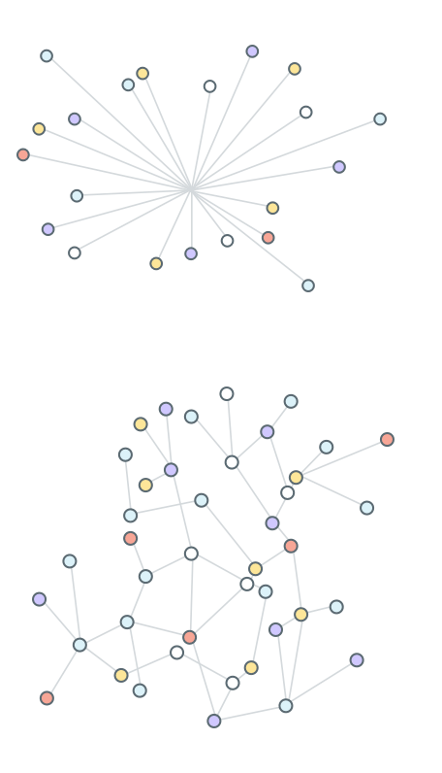
Introduction
Consensus protocol: drives the dynamics of multi-agent systems in an efficient and secure way to a common behaviour.
Centralized protocol [Fig. 1]: fast convergence for small systems.
Distributed protocol [Fig. 2]: more scalable for large networks.
Applications: opinion dynamics, sensor networks, decentralized federated learning.
Fig. 1: Centralized protocol
Multi-Robot Systems presentation – Felli Stefano
Fig. 2: Distributed protocol
Notes:
As the paper title suggests, the main topic is consensus protocol
Consensus protocol is a foundational technique that drives the dynamics of multiple agents of a system in a reliable, efficient and secure way to a common behavior.
Centralized protocol: a central entity collects all the information and calculates the control action for all agents​​.
PRO: centralized protocol can offer faster and more deterministic convergence in smaller networks.
CON: limited Scalability. Central collection can become inefficient for large networks​​
Decentralized protocol: control action calculated locally by each agent using only the locally available information.
This is done through multiple consensus iterations. Need to define a topology.
PRO: more suitable for large networks due to its scalable nature and local calculations
CON: potentially slower and more iterative convergence.
Consensus protocols are crucial in various applications, including opinion dynamics, network routing, and federated learning problems.

Slide 4

Problem statement
Problem formulation
Motivation
N-agents system modeled as a graph $ℊ=\left(𝒱,ℰ\right).$
Each vertex i $∈𝒱$ models an agent. Set of neighbors is $N_{i}=\left\{j∈𝒱 \right| (j,i)∈ℰ\}$
Dynamics of agents: $x_{i}\left(t+1\right)=x_{i}\left(t\right)+u_{i}(t)$
Standard local controls: ${ u}_{i}\left(t\right)=−κ\sum_{j∈N_{i}}{(x_{i}\left(t\right)−x_{j}\left(t\right))}$, $κ>0$
Standard vector control: $u\left(t\right)= −κLx(t),$ where $L∈ℝ^{N×N}$ is the Laplatian matrix
Network dynamics: $x\left(t+1\right)=A(κ)x\left(t\right), A(κ)=\left(I−κL\right)$
Multi-Robot Systems presentation – Felli Stefano
Notes:
Sys modeled as a graph undirected, with set of vertexes and set of edges.
Dynamics discrete time -> INTEGRATOR: Nell'equazione continua x_dot = u, x_dot rappresenta la derivata di x rispetto al tempo,
che può essere approssimata come la differenza tra i valori di x in due istanti di tempo successivi nel dominio discreto. Così, possiamo scrivere:
x_dot = x(t+1)-x(t) => ecco che abbiamo x(t+1)-x(t)=u(t) -> x(t+1)=x(t)+u(t)
Std protocol, where N_i is set of neighbors -> nw dynamics is... with dynamic matrix (A) : eigenvalues mu_i = 1 -K*l_i

Slide 5
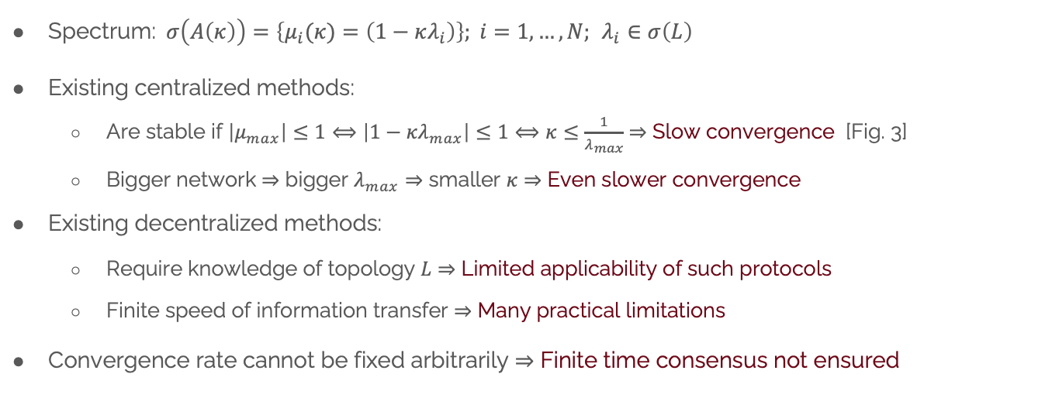
Problem statement
Problem formulation
Motivation
Spectrum:$σ\left(A\left(κ\right)\right)=\left\{μ_{i}(κ)=\left(1−κλ_{i}\right)\right\}; i=1,…,N;$ $λ_{i}∈σ\left(L\right)$
Existing centralized methods:
Are stable if $\left|μ_{max}\right|≤1⟺\left|1−κλ_{max}\right|≤1⟺κ≤\frac{1}{λ_{max}}$ $⇒$ Slow convergence [Fig. 3]
Bigger network $⇒$ bigger $λ_{max}⇒$ smaller $κ⇒$ Even slower convergence
Existing decentralized methods:
Require knowledge of topology $L$ $⇒$ Limited applicability of such protocols
Finite speed of information transfer $⇒$ Many practical limitations
Convergence rate cannot be fixed arbitrarily $⇒$ Finite time consensus not ensured
Multi-Robot Systems presentation – Felli Stefano
Notes:
Centralized protocols:
require restrictive conditions on the coupling gain K, that determines the mutual influence between nodes.
Convergence ensured only if K<=1/l_max
K small => k*l_i small => eigenvalues mu_i stay close to 1 (unitary circle boundary) =>slow convergence rates
Consequently, this leads to slower convergence rates and higher communication overhead.
Decentralized protocols:
* Practical limitation due to the need for each node to have the precise knowledge of the network topology
* Absence of a central entity:
Each node now has only local information from its neighbors (& possibly some additional information from previous time steps)
So all necessary information is not available in a single step
Nodes require more steps to communicate with others and exchange information
=> This communication is subject to delays due to the finite speed of information transfer.
Common problem: Convergence rate cannot be fixed arbitrarily
The following research aims to overcome these limitations.

Slide 6
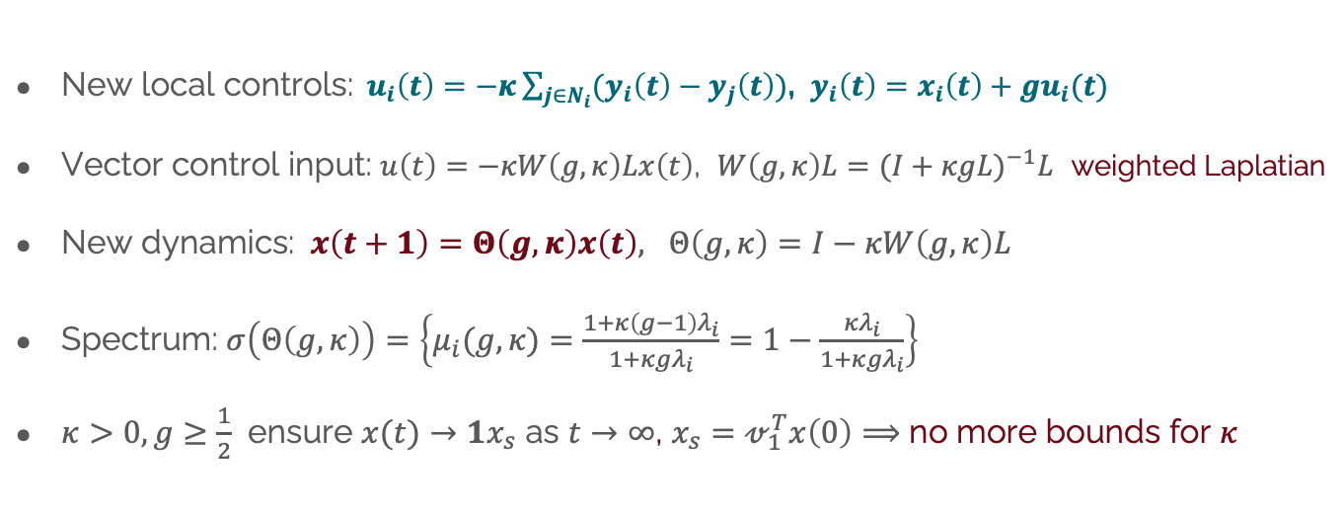
Proposed centralized protocol
New control input
Recalls
New local controls:${ u}_{i}\left(t\right)=−κ\sum_{j∈N_{i}}{(y_{i}\left(t\right)−y_{j}\left(t\right))}$, $y_{i}\left(t\right)=x_{i}\left(t\right)+gu_{i}(t)$
Vector control input: $u\left(t\right)=−κW\left(g,κ\right)Lx\left(t\right)$, $W\left(g,κ\right)L=(I+κgL)^{−1}L$ weighted Laplatian
New dynamics: $x\left(t+1\right)=Θ\left(g,κ\right)x\left(t\right), Θ\left(g,κ\right)=I−κW\left(g,κ\right)L$
Spectrum: $σ\left(Θ\left(g,κ\right)\right)=\left\{μ_{i}(g,κ)=\frac{1+κ\left(g−1\right)λ_{i}}{1+κ{gλ}_{i}}=1−\frac{κλ_{i}}{1+κ{gλ}_{i}}\right\}$
$κ>0,g≥\frac{1}{2}$ ensure $x(t)→1x_{s}$ as $t→∞$, $x_{s}=𝓋_{1}^{T}x\left(0\right)⟹$ no more bounds for $κ$
Multi-Robot Systems presentation – Felli Stefano
Notes:
Extension of the Mattioni et al. work
Local controls
Centralized control vector: Weighted Laplatian W, associated to a new dummy network. W depends on L, that can be computed locally only if agents know the topology.
New eigenvalues
Recall Passivity: defined storage function S(x) = 0.5x(t)^2
lets compute increment delta_S=S(x(t+1))-S(x(t))
substitute x(t+1) = x(t) + u(t) in the increment
inn the increment, express x in terms of the output and input: y = x+gu -> x=y-gu
g=1/2: Loseless: the energy provided by the input exactly matches the change in stored energy, with no additional energy dissipation. The system does not generate or dissipate extra energy.
g>1/2: input-strictly passive: agents dissipate a certain amount of energy, contributing to enhanced stability and robustness.

Slide 7
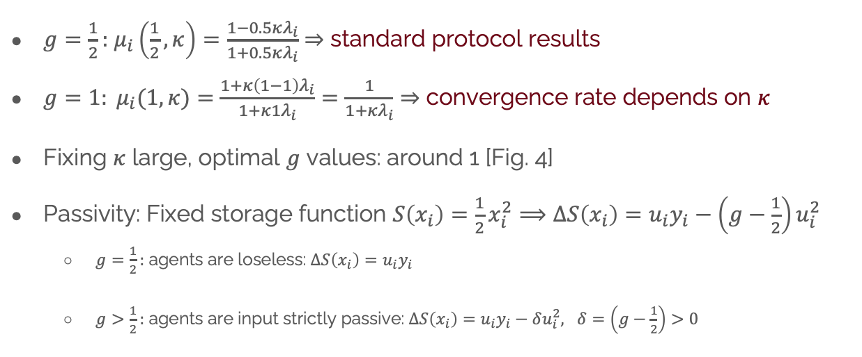
Proposed centralized protocol
New control input
$g=\frac{1}{2}:$ $μ_{i}\left(\frac{1}{2},κ\right)=\frac{1−0.5κλ_{i}}{1+0.5κλ_{i}}$ $⇒$ standard protocol results
$g=1: μ_{i}(1,κ)=$ $\frac{1+κ\left(1−1\right)λ_{i}}{1+κ{1λ}_{i}}=\frac{1}{1+κλ_{i}}⇒$ convergence rate depends on $κ$
Fixing $κ$ large, optimal $g$ values: around 1 [Fig. 4]
Passivity: Fixed storage function $S\left(x_{i}\right)=\frac{1}{2}x_{i}^{2}⟹ΔS\left(x_{i}\right)=u_{i}y_{i}−\left(g−\frac{1}{2}\right)u_{i}^{2}$
$g=\frac{1}{2}:$ agents are loseless: $ΔS\left(x_{i}\right)=u_{i}y_{i}$
$g>\frac{1}{2}:$ agents are input strictly passive: $ΔS\left(x_{i}\right)=u_{i}y_{i}−δu_{i}^{2}, δ=\left(g−\frac{1}{2}\right)>0$
Recalls
Multi-Robot Systems presentation – Felli Stefano

Slide 8
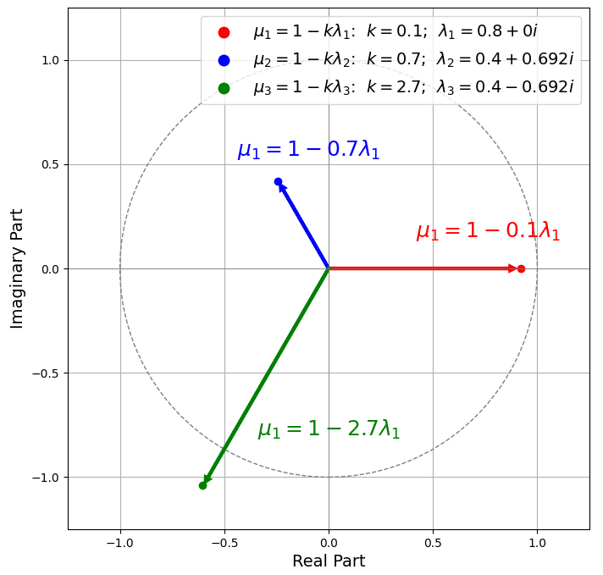
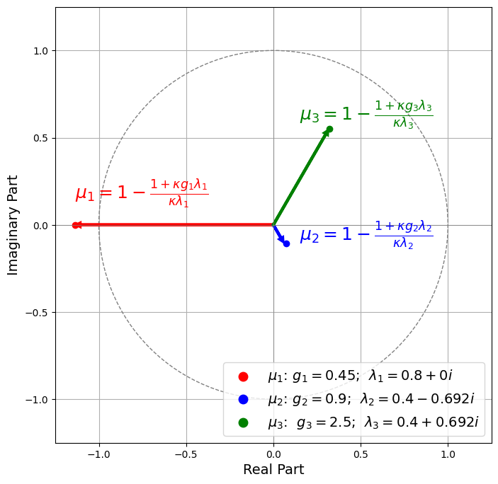


Eigenvalues plots
Fig. 3: Eigenvalues with standard protocol for $κ$varying
Fig. 4: New protocol eigenvalues, with fixed $κ=70$ and varying $g$
Multi-Robot Systems presentation – Felli Stefano

Slide 9
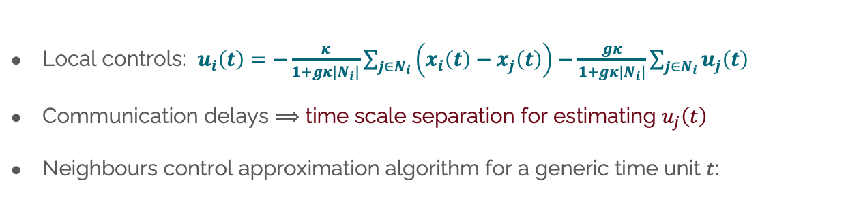
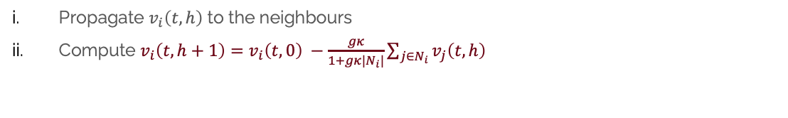
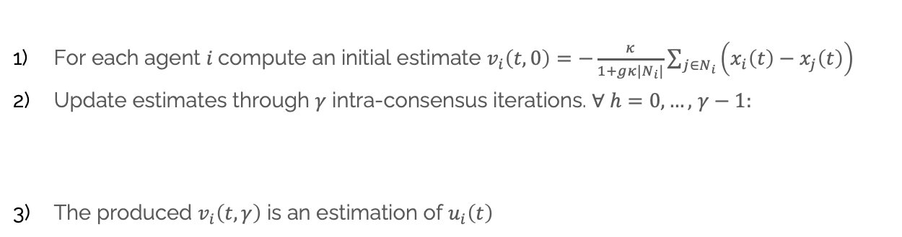
Distributed implementation
Control estimation
Local controls: $u_{i}\left(t\right)=−\frac{κ}{1+gκ|N_{i}|}\sum_{j∈N_{i}}{\left(x_{i}\left(t\right)−x_{j}\left(t\right)\right)−\frac{gκ}{1+gκ|N_{i}|}}\sum_{j∈N_{i}}{u_{j}\left(t\right)}$
Communication delays $⟹$ time scale separation for estimating $u_{j}\left(t\right)$
Neighbours control approximation algorithm for a generic time unit $t$:
Results
For each agent $i$compute an initial estimate $v_{i}\left(t,0\right)=$ $−\frac{κ}{1+gκ|N_{i}|}\sum_{j∈N_{i}}{\left(x_{i}\left(t\right)−x_{j}\left(t\right)\right)}$
Update estimates through $γ$ intra-consensus iterations. $∀ h=0,…,$ $γ−1:$
The produced $v_{i}\left(t,γ\right)$ is an estimation of $u_{i}\left(t\right)$
Propagate $v_{i}\left(t,h\right)$ to the neighbours
Compute $v_{i}\left(t,h+1\right)=$ $v_{i}\left(t,0\right) −\frac{gκ}{1+gκ|N_{i}|}\sum_{j∈N_{i}}{v_{j}\left(t,h\right)}$
Multi-Robot Systems presentation – Felli Stefano
Notes:
Local control laws are obtained by explicating u_i from the centralized one previously defined, such that it is composed by two main terms:
term 1: dependent only on states x_i and x_j: available at each time step t
term 2: neighbors controls dependent: need to estimate them, because if there are communication delays, agent I-th works in outdated information
Time scale separation involves separating the rapid exchange of local information between nodes (fast dynamics) from the slower updates of the overall system state (slow dynamics).
Algorithm for a generic time unit t:
initial estimates v_i(t,0) are computed for each agent
estimates are updated through \gamma intra-consensus iterations: for h=0...\gamma:
v_i(t,h) is propagated to the neighbors
v_i(t,h+1) is computed, using v_j(t,h)
Algorithm produces v_i(t,\gamma) that is an estimation of u_i(t)

Slide 10
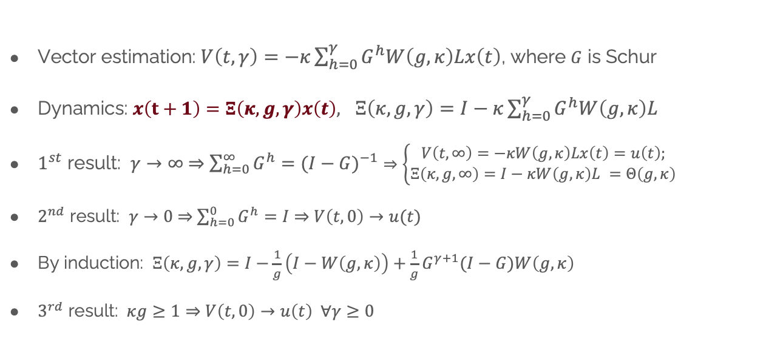
Distributed implementation
Control estimation
Vector estimation: $V\left(t,γ\right)=−κ\sum_{h=0}^{γ}{G^{h}W\left(g,κ\right)Lx\left(t\right)}$, where $G$ is Schur
Dynamics: $x\left(t+1\right)=Ξ\left(κ,g,γ\right)x\left(t\right),$ $Ξ\left(κ,g,γ\right)=I−κ\sum_{h=0}^{γ}{G^{h}W\left(g,κ\right)L}$
$1^{st}$ result: $γ→∞$ $⇒$ $\sum_{h=0}^{∞}{G^{h}}=(I−G)^{−1}$ $⇒\left\{\begin{aligned}V\left(t,∞\right)=−κW\left(g,κ\right)Lx\left(t\right)=u\left(t\right); \\ Ξ\left(κ,g,∞\right)=I−κW\left(g,κ\right)L =Θ\left(g,κ\right)\end{aligned}\right.$
$2^{nd}$ result: $γ→0$ $⇒$ $\sum_{h=0}^{0}{G^{h}}=I$ $⇒$ $V\left(t,0\right)→u(t)$
By induction: $Ξ\left(κ,g,γ\right)=I−\frac{1}{g}\left(I−W\left(g,κ\right)\right)+\frac{1}{g}G^{γ+1}(I−G)W\left(g,κ\right)$
$3^{rd}$ result: $κg≥1⇒$ $V\left(t,0\right)→u\left(t\right) ∀γ≥0$
Results
Multi-Robot Systems presentation – Felli Stefano

Slide 11
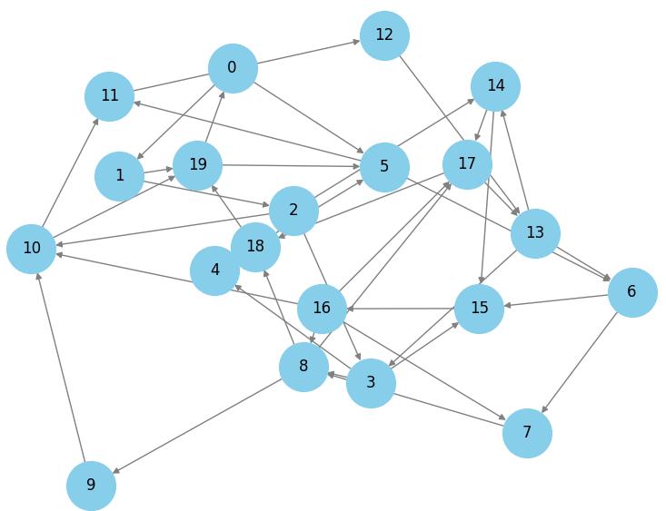
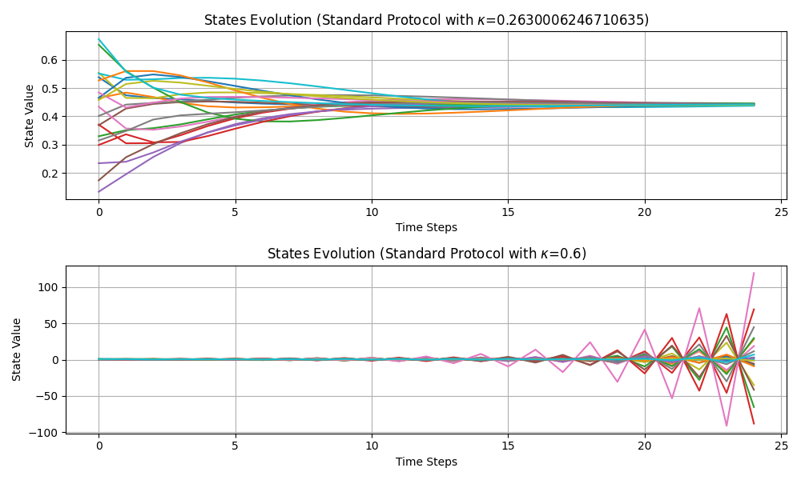
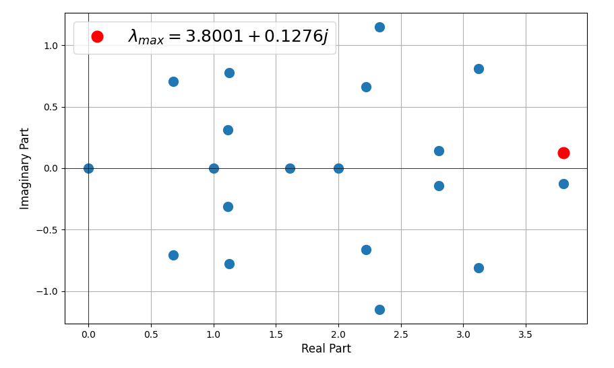



Simulation Results
Fig. 6: Standard Algorithm, by varying $κ.$ Convergence is ensured for values up to $κ=\frac{1}{{|λ}_{max⁡}|}≈\frac{1}{3..8022}=0.263$
Fig. 5: Strongly connected di-graph with $N=20$ agents and $λ_{max}=3.8001+0.12j$
Multi-Robot Systems presentation – Felli Stefano

Slide 12
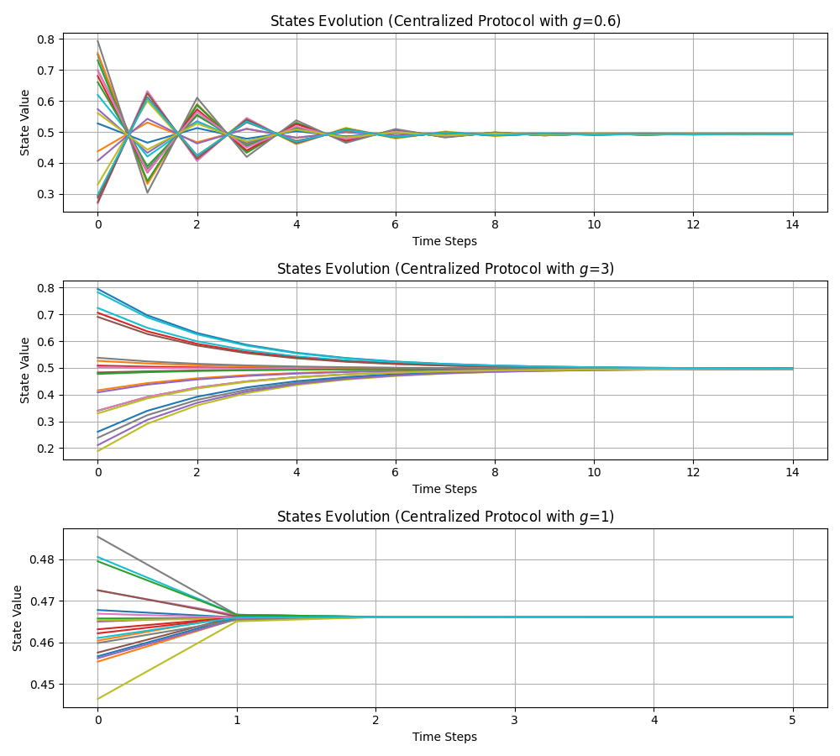
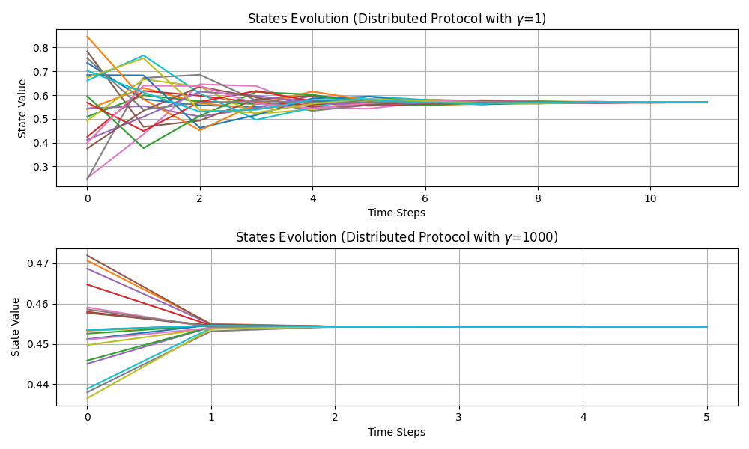


Simulation Results
Fig. 8: Distributed Algorithm by varying parameter $γ$, with fixed $κ=20$ and $g=1$
Fig. 7: Centralized Algorithm by varying parameter $g$, with fixed $κ=20$
Multi-Robot Systems presentation – Felli Stefano

Slide 13
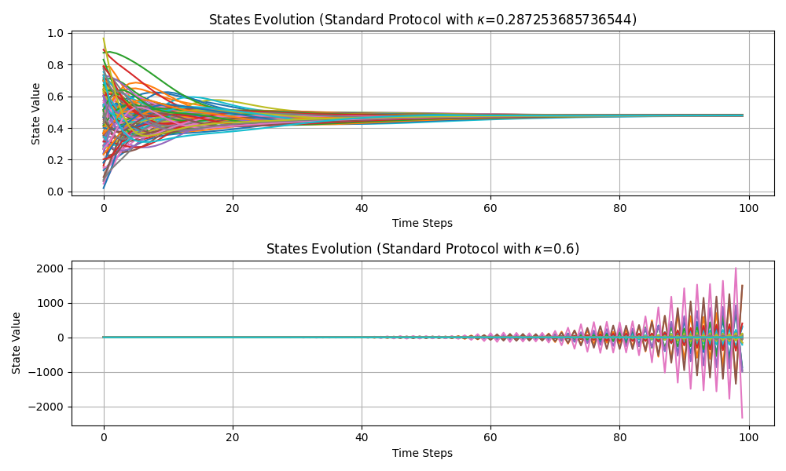
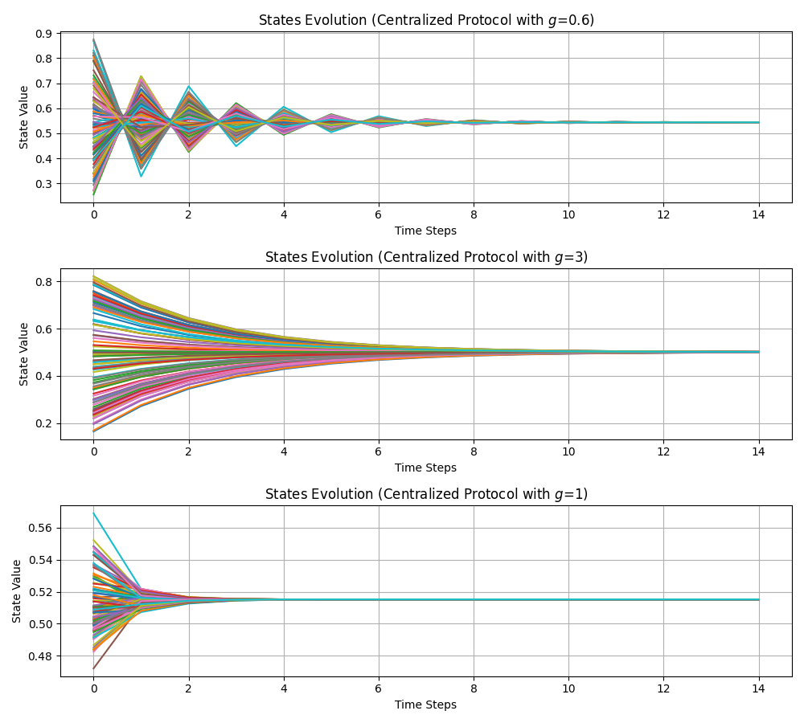
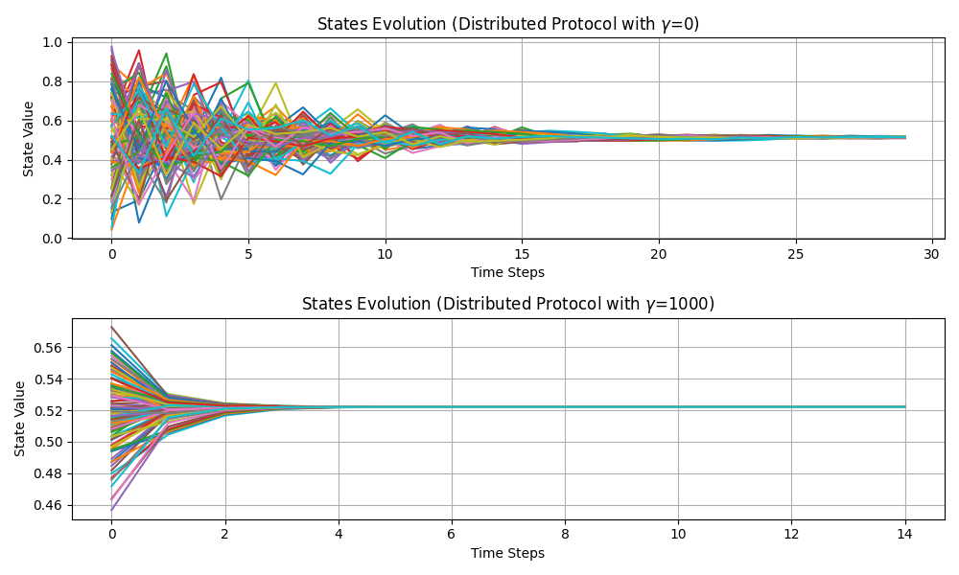

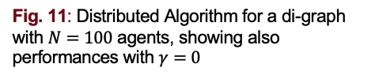

Simulation Results - Bigger $ℊ$
Fig. 9: Standard Algorithm for a di-graph with $N=100$ agents and $λ_{max}=3.843+0j$
Fig. 11: Distributed Algorithm for a di-graph with $N=100$ agents, showing also performances with $γ=0$
Fig. 10: Centralized Algorithm for a di-graph with $N=100$ agents
Multi-Robot Systems presentation – Felli Stefano

Slide 14
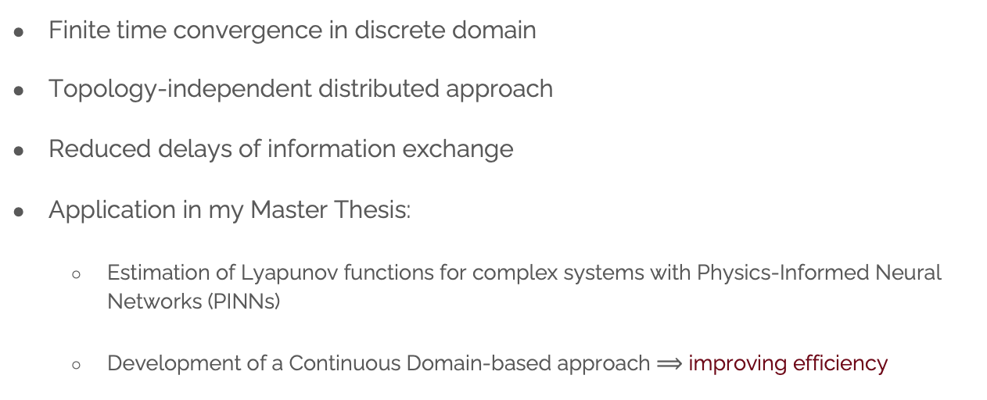
Conclusions and future work
Finite time convergence in discrete domain
Topology-independent distributed approach
Reduced delays of information exchange
Application in my Master Thesis:
Estimation of Lyapunov functions for complex systems with Physics-Informed Neural Networks (PINNs)
Development of a Continuous Domain-based approach $⟹$ improving efficiency
Multi-Robot Systems presentation – Felli Stefano

Slide 15
Thank you for the attention!
All My work and Simulations can be found on my GitHub Repo:
https://github.com/StefanoF00/CAMS_distributed_protocol.git

