Slide 1
Demonstration of Powder Tree Creator for AM Database
Material Data Management Consortium
Stefano Feijoo, Joe Torres, Jillian Adams, Nick Parra-Vasquez, Zach Smith, Lindsey Kuettner, Sendin Bajric, Phil Schembri
Los Alamos National Laboratory
January, 2018
LA-UR-18-20233

Slide 2
Why the need to visualize the powder ancestry?
We would like to:
know the complete pedigree of a powder before it is used.
examine how the history of powder mixing affects the as-measured properties of a powder (to create optimal mixes).
trace all parts manufactured that contain some fraction of a specified powder (in case it is learned there was an issue with that powder).
We consider our ‘app’ as a proof of concept. It would be nice if Granta could integrate such a feature into MI or Explore.
The app is created using the Python Toolkit.

Slide 3
How we use links between batches to track ancestry

Slide 4
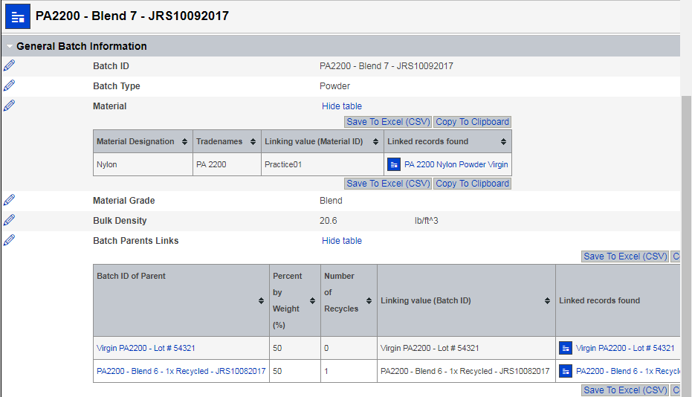
Linked tabular data is used for Batch Parents

Slide 5
The parents of a powder batch are linked
No batch parents
Has batch parents

Slide 6
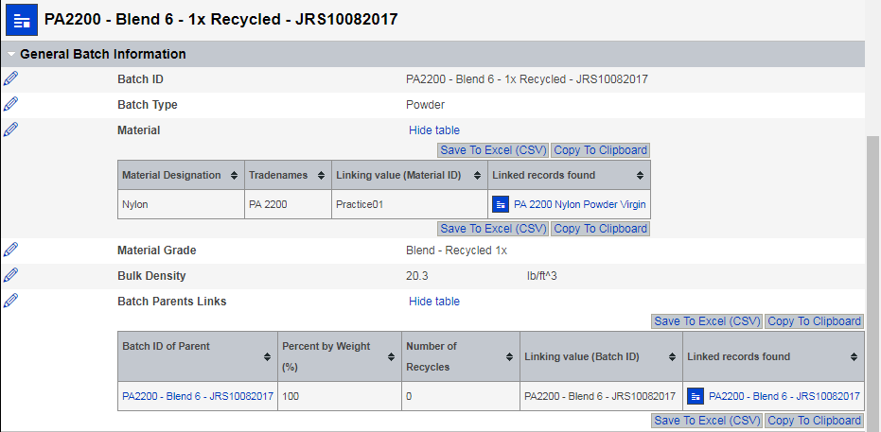
A recycled powder has only one ‘parent’: the unused version of the same powder
One batch parent (the unused Blend 6 powder)

Slide 7
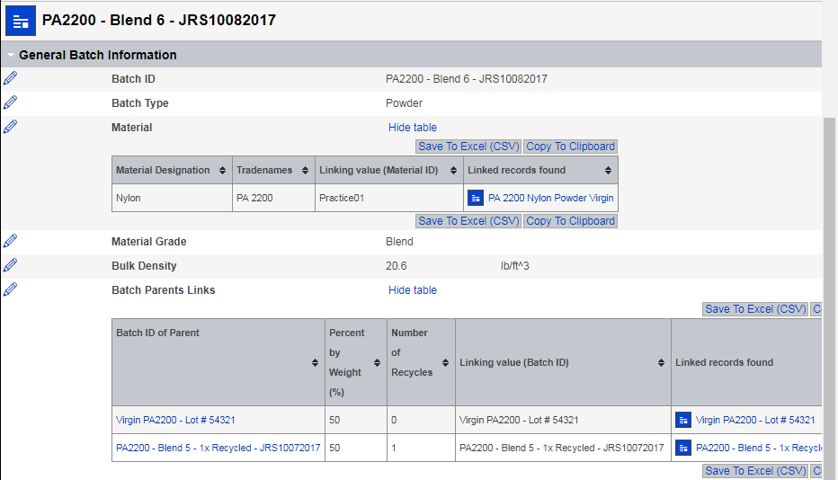
Unused powders either have multiple parents or are virgin powders
Parents of the unused Blend 6 powder

Slide 8
Visualizing these relationships using the Powder Tree Creator app

Slide 9
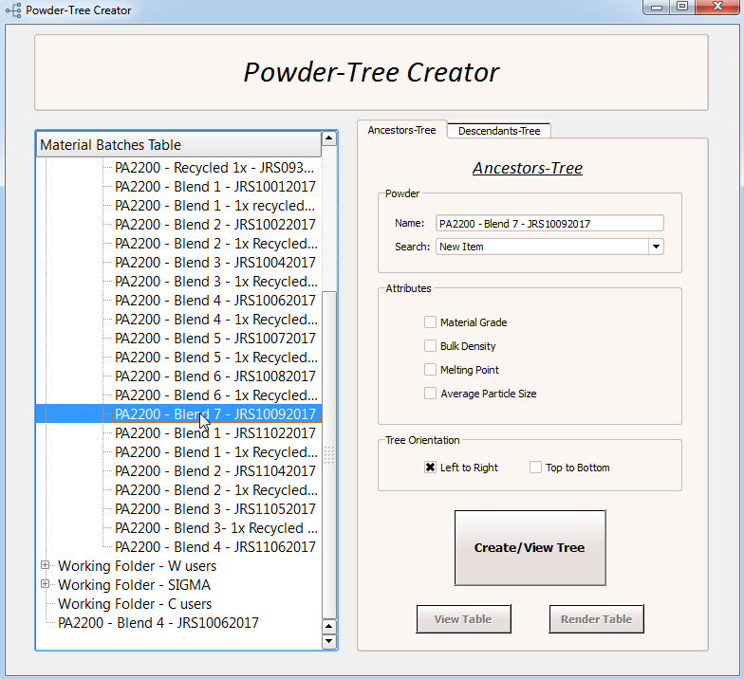
The app uses a GUI since many users will be occasional users

Slide 10
There are multiple ways to find the batch of interest
Browse the tree

Slide 11
There are multiple ways to find the batch of interest
Browse the tree
Search

Slide 12
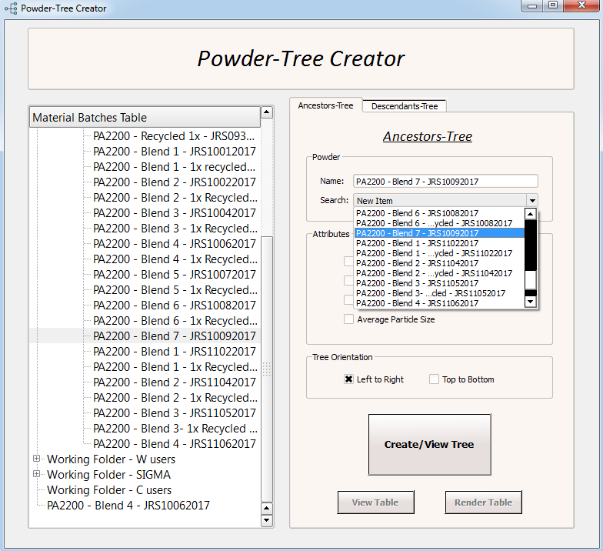
There are multiple ways to find the batch of interest
Browse the tree
Search
List

Slide 13
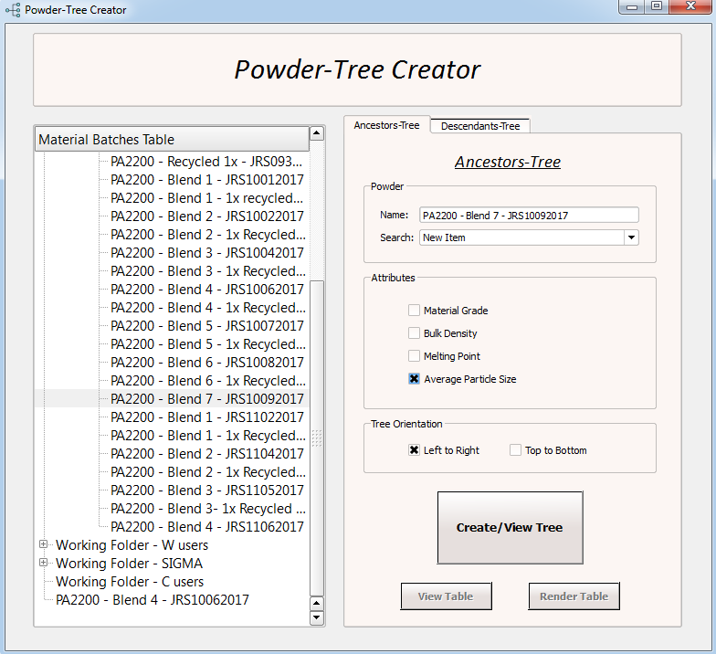
Attributes can be added to the tree report
Attributes to
include

Slide 14

Tree orientation is configurable: horizontal or vertical

Slide 15
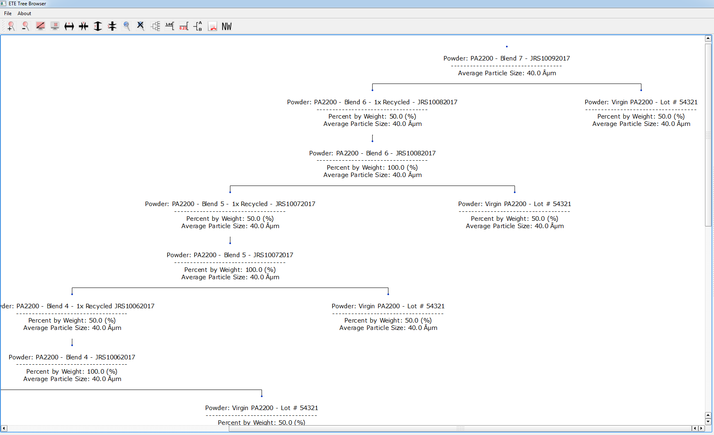
The output resembles a family tree

Slide 16
The output resembles a family tree
Powder batch of interest

Slide 17
The output resembles a family tree
Powder batch of interest
This parent is
virgin: no parents

Slide 18
The output resembles a family tree
Powder batch of interest
Single blend, before and
after use, has parent/child
relationship
This parent is
virgin: no parents

Slide 19
Tools used to create the application
The layout of the application was created using Qt Designer (a GUI application development framework).
The app’s source code uses OOP and takes advantage of the capabilities of the PyQt (a GUI widgets toolkit) library such as threads, signals, and built in functions.
To create the trees we use a recursive function and the ETE toolkit (library for analysis and visualization of trees) to place each parent in the correct location on the tree.
Other important packages used are numpy, pandas, and matplotlib.

Slide 20
Discussion and Issues to address:
Are there use cases we have not addressed?
Perhaps in other databases, like Product Risk?
Performance
Opening the app is slow, mostly because of the libraries that need to be loaded from disk.
Generating trees is not prohibitively slow but faster would be nice.
How to create a meaningful report of the weight-percent of ancestors in the powder of interest.
Is Python not the optimal tool for such an app?

